Slide 1
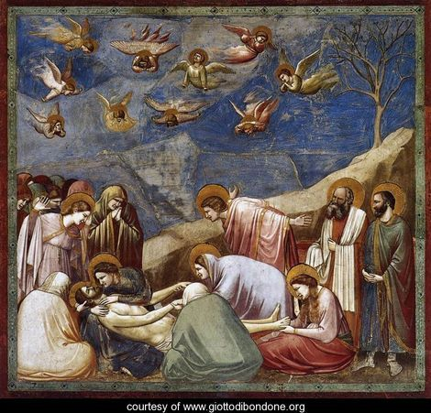
Lamentation of Christ by Giotto di Bondone (1303)

Slide 2
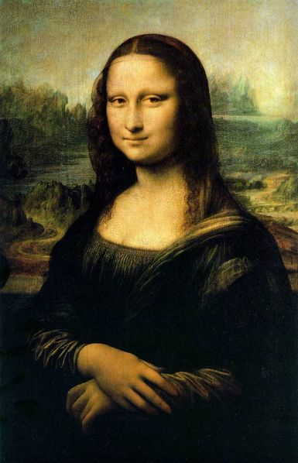
Mona Lisa by Leonardo Da Vinci (1480)

Slide 3
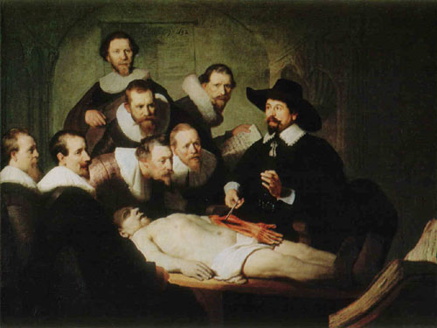
Dr. Tulp’s Anatomy Lesson by Rembrandt van Rijn (1608)

