Slide 1
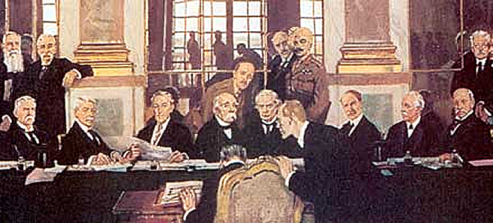
The Treaty
of Versailles

Slide 2



What We Will
Learn Today:
What did the Allies want at the Treaty of Versailles?
What was Germany’s punishment?
What are reparations?
What was the League of Nations?

Slide 3
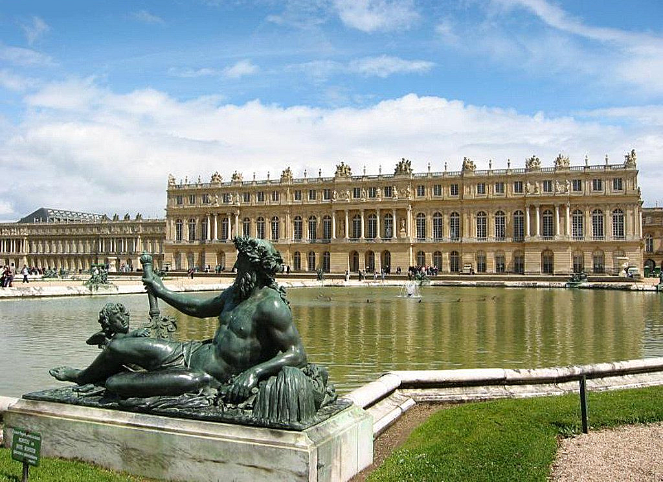
Versailles Today

Slide 4
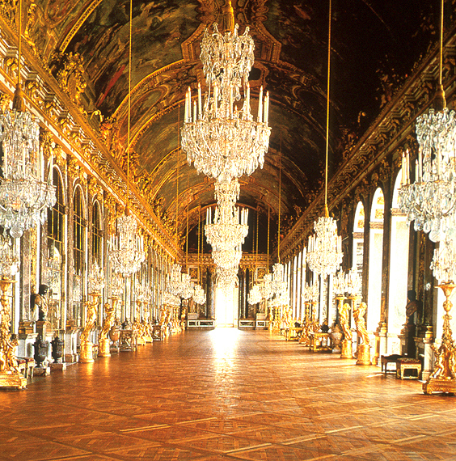
Versailles Today

Slide 5
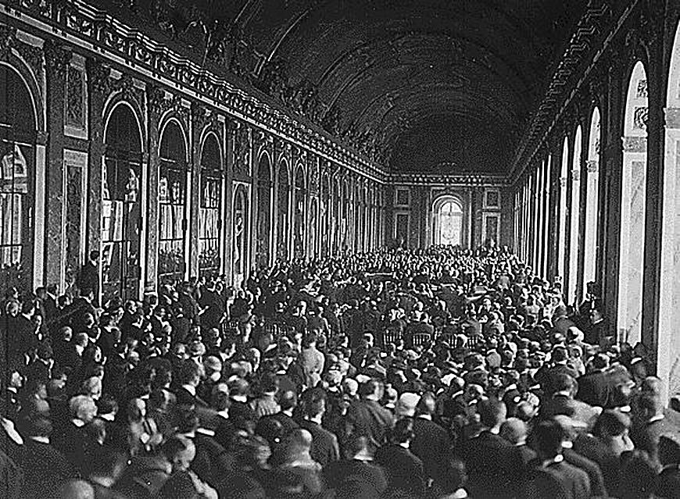
Delegates at Versailles, 1919

Slide 6
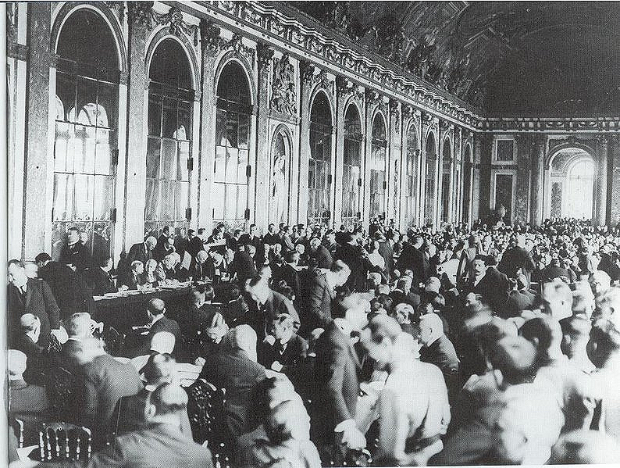
Delegates at Versailles, 1919

Slide 7
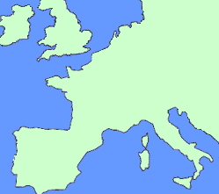
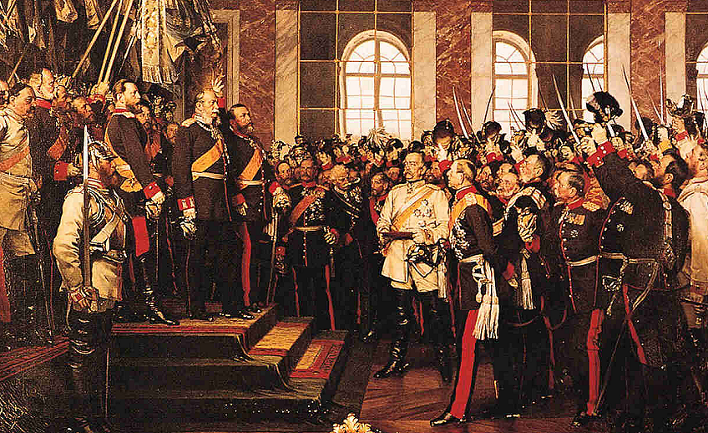
Why Versailles?
The French wanted to crush Germany in the same place where Bismarck formed it in 1871.

Slide 8
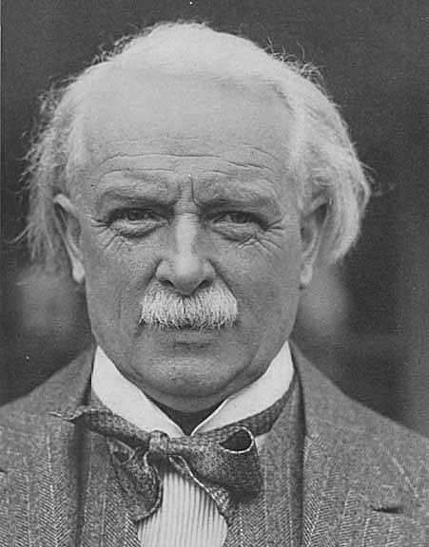
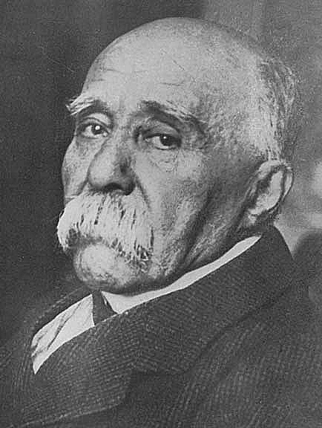
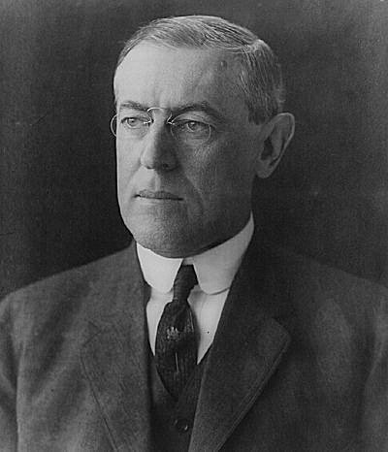
The "Big Three"

Slide 9
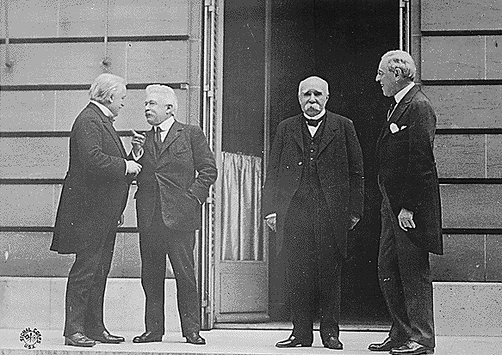
The "Big Three"
David Lloyd
George
(Britain)
Vittorio
Orlando
(Italy)
Georges
Clemenceau
(France)
Woodrow
Wilson
(US)
Although there were delegates from 39 nations at the conference, the important decisions were made by the leaders of the three strongest Allied powers: the US, Britain, and France.

Slide 10
American President
Woodrow Wilson

Slide 11
The "Big Three"
United States
Wilson wanted “peace without victory,” and wanted defeated nations to be treated well to avoid a war of revenge in the future.
Wilson introduced America’s goals his Fourteen Points, which were admired by the Germans, but not the other Allies.
Wilson wanted to eliminate the basic causes of war, such as conflicts over nationalism and imperialism.

Slide 12
The "Big Three"
Wilson also called for an end to alliances, a reduction of military arms, and self-determination.
Self-determination – the idea that the peoples of Eastern Europe would chose their own form of government.
Wilson also argued for freedom of the seas, and the formation of the League of Nations.
League of Nations – a group of countries with the goal of settling disputes through negotiation, rather than war.

Slide 13

French Prime Minister
Georges Clemenceau

Slide 14
The "Big Three"
France
The opposite of Wilson was Clemenceau from France who was nicknamed the “Tiger” for his fierce war policy.
Clemenceau wanted to crush the Germans so that they could never again invade France.
Clemenceau felt that Wilson wanted to be too soft on Germany and said, “Wilson has Fourteen Points…God Almighty has only ten!”

Slide 15
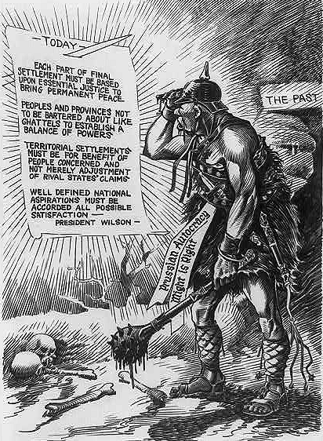

Slide 16
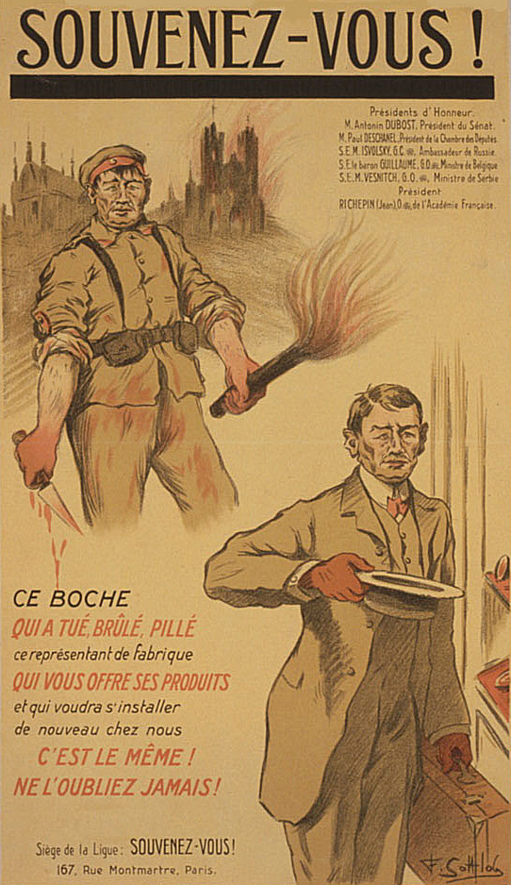
Remember!

Slide 17
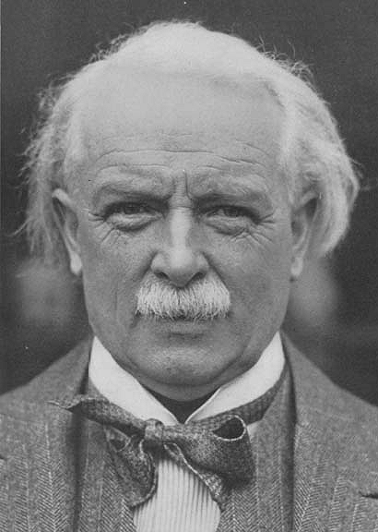
British Prime Minister
David Lloyd George

Slide 18
The "Big Three"
Great Britain
Lloyd George of Great Britain held a middle position between Wilson and Clemenceau.
While promising to make the Germans pay, Lloyd George knew that destroying Germany would not be good for Europe.
Lloyd George helped work out many of the compromises in the treaty.

Slide 19

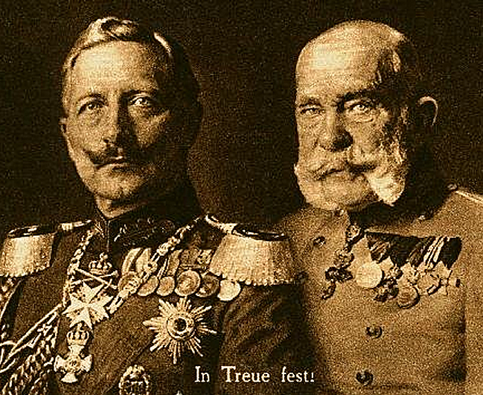


Punishing the
Central Powers

Slide 20

Punishing the
Central Powers
Germany
Germany’s punishment in the Treaty can be remembered as:
BRAT
1. Germany had to accept the Blame for starting the war in the form of a “war guilt” clause.
“The Allied and Associated Governments affirm, and Germany accepts, the responsibility of Germany and her allies for causing all the loss and damage to which the Allied and Associated Governments and their nationals have been subjected as a consequence of the war imposed on them by the aggression of Germany and her allies.”
Treaty of Versailles, Article 231

Slide 21
Punishing the
Central Powers
Germany
Germany’s punishment in the Treaty can be remembered as:
BRAT
1. Germany had to accept the Blame for starting the war in the form of a “war guilt” clause.
2. Germany had to pay over $33 billion in Reparations, or fines.
The reparations covered the destruction caused by the war, pensions for millions of Allied soldiers, widows and families.

Slide 22
Punishing the
Central Powers
Germany
Germany’s punishment in the Treaty can be remembered as:
BRAT
1. Germany had to accept the Blame for starting the war in the form of a “war guilt” clause.
2. Germany had to pay over $33 billion in Reparations, or fines.
3. Germany was forbidden to have an Army over 100,000 men, no submarines, and no air force.
4. Germany lost Territory and colonies to Britain and France.
Alsace and Lorraine were returned to France, land was lost to Poland, and the Rhineland was to be occupied by Allied troops.

Slide 23
QUICK REVIEW
David Lloyd George
Palace of Versailles
Georges Clemenceau
Woodrow Wilson
Treating Germany like a B.R.A.T.

Slide 24
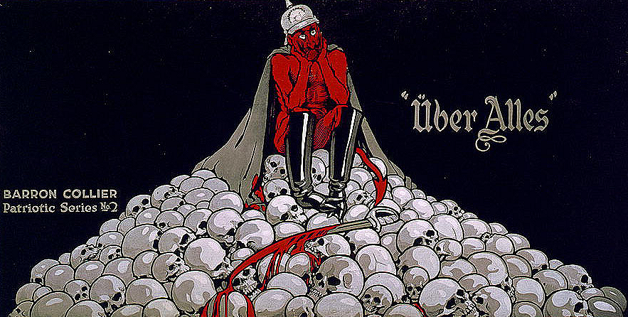

Slide 25
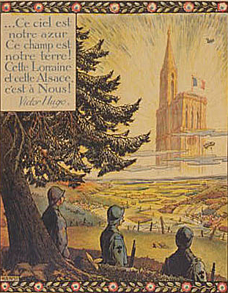
Caption: This sky is ours, this land is ours, Lorraine and Alsace are ours!”

Slide 26
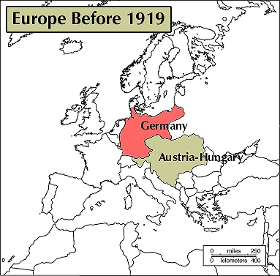

Slide 27
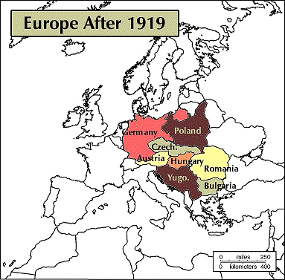

Slide 28
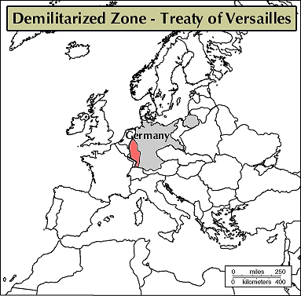
The industrial Rhineland would be occupied by Allied troops for 15 years.

Slide 29
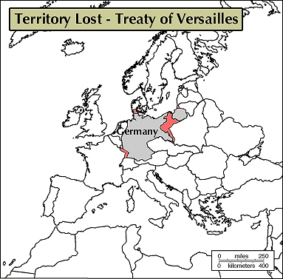
Germany lost Alsace, Lorraine, north Schleswig, and the Polish Corridor.

Slide 30
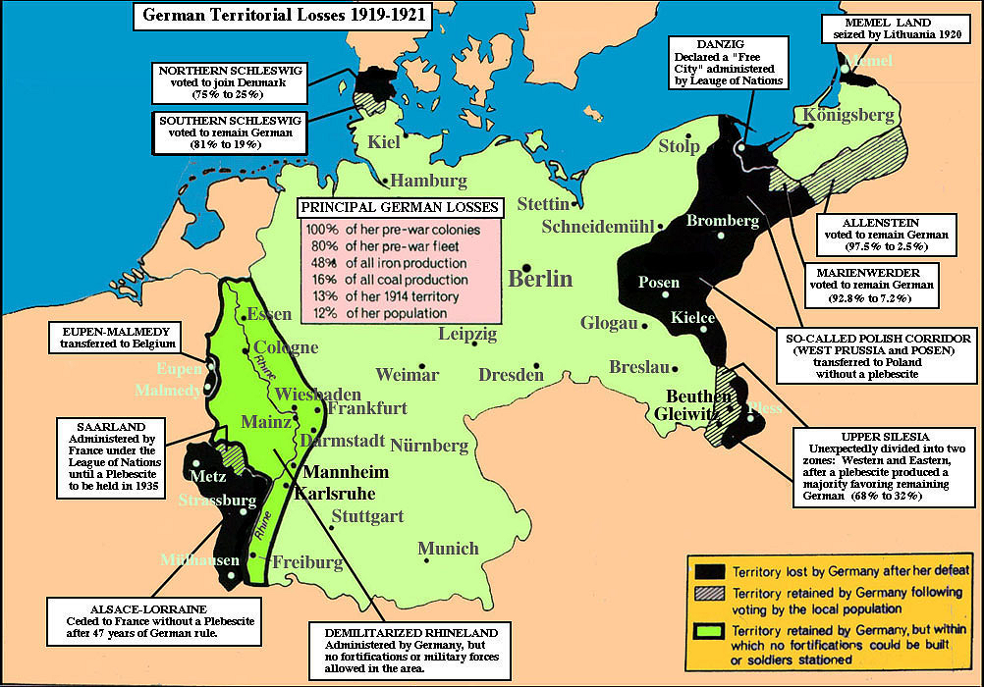

Slide 31
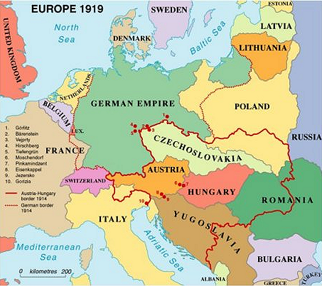

Punishing the
Central Powers
The break-up of the Austro-Hungarian Empire led to the independence of four new nations: Poland, Czechoslovakia, Hungary, and Yugoslavia.
Austria-
Hungary
Serbia, Bosnia, Herzegovina, and Montenegro made up Yugoslavia. Austria, deprived of its entire empire, became a small nation.
Ally Romania gained land, while Central Power Bulgaria lost land.

Slide 32
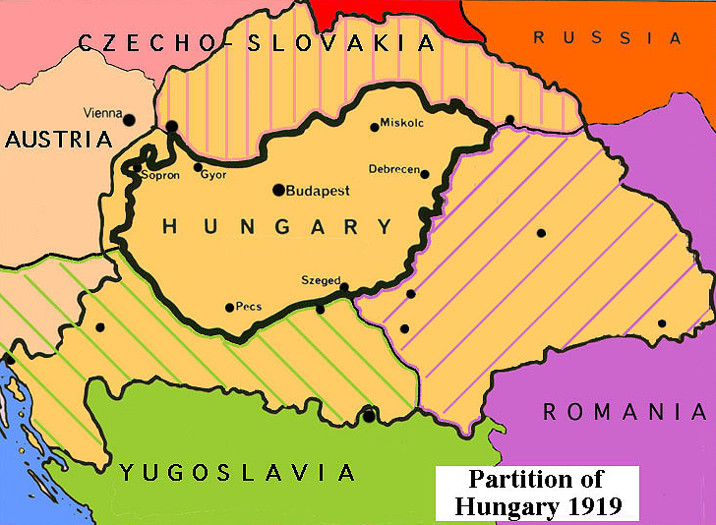

Slide 33
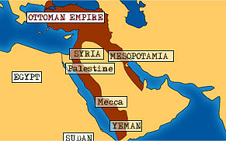

Punishing the
Central Powers
Ottoman
Empire
The weak Ottoman Empire (Turkey) was also broken up.
Some of the territories were given independence, while others such as Palestine, Iraq, and Syria were given to Britain and France.

Slide 34
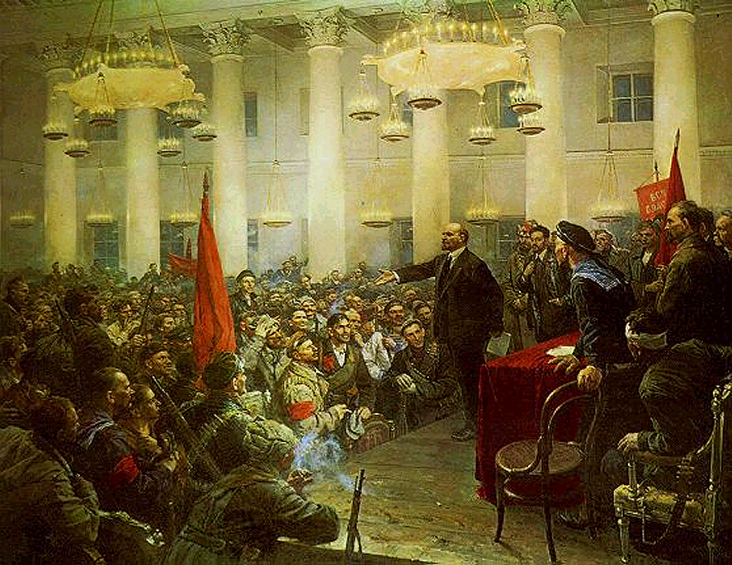
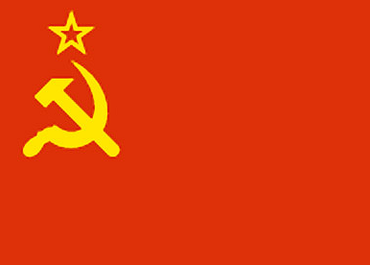
Punishing the
Central Powers
Communist
Russia
Since Russia’s new communist government left the war early, they were not invited to Versailles.
The Allies wanted to weaken Russia to keep communism from spreading westward.
Four new nations gained independence from Russia: Finland, Estonia, Latvia, and Lithuania. Russia also lost land to Poland and Romania.

Slide 35
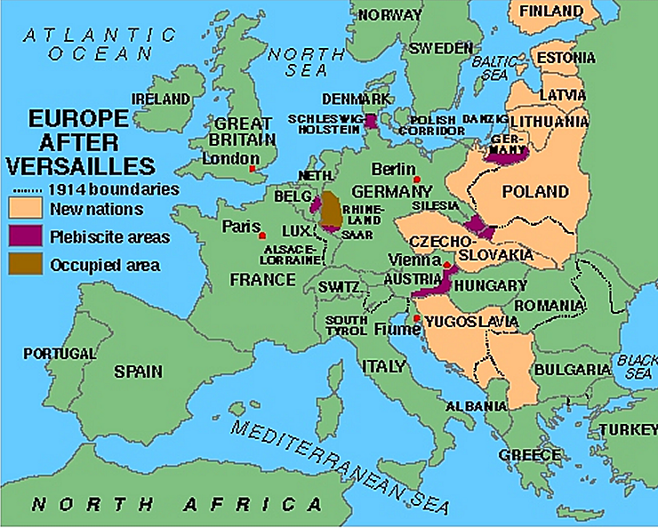
Land Russia lost

Slide 36
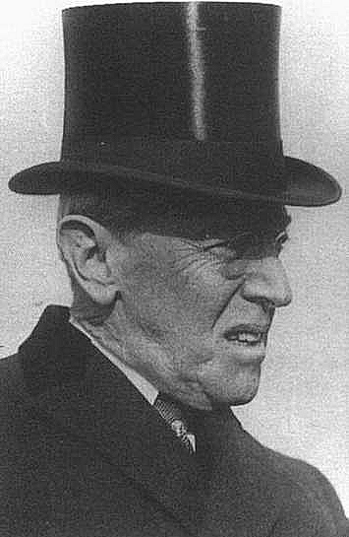
League of Nations
Wilson’s Creation
President Wilson succeeded in forming the League of Nations.
The countries that joined the League promised to take cooperative economic and military actions against any aggressive country.
Although Wilson’s idea, the United States Congress rejected the League because Americans feared it would pull them into future European wars.
The lack of the US severely weakened the League.

Slide 37



Anger over Versailles
Many nations were upset with the Treaty of Versailles, and felt their goals had not been achieved.
Germany was horrified by their reparations, reduced military, and territorial losses.
Americans also felt the Treaty was too harsh on Germany, and the US Congress refused to approve it.
Italy wanted to gain more land from Austria than it received.
Japan was angry because the Allies did not recognize all of its claims in China.

Slide 38

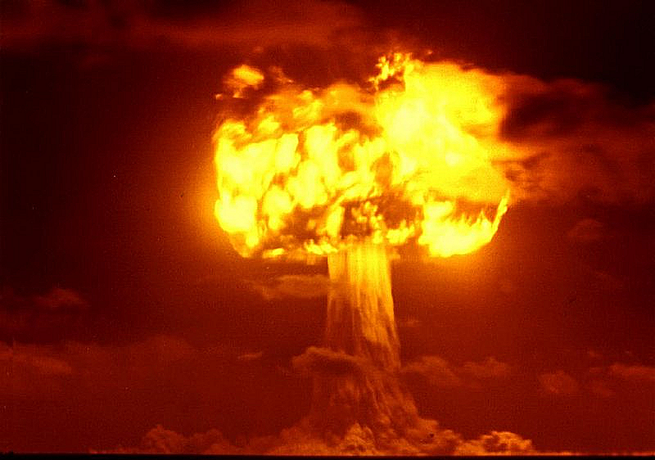
Anger over Versailles
China was angry that Japan had been given Germany’s sphere of influence.
Russia was angry they were not invited to Versailles, and upset over losing Finland, Estonia, Latvia, and Lithuania.
Unfortunately, the treaty that ended the “war to end all wars” merely provided the motivation for WWII, just twenty years later.

