Slide 1
Essential Question:
  Who were the major totalitarian leaders in the 1920s & 1930s?
  What were the basic ideologies of Fascists, Nazis, and Communists?
Warm Up Question: What was the economic effect of the Great Depression?

Slide 2
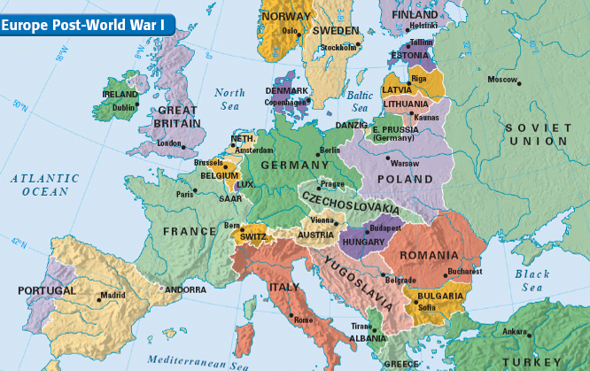
After WWI, many nations were struggling to rebuild
A global depression in the 1930s led to high unemployment &
a sense of desperation in Europe
The Treaty of Versailles created bitterness among many nations

Slide 3
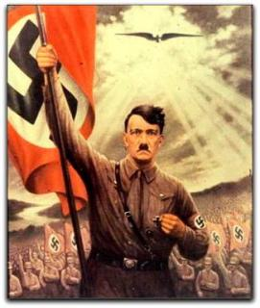
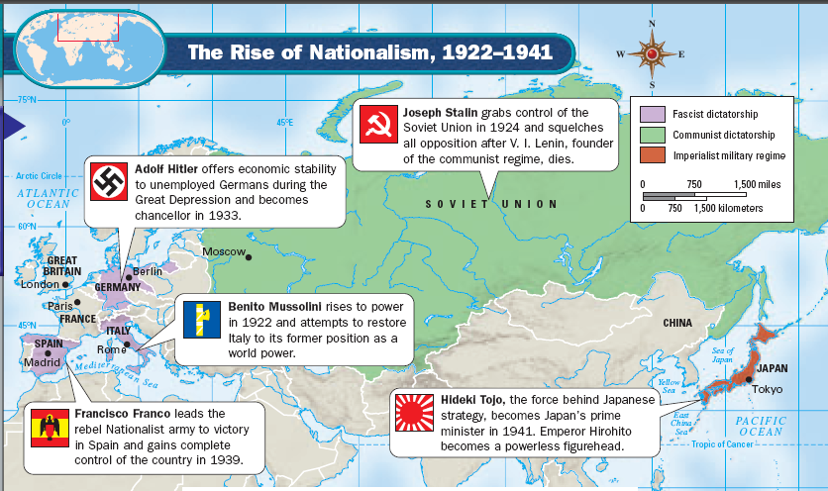
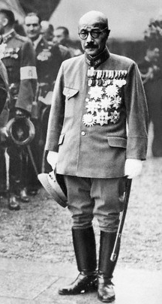
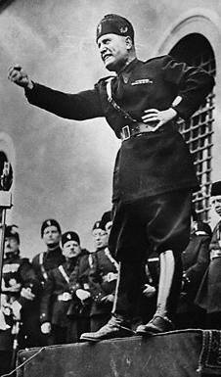
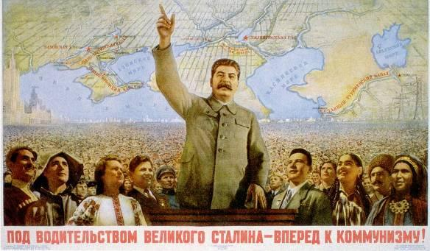
In this climate of postwar uncertainty, nationalism increased & citizens turned
to totalitarian dictators to rule the nation

Slide 4
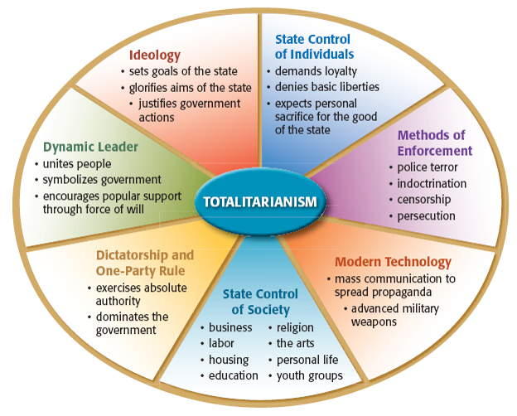
Totalitarian leaders are dictators who control all aspects of the government & the lives of the citizens
  Totalitarian leaders gained support by promising jobs, promoting nationalism, & using propaganda
  Dictators held on to their power by using censorship, secret police, denying liberties, & eliminating opposing rivals or political parties

Slide 5

Among the first totalitarian dictators was Joseph Stalin of the Soviet Union
Stalin was Communist &
seized all property, farms, factories in order to control the economy & create equality
He used a
secret police &
the Great Purge
to eliminate rivals

Slide 6
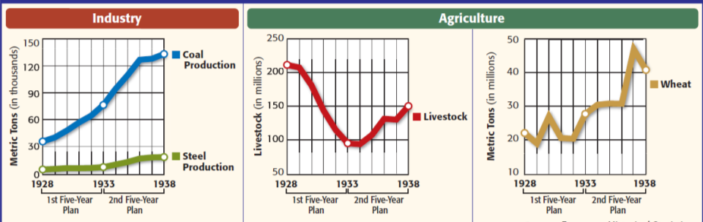
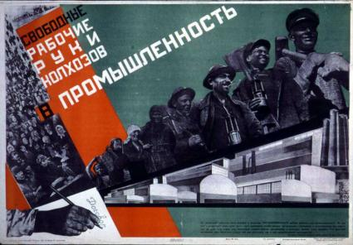
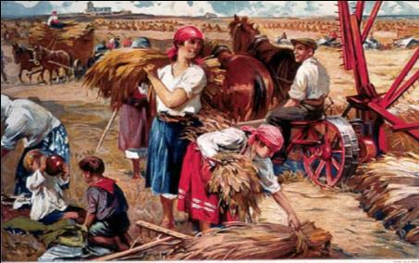
Stalin’s Five Year Plans & collective farms improved the Soviet Union’s industrial & agricultural output

Slide 7
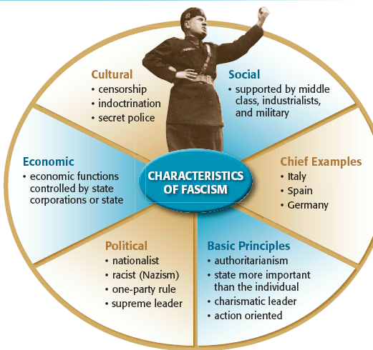
Not all totalitarian dictators were Communists
In Italy, Germany, & Spain, people turned to an extremely nationalist gov’t called fascism
Fascist gov’ts were controlled by dictators who demanded loyalty from citizens
Fascists did not offer democracy & used one-party to rule the nation
Unlike Communists, fascists believed people could keep their property

Slide 8
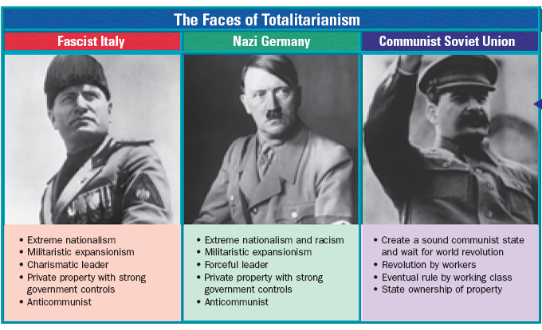
Totalitarian Regimes in Europe & Asia
Mussolini & Hitler believed in fascism: the idea that nations need strong dictators, total authority by one party, but that people can keep private property
Stalin was a Communist believed that the government should control all property & business
Notes:
In some ways, fascism was similar to communism. Both systems were ruled
by dictators who allowed only their own political party (one-party rule). Both
denied individual rights. In both, the state was supreme. Neither practiced any
kind of democracy. However, unlike Communists, Fascists did not seek a classless
society. Rather, they believed that each class had its place and function. In
most cases, Fascist parties were made up of aristocrats and industrialists, war veterans, and the lower middle class. Also, Fascists were nationalists, and
Communists were internationalists, hoping to unite workers worldwide.

Slide 9
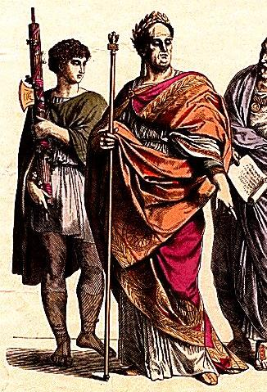
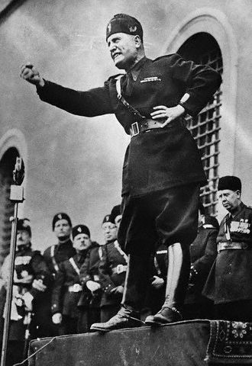
In Italy,
Benito Mussolini formed the Fascist Party
Mussolini gained popularity by promising to revive the economy, rebuild the military, & expand Italy to create a new Roman Empire
Mussolini named his Fascist Party after the fasces, a Roman symbol of authority & power

Slide 10
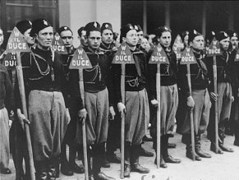
Mussolini created the Blackshirts (a secret police force) to enforce the goals of his Fascist Party

Slide 11
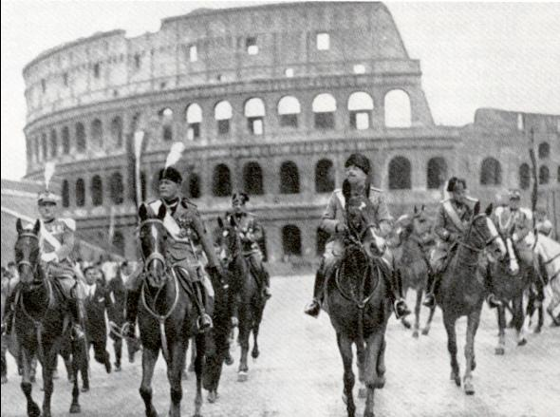
By 1922, Mussolini was popular enough to lead a “March on Rome” & forced the Italian king to name him prime minister

Slide 12
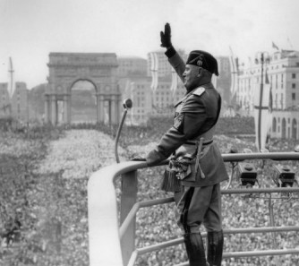
As prime minister, Benito Mussolini was known as “Il Duce” (the chief)
Mussolini ended democracy & all opposition parties
Mussolini built up the military to create new jobs
He planned to conquer new territories in Africa for Italy

Slide 13
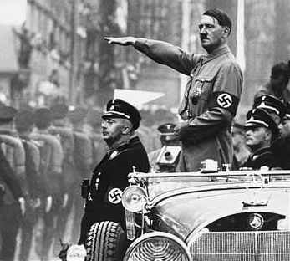
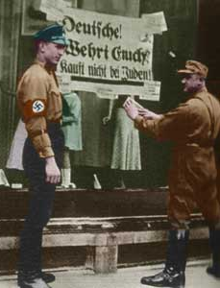
The Nazis were a fascist group in Germany that wanted to overthrow the disloyal Weimar Republic
Adolf Hitler was
an early Nazi recruit
& quickly rose to
power in the party
The Nazis created their own militia called the Brown Shirts
Hitler planned a march on Munich but he was arrested
& jailed for 9 months
Hitler was impressed by Mussolini & used many of his ideas to make the Nazi Party strong in Germany

Slide 14
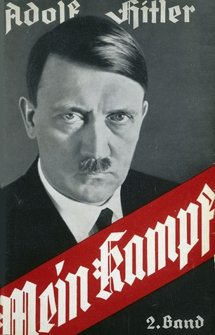
While in jail, Hitler wrote Mein Kampf which outlined his plans for Germany
He wrote that Germans were members of a master race called Aryans & all non-Aryans were inferior
He declared that Germans needed lebensraum (living space) & should conquer Eastern Europe & Russia
He called the Versailles Treaty an outraged & vowed to regain land taken from Germany after the war
Notes:
While in jail, Hitler wrote Mein Kampf (My
Struggle). This book set forth his beliefs and his goals for Germany. Hitler asserted that the Germans, whom he incorrectly called “Aryans,” were a “master race.” He declared that non-Aryan “races,” such as Jews, Slavs, and Gypsies, were inferior. He called the Versailles Treaty an outrage and vowed to regain German lands. Hitler also declared that Germany was overcrowded and needed more lebensraum, or living space. He promised to get that space by conquering eastern Europe and Russia.

Slide 15
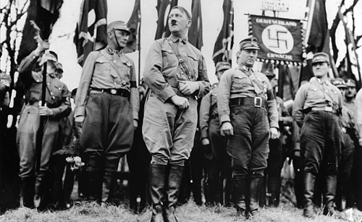
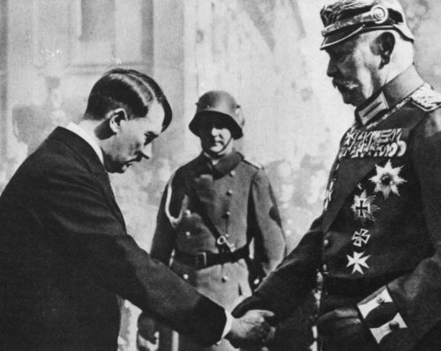
When Hitler was released from jail in 1924,
he spent years organizing the Nazis into Germany’s most powerful political party
In 1933, Hitler was named chancellor (prime minister)
of Germany
As chancellor, Hitler used his power to name himself dictator
He called his gov’t the Third Reich to promote pride & nationalism

Slide 16
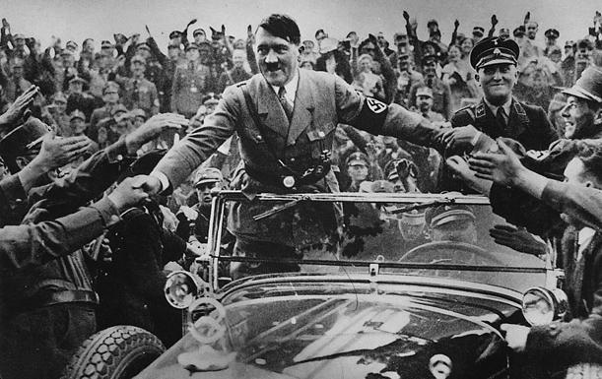
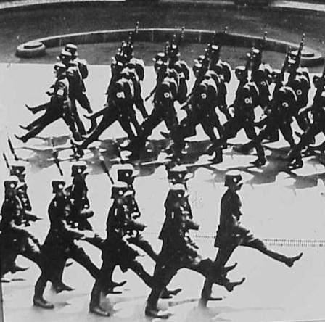
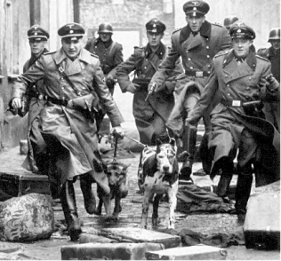
Hitler put Germans to work by building factories, highways, weapons, & increasing the military
He created the gov’t protection squad called the SS and a secret police called the Gestapo to eliminate rivals & control all aspects of Germany

Slide 17
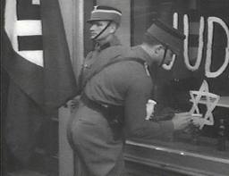
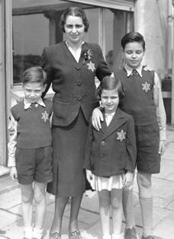
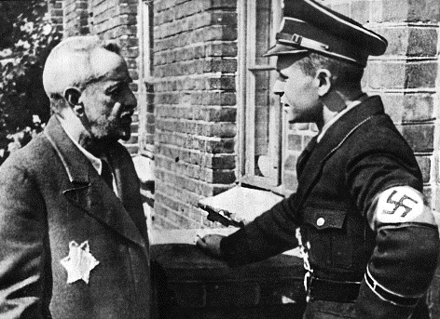
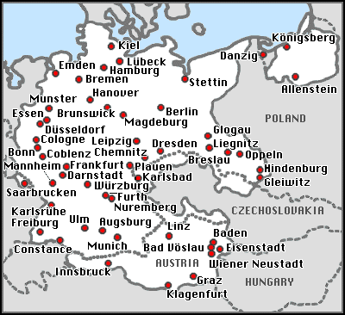
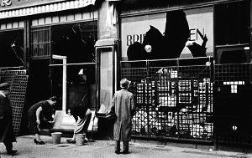
In 1935, Hitler began a series of anti-Semitic laws called the Nuremburg Laws that deprived German Jews of the rights of citizens, forbade mixed Jewish marriages, & required Jews to wear a yellow star
In 1938, Hitler ordered Kristallnacht (Night of Broken Glass), a series of attacks on Jewish synagogues & businesses

Slide 18
After WWI, Japan was the strongest nation in Asia & was ready to conquer new lands to provide resources for Japanese industry
Emperor Hirohito, gave
full control of the Japanese military to Hideki Tojo who served as a military dictator

Slide 19
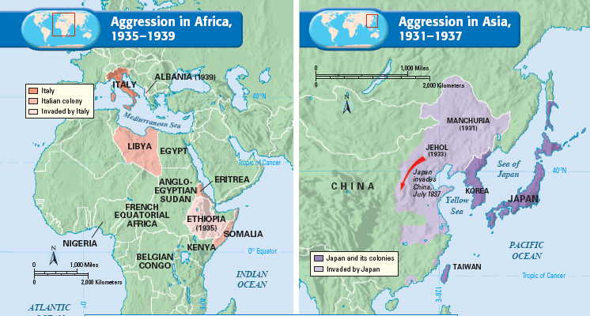
In the 1930s, Japan, Italy, & Germany began aggressively expanding into new territories… these actions caused World War II in 1939
Italy invaded Ethiopia & Albania
Japan invaded Manchuria, northern China; invaded Indochina & the East Indies

Slide 20
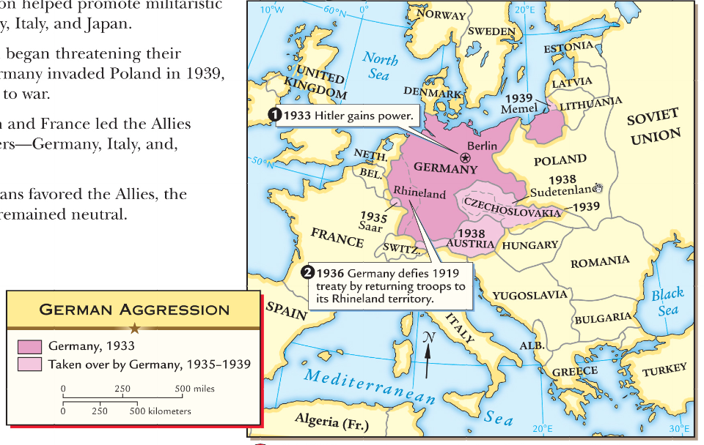
Germany annexed Austria & Czechoslovakia

Slide 21
Closure Activity:
Compare Fascism, Communism, & Democracy
Use your notes & knowledge of fascism, communism, & democracy to complete the chart on the back of the notes
  Define each form of government
  Provide as many differences & similarities as you can
  Be prepared to share your answers

