Slide 1
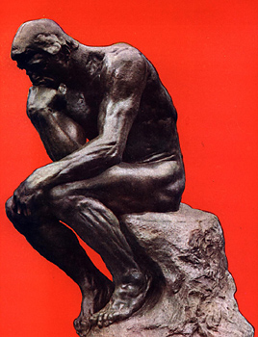

Humanism
An intellectual movement at
the heart of the Italian Renaissance that focused on worldly subjects instead of religious issues.
• Celebrated the individual
• Stimulated the study of Greek and Roman literature
and culture
• Was supported by wealthy patrons

Slide 2
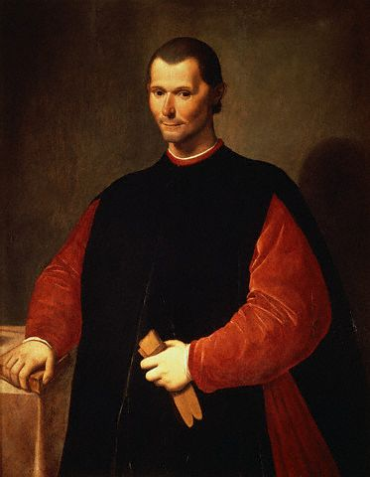
Political Ideas of the Renaissance
Niccolò Machiavelli
“The Prince”
Machiavelli observed city-state rulers of his day and produced guidelines for the acquisition and maintenance of power by absolute rule.
He felt that a ruler should be willing to do anything to maintain control without worrying about conscience.
Niccolò Machiavelli

Slide 3

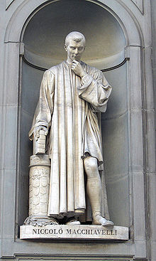
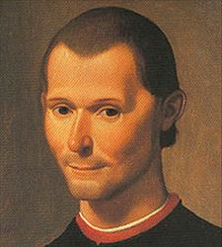
Machiavellian
Niccolò Machiavelli (1469 - 1527)
The Prince (1513)
Better for a ruler to be feared than to be loved
Ruler should be quick and decisive in decision making
Ruler keeps power by any means necessary
The end justifies the means
Be good when possible, and evil when necessary

