Slide 1

Republic to Empire
AIM: How did the Roman Empire begin?
Do Now: Why was Egypt important to the Romans? (Hint: Think River Valley)

Slide 2
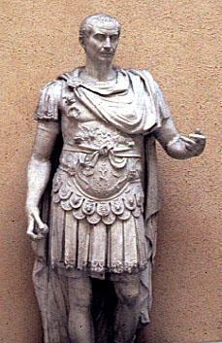
Julius Caesar
Formed a triumvirate (“rule of three) with Crassus and Pompey (military generals)
He ruled as consul for one year, then became governor of Gaul
During his rule of Gaul he won many battles that won him popularity back in Rome

Slide 3
Julius Caesar
Crassus dies in battle
Pompey had become his rival, he asked the senate to order Caesar to disband his army and return home.
Crossing of the Rubicon (Jan 10 49 BC)
  Caesar defied orders of the Roman Senate by marching across the Rubicon
Notes:
Ceasar refuses – rebel act. Instead marches home with army to march on Rome. Crosses Rubicon.

Slide 4
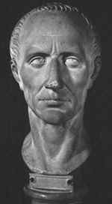
Julius Caesar
  By 44 BC Caesar become dictator for life
Expanded the senate – 900 members.
  Reduced their power to advisory council.
Created jobs.
Introduces 365 ¼ day calendar.

Slide 5
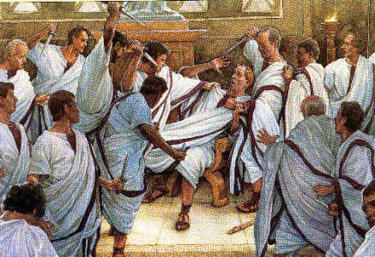
Ides of March
March 15 44 B.C.
Stabbed 23 times
Led by Gaius Cassius and Marcus Brutus
Famous last words “Et tu, Brute?”
Notes:
Ides means the middle of the month - “You too, Brutus?”

Slide 6
Caesar, Mark Antony, Cleopatra
Pompey fled to Egypt
  Caesar followed him there.
  Arrived to find him beheaded
While in Egypt Caesar met Cleopatra, he helped her to defeat her enemies
They fell in love, Cleopatra had a boy named Caesarion.

Slide 7
Caesar, Mark Antony, Cleopatra
Cleopatra returned home after Caesar’s death
Later she would meet Mark Antony in Egypt
    Mark Antony fell in love with Cleopatra.
    They will produce twins together.

Slide 8



Second Triumvirate
Second Triumvirate:
  Octavian, Mark Antony and Lepidus.

Slide 9
Octavian, Mark Antony, Cleopatra
Octavian-Grand-nephew of Ceasar was in charge of Rome
Mark Antony wanted to be sole ruler of Rome
He married and put Cleopatra in power, which angered Octavian
  Antony was already married to Octavian’s sister

Slide 10
Octavian and Mark Antony
Octavian persuades the senate to declare war on Antony
Eventually Octavian will defeat him at the Battle of Actium
Mark Antony and Cleopatra fled back to Egypt
While in Egypt Cleopatra spreads a rumor that she has committed suicide, Mark believes the rumor and kills himself
Cleopatra will follow realizing that she has lost control of Egypt
Notes:
Start here on January

Slide 11
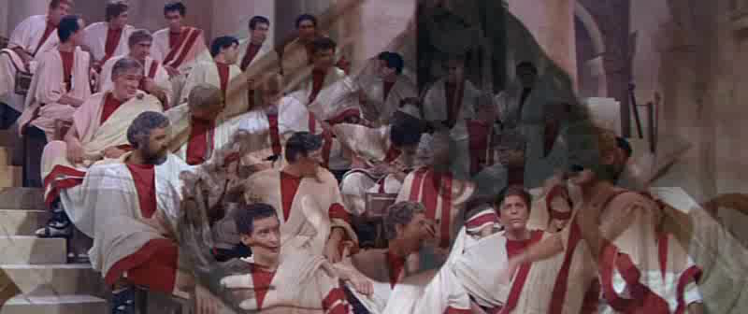
Octavian discusses Antony’s betrayal of Rome
The Roman Senate is split, some for Antony, some for Octavian
Antony makes a will, naming Egypt his preference over Rome.
The Senate votes to make war with Antony and Cleopatra & Egypt

Slide 12
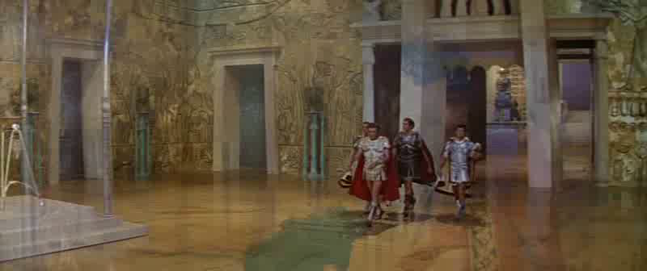
Cleopatra summons Marc Antony to Alexandria
Wants Antony to cede territories to Egypt
This makes Rome declare war on Egypt
Antony & Cleopatra fight a naval battle at Actium (Greece) & are defeated by Agrippa & Octavian. They head back to Alexandria

Slide 13
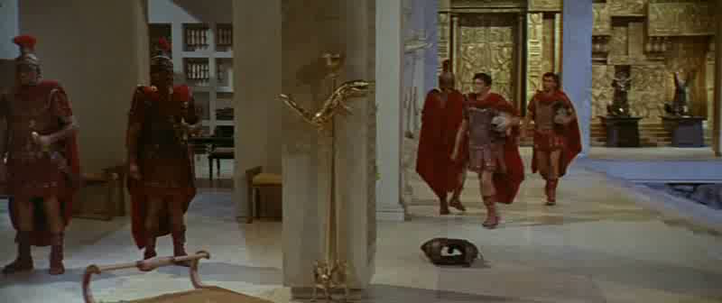
Anthony thinks Cleopatra is dead. He kills himself.
Octavian captures Alexandria & finds Cleopatra alive & in her tomb.
Octavian finds out Antony is dead.
Octavian is now the sole leader of Rome.

Slide 14
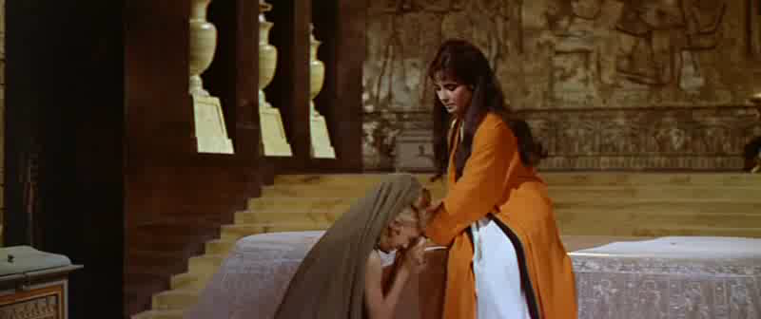
Cleopatra asks her servants to bring her the basket with the Asps
She knows her son (Caesarian) is dead
She kills herself by being bit by the Asp
Archaeologists have never found Antony & her tomb

Slide 15
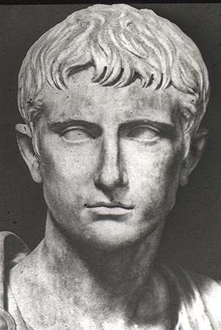
Augustus
After the defeat of Antony and Cleopatra, Octavian becomes Augustus
“exalted one”
Will start the Pax Romana (Roman peace) –Lasts 200 yrs

