Slide 1
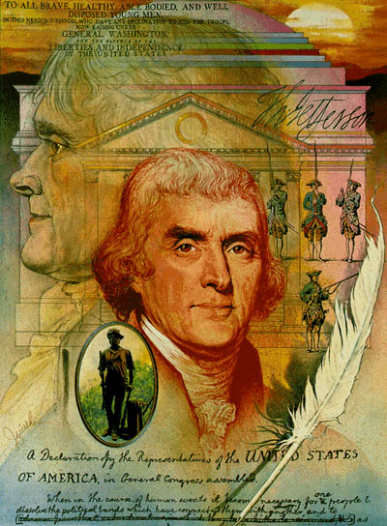
Thomas
Jefferson
AIM: What were some of the accomplishments and/or difficulties of Thomas Jefferson’s presidency?
The Presidency of
(1743-1826)

Slide 2
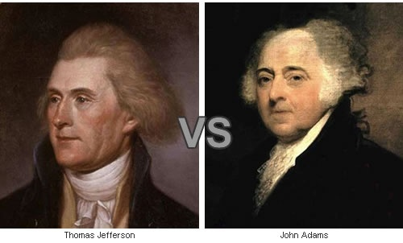

One of the Closest Presidential Elections in U.S. History
Jefferson vs. Adams, 1800
Notes:
n case you’re wondering exactly how down-and-dirty these campaigns got, consider the fact that this is the only election in history where a vice president has run against the president he was currently serving under. You can imagine that things were a little tense in the White House in the months leading up to the election.
Jefferson hired a writer to pen insults rather than dirty his own hands (at least at first). One of his most creative lines said that Adams was a “hideous looking character which has neither the force and firmness of a man, nor the gentleness and sensibility of a woman.”
Adams’ Federalists carried things even further, asking voters, “Are you prepared to see your dwellings in flames… female chastity violated… children writhing on the pike? GREAT GOD OF COMPASSION AND JUSTICE, SHIELD MY COUNTRY FROM DESTRUCTION.” I bet the Federalists would be so very upset to know that Jefferson was immortalized in 1936 as one of America’s great presidents on Mount Rushmore.
After such a nasty election, Congress passed the Twelfth Amendment, stating that the nominee to get the second-most number of votes would no longer be elected vice president.

Slide 3
Vote Count – Election of 1800
Presidential Candidate | Party | Home State | Popular Vote^{(a), (b), (c)} |  | Electoral Vote
 |  |  | Count | Percentage
Thomas Jefferson | Democratic-Republican | Virginia | 41,330 | 61.4% | 73
Aaron Burr | Democratic-Republican | New York | — | — | 73
John Adams | Federalist | Massachusetts | 25,952 | 38.6% | 65
Charles Cotesworth Pinckney | Federalist | South Carolina | — | — | 64
John Jay | Federalist | New York | — | — | 1
Total |  |  | 67,282 | 100.0% | 276
Needed to win |  |  |  |  | 70

Slide 4
Election of 1800
The election exposed one of the flaws in the original Constitution. People in the Electoral College could only vote for president; the vice president was the person who had the second largest number of votes during the election.
Alexander Hamilton persuaded the Federalist to side with Jefferson because he would be easier to deal with than Burr.
Jefferson vs. Adams
Result:
Democrat-Republicans voted for Burr on the ballot for Vice President separately and Burr, not Adams received the most Electoral Votes! Jefferson and Burr tied at 73 Electoral Votes Each.
The House Of Representatives Voted for Jefferson. and Burr became Vice President.
Notes:
Burr and Hamilton were political rivals and enemies.

Slide 5
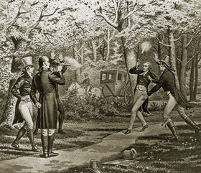
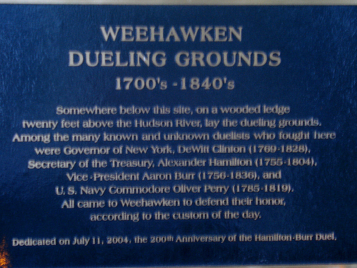
Burr – Hamilton Duel July 11, 1804
Notes:
Heights of Weehawken, New Jersey – Near the Present Day George Washington Bridge
The relationship between Alexander Hamilton and Aaron Burr was charged with political rivalry and personal animosity. Alexander Hamilton, the nation's first Secretary of the Treasury, was the chief author of The Federalist papers advocating a strong central government. Burr represented the old Republican Party. His greatest accomplishment was achieved in 1800 when he was elected Vice President to Thomas Jefferson. Hamilton considered Burr an unprincipled rogue. The antagonism between the two came to a head in 1804 when Hamilton thwarted Burr's attempt to gain re-nomination for Vice President as well as his bid to win the governorship of New York. Burr responded by challenging his antagonist to a duel, an invitation Hamilton felt compelled to accept.
The day before the duel Alexander Hamilton wrote his will, setting his affairs in order. In the early morning of July 11, 1804 he boarded a barge and set sail from Manhattan to the New Jersey shore. Accompanying him were his second, Nathaniel Pendleton and Dr. David Hosack, a physician. The party reached their destination shortly before 7:00 to find Aaron Burr and his second, W. P. Van Ness, awaiting them. The two had already cleared away some underbrush to form a dueling field. After the duel the two seconds collaborated in writing a description of the event that was published shortly thereafter:
"Colonel Burr arrived first on the ground, as had been previously agreed. When General Hamilton arrived, the parties exchanged salutations, and the seconds proceeded to make their arrangements. They measured the distance, ten full paces, and cast lots for the choice of position, as also to determine by whom the word should be given, both of which fell to the second of General Hamilton. They then proceeded to load the pistols in each other's presence, after which the parties took their stations. The gentleman who was to give the word then explained to the parties the roles which were to govern them in firing, which were as follows:
The parties being placed at their stations, the second who gives the word shall ask them whether they are ready; being answered in the affirmative, he shall say- present! After this the parties shall present and fire when they please. If one fires before the other, the opposite second shall say one, two, three, fire, and he shall then fire or lose his fire.
He then asked if they were prepared; being answered in the affirmative, he gave the word present, as had been agreed on, and both parties presented and fired in succession. The intervening time is not expressed, as the seconds do not precisely agree on that point. The fire of Colonel Burr took effect, and General Hamilton almost instantly fell. Colonel Burr advanced toward General Hamilton with a manner and gesture that appeared to General Hamilton's friend to be expressive of regret; but, without speaking, turned about and withdrew, being urged from the field by his friend, as has been subsequently stated, with a view to prevent his being recognized by the surgeon and bargemen who were then approaching. No further communication took place between the principals, and the barge that carried Colonel Burr immediately returned to the city. We conceive it proper to add, that the conduct of the parties in this interview was perfectly proper, as suited the occasion."

Slide 6
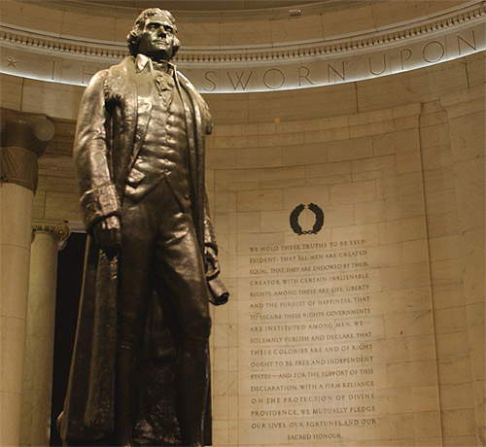
First Inaugural Address
Essential Principles of Government
  “equal and exact justice to all men”
  “peace, commerce, and honest friendship with all nations”
  “the support of state governments”
  “the preservation of general government”
  punishment for those who choose to revolt
  compliance with the decisions of the majority
"We are all Republicans:
We are all Federalists"

Slide 7
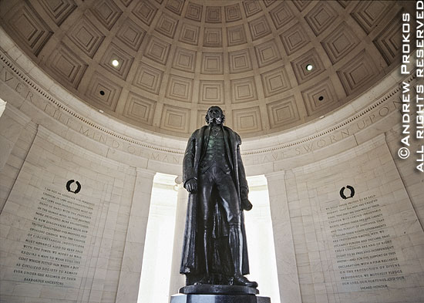
Second Inaugural Address
Delivered on March 4, 1805
Stresses the importance of American neutrality in matters of foreign affairs
Outlines the Louisiana Purchase and the processes by which the original inhabitants of the land will become citizens of the United States
Stresses the importance of harmony amongst all inhabitants of America

Slide 8
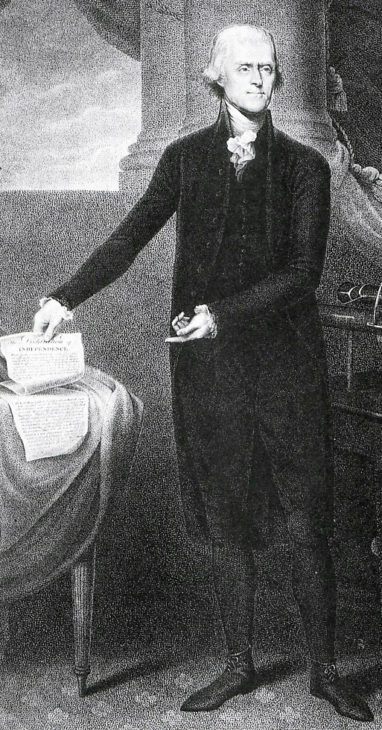
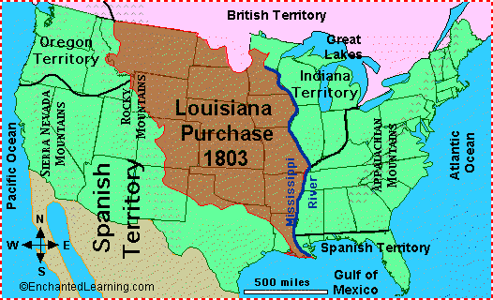
The Jeffersonian Era
Purchased Louisiana Territory from France for 15 Million
Sent Lewis & Clark to Explore the Louisiana Territory.

Slide 9
LOUISIANA PURCHASE - 1803

Slide 10
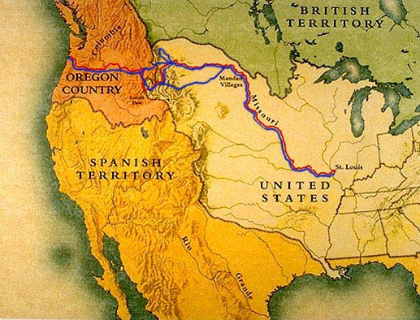
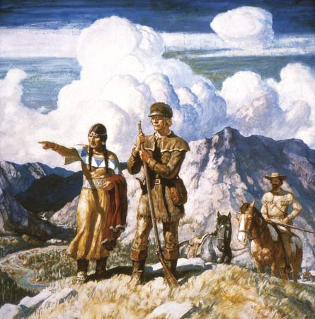
The Journey Begins
In a letter dated June 20, 1803, Jefferson wrote to Lewis
“ The object of your mission is to explore the Missouri river, and such principal stream of it as by its course and communication with the waters of the Pacific Ocean whether the Columbia, Oregon, Colorado or any other river may offer the most direct and practicable water communication across this continent for the purposes of commerce.
Lewis & Clark
Sacagawea
(American-Indian Guide)
33 Soldiers &
Other Mountain Men
Start in 1804 – Ended in 1806
Traveled 8,000 miles in 2½ Years
Inbound - West
Outbound – East

Slide 11
Embargo Act of 1807
1803 - Renewal of the Napoleonic Wars between France and Great Britain
America was once again trapped between the two nations
Jefferson wanting to stay neutral proposed an embargo on all foreign trade (Embargo Act)
This was highly unsuccessful and devastated the American Economy
1809 Congress repealed (took away by law) the unsuccessful Embargo Act

Slide 12
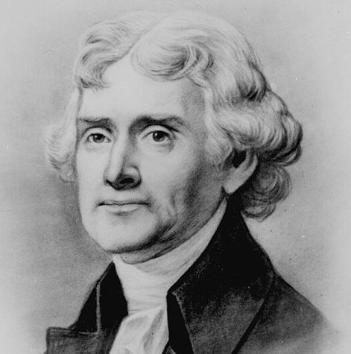
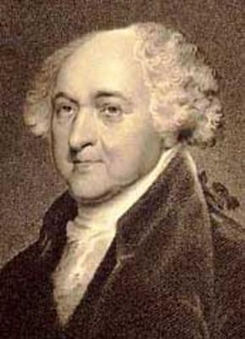
Hmm … I think I’ll appoint a whole bunch of people to office and mess Jefferson up !
Jefferson
Election of 1800
Adams

Slide 13
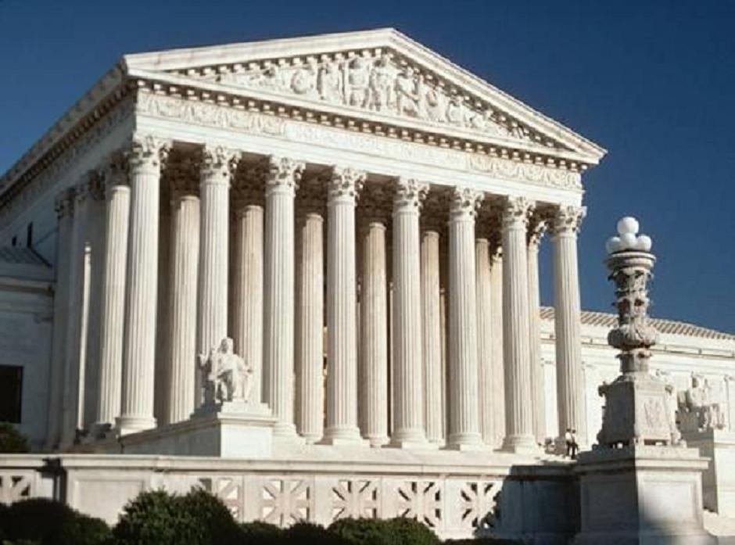
Supreme Court

Slide 14
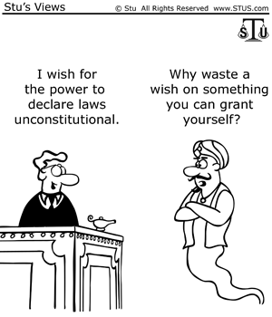
MARBURY V. MADISON – 1803
Equal
Power to
All Branches of Gov’t
Supreme Court could make laws and acts of both the Legislative and Executive Branch unconstitional

Slide 15

John Adams, ever the patriot, died on July 4th, 1826 - the 50th anniversary of the Declaration of Independence. His last words? "Jefferson Lives."
Little did he know that Jefferson, incredibly, had also died on the
4th of July - just a few hours earlier.
Jefferson lives
Election of 1800
Adams

