Slide 1
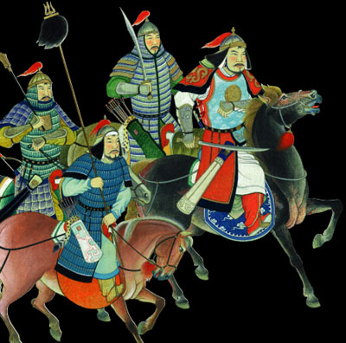
THE
Mongol
Empire
Aim: What were the results of the Mongol Empire’s expansion?
Do Now: Complete Mongol Worksheet

Slide 2
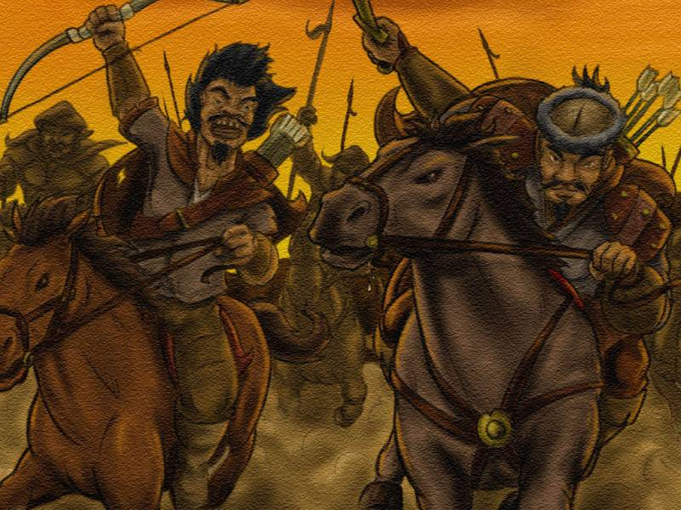
The Mongols
Known as nomadic, fierce warriors, expert horsemen
From the steppe in Asia
(dry, grassy region)
Lived in kinship groups
called clans
Around 1200, leader named Temujin (Genghis Khan) united Mongols under his leadership.
Campaign of terror across Central Asia, destroying
cities and slaughtering people

Slide 3
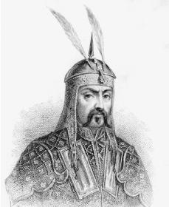
Genghis Khan
Title means “universal ruler”
Brilliant organizer and warrior
Used cruelty and fear as weapons
Died in 1227, but his successors continued to expand empire

Slide 4
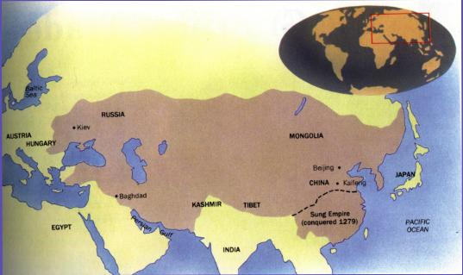
The Mongol Empire (1216-1400 C.E.)
4 regions or khanates
  Mongolia and China
  Central Asia
  Persia
  Russia
Largest land empire ever.
Stretched across Asia and eastern Europe.
It was approximately one million square miles.

Slide 5
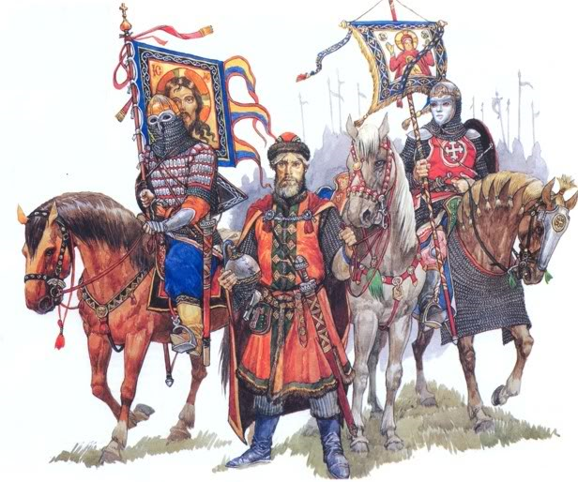
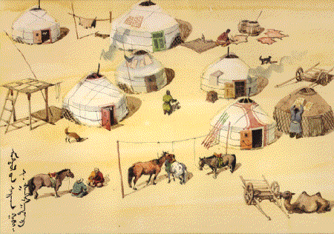
Mongol rulers
Tolerant rulers in times of peace
Imposed stability, law and order across Eurasia (Pax Mongolica)
Provided safety for trade between Europe and Asia
Mongol rulers relied on foreigners to help rule the government

Slide 6
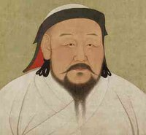
Kublai Khan
Grandson of Genghis Khan, took power in 1260
Founded the Yuan Dynasty
United China for first time in 300 years
Opened China to foreign contacts and trade
Tolerated Chinese culture and government
Lived luxurious life of Chinese emperor
Failed to conquer Japan
Restored the Grand Canal,
built paved highway
Encouraged trade

Slide 7
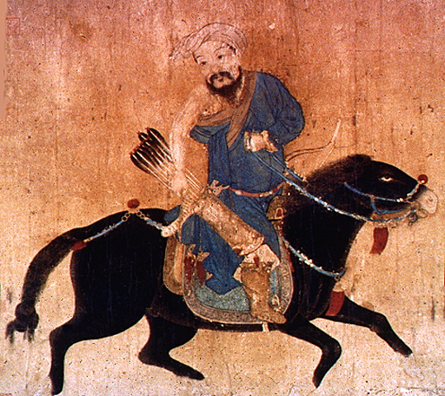
The End of Mongol Rule
Succession crisis after death of Kublai Khan
Many rebellions in 1300’s
Chinese overthrew Mongols in 1368
Other Khanates declined, except for Russia

