Slide 1
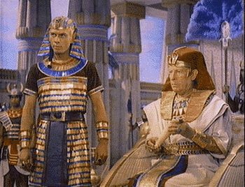
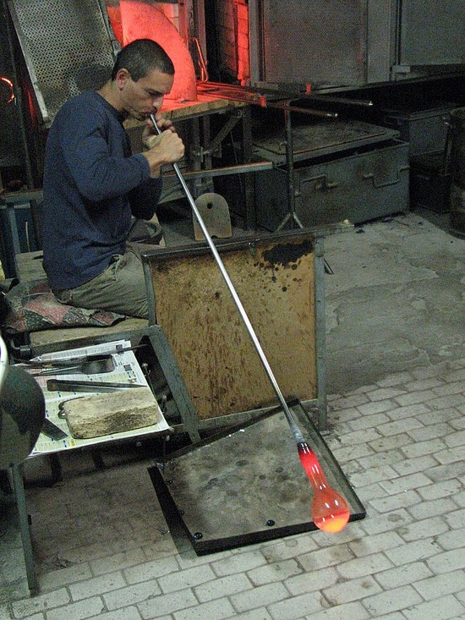
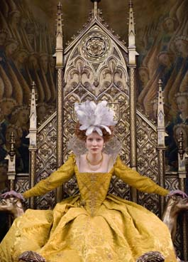
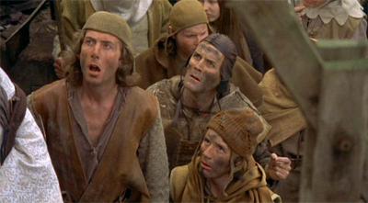
Do Now: What is a social pyramid?
AIM:
Pharaoh
A hierarchy (order or ladder) of society (people)
Class
Artisan
Queen
Peasants

Slide 2
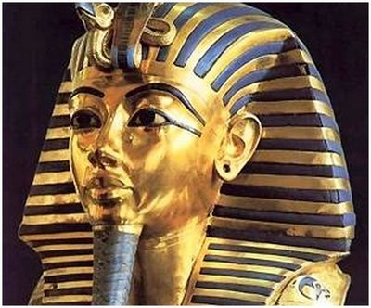
Pharaoh / King
1
E
G
Y
P
T
2
Priests / Nobles
Soldiers
3
4
Scribes
5
Merchants
6
Farmers
7
Slaves & Servants

Slide 3
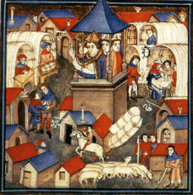
Europe – Middle Ages
F
EUDA
L
I
SM
1
King
Clergy
Nobles
2
Lords
3
Knights Vassals
Peasants
Serfs
4

Slide 4
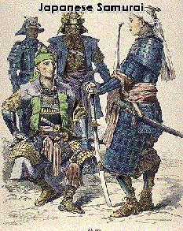
Japan
F
EUDA
L
I
S
M
Emperor (Figurehead)
1
2
Shogun
Diamyos
3
3
Samurai
4
Peasants
5
Artisans
6
Merchants

Slide 5
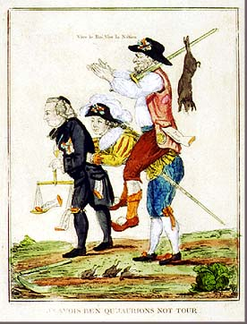
Pre - 1789
F
R
A
N
C
E
1st Estate
Clergy
1
2nd Estate
Nobility
2
3rd Estate
3
Everyone
Else

Slide 6


Slide 7

Based upon the social pyramids reviewed,
What does social class tell us about a society?

Slide 8
Homework: Complete a social class pyramid
for the missing society not in today’s lesson.
(hint: Slumdog Millionaire)

Slide 9
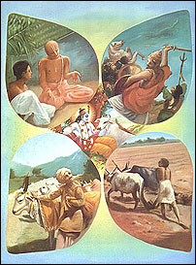
India – Caste System
I
N
D
I
A
1
Brahmins
(Priests)
KSHATRIYAS
2
(Warriors)
Vaisyas
(Farmers, Merchants, Artisans, Herders)
3
4
Sudras
(Farm Workers, Servants, Laborers)
UNTOUCHABLES

