Slide 1
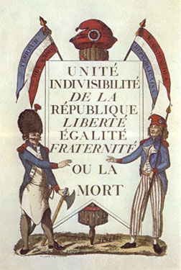
French Revolution Stage 2 & 3
AIM: How did the stages of the French Revolution differ and which group benefited the most?
Do Now: Complete the following sentence
France was originally led by a ______________ whose powers were __________. The ______________ wrote a new constitution and limited the king’s power a tried to equalize the ___________.

Slide 2
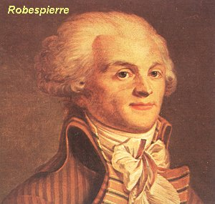
Second Stage
Radical Revolution
Disillusionment of the lower class (inflation)
No strong leader
France drawn into war in Europe
Failure in wars (1792-1797)
  Moderates removed as
  leaders of
  National Assembly
  Counter-revolutions
  King and queen arrested

Slide 3
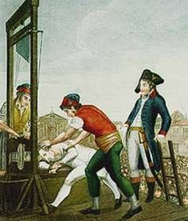
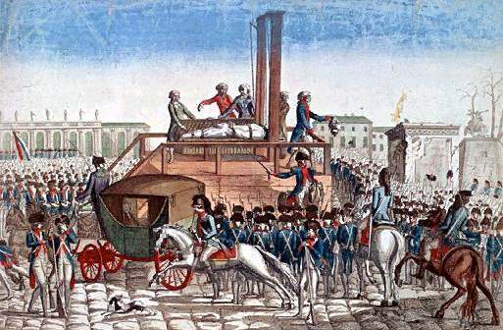
Second Stage
Reign of Terror (1793-1794)
Committee for Public Safety
Headed by Robespierre
Reforms
  Metric system
  New calendar
  Universal suffrage
  Slavery eliminated
  Paris commune
  Land redistribution
  Defaced churches
Guillotine
  Approx 40,000+ die
  By summary execution
  or guillotine
  King and Queen Beheaded

Slide 4

Execution of 40,000+
“Enemies of the Nation”
Stress on radical definition
of equality
Wanted a legal maximum on
personal wealth
Wanted a regulation of
commercial profits
End of Robespierre’s
dictatorship on July 28, 1794
Robespierre executed by
Guillotine

Slide 5
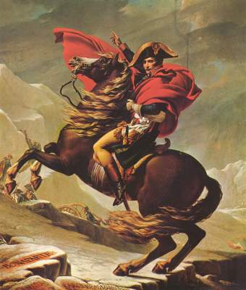
Third Stage—Return of the Moderates (1794-1799)
The Directory governed
Death of Robespierre
Some military successes (Napoleon as General)
Directory criticized for
poor leadership
Directory desperate for
a popular leader
  Napoleon invited to be consul to protect Paris & France

Slide 6
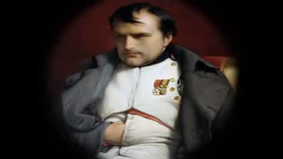
The Rise of Napoleon

