Slide 1
Emperors During the
Pax Romana
In the Roman Empire
AIM: What was the Pax Romana?
Do Now:?

Slide 2
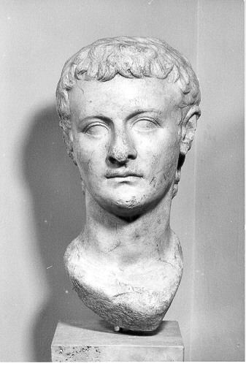
Caligula
Mentally disturbed
Assassinated after short brutal reign

Slide 3
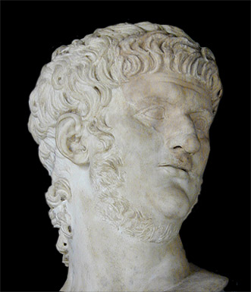
Nero
Good administrator but vicious
Murdered many
Persecuted Christians
Committed suicide

Slide 4
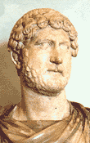
Hadrian
Consolidated earlier conquests
Reorganized the bureaucracy

Slide 5
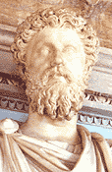
Marcus Aurelius
Brought empire to height of economic prosperity
Defeated invaders
Wrote philosophy

Slide 6
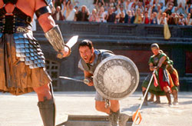
Gladiators
Condemned criminals
Prisoners of war
Slaves
Free men

Slide 7
Start of the Roman Collapse
Cost of defense
Inflation
Overworked soil
Disease

Slide 8
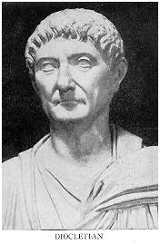
Diocletian
Absolute ruler
Limited personal freedoms
Fixed prices
Persecuted Christians
Divided empire East (Greek) and West (Latin)

Slide 9
Diocletian
He took eastern half, named a co-ruler
Would retire from power due to health
Civil war broke

Slide 10
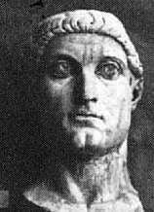
Constantine
Fought 3 others for control
When he gained control he re-established 1 ruler
Moved capital to Byzantium, later Constantinople

Slide 11
Western Empire
Because of the capital being moved the west was open to invasions
Huns- Mongolian nomads
Germanic tribes- Franks, Burgundians, and Vandals

Slide 12
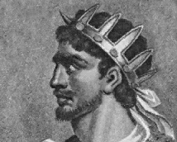
Attila the Hun
Marched with 100,000 soldiers
Attacked over 70 cities on the way to Rome
He could not gain control of Constantinople
Pope Leo I helped

Slide 13
Last Emperor
Romulus Augustulus was the last Roman Emperor
Overthrown by German general named Odoacer
The Eastern half lasted until 1453 when they were conquered by the Ottoman Turks

Slide 14
Causes of Fall
Political
  Burden not reward
  Military interference
  Civil war
  Division of empire
  Moving of capital
Social
  Decline interest in public affairs
  Disloyalty, lack of patriotism
  Rich v. poor

Slide 15
Causes of Fall
Economic
  Poor harvests
  Disruption of trade
  Inflation
  Tax burden
  Rich v. poor
Military
  Threat from European tribes
  Low funds
  Problems recruiting

