Slide 1
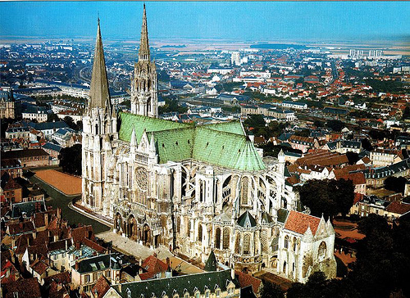
The Role of the Roman Catholic Church in the
Middle Ages
Aim: What group had the social, political and economic power in the Middle Ages?
Do Now: Based upon the Feudal system social pyramid what group had the most power in Medieval Europe?

Slide 2
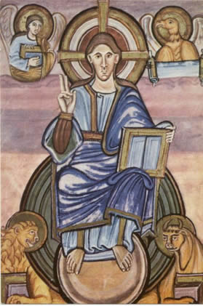
Role of Church in Middle Ages
Never was there a time when the Church was so powerful in Western Civilization.
The Church was led by popes. Priests and nuns converted and gave care to the people.

Slide 3
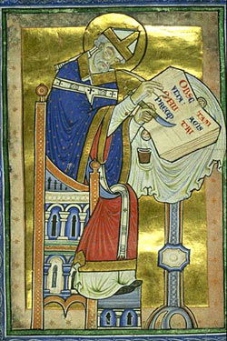
Role of Church
Monks were spiritual leaders (obviously)
They lived in monasteries that acted like trade schools and YMCAs

Slide 4
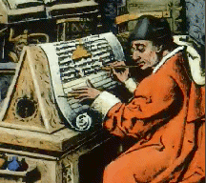
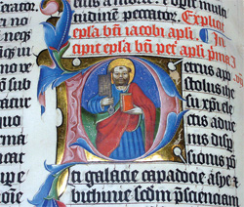
Role of Church
They spent years transcribing
the Bible (making illuminated manuscripts) since the printing press wasn’t used in Europe yet.

Slide 5
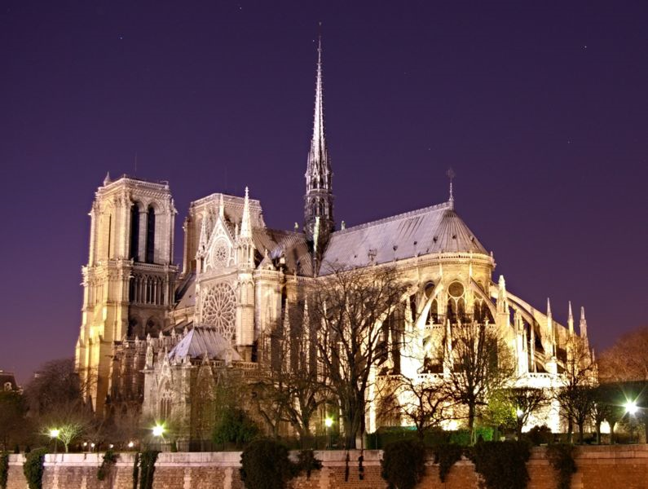
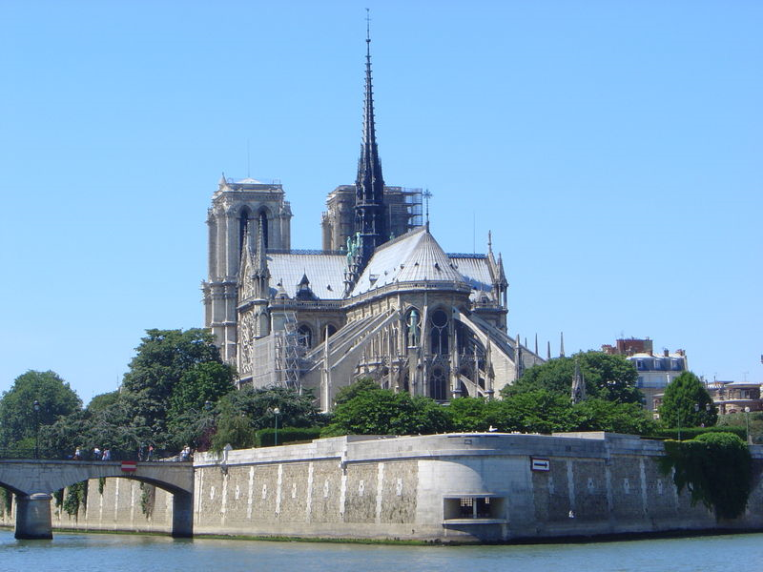
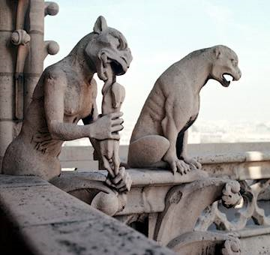
Churches and Cathedrals during the Middle Ages
Gothic – Buildings (Churches) Reaching to Heaven
Gargoyles
Notre Dame de Paris
Started 1163 / Completed 1365

Slide 6
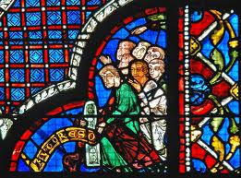
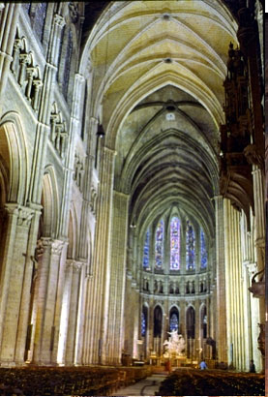
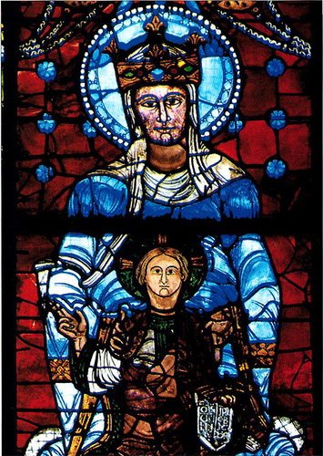
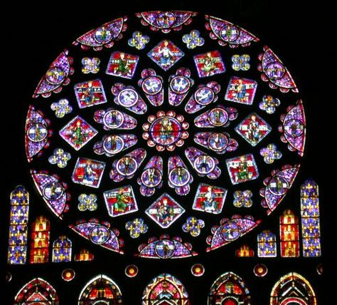
Chartres Cathedral
Tours France
Stain Glass Windows

Slide 7
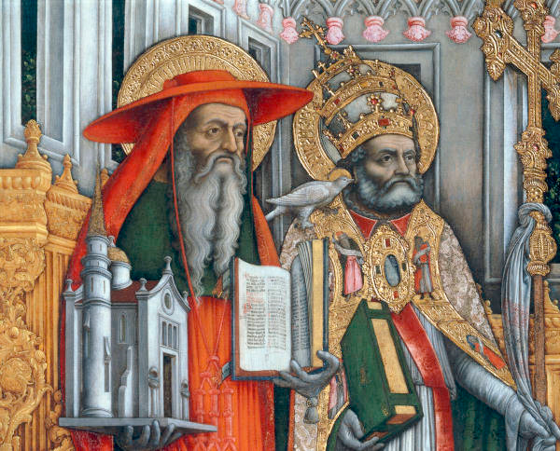
Power of the Church
Since there were
no strong empires
or kingdoms the Church was one organization that had respect and power.
Popes/Church were more powerful than kings!
Pope Gregory I

Slide 8
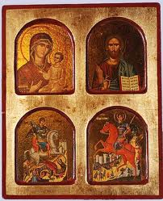
During Middle Ages
Dispute over use of icons (Holy Images) contributed to split
Byzantine Emperor outlawed prayer to icons
Two branches of Christianity grew further apart
1054 provoked a permanent split between Byzantine, Eastern (Greek) Orthodox and Roman Catholic Church
Iconoclasm – The breaking of images; religious controversy of the 8th c. Byzantine emperor attempted, but failed to suppress icon worship

Slide 9
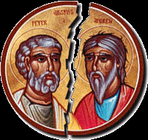
CHRISTIANS
BUT DIFFERENCES DIVIDED!!!
Divisions in the Church
West
Pope in Rome
Latin Language
Clergy Not Married
Most important holy day Christmas
East, Constantinople
Patriarch in the Byzantine-rejected Pope’s authority
Clergy could marry
Greek Language
Most important holy day Easter

Slide 10
