Slide 1
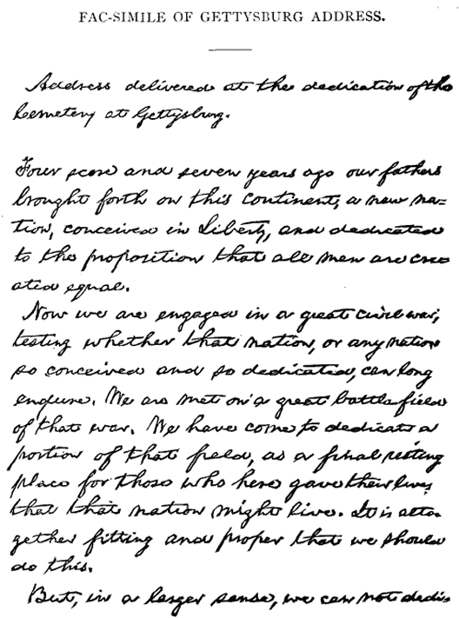
Primary Documents
What is a primary document ?
A primary document is something written, spoken, or visual by a witness to an event.
Journal , Letter or Poem
Law (U.S. Constitution)
Photo or Video
Portrait (Painting of a Person)
Anything witnessed by someone and/or interviewed by someone and then put into a format that other people in the future could see or hear.

Slide 2

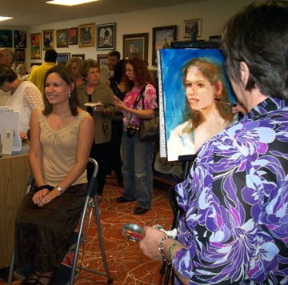
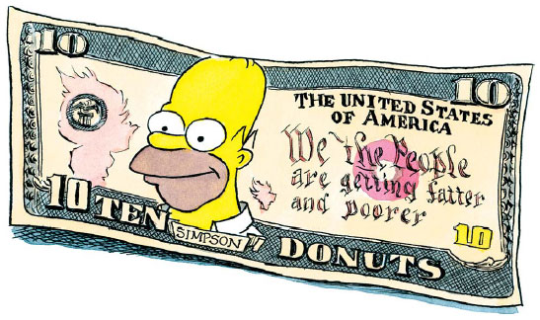
Portrait
What is a Portrait ?
Why do you think a portrait is usually a primary document?
A portrait is an image/painting or a likeness of a person, usually done when the person is in front of the artist. (Witness)

Slide 3
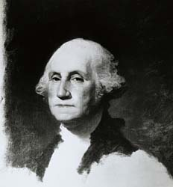
Primary
Document
Unfinished Portrait - 1796 Artist: Gilbert Stuart 1755-1828

Slide 4
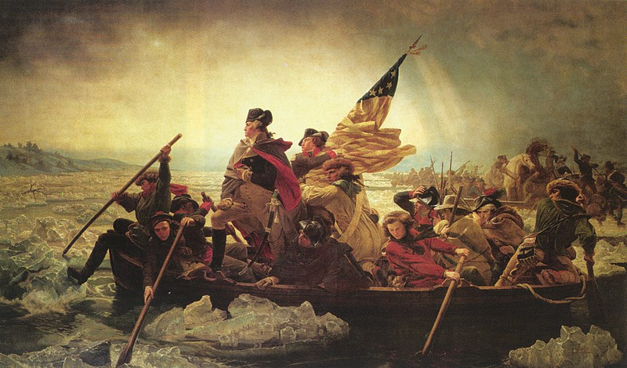
Not a Primary
Document
George Washington Crossing the Delaware, 1851
Artist: Emanuel Gottlieb Leutze, American, 1816-1868
Metropolitan Museum of Art, New York City

Slide 5
How to Know If Something is a Primary Document?
Primary Document
Person was alive when the event happened
Person interviewed someone who was alive when the event happened
Document was written at the time of the event
Person witnessed the event (first hand account)

Slide 6
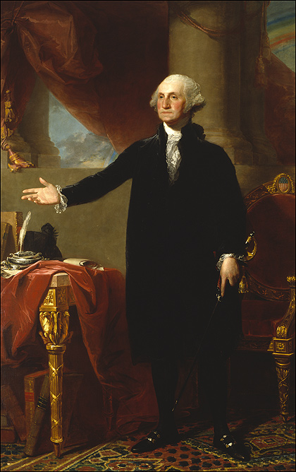
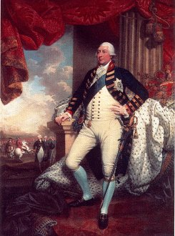
GEORGE WASHINGTON Gilbert Stuart 1796
KING GEORGE III – GREAT BRITAIN
Mather Brown 1790
Looks Like He’s Working or Giving a
Speech
Red Drapes
Looks Like Waiting
for Someone
Holding Sword
(Non-Military)
Roman Columns
Sword
(Royal/Military)
Velvet Robe
(Non-Military)
Storm Clouds
Military Uniform
Rainbow
Chair
People Waiting to
See Him Outside
Desk, Pen, Books
No Desk, Pen, Books
Royal Robes
Venn Diagram

Slide 7
GEORGE WASHINGTON Gilbert Stuart 1796
KING GEORGE III – GREAT BRITAIN
Mather Brown 1790
Based upon your observations name two things that you think about when you look at them?
What questions do these portraits raise in your mind?
Where could you find the answers to them?

Slide 8
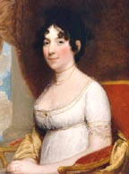
Dolley Madison (1768-1849)

Slide 9
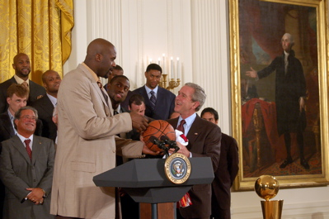
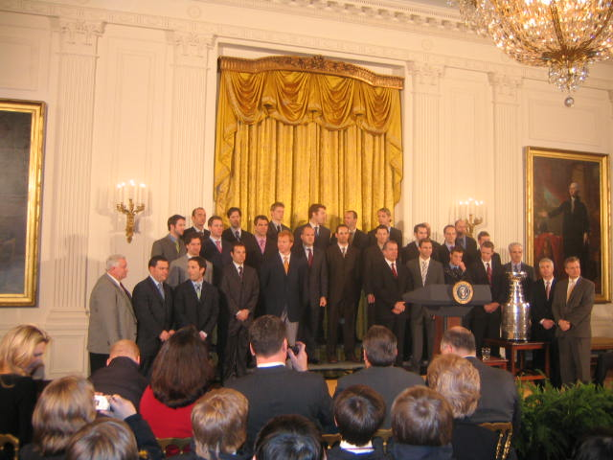

Slide 10
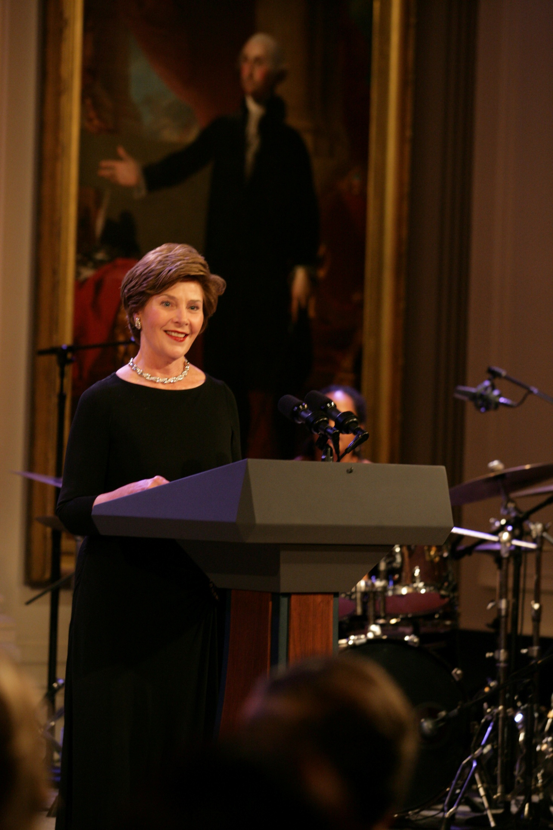

Slide 11
