Slide 1
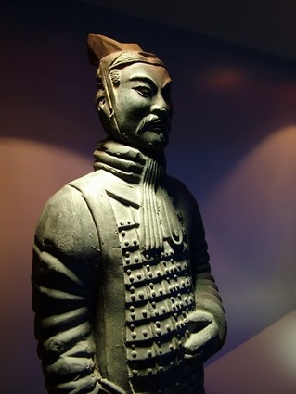
Ancient China
Qin and Han
Dynasties
Aim: What were the
Great Ancient Chinese Empires??
Do Now:
What Continent is China On?
What characteristics started Chinese civilization?

Slide 2
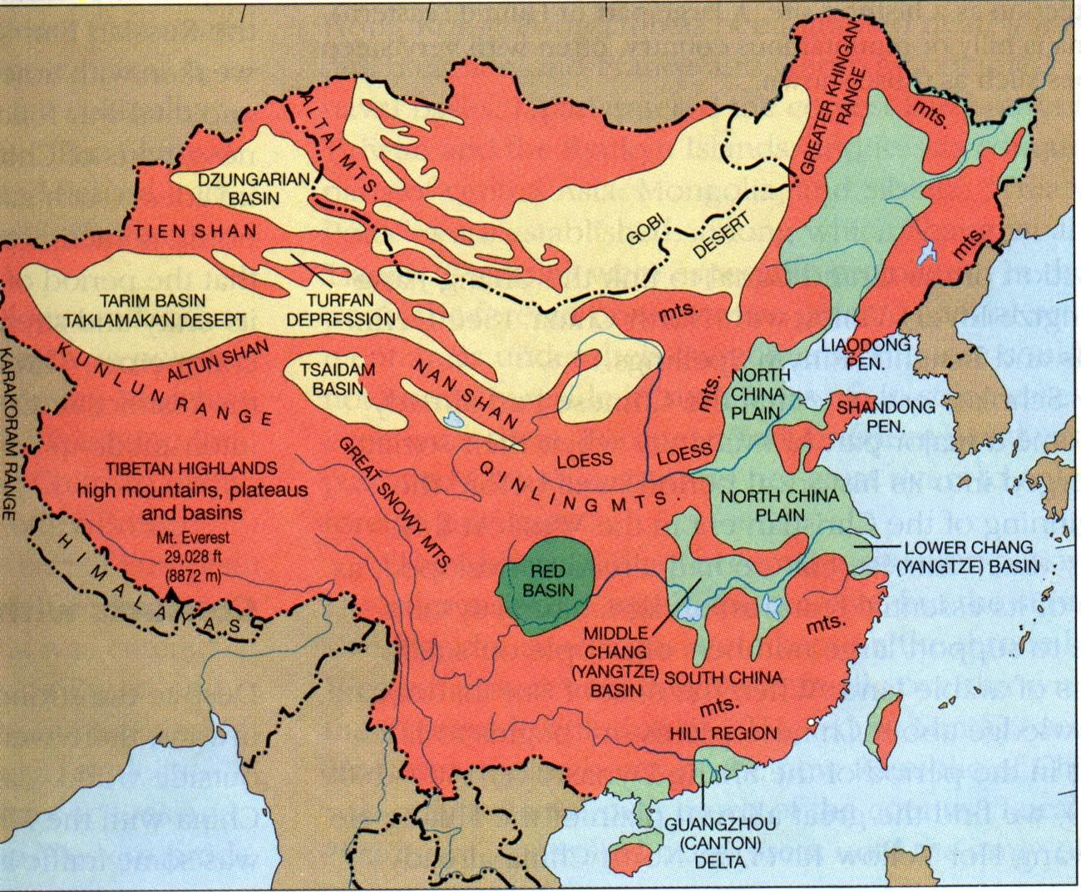
Mountains, sea, and desert provide some protection and isolation
except vulnerable to northwest

Slide 3

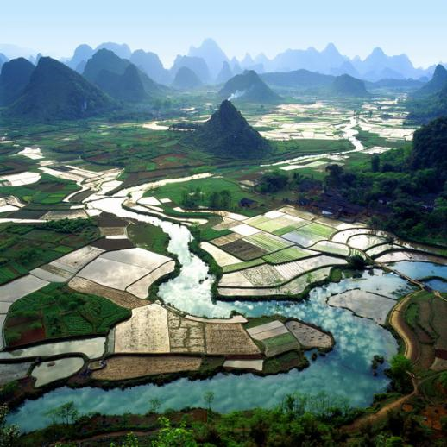
River valleys
Yellow (Huang Ho) earliest civilization - damaging floods
Yangtze - very important in unification- transportation- irrigation
Notes:
Chinese civilization originated in various city-states along the Yellow River valley in the Neolithic era. The written history of China begins with the Shang Dynasty (ca. 1550 BCE – ca. 1046 BCE).Turtle shells with ancient Chinese writing from the Shang Dynasty have been carbon dated to as early as 1500 BCE. The origins of Chinese culture, literature and philosophy, developed during the Zhou Dynasty (1045 BCE to 256 BCE) that followed the Shang. It was the longest lasting dynasty and spans the period in which the written script evolved from ancient oracle script to the beginnings of modern Chinese writing.
The feudal Zhou Dynasty eventually broke apart into individual smaller states, beginning the Warring States period. In 221 BCE, Qin Shi Huang united the various warring kingdoms and created the first Chinese empire. Successive dynasties in Chinese history developed bureaucratic systems that enabled the Emperor of China to directly control the vast territories.
The conventional view of Chinese history is that of a dynasty alternating between periods of political unity and disunity and occasionally becoming dominated by foreign Asian peoples, most of whom were assimilated into the Han Chinese population. Cultural and political influences from many parts of Asia, carried by successive waves of immigration, expansion, and assimilation, merged to create modern Chinese culture.
In china we can find ten dynasties:

Slide 4


Slide 5
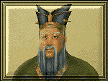
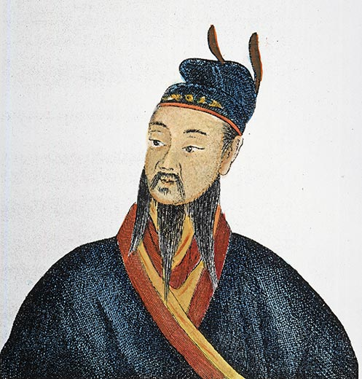
Important Dynasties
Qin Dynasty
221 B.C. - 206 B.C.
First Emperor
Qin Shi Huangdi
Dynasty was short-lived
Han Dynasty
206 B.C. – 220 A.D.
The Most
Famous Ruler
Han Wu Di
Dynasty lasted
over 400 years.

Slide 6
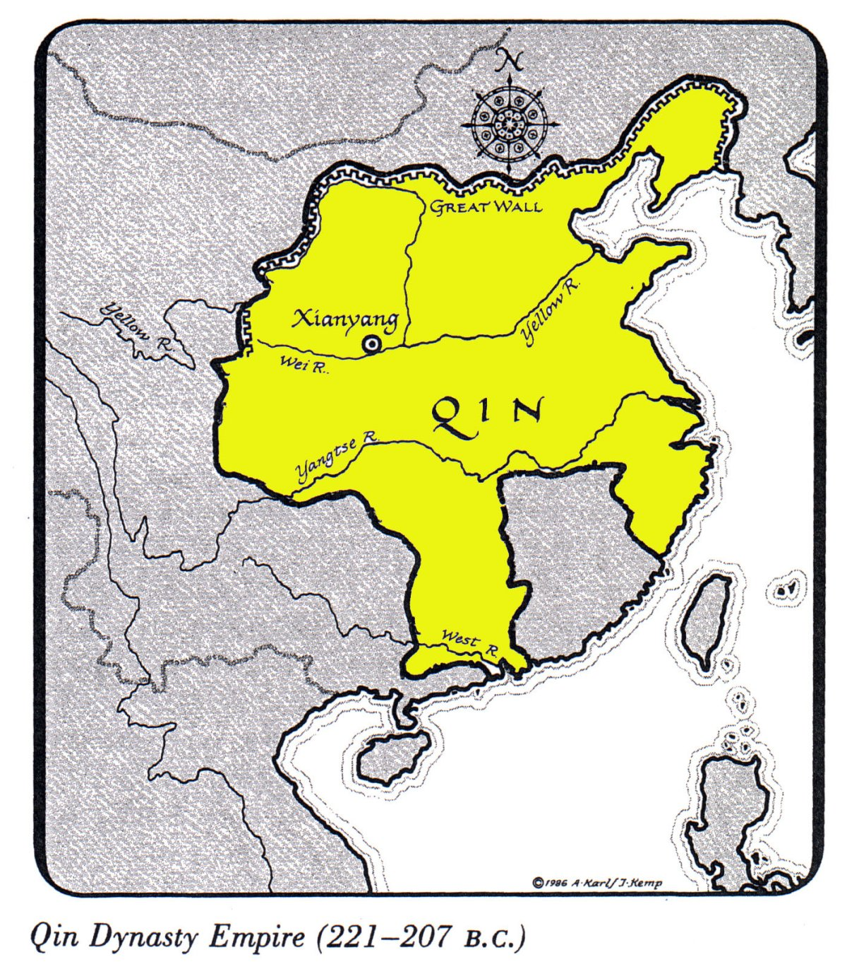
Geography:
Qin Dynasty
Extended Chinese territory to the south
Reached up to present-day
Hong Kong
on the South China Sea
and Northern Vietnam.

Slide 7
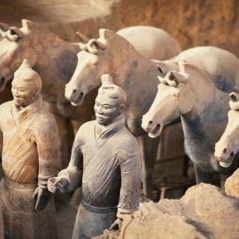
Qin (Ch’in) Dynasty 221-206 BCE
Dominated by “The First Emperor”
Qin Shi Huangdi
(Chin Shi Huang Ti)
Ambitious = understatement
centralized the government
by eliminating the
feudal (land for military service) lords
constructed roads and canals
The Great Wall (to keep out invaders)
An amazing tomb found in 20th Century

Slide 8
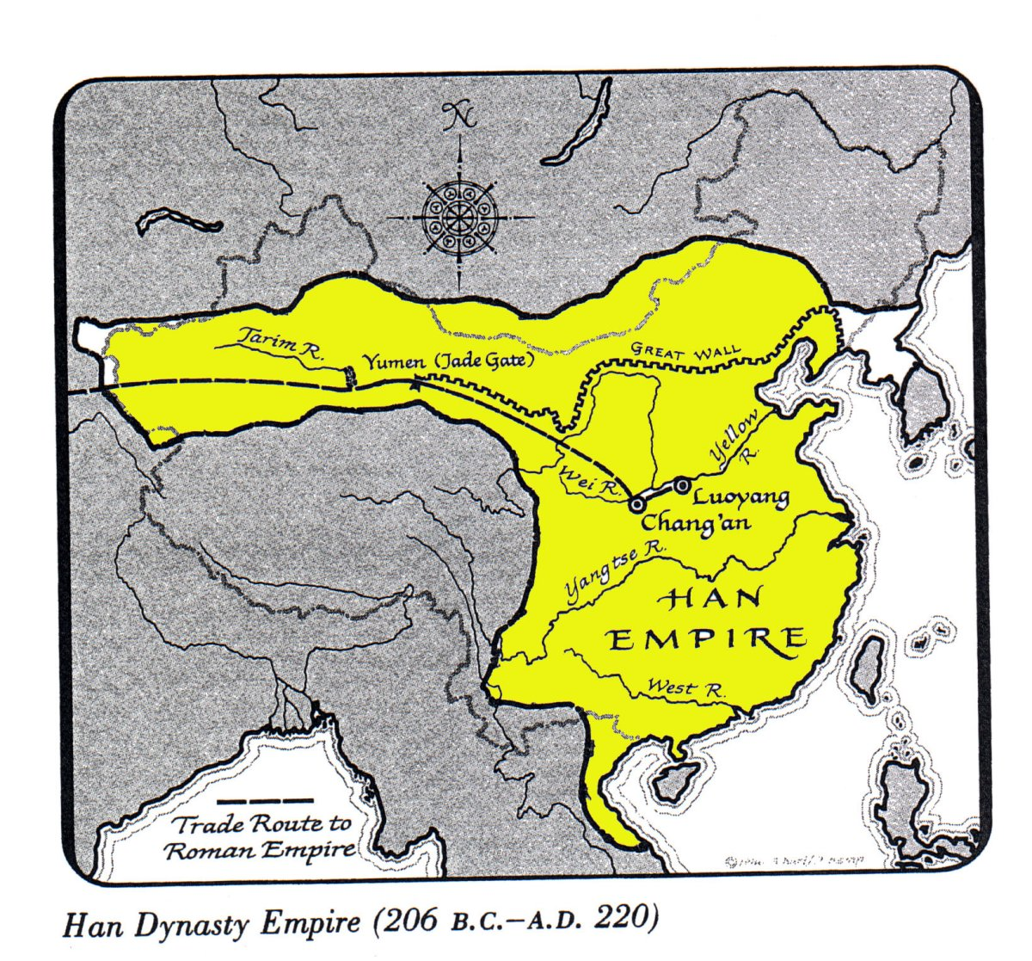
Geography:
Han Dynasty
Extended to Korea,
Indochina,
and
Central
Asia.

Slide 9
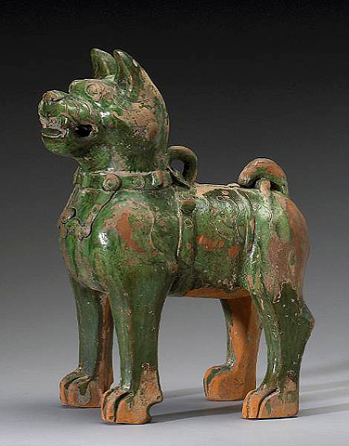
Han Dynasty
202BCE-220 CE
(Roman Times)
Similar: built cities, officials to
carry out edicts, heavy taxes
collapsed under invasions and
internal revolts
Contact/Trade along the Silk Road
Combination of Confucius and
Legalism (humans are evil and
need to be controlled using
laws in order to prevent chaos)
Advanced in science and literature
Invented paper, magnetic compass

Slide 10
Agriculture
The Emperors encouraged the development of agriculture.
Grew rice, and wheat, and provided salt.
Under Wu Di’s reign the Lou Che was invented, which was used for plowing and planting. This saved manual labor.
Silk was invented and was used as currency.

Slide 11
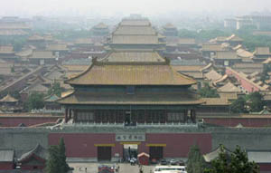
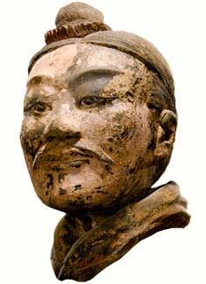
Population Growth & Decline
With the advanced technology
farming flourished more.
As farming became more
productive, population thus
naturally increased.
As the rulers expanded
the Chinese territory toward
such countries as Korea and
Vietnam, population increased
as more land was gained.

Slide 12
Social Structure
Bureaucracy – a body of non-elective government officials
Aristocracy - a hereditary (ancestry) ruling class
Aristocracy
&
Bureaucracy
Skilled laborers
(Iron workers, farmers, etc.)
Specialization = Skilled Laborers
Unskilled laborers

Slide 13
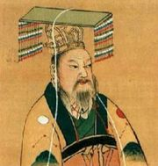
Government Structure
Shi Huangdi
He provided a single law code for the whole empire
Established a uniform tax system
Appointed governors to each district. These rulers had legal and military powers. They also had their own lower rulers for smaller regions.
Epitome of effective centralized government

Slide 14
Government Structure
Han Dynasty
Established 130,000 bureaucrats. Had to take examinations.
Judicial matters were done by local governments.
Military was not extremely strong.
Emphasized Confucian philosophy as an official Chinese values..
Sponsored public works (irrigation/canal systems)
Standardized currency to facilitate trade
Regulated agricultural supplies

Slide 15
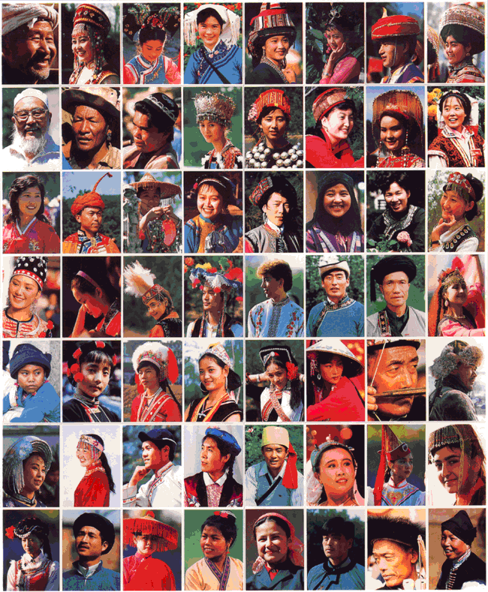
Family Organization
Patriarchal families
Extended family networks through
brothers, uncles, grandparents, and others.
The practice of ancestor worship was important to family authority among the affluent landowners.
Village authority was supreme over family rule among the ordinary farmers.

Slide 16

Engineering in Ancient China

