Slide 1
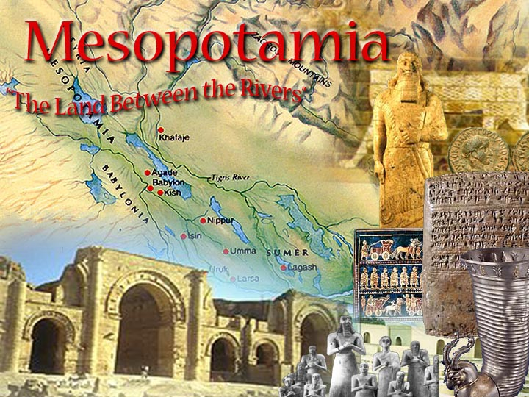

Slide 2
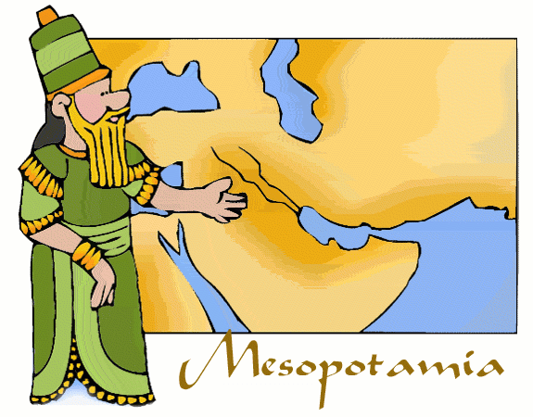
Geography of Mesopotamia
What does Mesopotamia mean?
The Land Between the Two (2) Rivers
What are the names of these two rivers?
Tigris River
1.
Euphrates River
2.

Slide 3
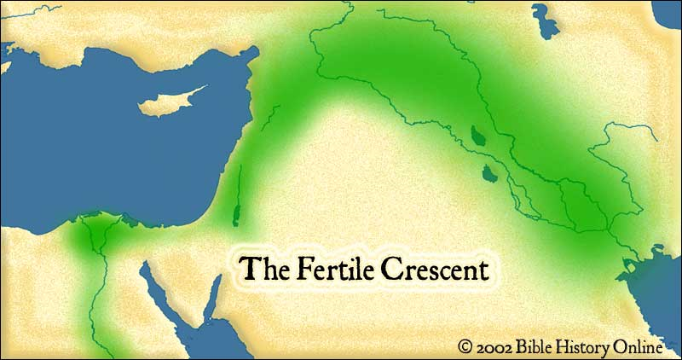
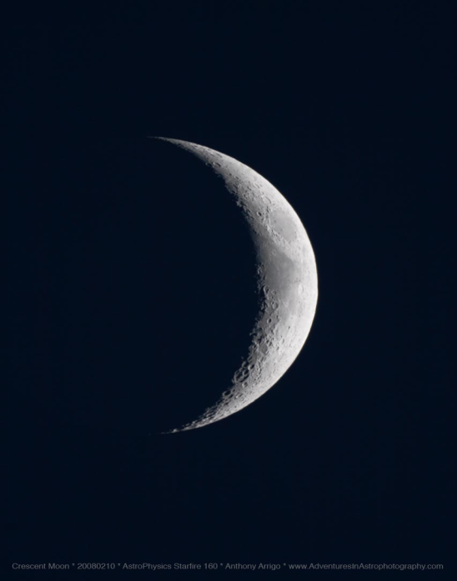

What is another name for the
Area Around Mesopotamia?
The Fertile Crescent
Why would we call it that?
Because it is shaped like a quarter moon and the land is able to be farmed over and over. (Green Area)

Slide 4
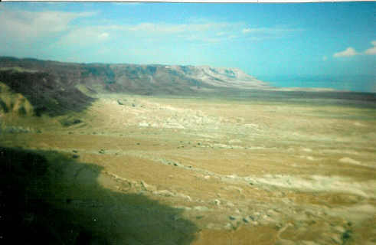
An area of elevated flat land.
What is a Plateau?

Slide 5


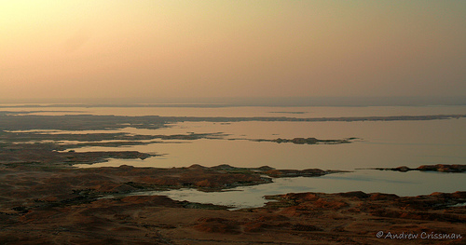
The paths of the Tigris
and Euphrates Rivers.
This creates Mesopotamia and rich farming land.
Taurus Mountains
(In Present Day Turkey)
1. Water from the melting snow rushes to the valley below.
Plateau
Flood Plain
Persian Gulf
2. The Two Rivers form and run over the Elevated Flat Land
3. The Rivers flow and flood the low land making the land fertile for planting crops
4. The Two Rivers
Empty into the Persian Gulf
Can you name the
current country Mesopotamia is located in?

Slide 6
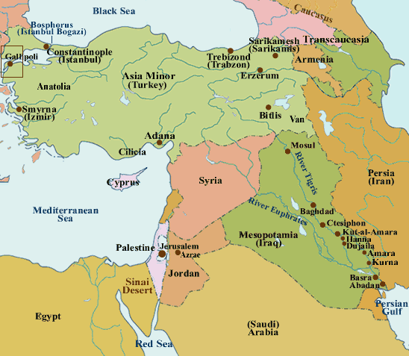
IRAQ

Slide 7
From Rivers to Fields
Silt
Silt flows down Tigris & Euphrates
Deposits mostly down near Persian Gulf (Southern Mesopotamia)
Droughts
Not much Rain
Flood at Harvest
Time not at Growing Time
Irrigation
Create Canals and
Artificial Lakes
Controlled Water for use when needed

Slide 8
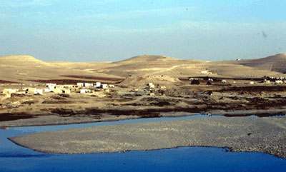
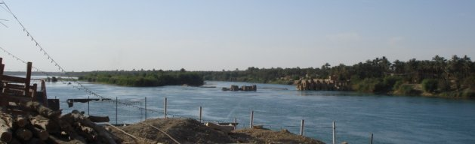
Notes:
Euphrates River

Slide 9
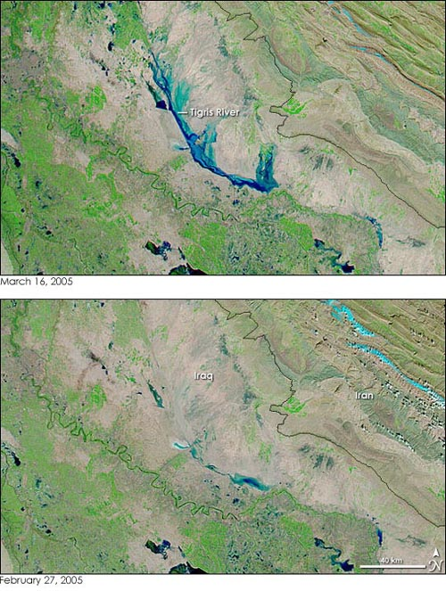
Do you think the
rivers flood today?
Tigris River
Satellite Image of the Tigris River Before & After Flooding
Iraq, 2005
After Flooding
March 16, 2005
Tigris River
February 7, 2005
Before Flooding

Slide 10
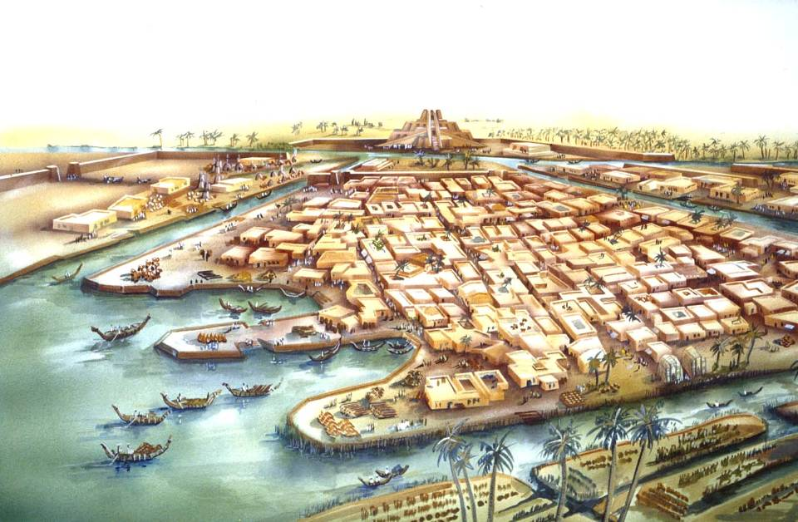
Mesopotamia Civilizations
Sumerian City States

Slide 11
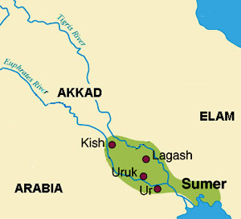
Sumer
What is a city-state?
A self-governing city which also governs surrounding villages.
Eridu
Most important city-states were: Ur, Uruk, Eridu

Slide 12
Sumer
City-States
c. 3000 BC
Same time as
Menes unified
Egypt
Sometimes
fought for control
of neighboring city-states

Slide 13
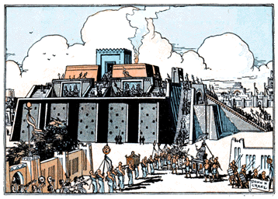
Architecture (building) - Ziggurat
Located in center of cities, large, towering
mud-brick building.
Had a temple at the top, for religious purposes.

Slide 14
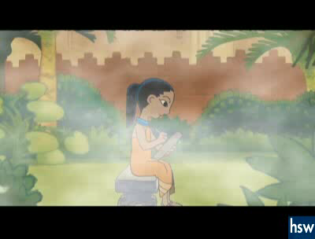

Slide 15
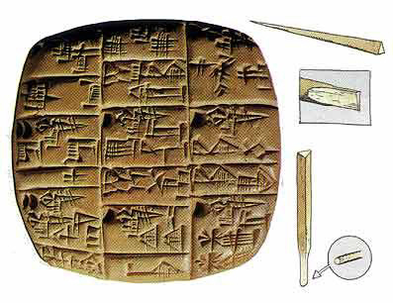
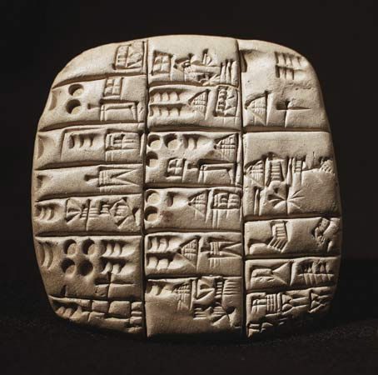
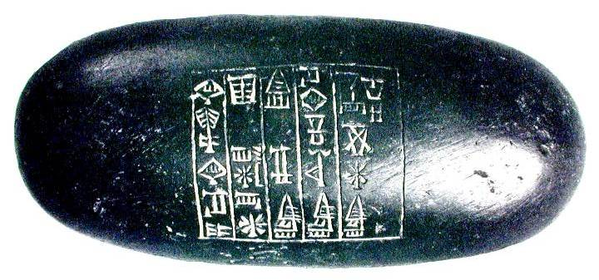
Writing
Cuneiform – System of writing invented in Sumer.
Used for record keeping, laws, stories, instructions, riddles, proverbs, education, math, and science.
Scribes – Mostly Boys, but some girls (rare)

Slide 16
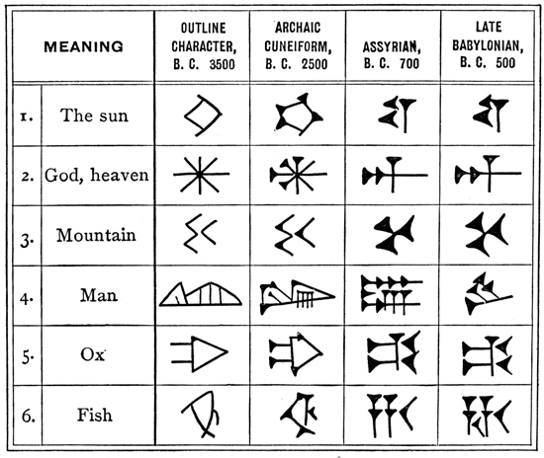
Picture

Slide 17
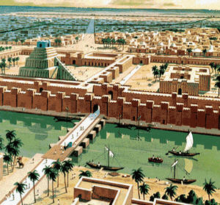
City Life
Huge city gates, with large walls.
Often went to war with other city-states, for resources such as river water.
Food brought to cities by area farmers

Slide 18
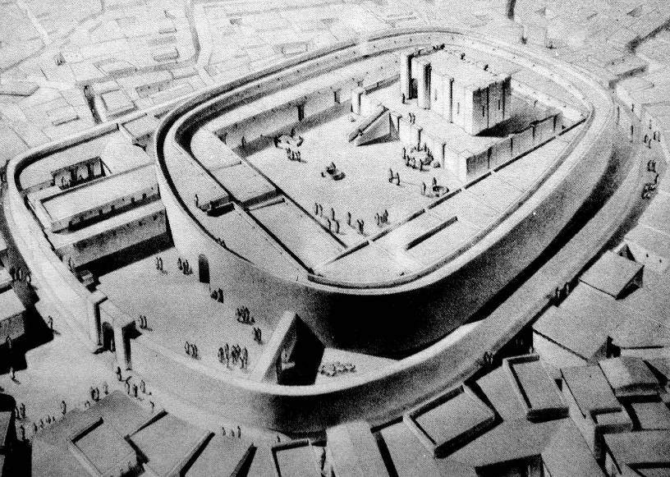
Religion
City revolved around temple & religion.
Food brought to feed temple god and priests and King.
Each city-state worshiped a different god or goddess. Polytheism (many gods)
(Ishtar – Love & War or Enki – Water)

Slide 19
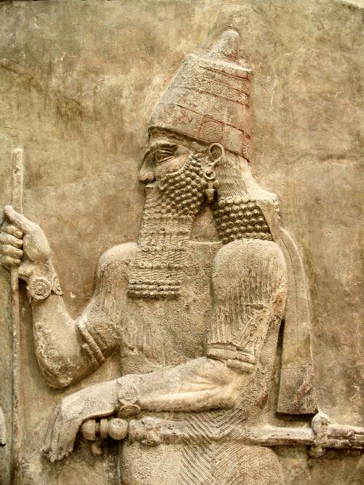
Sargon
Founder of the
World’s 1st Empire
(Akkadian Empire)
Worked his way up as servant of King of Kish, and then took over as King.
Expanded Empire North (Syria) and West to Mediterranean Coast (Phoenicians)

Slide 20
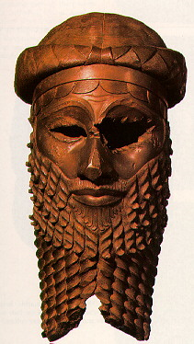
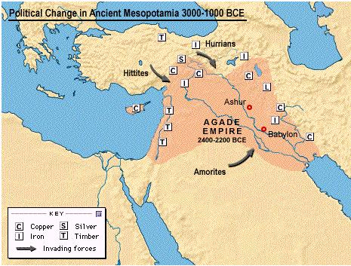
Sargon
2334 BC - 2279 BC
He traded
with all
areas of
his
empire.
Mesopotamian farm goods traded for timber & wine.
Cuneiform writing became the language of the empire.

Slide 21
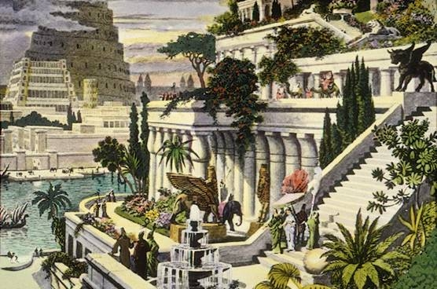
Babylonian Empire

Slide 22
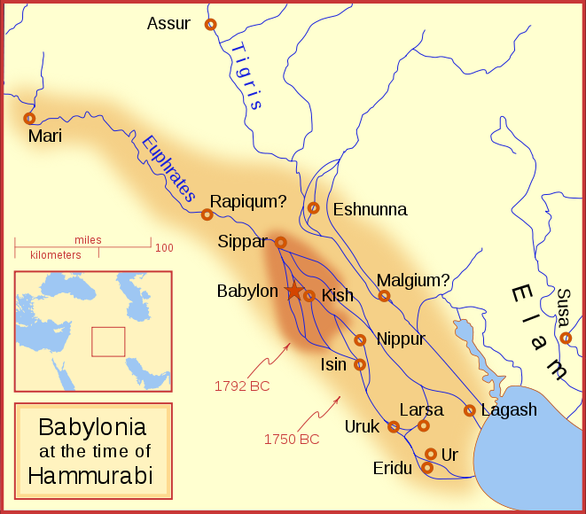
500 Years after Sargon ruled Mesopotamia
another was created.
The city-state of Babylon
c. 1800 BC Hammurabi started to gain control of the old city-states of Sumer

Slide 23
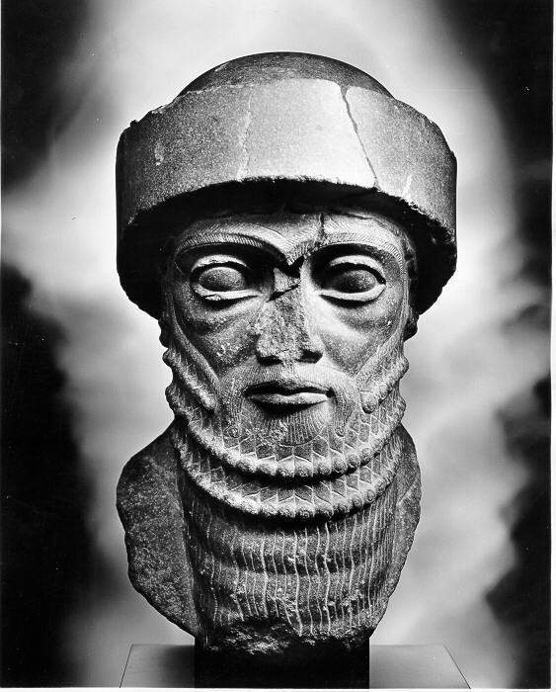
Hammurabi
of Babylon (1790-1752 BC) was able to create a unified kingdom over all of southern Mesopotamia

Slide 24
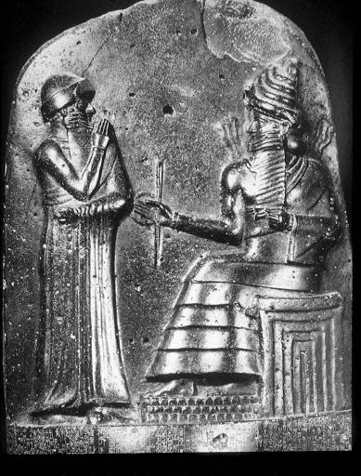
What are
codes of law?
It is a written set of laws that apply to everyone under a government.

Slide 25
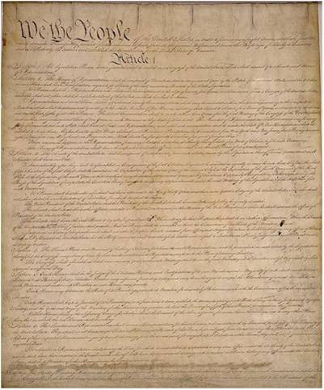
The United States Constitution
What is the main code
of law of the United States?

Slide 26
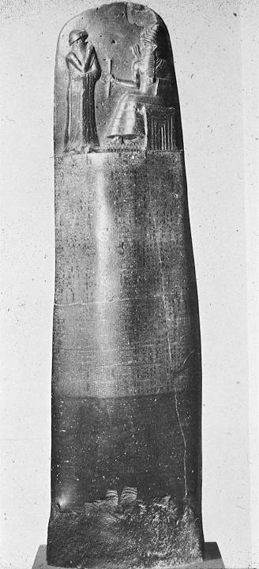
Code of Hammurabi
Discovered in 1901 in Susa
Pillar with over 200 laws
One of the oldest code of
laws. (4,000 years old)
Showed Slavery existed in
Babylonia.
Not everyone was treated
the same. Different laws
for different groups of
people.
Why?

Slide 27
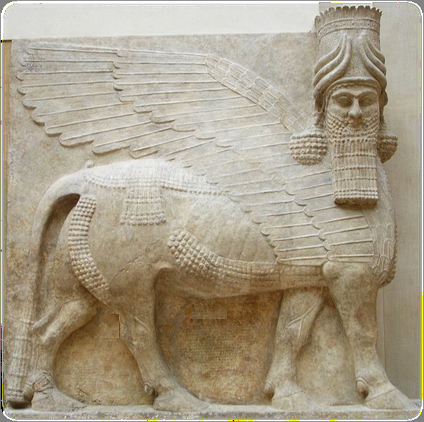

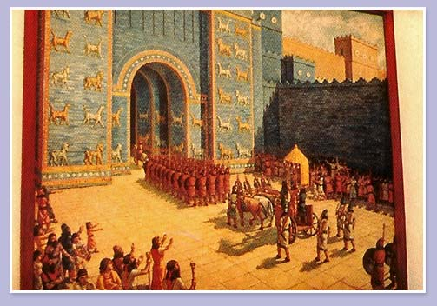
The Sumerian
city-states
rebelled against
the Old Babylonian
Empire of
Hammurabi’s
was gone.
689 BC a powerful Northern city-state called Nineveh destroyed Babylon.
60 years later the Babylonians rebuilt their city and their empire

Slide 28
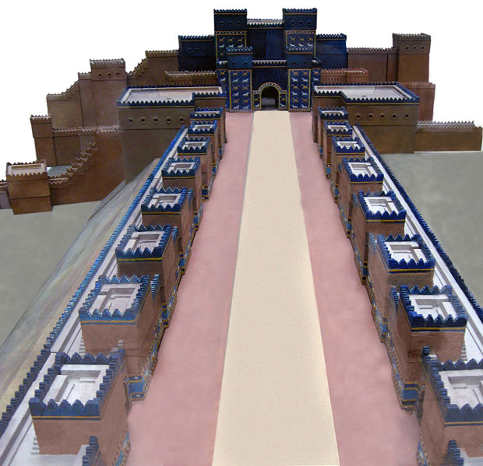
c575 BCE - Gate to Babylon ordered built by King Nebuchadnezzar in honor of the Assyrian Goddess Ishtar.

Slide 29
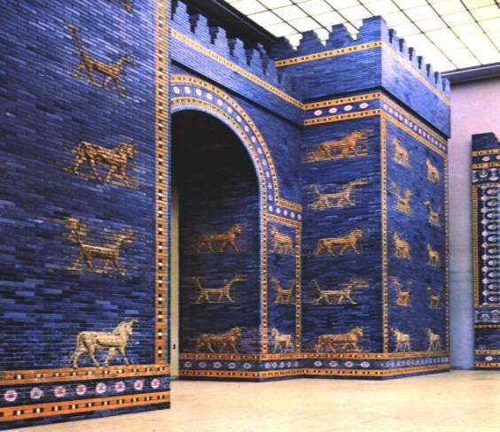
The Ishtar Gate of Babylon
Pergamon Museum in Berlin

Slide 30
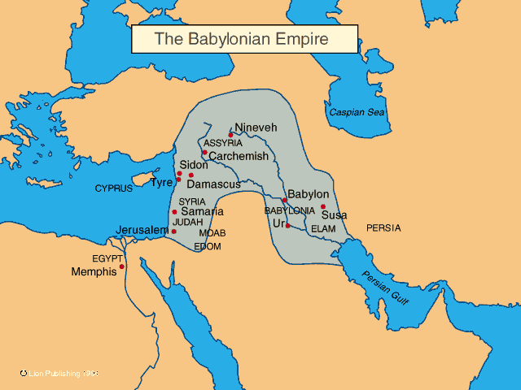

Slide 31
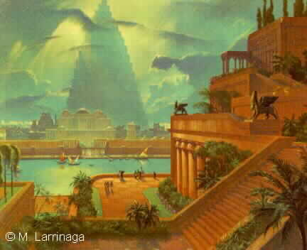
The “New” Babylonian Empire
Babylon was the largest city in the world at the time.
They worshiped the same gods as the previous Mesopotamian peoples.
Although no longer around, Mesopotamian civilization lives on through their writing about schools, literature, science and law.

Slide 32
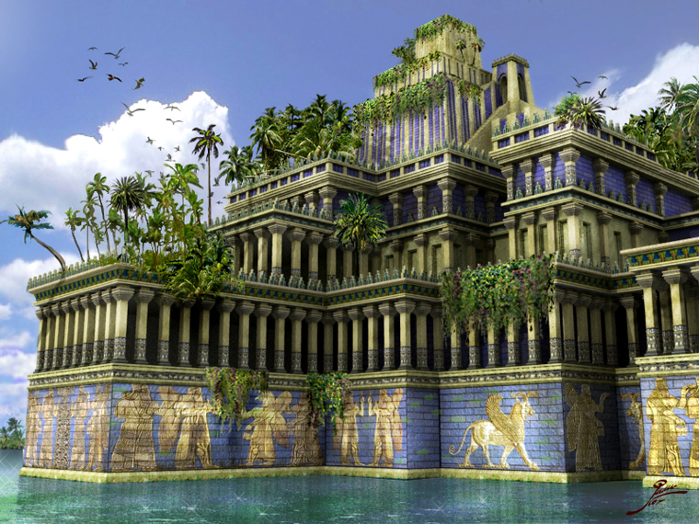
The Hanging Gardens of Babylon

