Slide 1
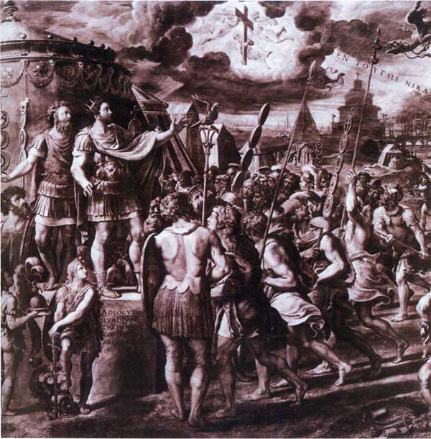

Aim: How did Christianity effect and
change during the Roman Empire?
Do Now: Interpret the photo seen by using the Photo Analysis Worksheet
The Rise of Christianity

Slide 2
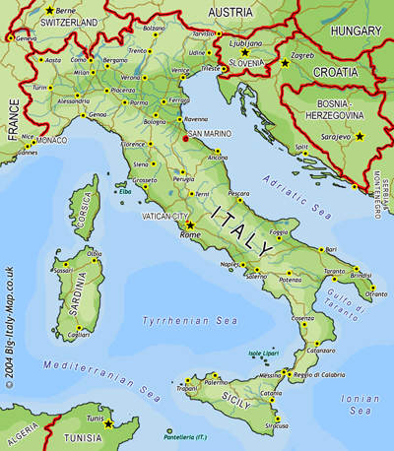
The city of Pompeii is located just southeast of Naples.
It was a thriving city until 79 AD when Mt. Vesuvius buried it.

Slide 3

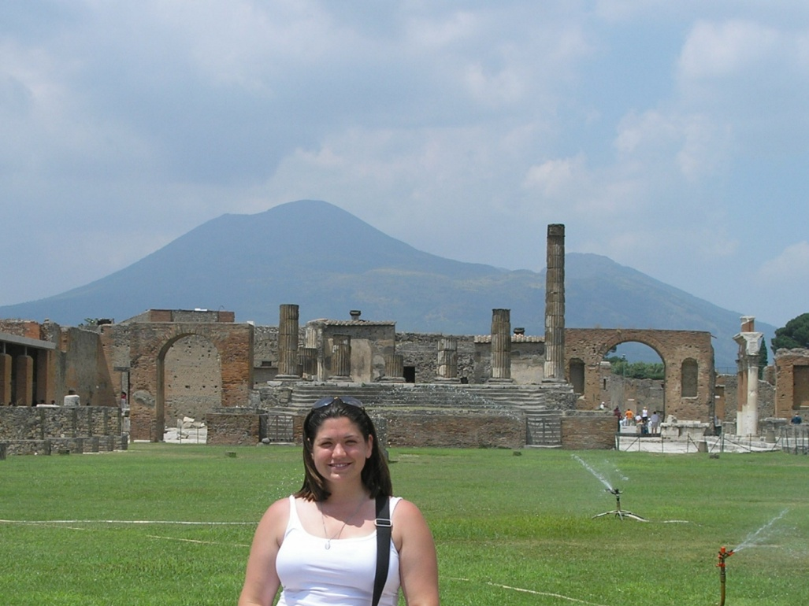

Slide 4
Jesus of Nazareth
Against this background, a spiritual leader named Jesus of Nazareth emerged, teaching people to prepare for God’s Judgment Day.
Life
Preaching
Nearly all knowledge of Jesus comes from Gospels—first four books of New Testament
New Testament and books of Hebrew Bible make up today’s Christian Bible
Jesus born in Bethlehem, near Jerusalem
Learned carpentry, studied writings of Jewish prophets
Jesus preached message of renewal and warning
Gathered group of disciples
Created excitement by performing miracles of healing; defending poor, oppressed
Instructed people to repent of sins, seek God’s forgiveness
Must love God above all, love others as much as self
The Rise of Christianity

Slide 5
Death and Resurrection
Jesus’s popularity, crowds alarmed authorities who feared political uprisings
Jesus arrested, tried, sentenced to death by Roman Governor – Pontius Pilate
According to New Testament, after crucifixion
  Jesus rose from dead
  Spent 40 days teaching disciples
  Ascended into heaven
Followers believed Resurrection, Ascension revealed Jesus as the Messiah

Slide 6
The Spread of Christianity
After Jesus’s death, his disciples began teaching that all people could achieve salvation—the forgiveness of sins and the promise of everlasting life.
Apostles
Paul of Tarsus
Conversion
Jesus’s 12 disciples worked to spread message
Earliest Christian missionaries
Apostles traveled widely, teaching mostly in Jewish communities
Paul, originally known as Saul, born in Tarsus, in Asia Minor
Had actively opposed those teaching that Jesus was the Messiah
Paul had conversion on way to Damascus, became Christian
If not for his work, Christianity
might have remained a branch of Judaism

Slide 7
The Spread of Christianity
Converting the Gentiles
Paul believed God sent him to convert non-Jews, or Gentiles
Paul helped make Christianity broader religion, attracted many new followers
Helped establish Christian churches throughout eastern Mediterranean
Paul’s epistles, or letters, to those churches later became part of the New Testament
Roman Christianity
Paul found some Jewish customs hindered missionary work among non-Jews, dispensed with those requirements for Christians
Paul emphasized new doctrines that helped distinguish Christianity from Judaism
Christianity spread; message of love, eternal life after death found appealing
By AD 300, some 10 percent of Roman people were Christian

Slide 8
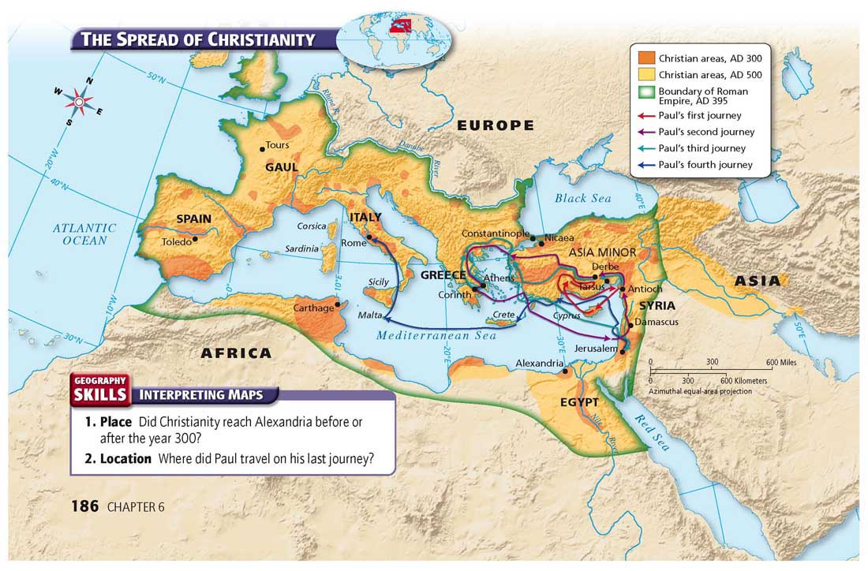

Slide 9
Persecution
Results
As Christianity spread through Roman world, some local officials feared Christians conspiring against them; arrested, killed many Christians
Those killed seen by Christians as martyrs, people who die for their faith
Threat
Christians persecuted at local level, but large-scale persecution rare during first two centuries after Jesus’s life
Large-scale persecution by Romans grew as rulers saw Christianity as threat
Imperial Approval
Spread of Christianity hastened by conversion of emperor Constantine
AD 313, Constantine made Christianity legal within empire, Edict of Milan
By late 300s, polytheism gradually disappeared from empire

Slide 11
Pompeii was a gorgeous city before that terrible day in 79 AD. From the city you could see Mt. Vesuvius’ majestic peak from anywhere in the city. People of all standing would be busy with their daily work.

Slide 12
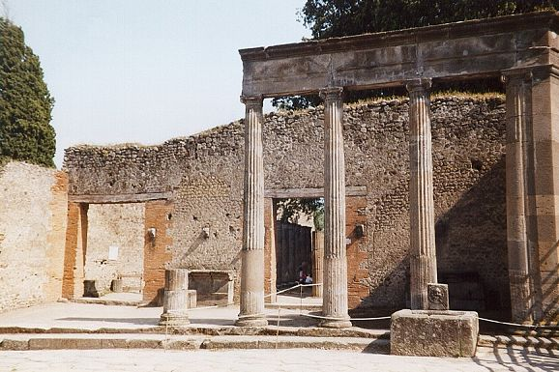
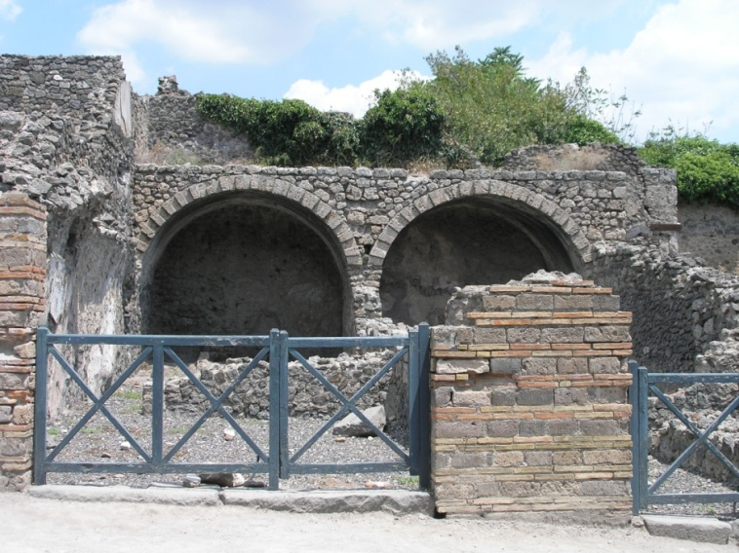
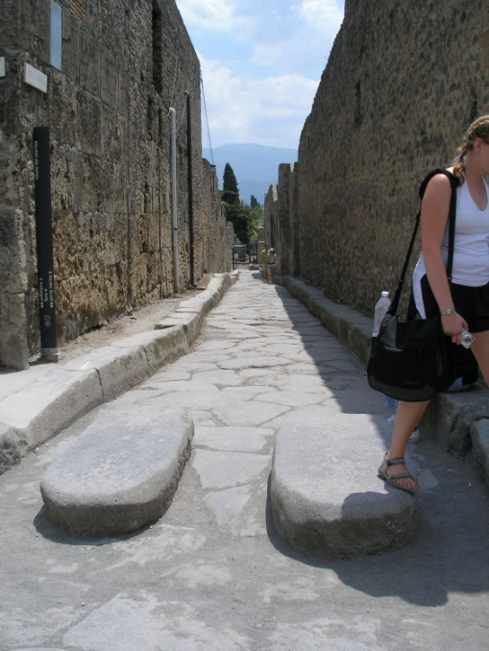
INSIDE THE CITY
Inside the city it was normally dark and dirty looking. Houses near the open square doubled as stores. People would sell things such as fish out of their windows. The trash was discarded into the streets. The slaves were in charge of cleaning up the streets, which was not an easy task. Often the streets would have to be flooded in order to clean them, which is why there was large stepping stones in the road. People could then get across while the streets were flooded.

Slide 13
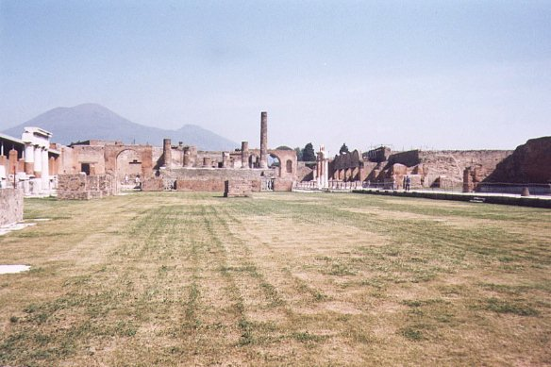
OPEN SQUARE
Cries from people of all backgrounds filled the air along with the smells from the outdoor fish market.
The open square was used in a varieties of ways. School would be held in the open square when the teacher could find an open place. Candidates running for office would shout their political views out at the top of their lungs attempting to receive votes. Meetings of all kinds where being held between then the massive amounts of people trying to sell their goods.

Slide 14
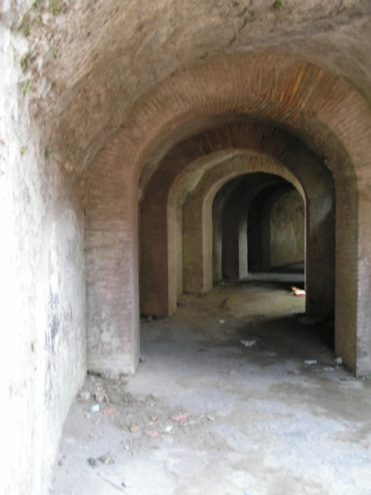
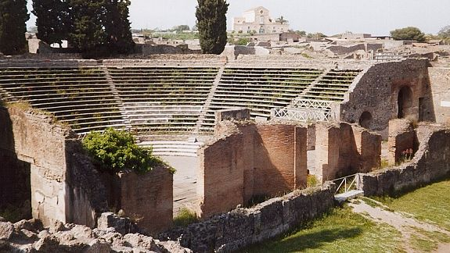
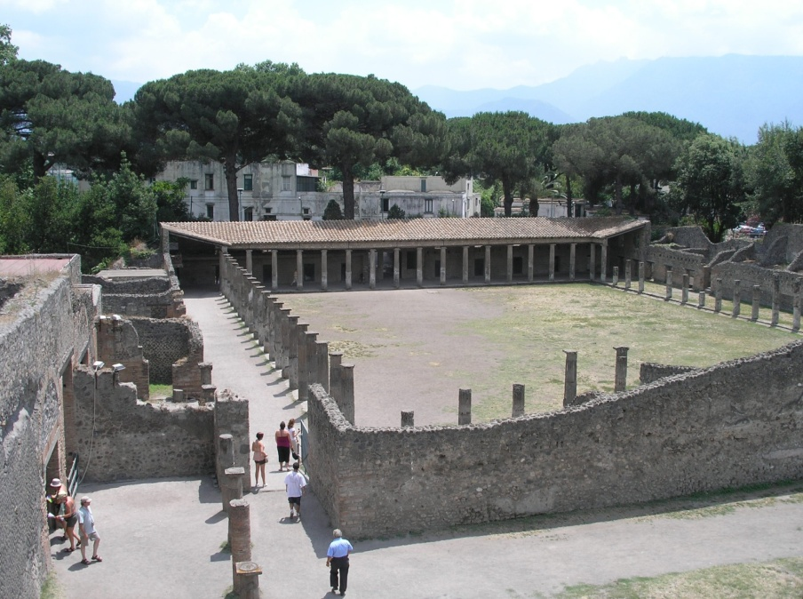
AMPHITHEATERS AND SPORTS YARD
Pompeii has two amphitheaters. One was used for plays. The amphitheater to the lower right was famous for the gladiator games. Animals such as lions and bears were brought into the arena through underground tunnels. The animals would fight each other, then the last remaining animal would be hunted by people. People thought the bloodier the battle the more exciting it was.
The sports yard was used for most of the sports games that did not include killing animals. Chariot races, javelin throwing, and other Olympic games were held here.

Slide 15
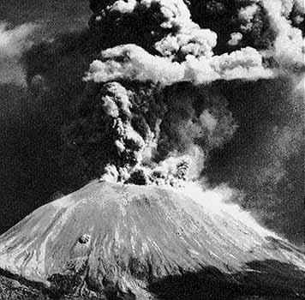
The Warning Signs
In the up coming months and days before Mt. Vesuvius erupted, the people had many warning signs telling them to leave the city. Most people ignored the signs thinking nothing would happen to them.
Wells started to dry up due to the magmas heat inside the volcano.
The mountain started to bulge due to the pressure building inside.
Stream would escape from the top sending a small amount of rocks up into the air.

Slide 16
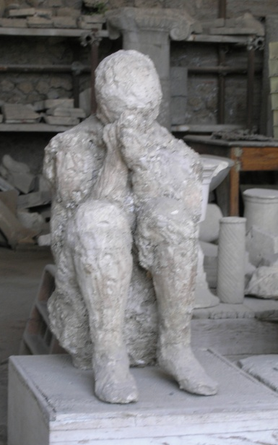
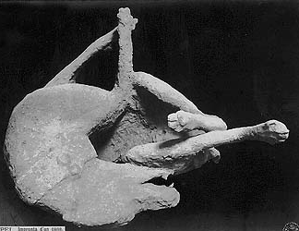
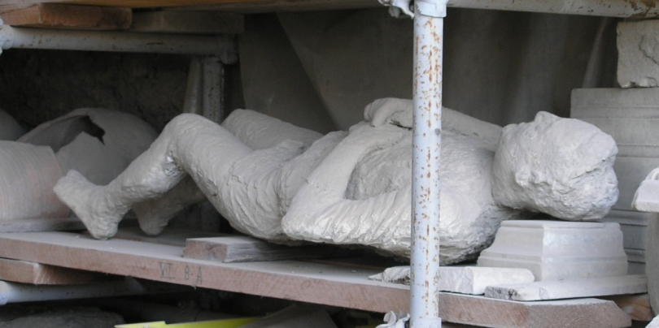
Frozen in Time
Six inches of ash fell on the city every hour making 20 feet of ash fall in total. It burned through wood ceilings destroyed everything in Pompeii. Pompeii was talked about for generations after it was buried, but no one could find it. Over time Pompeii was thought to be a legend. In the late 1700’s an Italian farmers was digging a well. He dug right through the top of a church that was built in the city of Pompeii nearly 2000 years before. The people perished in the city were “frozen in time.” Scientist even found eight-one loafs of bread in an oven from the day Mt. Vesuvius erupted.

