Slide 1
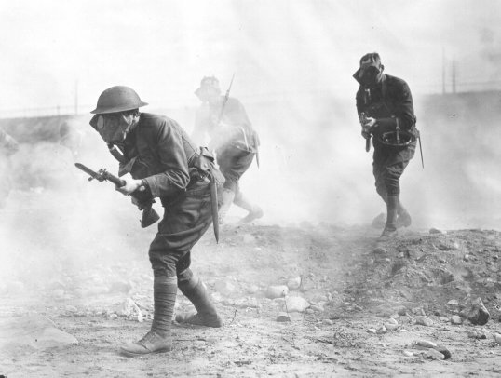
AIM: What were the results of WWI?
Do Now:
WII Worksheet
World War I & Results

Slide 2


Slide 3
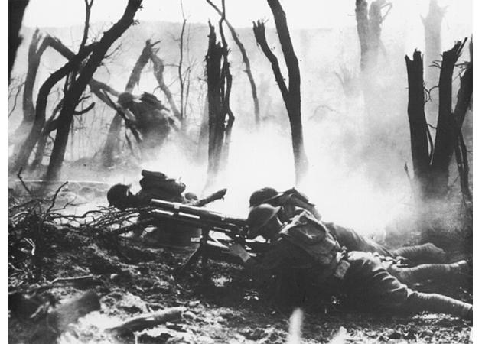
Total
Mobilized
Killed
& Died
Wounded
Prisoners
& Missing
Total
Casualties
Casualties %
of Mobilized
ALLIES
Russia
12,000,000
1,700,000
4,950,000
2,500,000
9,150,000
76.3
France
8,410,000
1,357,800
4,266,000
537,000
6,160,800
76.3
British Empire
8,904,467
908,371
2,090,212
191,652
3,190,235
35.8
Italy
5,615,000
650,000
947,000
600,000
2,197,000
39.1
United States
4,355,000
126,000
234,300
4,500
364,800
8.2
Japan
800,000
300
907
3
1,210
0.2
Romania
750,000
335,706
120,000
80,000
535,706
71.4
Serbia
707,343
45,000
133,148
152,958
331,106
46.8
Belgium
267,000
13,716
44,686
34,659
93,061
34.9
Greece
230,000
5,000
21,000
1,000
17,000
11.7
Portugal
100,000
7,222
13,751
12,318
33,291
33.3
Montenegro
50,000
3,000
10,000
7,000
20,000
40.0
TOTAL
42,188,810
5,152,115
12,831,004
4,121,090
22,104,209
52.3
Central Powers
Germany
11,000,000
1,773,700
4,216,058
1,152,800
7,142,558
64.9
Austria-Hungary
7,800,000
1,200,000
3,620,000
2,200,000
7,020,000
90.0
Turkey
2,850,000
325,000
400,000
250,000
975,000
34.2
Bulgaria
1,200,000
87,500
152,390
27,029
266,919
22.2
Total
22,850,000
3,386,200
8,388,448
3,629,829
15,404,477
67.4
GRAND TOTAL
65,038,810
8,538,315
21,219,452
7,750,919
37,508,686
57.6

Slide 4
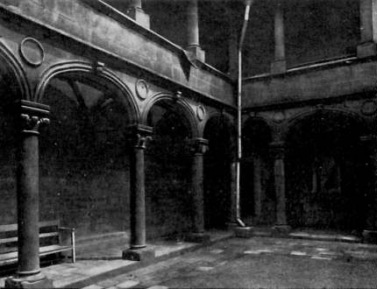
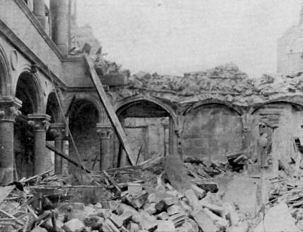
Before
After
Notes:
Verdun: Cloister of the Hotel de la Princerie

Slide 5
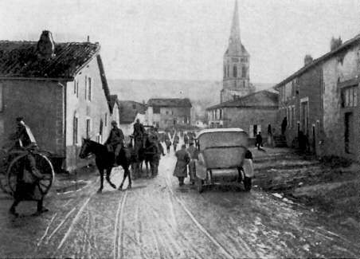
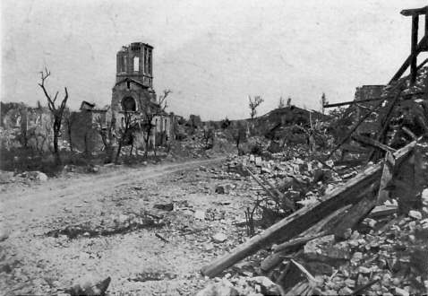
Before
After
Notes:
Esnes france

Slide 6
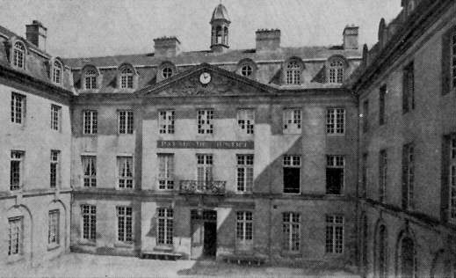
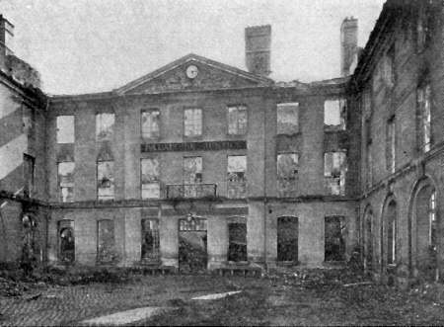
Before
After

Slide 7
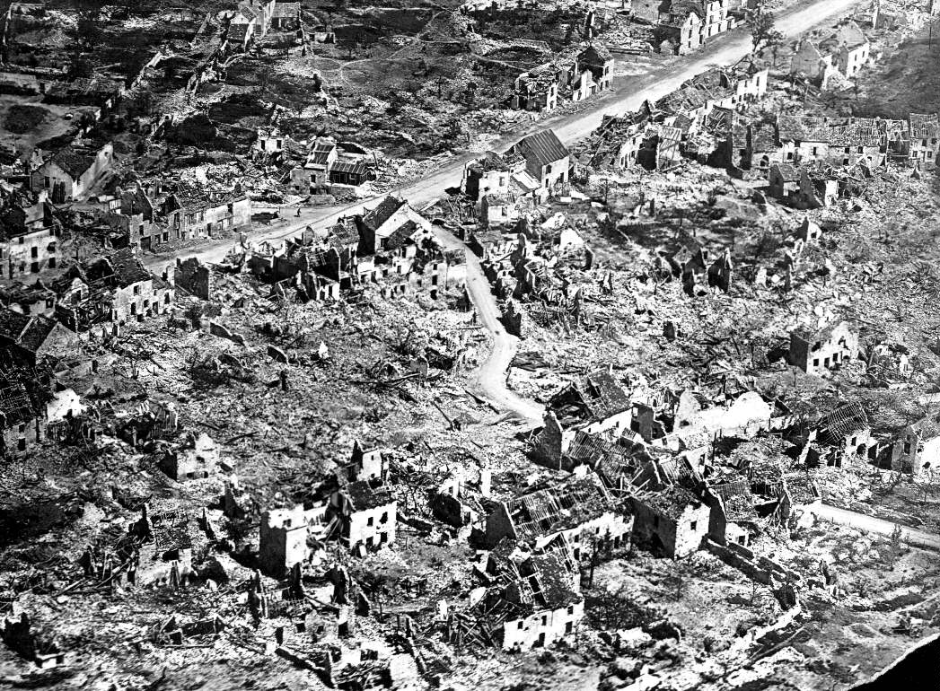
Notes:
What level of destruction do these pictures indicate? What are some emotions evoked when viewing these images? What happened to the originally charming and vibrant Village of Esnes? Why is it significant that major civic buildings such as the Courthouse (Palace of Justice), cathedral, and City Hall (Hotel de Ville) were destroyed? Can you envision what these buildings and towns may have looked like before the war? How long do you think it would take to rebuild these buildings and communities? How much do you think it would cost? Can a community ever really recover from such destruction? Ask students to speculate, based on this information, how France's goals for the postwar settlement might differ from U.S. goals. What might France fear? What would France probably want with respect to Germany? Why? Would those desires be reasonable? Why or why not? Why might the U.S. be able to take a more idealistic perspective?

Slide 8
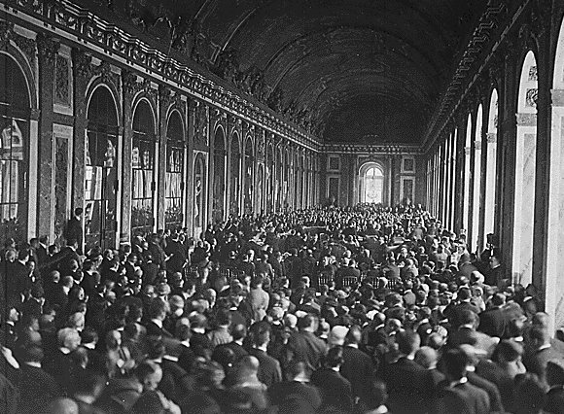
The Paris Peace Conference
Treaty of Versailles with Germany
France and Britain created a severe treaty that punished Germany
Germany had to:
***Return Alsace –Lorraine region to France
***Keep area near France, called Rhineland, demilitarized
***Pay war reparations of 32 billion dollars
***Agree to war guilt clause

