Slide 1

The Rise of Fascism in Italy

Slide 2
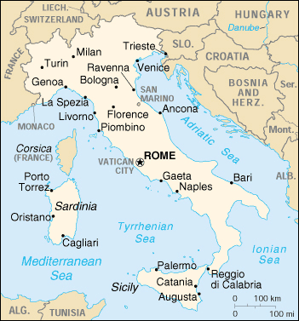
World War One
Italy was originally a member of the Triple Alliance with Germany and Austria
In 1914 when war broke out Italy remained neutral
In 1915 Italy joined the Allied Powers Britain and France after being promised the Austrian province of Trieste. Trieste had a large population of Italians
Why did Italy join the Allies in World War One?

Slide 3
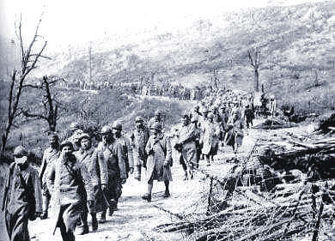
Sold Out!
Treaty of Versailles unfair to Italy!
Coveted territory granted to Yugoslavia
Millions of Italians die in vain!
Italian prisoners after the battle of Caporetto
Why did Italians feel as if they were treated unfairly by the Treaty of Versailles?

Slide 4
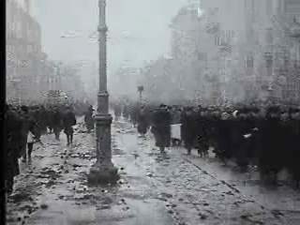
Post War Italy
No jobs for veterans
Workers Strike
Workers take over factories
Peasants seize land
Trade declines
Taxes rise
Upper classes fear a Communist Revolution
Russians rebelling against their Czar in 1917
Why would upper class Italians fear a Communist Revolution in 1920?

Slide 5
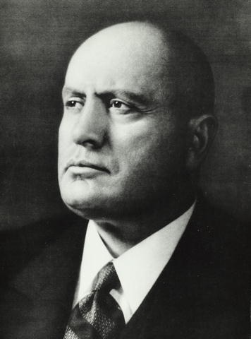
The Rise of
Benito Mussolini
A Fierce nationalist
Spoke out about the Italian government and its weakness at The Treaty of Versailles
A great public speaker

Slide 6
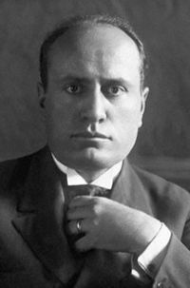
By 1922, as Italy slipped into political chaos, Mussolini declared that only he could restore order and was given the authority. He gradually dismantled all democratic institutions, and by 1925, had made himself dictator, taking the title "Il Duce" ("the Leader").
http://www.biography.com/people/benito-mussolini-9419443#impassioned-socialist
Check out this video
Why were the people of Italy willing to support Mussolini?

Slide 7
Fascism Vs. Communism
Mussolini’s Italy
No freedom of speech
Censorship of the press
Active secret police
Nationalization of the industries under control of the owners
Stalin’s USSR
No freedom of speech
Censorship of the press
Active secret police
Nationalization of the industries under the control of the government
What is the main difference between Fascism and Communism?

Slide 8
The Political Spectrum
Democrats
Radicals
Looking for violent change. People who wish to completely turn society upside down
Liberals
Open to change usually looking for more freedom and rights for the people
Moderates
In the middle of the spectrum these people are literally in the middle. Advocating views expressed by both sides.
Republicans
Conservatives
Opposed to change, usually want to give the government power over the individual
Reactionaries
Violently opposed to change and actually want to change things back to the way they used to be, giving the government and upper class more power
Fascists
Communists
Where would you find the Fascists?
Which area would represent the modern democratic party in America?
Where would you find the Communists?
Where would you find the modern American Republican Party?
If Fascism and Communism are on opposite sides of the spectrum, why are they are so similar?

Slide 9
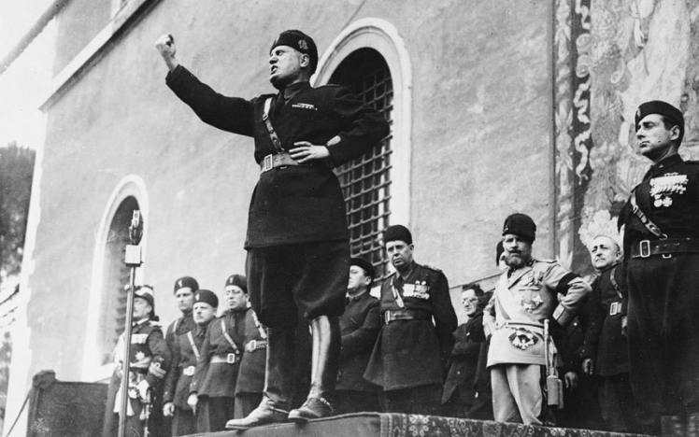
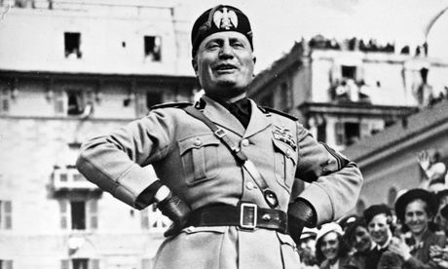
Mussolini as Prime Minister
Mussolini giving a fiery speech from a Rome balcony
How does Mussolini portray himself in public? What image does he want to public to have of him?
Why do you think this image is so important to Mussolini?
Why do you think Mussolini relates everything to a battle?

Slide 10
Accomplishments of Fascist Italy 1925-1939
Reduced unemployment
Increased the size of the Italian Armed forces
Built highways
Drained Swamps
MADE ITALY STRONG AGAIN

Slide 11
Military Decisions of Mussolini
In 1935, Benito Mussolini invaded Ethiopia. The ill-equipped Ethiopians were no match for Italy's modern tanks and airplanes, and the capital, Addis Ababa, was quickly captured. Mussolini incorporated Ethiopia into the new Italian Empire.
In 1939, he sent troops into Spain during the Spanish Civil War to support Fascist Francisco Franco.
Why would Mussolini invade Ethiopia and send troops into Spain?

Slide 12
An Ally for Italy
Impressed with Italy's early military successes, German dictator Adolf Hitler sought to establish a relationship with Benito Mussolini; he was flattered by Hitler's overtures and interpreted the recent diplomatic and military victories as proof of his genius. By 1939, the two countries had signed a military alliance known as the "Pact of Steel."
http://www.biography.com/people/benito-mussolini-9419443#military-exploits-
For what reasons did Italy and Germany form an alliance?
(Also think about leadership styles)
Predict, if Germany gets involved in a war, what will happen to Italy?

Slide 13
Mussolini’s Downfall
Italy was forced into World War II and its military was not able to keep up with the war. Therefore, Italy was taken over by the Allied Powers
Mussolini was forced to resign and was arrested; German commandos later rescued him. Mussolini then moved his government to northern Italy, hoping to regain his influence.
Mussolini and his mistress attempted to escape to Switzerland, but were captured by the Italian underground on April 27, 1945. They were executed the following day, in Mezzegra, Italy, and their bodies were hung on display in a Milan plaza. The Italian masses greeted Mussolini's death without regret.

Slide 14
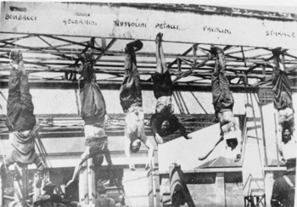
Check out this video
What lead to the demise of Mussolini?
How did the people of Italy feel about the death of Mussolini? Why?

Slide 15



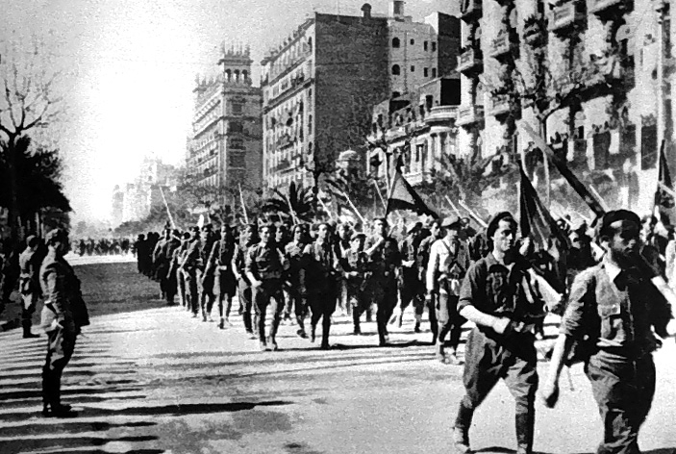
What is Italian Fascism?
The rebuilding of the glory that was Rome
Providing jobs for Italian workers
Keeping Italian capitalists wealthy
Making Italy strong!
OR?

Slide 16
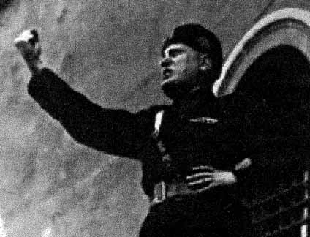
A way to make Mussolini powerful?

Slide 17
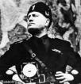

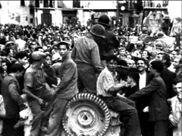
Does Fascism help the leader, the nation, or the people?

