Slide 1
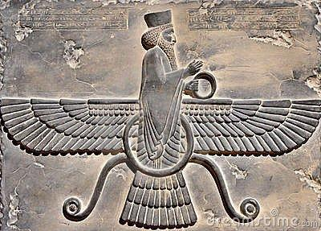
P.E.R.S.I.A
This is a guide to help you obtain better analysis of historical texts and concepts.

Slide 2

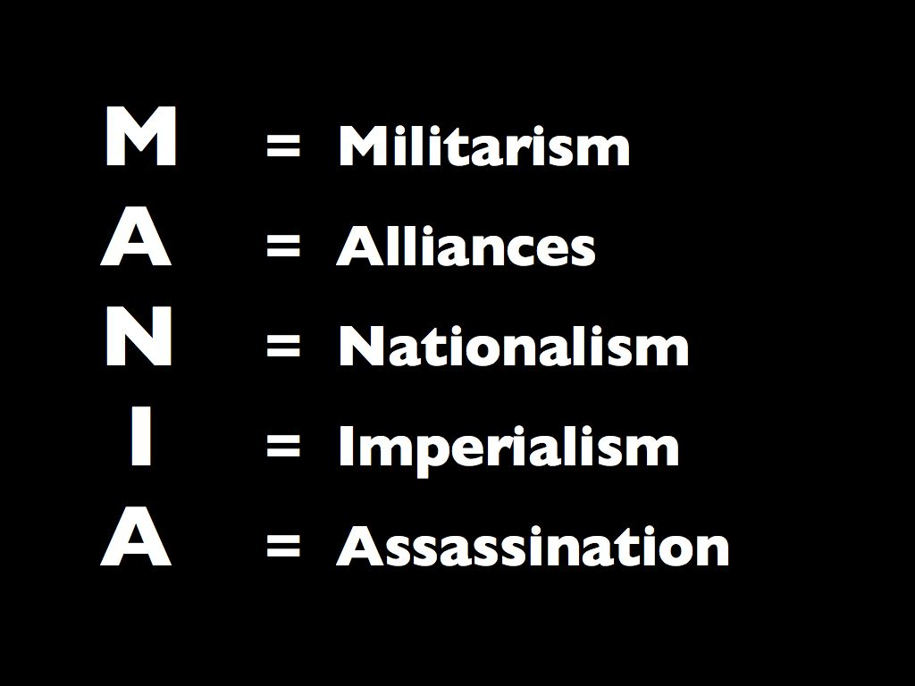
P.E.R.S.I.A is an Acronym
Meaning each letter of the
word stands for something else.
Causes of World War I

Slide 3
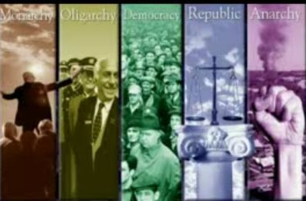
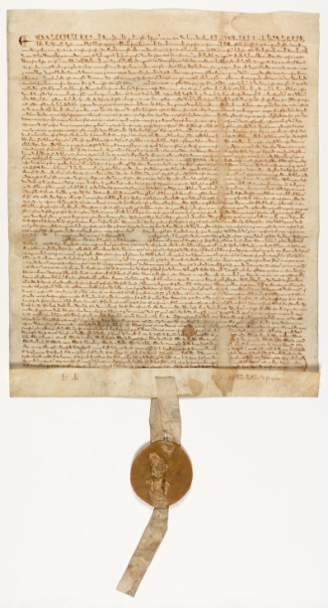
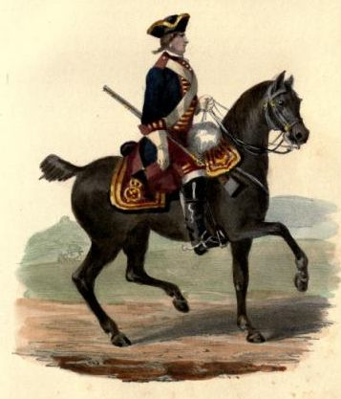
P stands for…
Political
meaning anything to do with government
Military
Types of Government
Laws

Slide 4
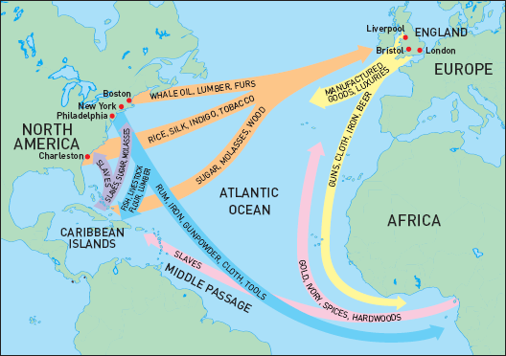
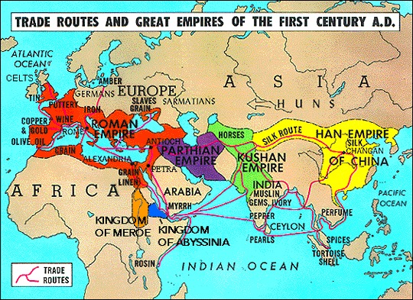
E stands for…
Economics
meaning anything to do with trade

Slide 5
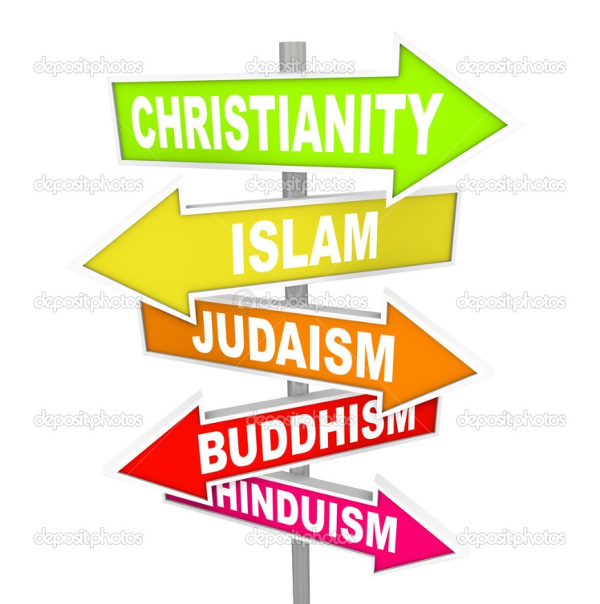

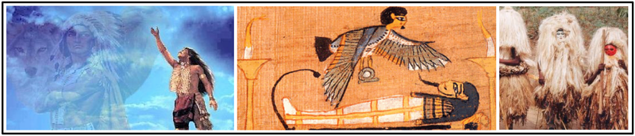
R stands for…
Religion
meaning a strong spiritual belief or faith followed within a country/nation/state

Slide 6
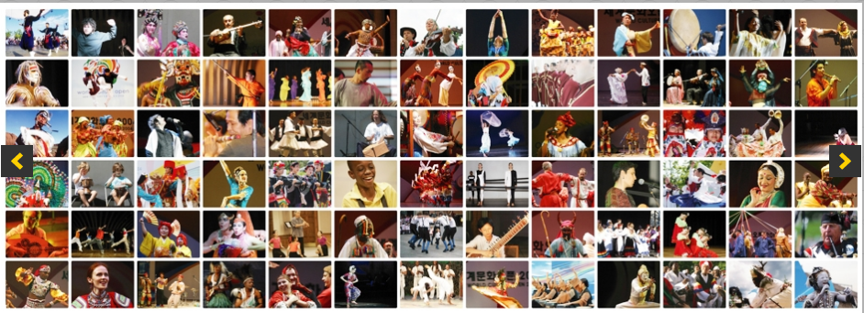
S stands for…
Social
Anything to do with people, society,
culture, social class

Slide 7

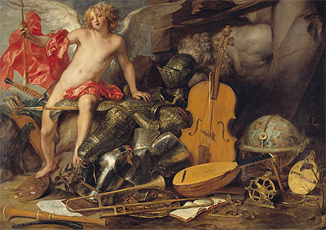
I stands for…
Intellectual
Anything to do with education, the arts,
science, and technology.

Slide 8

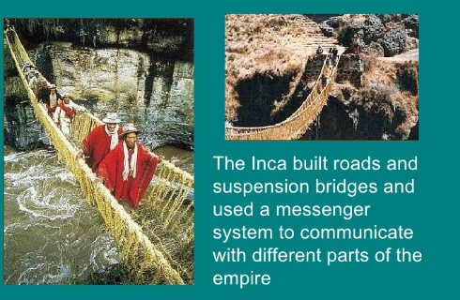
A stands for…
Area
Meaning the geographic location of a particular country and the effects geography has on it.

Slide 9

Activity
Complete the PERSIA worksheet assigning a category to each passage.

