Slide 1
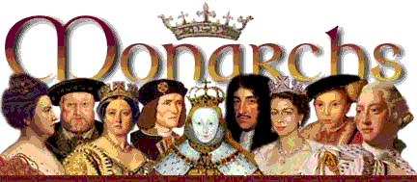
Important English Monarchs
AIM: Who was the greatest English monarch?
Do Now: What event during the Renaissance caused royal power to grow?

Slide 2

The Normans - 1066 - 1154
The Normans were descendants of Vikings who had settled by force in North East France around the mouth of the Seine River. The land they occupied became known as Normandy. (The name Normandy comes from the French normand, meaning Norsemen and Normans)
King William I, the Conqueror
(r. 1066 – 1087)
    Age at death 59
    Ascended to the throne: Age 38
    Crowned: 25 December 1066 at Westminster Abbey
    Beat King Harold at
    Battle of Hastings 1066 – Called the Norman Conquest of England to become King

Slide 3
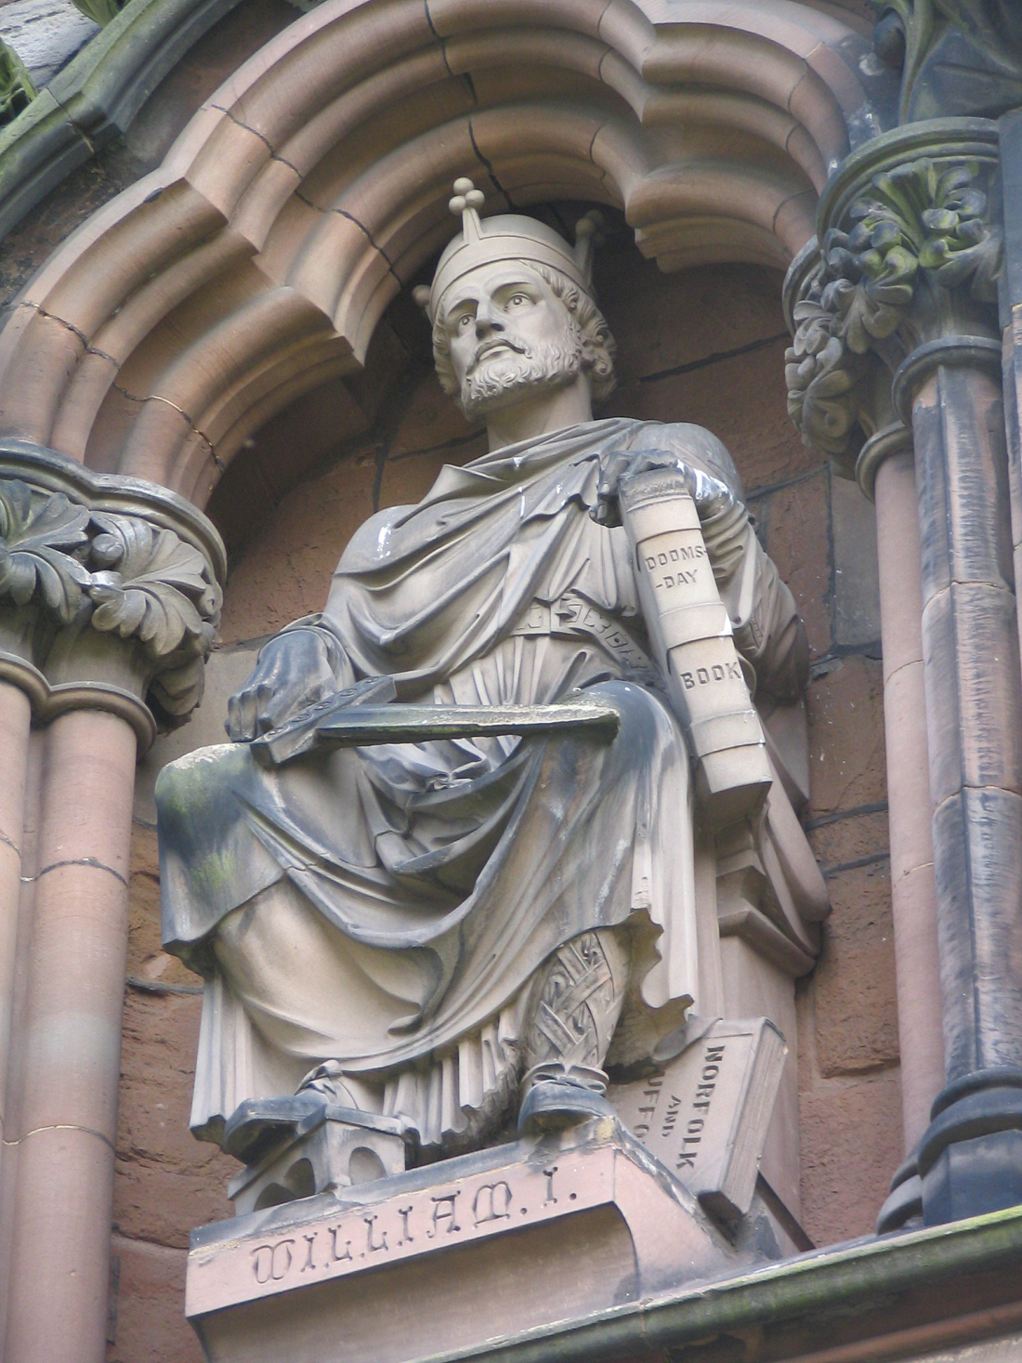
William I ruled simultaneously in
both England and
parts of France.
This caused battles over territory in
France for the
next 500 years.

Slide 4
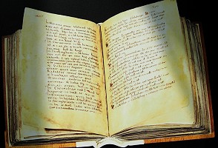
In 1085 the Domesday Survey was begun and all England was recorded so William knew exactly what his new kingdom contained. The Domesday Book was, in effect, the first national census in England.

Slide 5
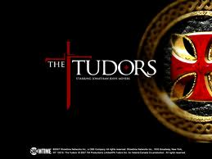

Slide 6

King Henry VIII
(r. 1509 – 1547)
  Age at Death 55
  Ascended to the throne: 1509 age 17 years
  Married:
  (1) Catherine of Aragon 1509-1533 Divorced
  (2) Anne Boleyn 1533-1536 Beheaded
  (3) Jane Seymour 1536-1537 Died
  (4) Anne of Cleves 1540 Divorced
  (5) Catherine Howard 1540-1542 Beheaded
  (6) Catherine Parr 1543-1547 Survived
  Children: Three who survived infancy; Mary, Elizabeth and Edward
  Succeeded by: his son Edward VI
The best known fact about Henry VIII is that he had six wives!
Henry argued with the Pope and made himself the head of the new 'Church of England'.

Slide 7


Slide 8
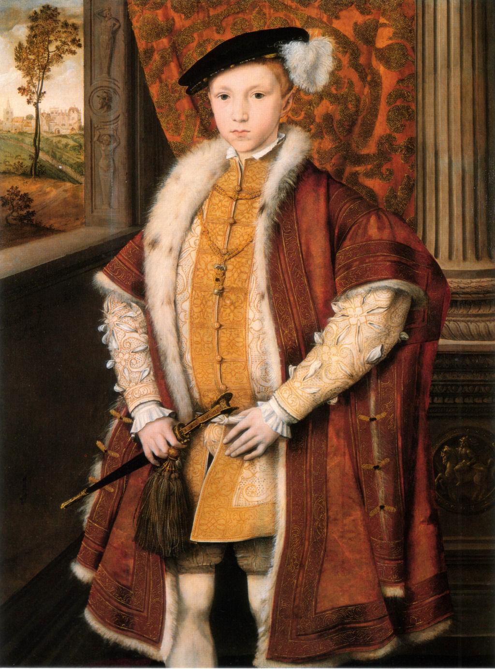
King Edward VI (r. 1547-1553)
Age at Death 16. Son of Henry VIII and Jane Seymour. Unmarried. Died from consumption. Edward was the only son of Henry VIII. Edward VI became king at the age of nine upon the death of his father, Henry Vlll. He was known as 'The Boy King'. Edward was a sickly child and the country was run by his protectors
Edward enjoyed reading about battles and writing Greek.
Edward died at the age of 16 in 1553

Slide 9
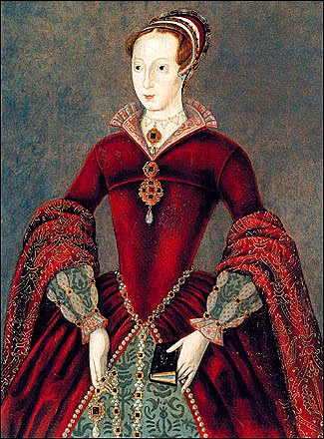
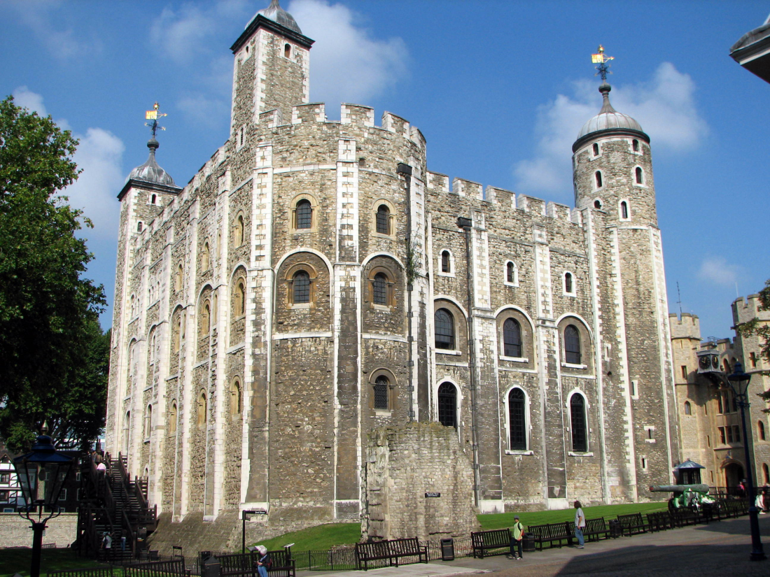
After Edward's death there was a dispute over the succession. As Mary was Catholic, LADY JANE GREY, a protestant was named as the next in line to the throne.
She was proclaimed Queen but Mary entered London
with her supporters and Jane was taken to the Tower. She reigned for only 9 days.
She was executed in 1554,
age 17.

Slide 10


Slide 11
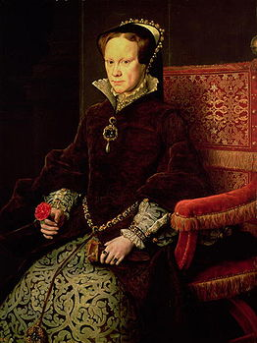
Queen Mary I (Bloody Mary)
(r. 1553 – 1558)
Age at Death 42
Parents: Henry VIII & Catherine of Aragon
Ascended to the throne: Age 37
Married: Philip II of Spain
Children: None
Succeeded by: her half sister Elizabeth
Her nickname was Bloody Mary because of the huge numbers of people she murdered to return England from its Protestant regime back to the Roman Catholic faith.

Slide 12
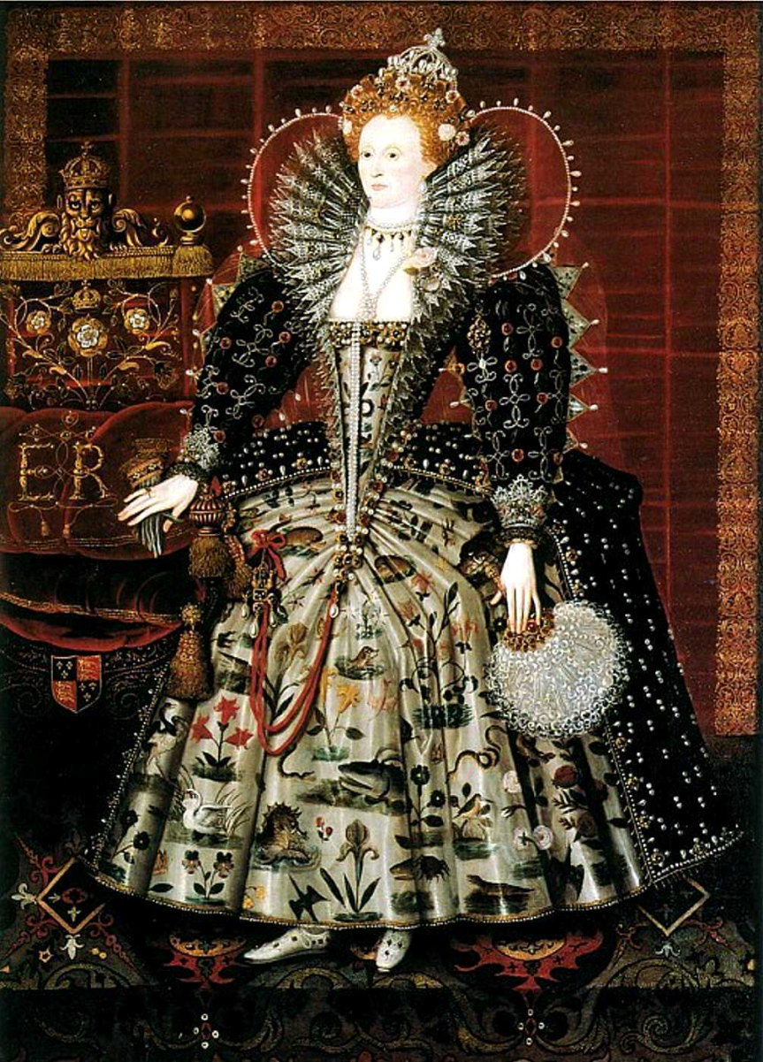
Queen Elizabeth I
(r. 1558 – 1603)
Age at Death 69
Parents: Henry VIII and Anne Boleyn
Ascended to the throne: Age 25
Married: Never Married
Children: None
Succeeded by: James of Scotland
Considered a “Golden Age” or “Elizabethan Age”
The Age of Exploration was at its height during her reign.
Fought off the Spanish Armada.
Named James VI of Scotland her heir, uniting the two countries Scotland and England.

Slide 13
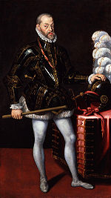
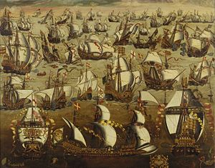
The Spanish Armada - 1588
King Philip II of Spain
I know I have the body but of a weak and feeble woman; but I have the heart and stomach of a king, and of a king of England too, and think foul scorn that Parma or Spain, or any prince of Europe, should dare to invade the borders of my realm; to which rather than any dishonour shall grow by me,
I myself will take up arms, I myself will be your general, judge, and rewarder of every one of your virtues in the field.
Sailed to invade England
Wanted to stop England Involvement in the Netherlands
Wanted to stop England from profiting from trade
It was a Holy War to bring Roman Catholicism back to England
Spain – Roman Catholic
England – Protestant (Church of
England)
Failed – England beat them back at sea and the weather finished them off

Slide 14
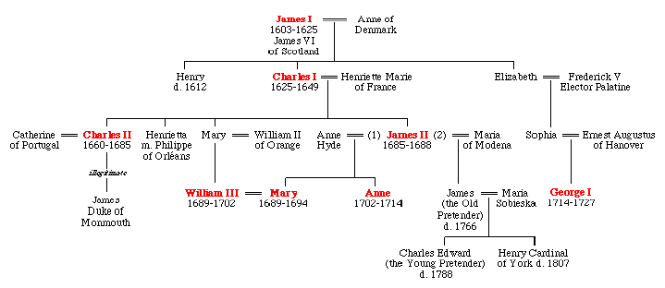
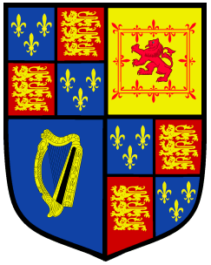
The Stuart Monarchy

Slide 15
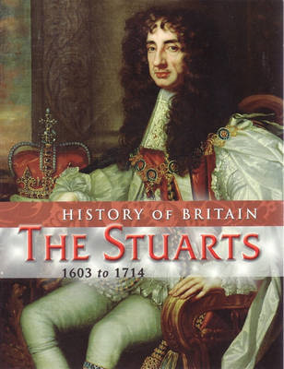
The Stuarts
Union of Scottish and English Crowns
The Stuarts were the first kings of the United Kingdom.
Scotland provided England with a new line of kings, the Stuarts. They were to bring disaster to the nation for, coming from Scotland where royal power had not been curbed by Parliament, they had no understanding of the more democratic ways that had developed in England.

Slide 16
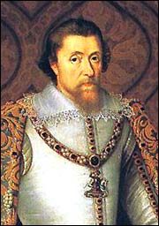
James I (r. 1603 - 1625)
Age at Death 58
Ascended to the throne: Age 36
Children: Henry, Elizabeth and Charles
Succeeded by: his son Charles
King of England from 1603 and Scotland
(as James VI) from 1567
(29 Years as King of Scotland)
When James became King of England, he was already a king - King James VI of Scotland. He was the first monarch to rule both countries and the first to call himself 'King of Great Britain'. However it was not until 1707 that an act of Parliament formally brought the two countries together.
James authorized the translation of the King James Bible. He also had Sir Walter Raleigh (explorer) executed.

Slide 17
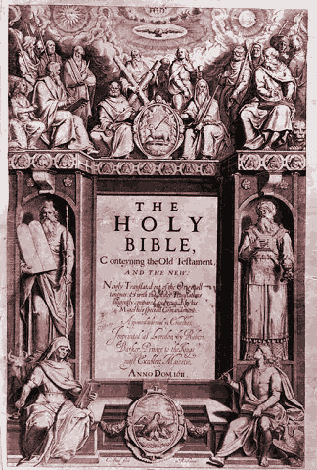
King James Bible,
1611

Slide 18

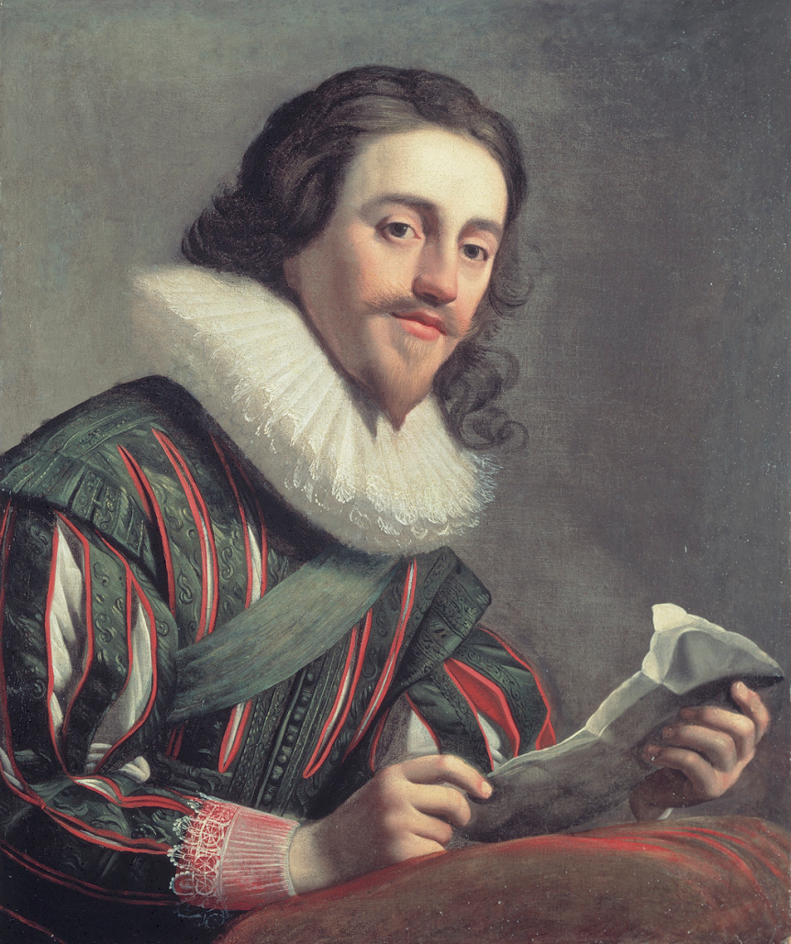
Charles I (r.1625 – 1649)
Age at Death 49
Ascended to the throne: Age 24
Died: (executed), aged 48 years
King of Great Britain and Ireland from 1625
Fought against the Parliament leading to civil war.
Was executed as a result 1649.

Slide 19
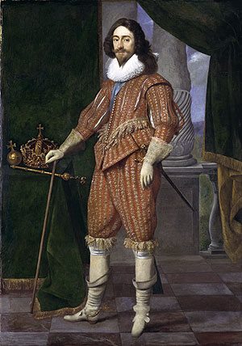
The “Long” Parliament
In session from 1640 to 1660.
  Laud executed.
  Triennial Act passed → Parliament must be called in session at least once every 3 yrs.
  Parliament can’t be adjourned without its own consent!
Charles enters the House of Commons to end the session and arrest 5 MPs→ unsuccessful
Charles heads north to form an army!

Slide 20

The
Civil War
(1642-1649)

Slide 21
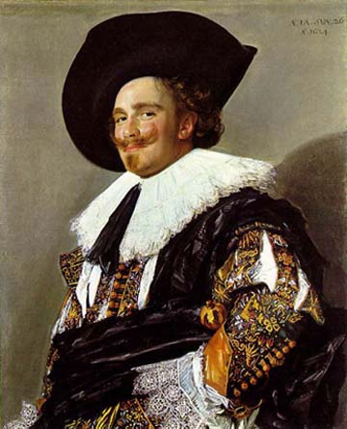
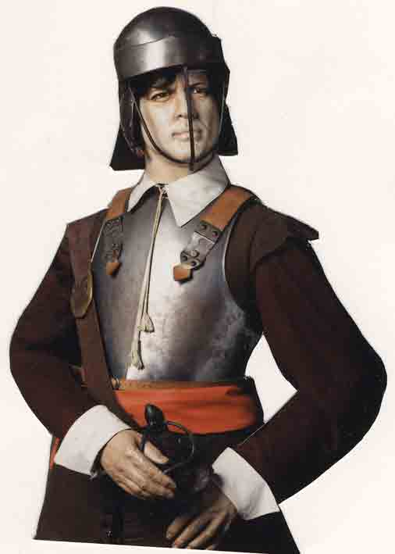
Civil War
(1642-1649)
Royalists
(Cavaliers)
Parliamentarians
(Roundheads)
House of Lords
N & W England
Aristocracy
Large landowners
Church officials
More rural
House of Commons
S & E England
Puritans
Merchants
Townspeople
More urban

Slide 22
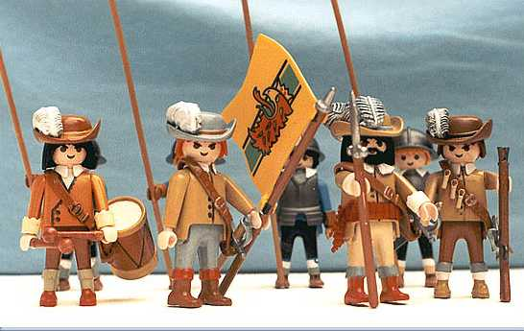
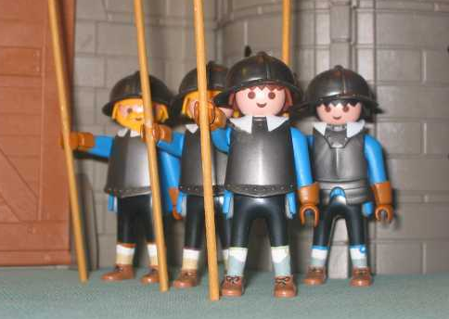
Playskool Version
of the English Civil War
Roundheads
Cavaliers

Slide 23
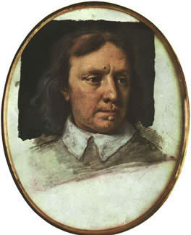
Oliver Cromwell [1599-1658]
Officer of the Parliamentary army [cavalry] → the New Model Army.
Led the army that defeated royal forces and now controlled the government.
He wore…a plain cloth-suit, which seemed to have been made by a poor tailor; his shirt
was plain, and not very clean; and I
remember a speck or two of
blood upon his collar…his face was
swollen and red, his voice sharp and
untunable, and his speech full of
passion. [Sir Philip Warwick,
a Royalist, 1640]

Slide 24
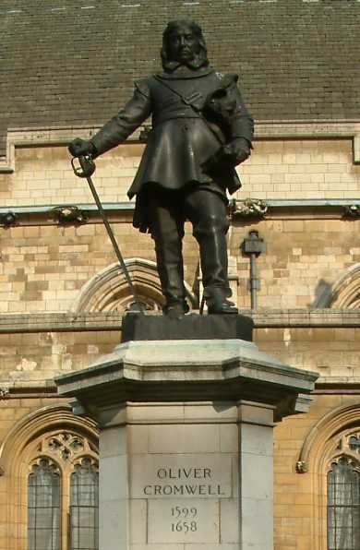
The Commonwealth (1649-1653)
The Protectorate (1654-1660)

Slide 25
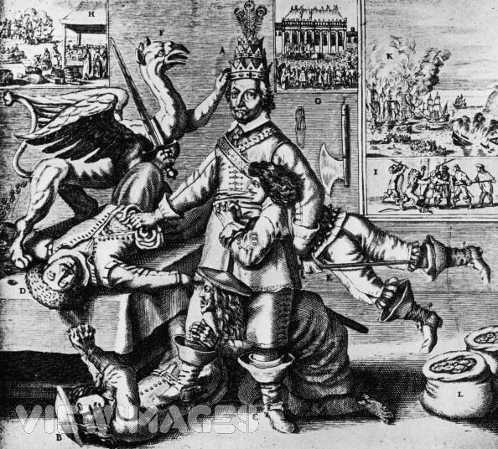
Cromwell—Lord Protector or King??
England longs for an end to martial law!
Cromwell dies in 1658 and his son, Richard, takes over, but is weak and lasts for only two years.

Slide 26
The
Restoration
(1660-1688)
Parliament could no more exist without the Crown than the Crown without Parliament. This was the most important lesson of the English Civil War!

Slide 27
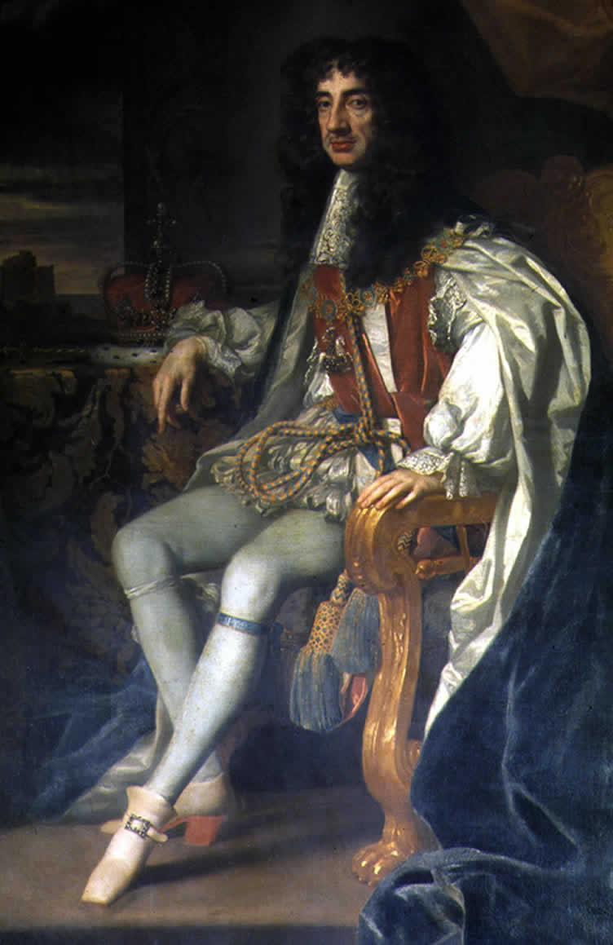
King Charles II [r. 1660-1685]
Had charm, poise, & political skills [unlike his father!].
Restored the theaters and reopened the pubs and brothels closed during the Restoration.
Favored religious toleration.
Had secret Catholic sympathies.
Realized that he could not repeat the mistakes his father had made.

Slide 28
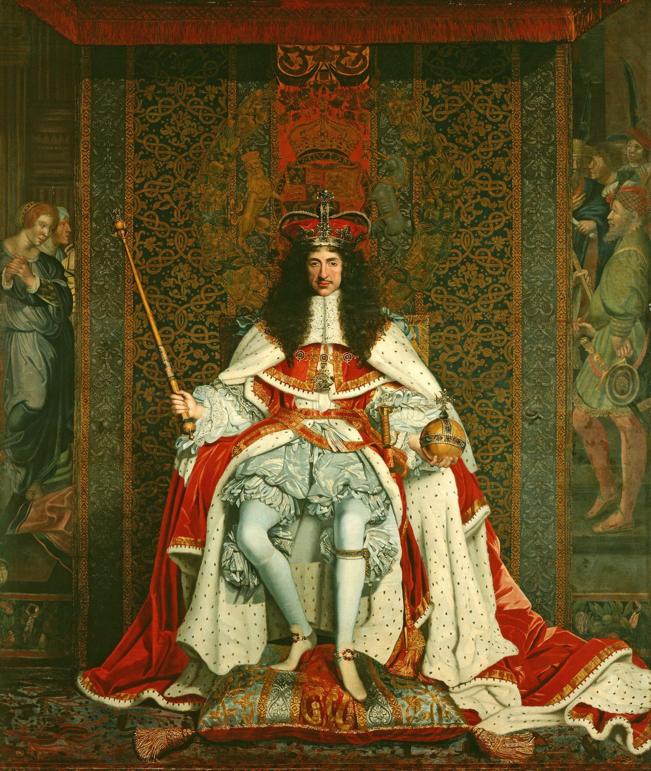
King Charles II [r. 1660-1685]
1661 → Parliament [filled with Royalists]
  Disbanded the Puritan army.
  Pardoned most Puritan rebels.
  Restored the authority of the Church of England.

Slide 29
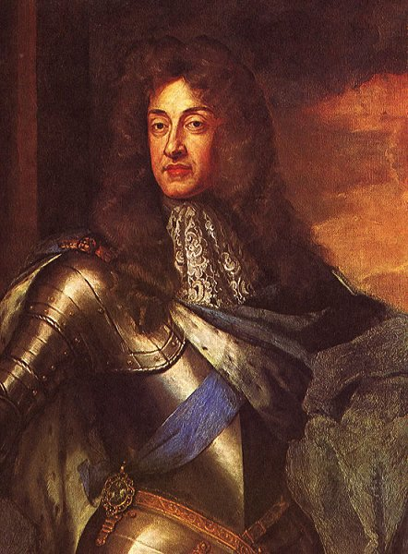
King James II [r. 1685-1688]
Was a bigoted convert to Catholicism without any of Charles II’s shrewdness or ability to compromise.
Alienated even the Tories.
Provoked the revolution that Charles II had succeeded in avoiding!

Slide 30
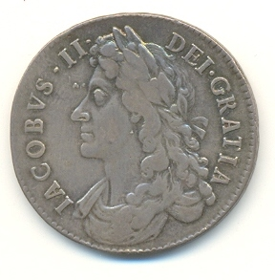
King James II [r. 1685-1688]
Introduced Catholics into the
High Command of both the
army and navy.
Camped a standing army a few
miles outside of London.
Surrounded himself with
Catholic advisors & attacked
Anglican control of the
universities.
Claimed the power to suspend or dispense with Acts of Parliament.
  He extended religious toleration without Parliament’s approval or support.

Slide 31
The
Glorious
Revolution
1688

Slide 32
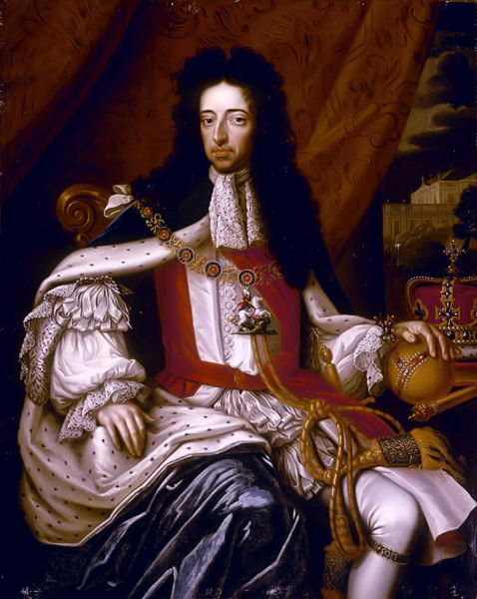
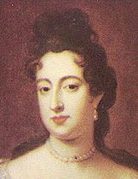
The “Glorious” Revolution: 1688
Whig & Tory leaders offered the throne jointly to
James II’s daughter Mary [raised a Protestant] & her husband, William of Orange.
  He was a vigorous enemy of Louis XIV.
  He was seen as a champion of the Protestant cause.

