Slide 1
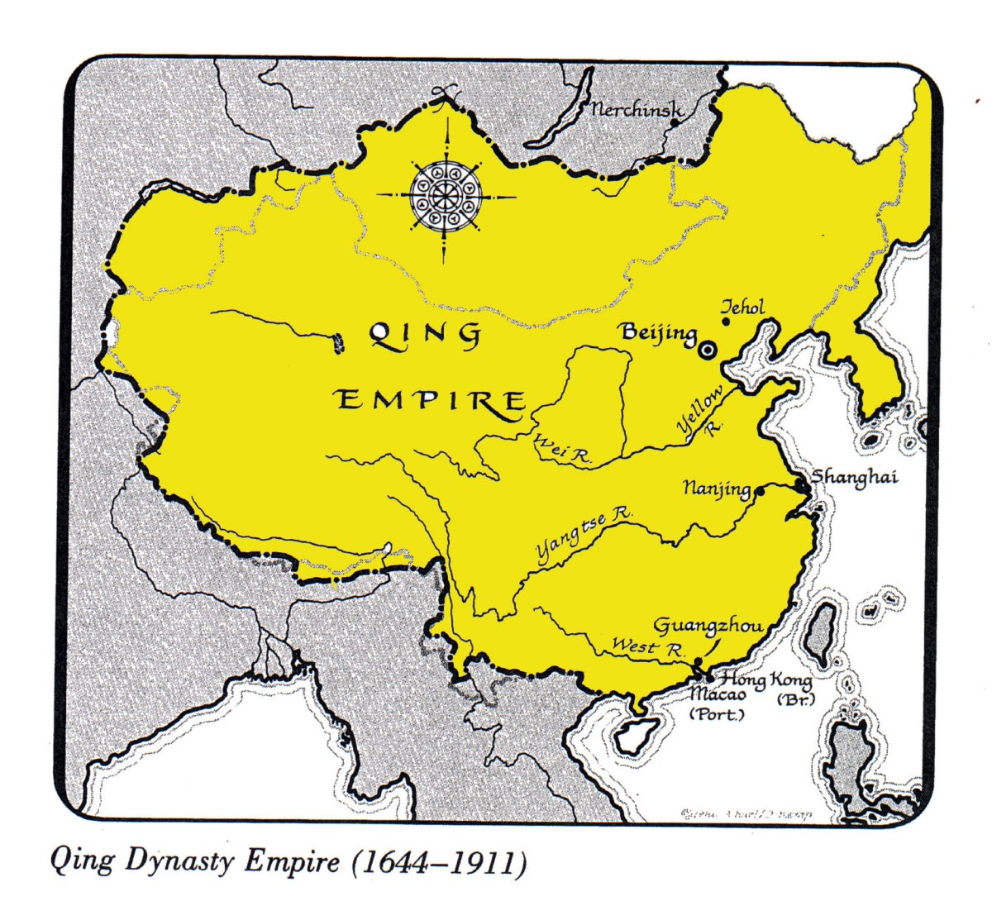
Qing Dynasty
1644-1911
Manchus invaded and set up Qing Dynasty
2nd Foreign Dynasty

Slide 2
Rule by Manchus
Like Mongols, did not want to adopt Chinese culture
Passed laws forbidding Manchus to marry Chinese people or wear Chinese clothes
They did keep Confucianism
Continued policy of isolationism

Slide 3
Trading with Europeans
Give Europeans a place to set up trade posts, limited to that area
Unbalanced trade for the British, the Chinese don’t need anything the British have
British begin bringing in Opium from India to trade
Opium is illegal in China
Notes:
Canton, China was the trading port city for Europeans

Slide 4
Opium War
1839-Chinese throw Opium into the ocean
British merchants want money to pay for the Opium, British government backs them up
Go to war, the British win
China must:
Make new trade agreement (unbalanced trade for China)
Give Hong Kong to Britain
Pay settlement to Britain

Slide 5
Europeans in China
China was divided into European spheres of influence, each nation controls trade in a specific sphere
Forced to sign the “unequal treaties” with Britain, France, US, and Russia
Gave extraterritoriality to Westerners
Extraterritoriality: if you commit a crime in China you will be tried in your home country

Slide 6
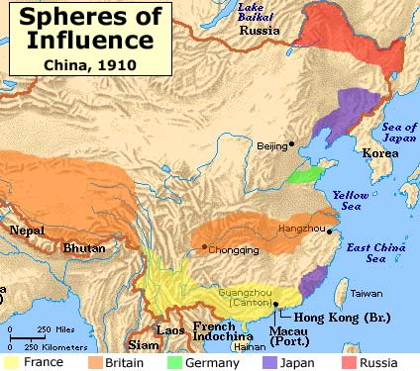

Slide 7
Open Door Policy—U.S.
This policy would guarantee equal trading rights for all and prevent one nation from discriminating against another within its sphere
Notes:
John Hay Sec. of State, sent letter to foreign powers with idea of open door policy.
The nations replied that they liked the concept of the Open Door, but that they could not support or enforce it. Hay's plan had been politely rejected. Nevertheless Hay announced that since all of the powers had accepted the Open Door in principle, the United States considered their agreement "final and definitive."

Slide 8
China Nationalist Movements
People begin to revolt against the dynasty
Qing are losing their “mandate from heaven”
Taiping Rebellion
Hong Xiuquan, a leader in Southern China believed he was the younger brother of Jesus Christ, and God had commanded him to save humanity
He declared a new dynasty the Taiping
The Qing put an end to the rebellion
This rebellion only made China weaker
Notes:
1851-1864
Western powers sided with Qing to avoid any financial collapse of trade
Son of a farmer
He had taken and failed the grueling civil service examinations three times. During the last part of this process he had begun to have visions, and grew to believe that he was the brother of Jesus Christ, and decided to form a new kind of community based on some of the Christian precepts, such as the 10 Commandments.

Slide 9
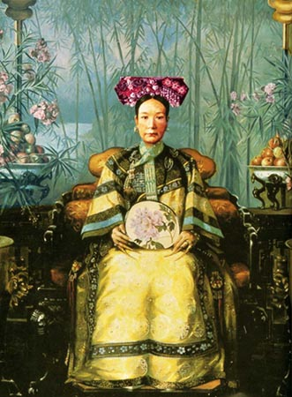
Empress Dowager Cixi
Dominated China for over 40 years
Opponent of westernizing
Took money from new navy to build a summer palace
A marble pavilion in the shape of a boat in a lake
Notes:
Rose to power 19th c.
Low ranking wife of emperor, then had his only son, moves up in rank
Emperor dies 5 years later
She will rule for her son, council of elders disagrees, she has 3 of them killed and disbanded the rest,
Against all modernization: her son built schools to study foreign languages and he modernized army. She reduces the amount of power he had, undid all of his reforms, eventually son dies,
Her 4 year old nephew is next in line, she adopts him so she can maintain power, when he gets old enough she allows him to rule, but once he starts trying to modernize china, she came back and undid his reforms
The day she died she ordered his death, the next day he was poisoned

Slide 10
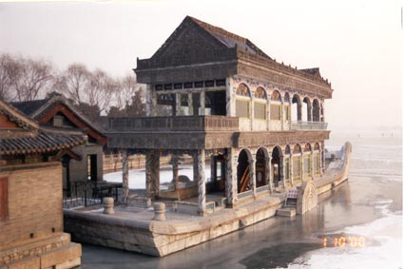

Slide 11
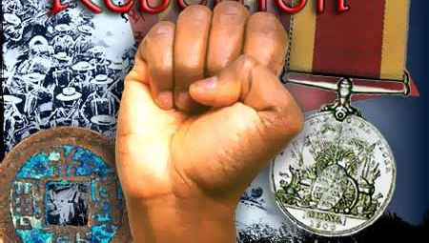
Boxer Rebellion
A group called the Society of the Harmonious Fists wanted to rid China of foreign influence
These people were called Boxers by the west
They revolted in 1900
The Empress publicly supported the Boxers calling for a war on all Western powers in China
An international army came in and put the revolt down
Notes:
religious society that had originally rebelled against the imperial government
Called boxers because the practice martial arts

Slide 12
End of the Qing Dynasty
After the Empress and Emperor died a 3 year old child was left to take over
More revolts against the dynasty
1911: the Western educated Chinese overthrew the dynasty ----established of the Chinese Republic
This led to a period of chaos
with no definite ruler

