Slide 1
The
Industrial
Revolution
AP European History – Mr. Ott – Park East High School

Slide 2
What was the
Industrial Revolution?

Slide 3
The Industrial Revolution:
Replacement of animal/human power by harnessed forms of natural energy
  Steam
  Electricity & Oil
  Nuclear Power
Making of goods by machines in factories
Accompanied by…
  Urbanization
  New class structure
  Slow but steady rise in standard of living
  Mass consumption of goods

Slide 4
Why Did
Industrialization
Begin in
Great Britain?

Slide 5
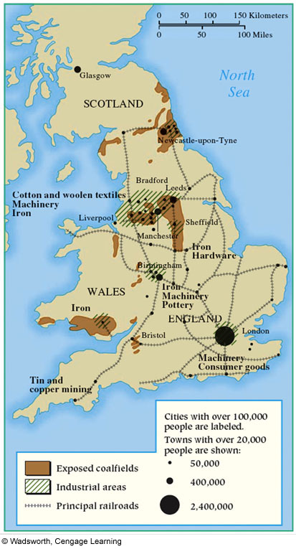
Industrial Great Britain

Slide 6
Why Britain?
Highly productive & innovative farmers (Agricultural Revolution)
National bank (supplied credit)
Substantial natural & mineral resources (coal & iron)
Plentiful rivers & well-developed system of canals
Stable political life (after 1688)
Mobile labor force (due to enclosure)
Colonial empire (wealth + markets)
Patent System → William Rosen (historian)

Slide 7
From Cottage
to
Factory

Slide 8
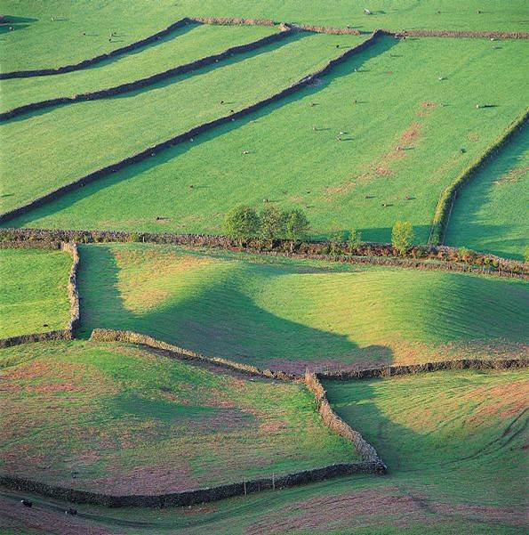
Enclosed Fields:

Slide 9
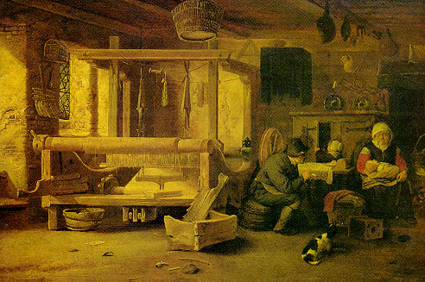
Cottage Industry → supplemental income

Slide 10
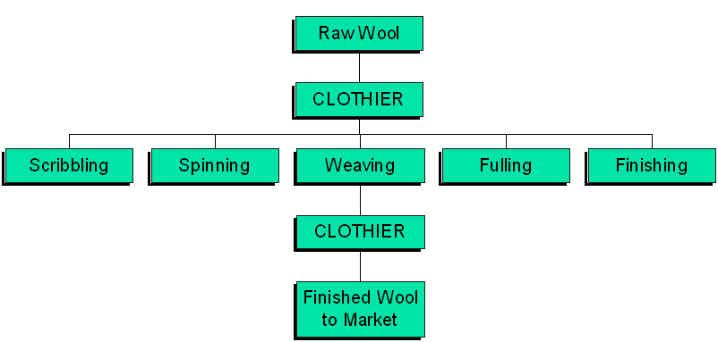
The “Putting Out” System

Slide 11
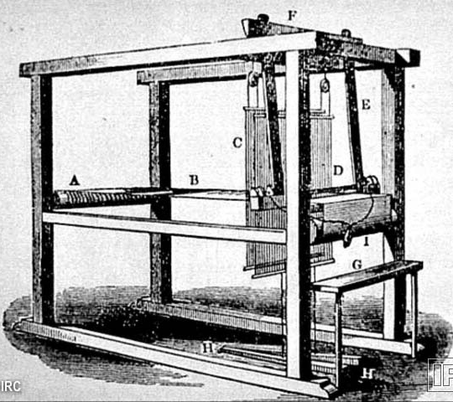
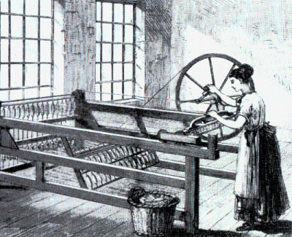
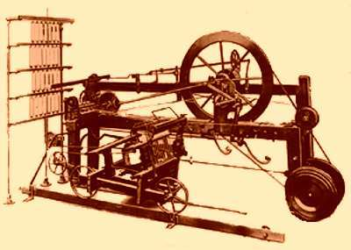
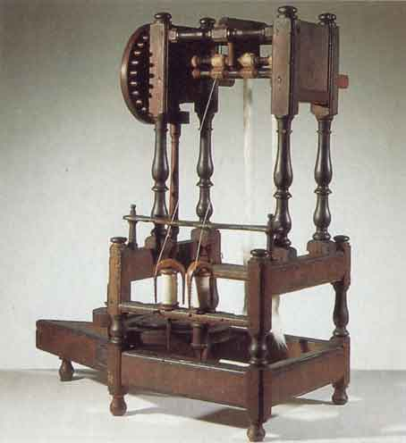
Innovations in Weaving & Spinning:
Kay’s “flying shuttle
Hargreaves’s “spinning jenny”
Crompton’s “spinning mule”
Arkwright’s “water frame”

Slide 12
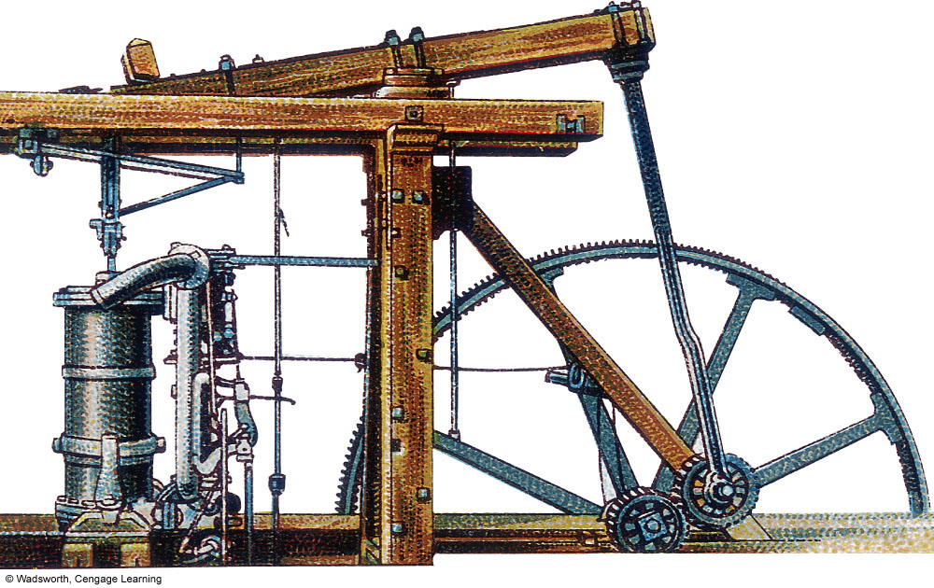
James Watt’s Steam Engine 1782 (
The Most Important Invention of the Industrial Revolution !

Slide 13
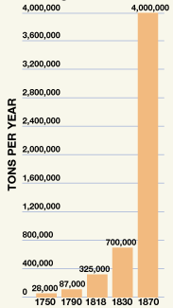
Coal Mining in Britain:
1800-1914
British Pig Iron
Production
1800 | 1 ton of coal | 50, 000 miners
1850 | 30 tons | 200, 000 miners
1880 | 300 million tons | 500, 000 miners
1914 | 250 million tons | 1, 200, 000 miners

Slide 14
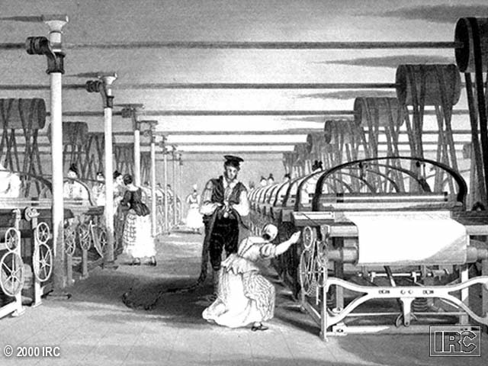
Cartwright’s Power Loom
Moved the workers from the cottage to the factory !

Slide 15
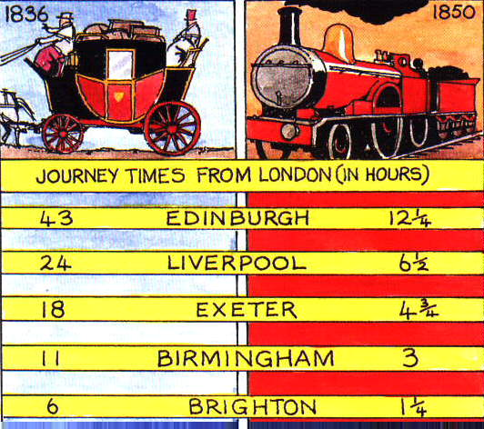
The Impact of the Railroad

Slide 16
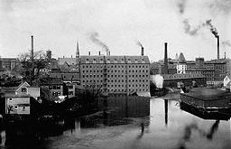
The Factory System
Rigid schedule.
12-14 hour day.
Dangerous conditions.
Mind-numbing monotony.

Slide 17
Textile Factory
Workers in England
1813 | 2400 looms | 150, 000 workers
1833 | 85, 000 looms | 200, 000 workers
1850 | 224, 000 looms | >1 million workers

Slide 18
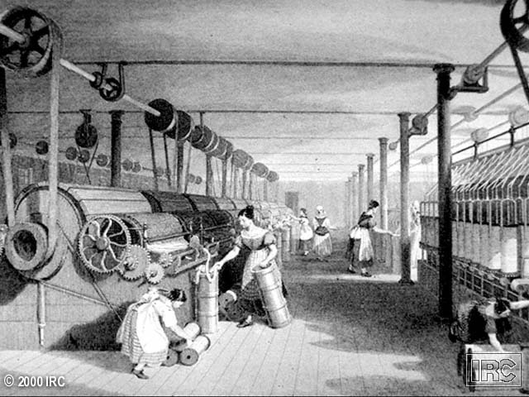
Textile Factory Workers in England

Slide 19
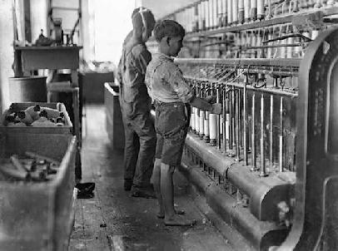
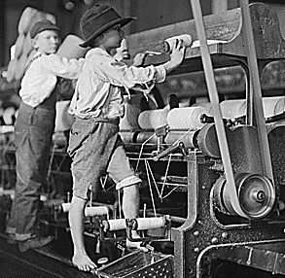
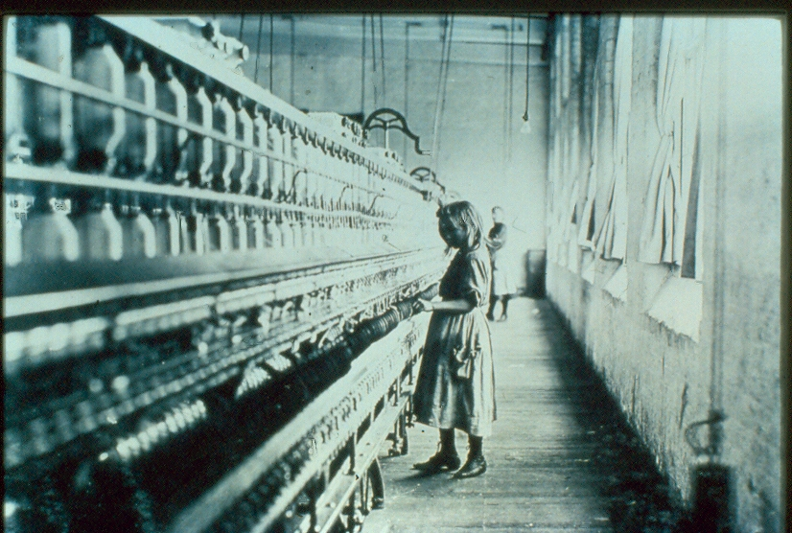
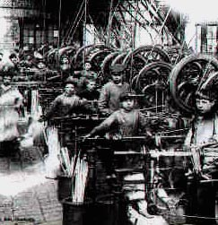
Child Labor in the Factories

Slide 20
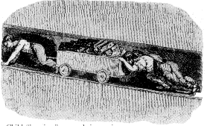
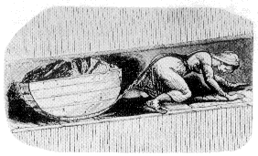
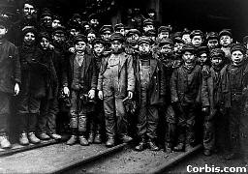
Labor in the Mines
Child
“hurriers”
Woman
“hurriers”
Young
Coal Miners

Slide 21
Young Coal Miners

Slide 22
Industrial England:
"Workshop
of the World"
That Nation of Shopkeepers!
-- Napoleon Bonaparte

Slide 23
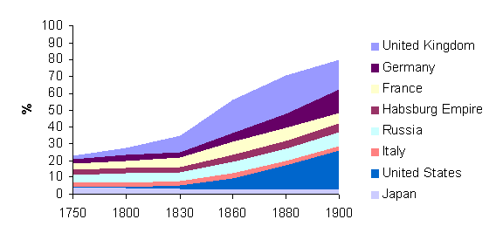
Share in World Manufacturing Output: 1750-1900

Slide 24
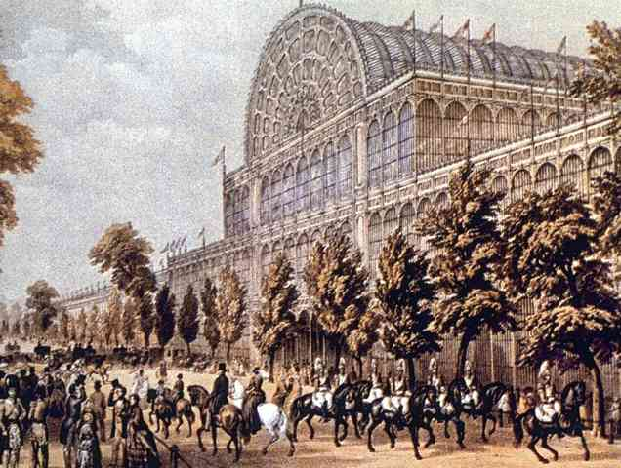
Crystal Palace Exhibition: 1851
Exhibitions of the new industrial utopia.

Slide 25
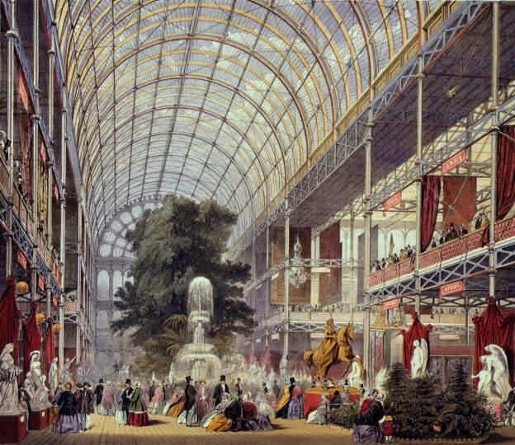
Crystal Palace: Interior Exhibits

Slide 26
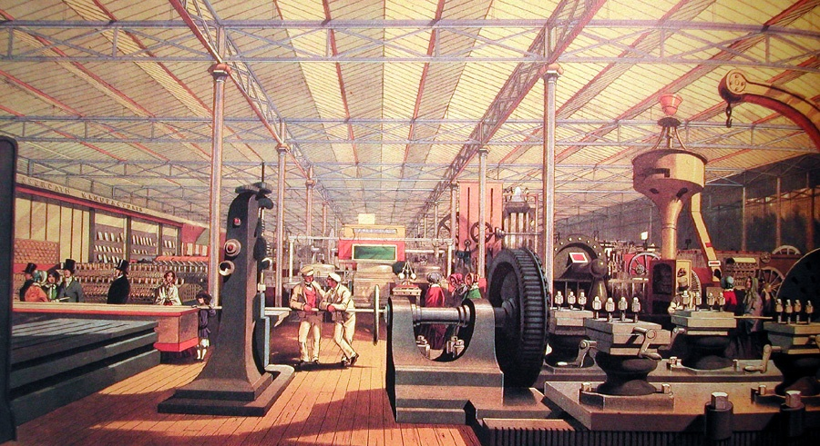
Crystal Palace:
British Ingenuity on Display

Slide 27
Industrialization
on the
Continent

Slide 28
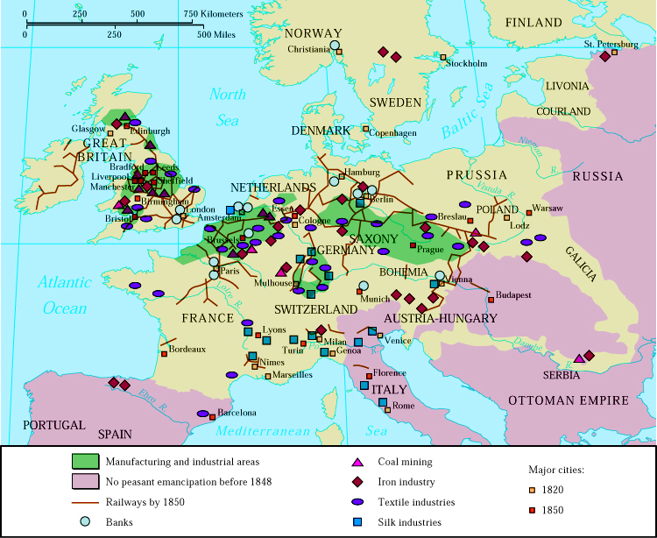
Industrialization By 1850

Slide 29
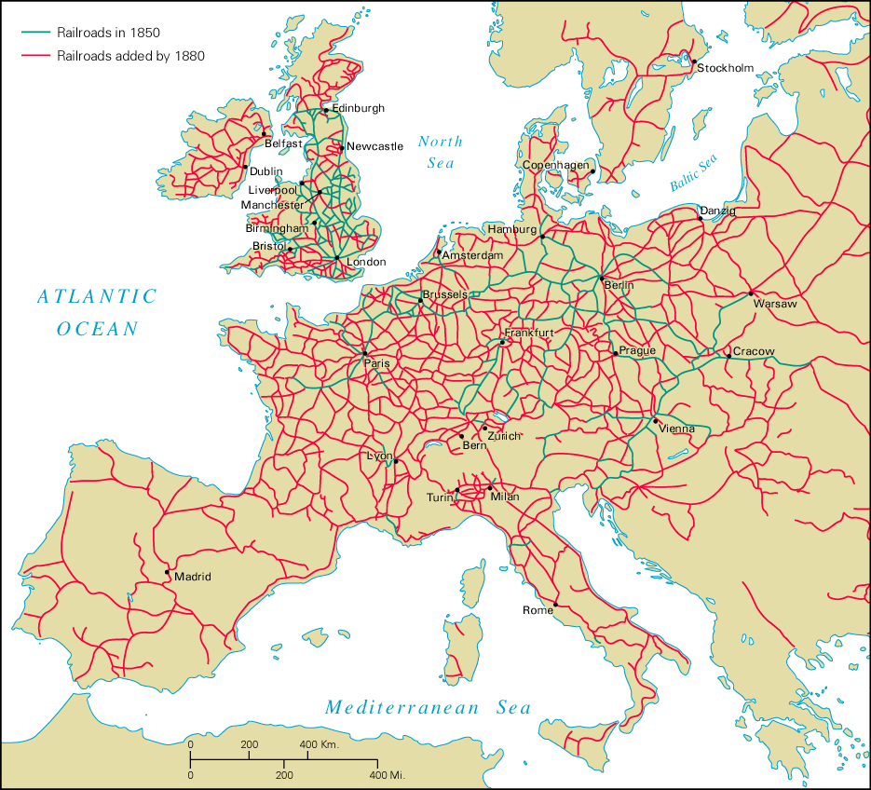
Railroads on the Continent

Slide 30
Industrialization on the Continent
State ownership of some industries.
  RRs → Belgium & most of Germany.
Tariffs
National Banks granted a monopoly on
issuing bank notes.
  Société Général & Banque de Belgique (Belgium)
  Crédit Mobilier (France)
  Darmstadt Bank (Germany)
Companies required to register with the government & publish annual budgets.
New legislation to:
  Establish limited liability.
  Create rules for the formation of corporations.
Postal system
Free trade zones → Ger. Zollverein

Slide 31
The Social Impact
of the
Industrial Revolution

Slide 32
New Industrial Social Order
“Bourgeoisie”
Nouveau Riche Industrialists,
Professionals, & White-collar workers
  15% of pop; 27% of wealth
Old Landed Aristocracy & Wealthiest Industrial Families
  5% of pop; 33% of wealth
New
Elite
Middle-Class
Working
Class
“Proletariat”
Skilled & Semi-skilled workers in cities & rural areas
  80% of pop; 40% of wealth

Slide 33
Reactions to & New
Ways of Thinking
About Industrialization

Slide 34
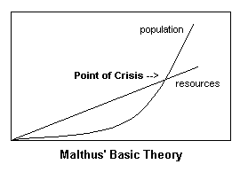

Thomas Malthus
Population growth will
outpace the food supply.
War, disease, or famine
could control population.
The poor should have
less children.
Food supply will then keep up with population.

Slide 35
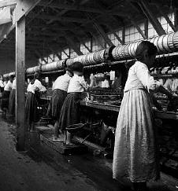
David Ricardo
“Iron Law of Wages.”
When wages are high,
workers have more
children.
More children create a
large labor surplus that
depresses wages.

Slide 36
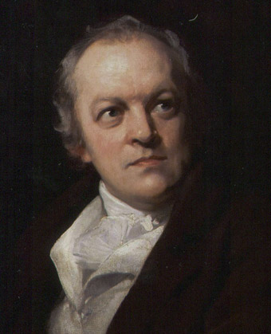
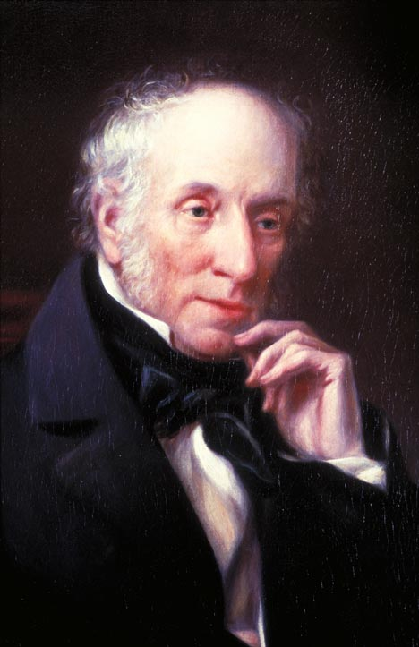
The Romantics:
William Blake
William Wordsworth
Lamented the loss of the rural lifestyle
Protested against the conditions of the urban poor

Slide 37
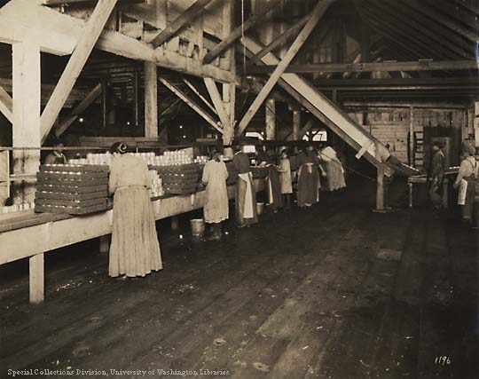
The Utilitarians:
Jeremy Bentham & John Stuart Mill
The goal of society is the greatest good for the greatest number.
There is a role to play for government
intervention to provide some social safety
net.

Slide 38
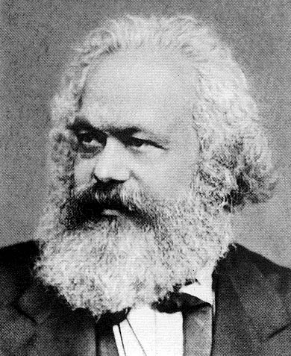
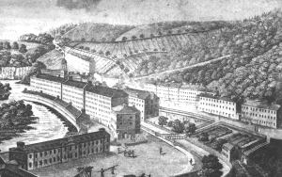
The Socialists:
Utopians & Marxists
People as a society would operate and own the
means of production, not individuals.
Their goal was a society that benefited
everyone, not just a rich, well-connected few.
Tried to build perfect communities [utopias].

Slide 39
Chartism: The “Peoples’ Charter”
Drafted in 1838 by William Lovett.
Goal → achieve political democracy
Radical campaign for Parliamentary reform of the inequalities created by the Reform Bill of 1832.
Votes for all men.
Equal electoral districts.
Abolition of the requirement that Members of Parliament [MPs] be property owners.
Payment for Members of Parliament.
Annual general elections.
The secret ballot.

Slide 40
Responses to
the new
Industrial Revolution

Slide 41
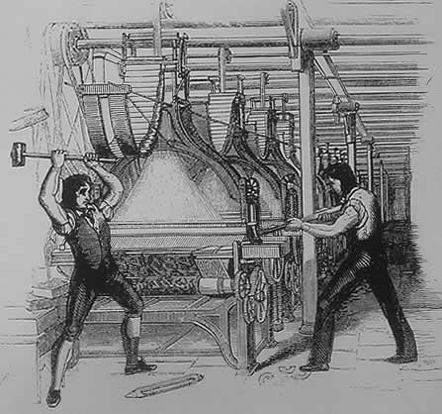
The Luddites: 1811-1816
Attacks on the “frames” [power looms].
Ned Ludd [a mythical figure supposed to live in Sherwood Forest]

Slide 42
Trade Union Movement
Became legal in 1824 (after repeal of Combination Acts)
New associations formed by skilled laborers in # of new industries
Served two purposes
    Preserve workers position by limited entry into their trade
    Gain benefits from employers
Willing to strike to obtain goals
National trade unions attempted but ultimately failed

Slide 43
Government Response
Parliament forbids the employment of pauper children (1802)
Sadler Commission to look into
working conditions
  Factory Act [1833] – limited working hours of children in factories; est. minimum age of 9.
Other important labor acts…
  Mines Act [1842] – women & boys under 10 prohibited from working in mines
  Ten Hour Act [1847] – limited workday for women & children

Slide 44
Government Response
Reform Bill [1832]
  Broadens the vote for the cities
  Industrial middle-class now represented
New Poor Law [1834] – indoor relief.
  Est. poor workhouses.
  Assumption that poor were responsible for their condition
  Families separated, forced to work & fed dreadful food
Public Health Law [1846]
  Based on 1842 report by Edwin Chadwick
  Created national health board
  Gave cities authority to build sanitary systems

Slide 45
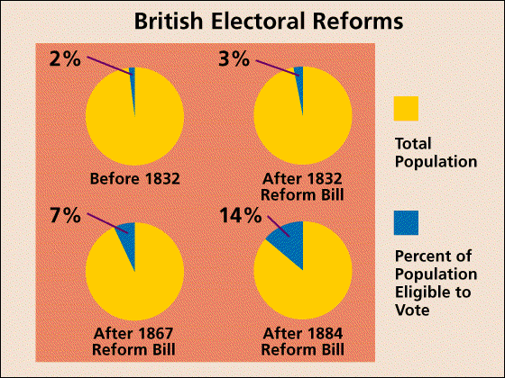
British Reform Bills

