Slide 1
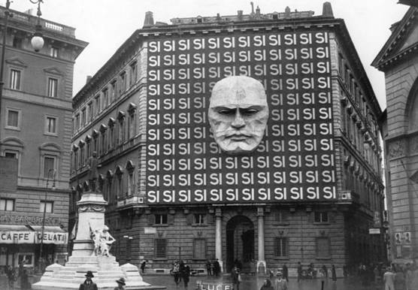
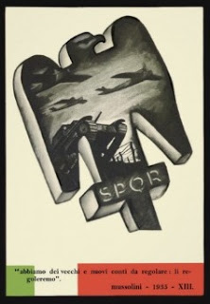
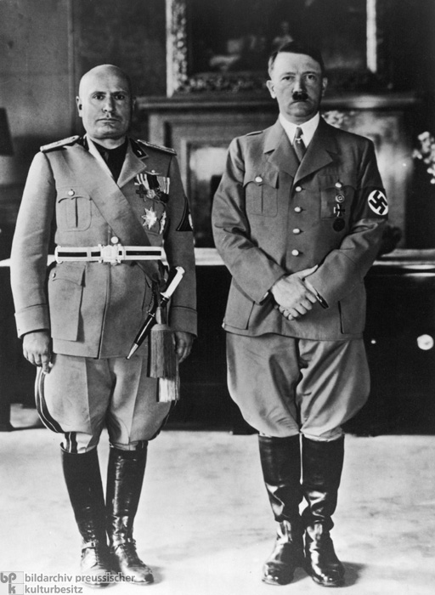
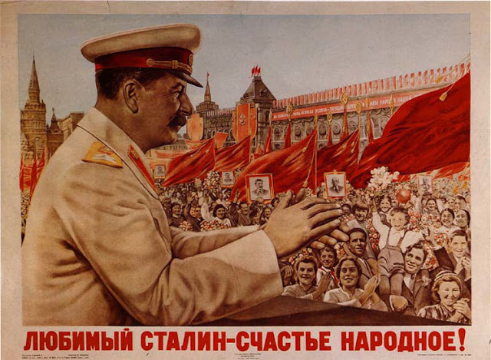
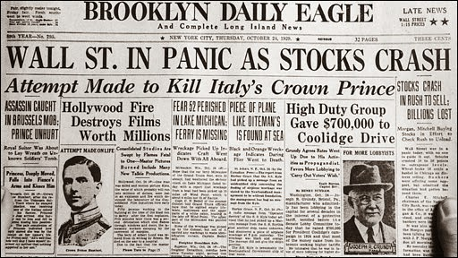
The Interwar Years 1919-1939

Slide 2
An Uncertain Peace: The Search for Security
Shortcomings of Versailles Treaty and German dissatisfaction
Weaknesses of the League of Nations
French search for security: GB/US isolationism and the “Little Entente”
Allied Reparations Commission, April 1921: $33 billion
  Paid in annual installments of billion gold marks
  Germany unable to pay in 1922
  French occupation of the Ruhr Valley

Slide 3
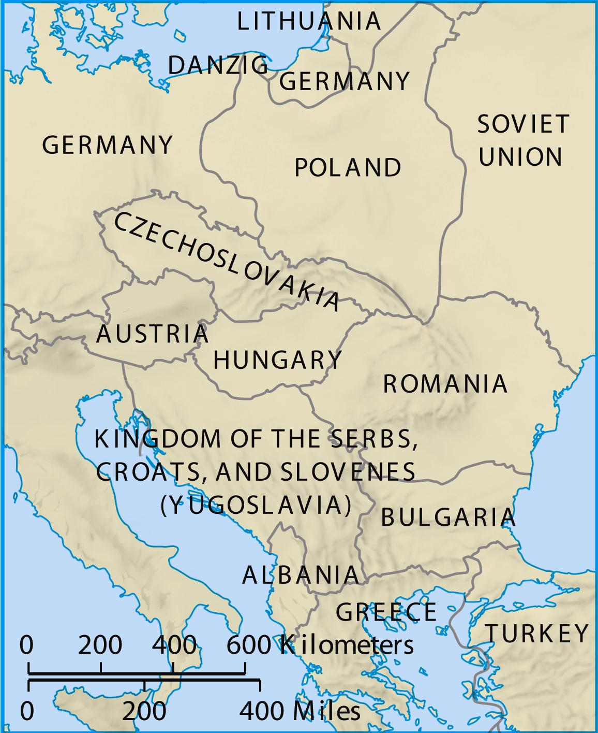
The Little Entente

Slide 4
The Hopeful Years: 1924-29
German mark falls to 4.2 trillion to $1, end of November 1923
Dawes Plan – $200 million loan & sympathy for Germany
Gustav Stresemann (1878-1929) and German cooperation
Treaty of Locarno, 1925 guarantees Germany’s western borders with France and Belgium. What about the East?
Germany joins League of Nations
Kellogg-Briand Pact: NO MORE WAR!
(Unsuccessful) push for disarmament
Improved relations with Soviet Russi

Slide 5
Causes of Worldwide Depression
  German reparations
  Expansion of production capacities and dominance of the United States in the global economy
    Britain and France owed huge war debts to the U.S.
    Better technologies allowed factories to make more products faster, leading to overproduction
  Excessive expansion of credit (people spending money they don’t have)
  Stock Market Crash of 1929
    Buying stock on margin
    A crisis in finance that led the Federal Reserve to raise interest rates
    Panic set in when stock prices crashed
  Inability of the League of Nations to stop aggression

Slide 6
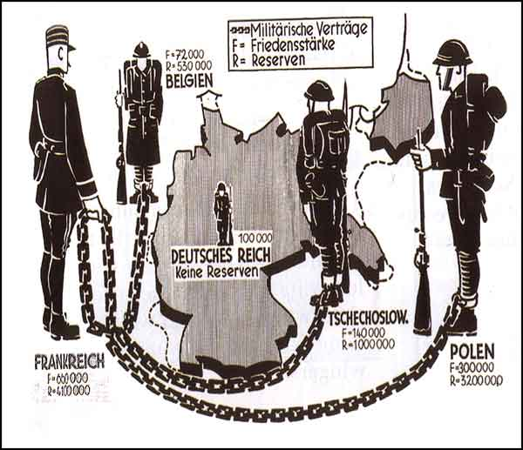
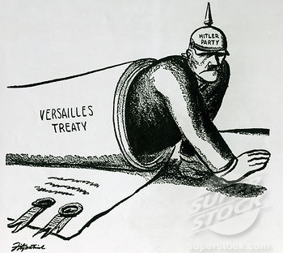
Versailles Goes Awry
The Treaty of Versailles was supposed to ensure peace, satisfy nationalistic desires, and exact revenge on Germany
Unfortunately, the terms of the treaty did not have the intended results

Slide 7
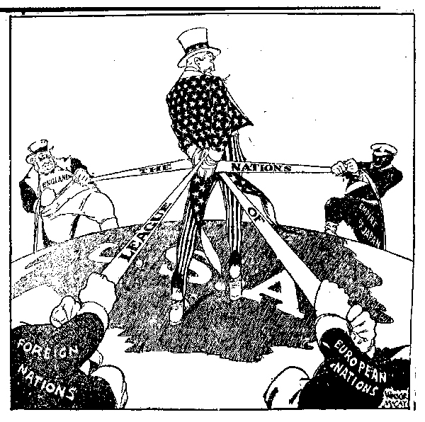
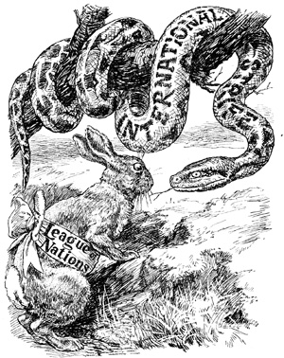
Ensuring Peace & Protecting New Nations?
The League of Nations is weak
  It cannot convince countries to disarm
    Why might that be the case?
  It cannot help all of the new, struggling nations that were created
  It does not include the U.S., Germany, or the newly created Soviet Union
    Why would this make it weaker?

Slide 8
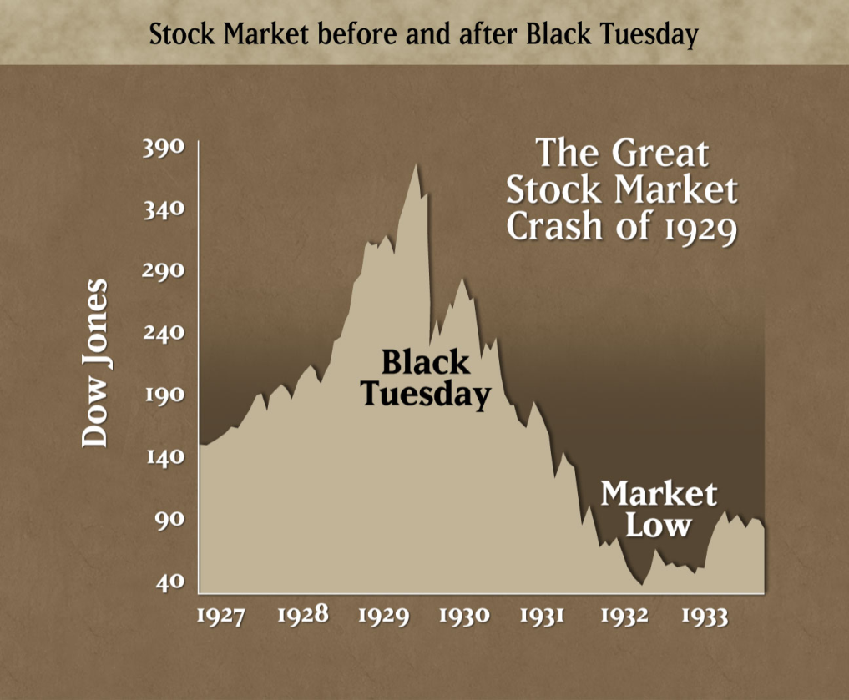
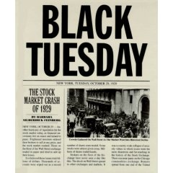
Long-term causes of the Great Depression
  Many countries had huge war debts from World War I
  Germany had to reparations for WWI
  European countries relied on American loans and investments
  The world economies were interconnected so when the United States economy (largest) failed, it affected the world economy severely.

Slide 9
Short-term causes of the Great Depression
The US stock market crashed in 1929
Banks demanded repayment of loans
Farms fail and factories close
The US reduced foreign trade to protect their economy (they increase tariffs which cause other countries to increase tariffs which causes a world wide decline in trade worsening the Great Depression)
The US stops loans to foreign countries
The American banking system collapses

Slide 10
Short-term Effects of the Great Depression
  Millions become unemployed worldwide
  Businesses go bankrupt
  Governments take emergency measures to protect their economies
  Citizens lose faith in capitalism, democracy, and the banking system
  Some nations turn toward authoritarian leader

Slide 11
The Democratic States: Great Britain
Loss of overseas markets and unemployment
Liberals under Lloyd George falter while Labour Party gains
Labour-Liberal Coalition’s short reign under MacDonald
Conservatives under Baldwin 1925-1929
Depression ousts Baldwin and Labour takes helm
Labour Party failed to solve problems; coalition “National Government” takes over 1931
Coalition claimed credit for prosperity
John Maynard Keynes (1883-1946) - economist
  Keynes says the government should create jobs
  Government should spend even if in debt – to stimulate economy
  Ignored by government

Slide 12
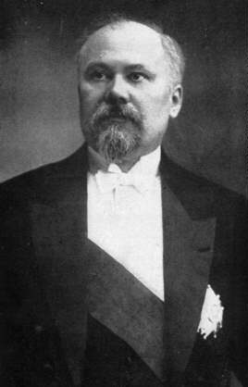
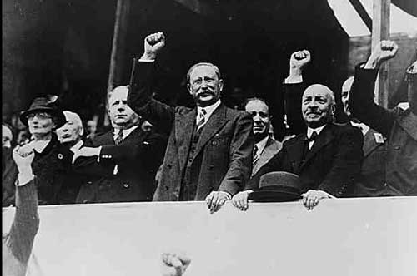
The Democratic States: France
Was the strongest power in Europe
Poincare and the National Bloc – Ruhr Valley fiasco (Assignment)
Cartel of the Left: socialists and radicals
Poincare’s return and the Depression
Government volatility: could not solve financial problems
Popular Front of socialists, radicals and communists
  Reaction to threat of fascism
  Leon Blum
  French “New Deal”
  Takes World War II to end the depression
Raymond Poincare (L) Leon Blum and his Popular Front (R)

Slide 13
The Democratic States (cont)
The Scandinavian States
  Socialist parties
  Expanded social services
  High taxes and large bureaucracies
The United States
  Herbert Hoover, (1929-1933)
    Great Depression: Stock Market crash/15 million unemployed
    No unemployment or poor relief
  Franklin D. Roosevelt, (1933-1945)
    New Deal
    Public Works

Slide 14
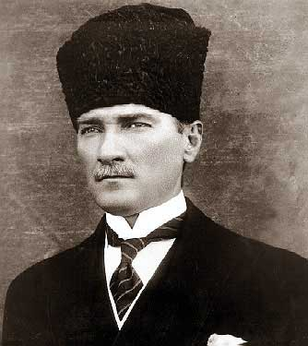
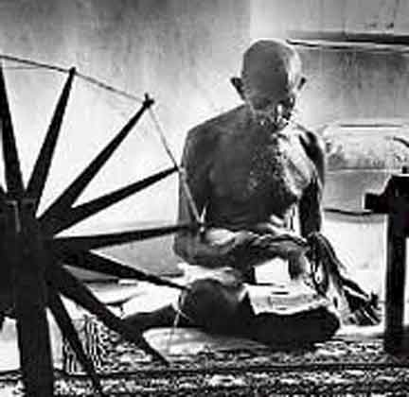
The Colonial Empires: Middle East and India
GB and France tried to maintain their colonial empires, but Depression opened door to change in Middle East, India and Africa
The Middle East
  Turkey, Iran, Saudi Arabia and Iraq gain independence while Euros maintain control of Syria, Lebanon, Jordan and Palestine
  Colonel Mustafa Kemal – “Ataturk”
    Republic of Turkey, 1923: westernized!
    Secular republic: Islamic control of politics ends; women given rights
India
  Mahatma (“great soul”) Gandhi
    Push for Indian independence and improved conditions for poor
    peaceful policy of civil disobedience
    GB grants internal self-government in 1935, but not independence

Slide 15
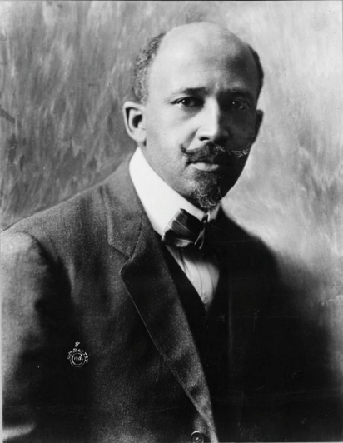
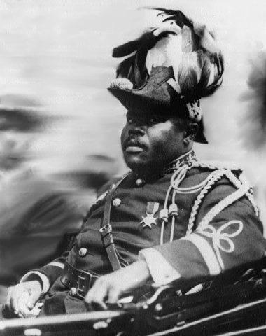
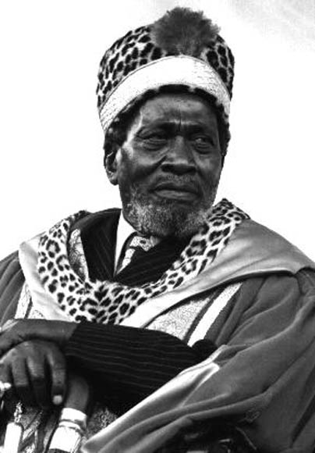
The Colonial Empires: Africa
After World War I, Africa became more politically active
Protest
  British Nigeria in 1929: women’s protest over high taxes
  Brits kill 50 women
  Did prompt reform – too little too late: these areas wanted independence!
African leaders speak up – many were educated in US or GB
  W. E. B. Du Bois: make all Africans aware of their cultural heritage
  Marcus Garvey: unity for all Africans!
  Jomo Kenyatta: Facing Mount Kenya argues that British rule is destroying African culture/tradition

Slide 16
Retreat from Democracy:
The Authoritarian and
Totalitarian States
By 1939 only major states to remain democratic are France and Great Britain
Wasn’t WWI fought to make the world “safe for democracy?”
Postwar societies were divided
  Class: unions strengthened during war; middle class lost ground
  Gender: women booted from workplace; many single women; women encouraged to go home and have kids (abortion, birth control outlawed)
  Great Depression exacerbated these divisions
The modern totalitarian state
  Active commitment of citizens
  Mass propaganda techniques
  High speed communication
  Led by single leader and single party
  Individual freedom was subordinate to collective will

Slide 17
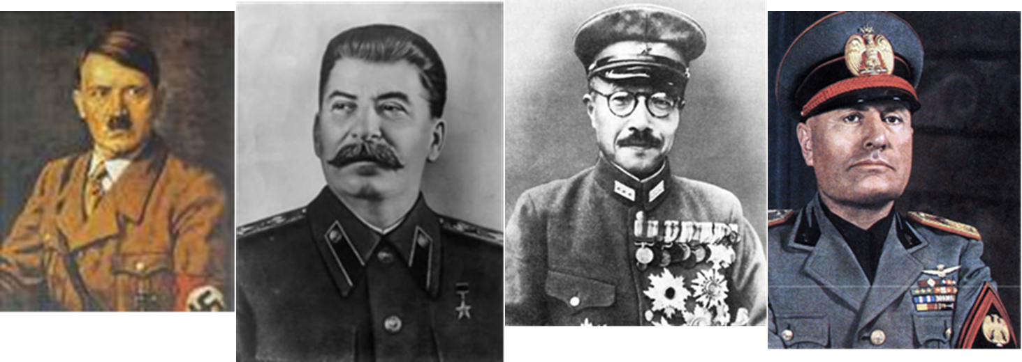
What were the long-term effects of the
Great Depression?
  Some nations turn toward
  authoritarian leaders (Dictators)
SOVIET UNION (USSR)
GERMANY
JAPAN
ITALY
ADOLF HITLER
HIDEKI
TOJO
BENITO
MUSSOLINI
JOSEF
STALIN

Slide 18
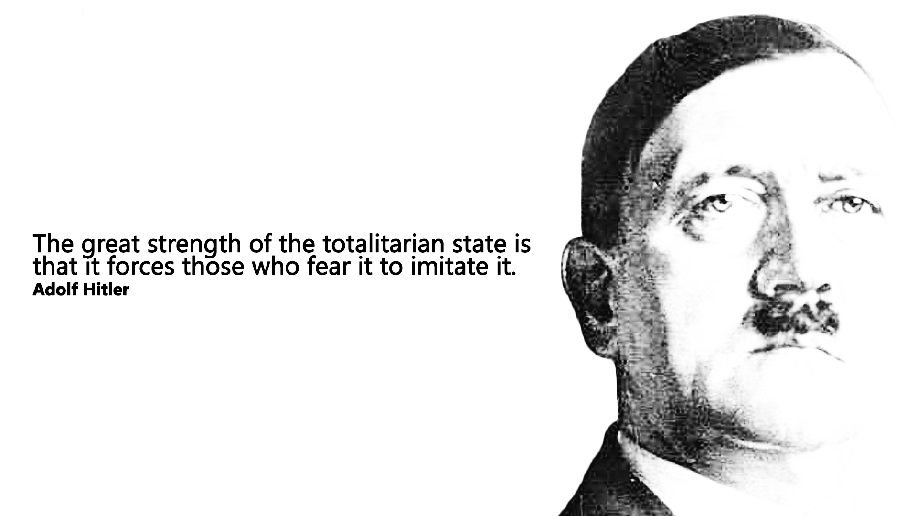
What is totalitarianism?
Totalitarianism is a form of government in which the ruler has total control over every aspect of public and private life.
What are some characteristics of totalitarian states?

Slide 19
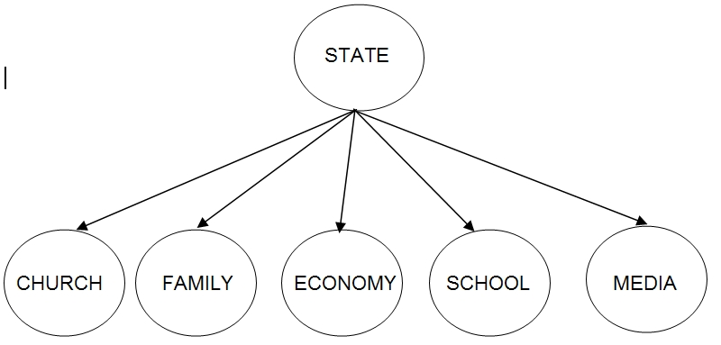
Some characteristics of totalitarian states are:
  Dictatorship and one-party rule
  Dynamic leader
  Organized violence
  Anti-democratic
  State control over all sectors of society
  Dependence on modern technology
  Ideology to win over the masses

Slide 20
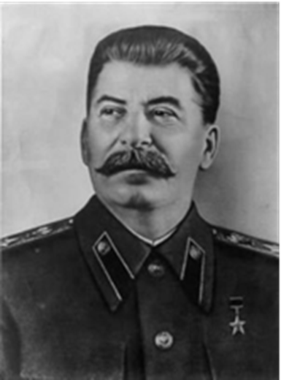
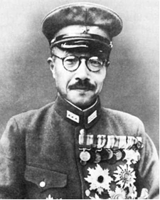
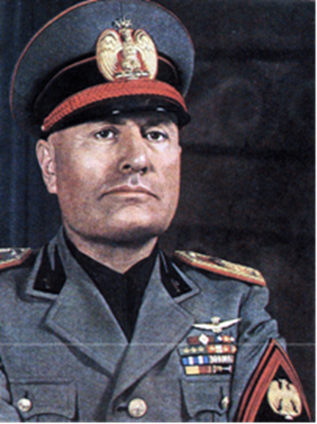
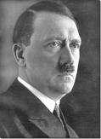
Who were the major totalitarian leaders and governments of pre-war world?
Soviet Union – Joseph Stalin
Germany – Adolf Hitler
Italy – Benito Mussolini
Japan – Hideki Tojo
What are four different types of totalitarian governments?

Slide 21
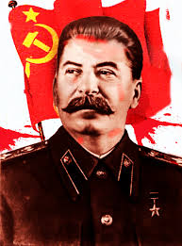
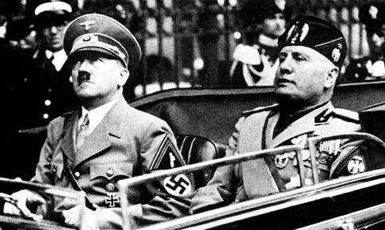
Types of Totalitarian Governments
Fascism, Nazism, Marxist-Leninist Communism, and Communism are the four different types of totalitarian governments.

Slide 22
Vocabulary
Fascism: a dictatorial/totalitarian form of government with a extreme nationalism, militarism, totalitarianism that values the state over the individuals; fascist governments forbid and suppress criticism and opposition to the government
Nazism: Germany’s version of Fascism with anti-semitism, and superior race theory.
Marxist-Leninist Communism: version of a classless society in which capitalism is overthrown by a working-class revolution that gives ownership and control of wealth and property to the state
Communism (beginning with Stalin): any system of government in which a single, usually totalitarian, party holds power, and the state controls the economy

Slide 23
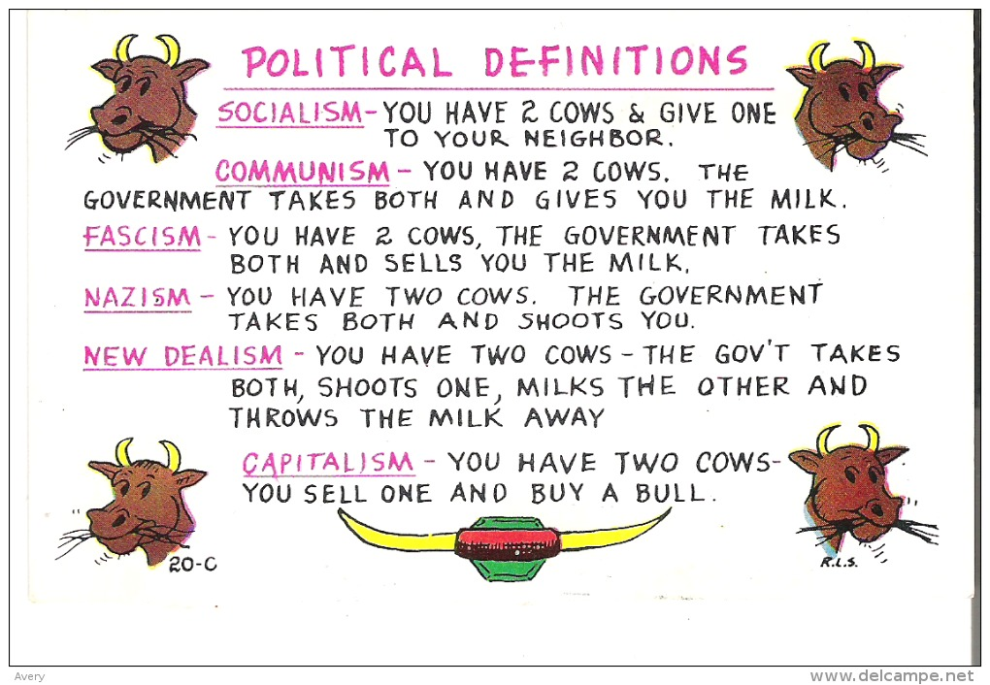
The Two Cow Scenario

Slide 24
Long-term Effects of the Great Depression
  Nazis take control of Germany
  Fascists come to power in other countries
  Soviet Union strengthens its grip on its people with Stalinist Communism
  Democracies try social welfare programs
  Japan expands in East Asia
  World War II breaks out

