Slide 1
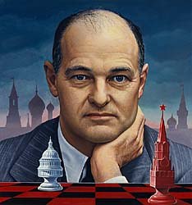
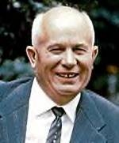
The East & West Sides
Of the Iron Curtain
Notes:
Kennan and Khrushchev ACT readings

Slide 2
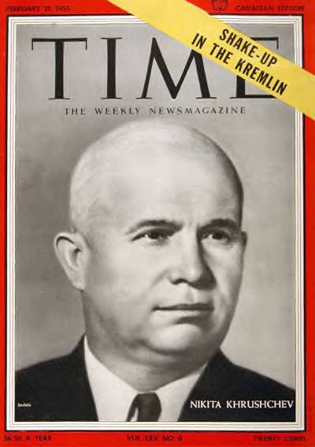
Nikita S. Khrushchev (1894-1971)
Leader from 1953 to 1964-tried to push light industry & consumer goods.
1956 “Crimes of Stalin” speech began the process of De-Stalinization at the Twentieth Congress of the Communist Party, 1956
Apparatchki (party bureaucrats) threatened by Khrushchev’s reforms-sabotaged & resisted
Notes:
Stalin’s body was removed from Red Square and buried
Stalingrad was renamed Volgograd

Slide 3
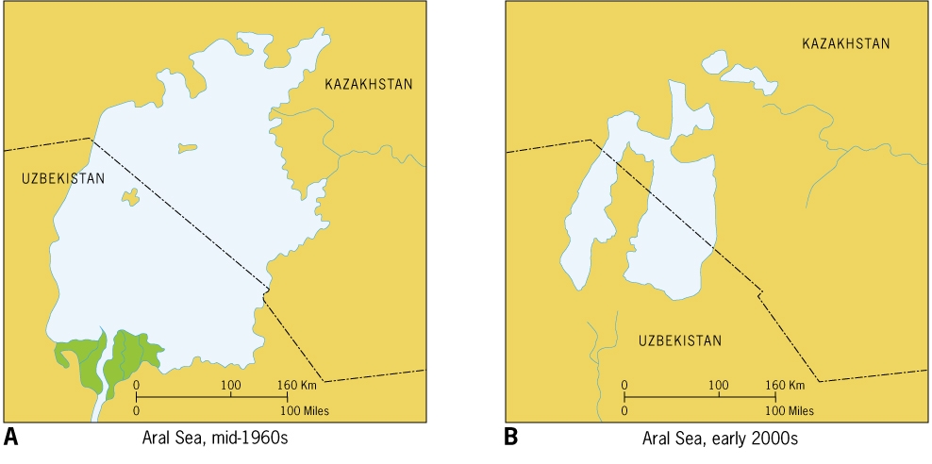
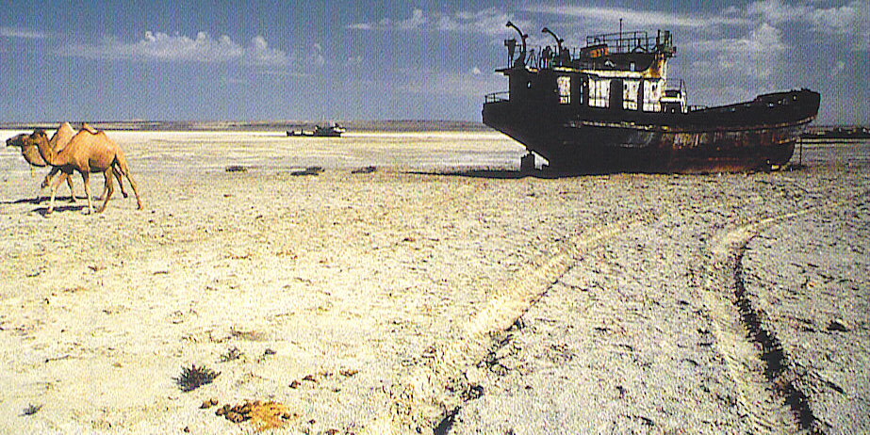
Notes:
The Aral Sea has lost ¾ of its surface area in 25 years
Many areas of the world also will suffer from a shortage of water
The Southwest US is increasing in population with insufficient water supplies

Slide 4
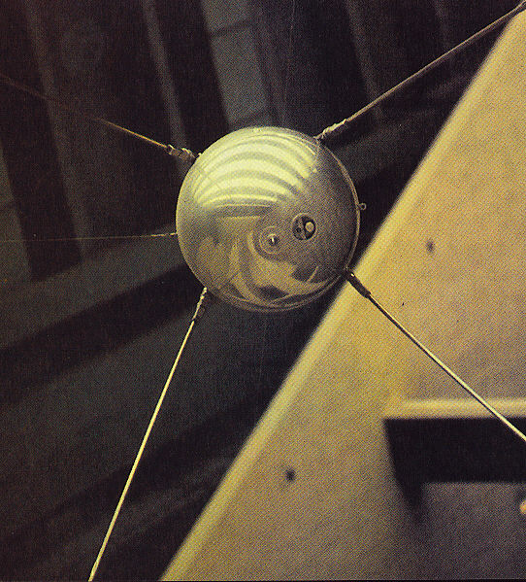
1957, the USSR launched the first satellite “Sputnik” and the Space Race began.
Soviet economy 2nd only to the US. Khrushchev promised that USSR would surpass the US: “We will bury you”, but
  “Virgin Lands” of Soviet Central Asia-irrigation to grow cotton-Aral Sea shrank
  Did not alter bureaucracy & inefficiency of the collective farm system.

Slide 5
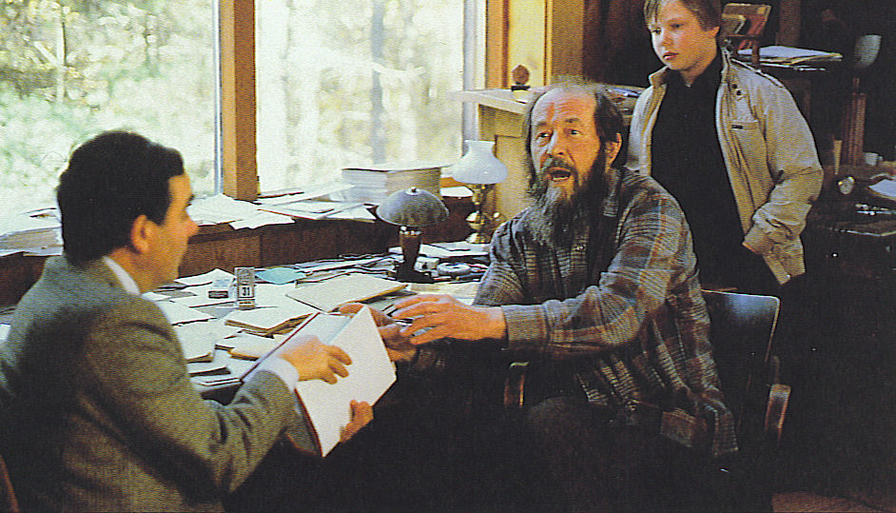
Khrushchev encouraged the “thaw” in cultural & intellectual freedom
1962, allowed Alexander Solzhenitsyn to publish, A Day in the Life of Ivan Denisovitch, which described the “Gulags”. In exile, he wrote the Gulag Archipelago.
Notes:
Alexander Solzhenitsyn was expelled from the Soviet Union in 1974 and settled in Vermont. A critic of communism, but also the unbridled greed and materialism of the West.

Slide 6
Eastern Europe: Behind the Iron Curtain
11 nations & 100 million Eastern Europeans fell under Communist style govts. with nationalized economies.
Collectivized land, but not as extensively as in the USSR-Bulgaria-most docile state-1/2 collectivized, Hungary only 1/3 and Poland almost none.
East Germany and Czechoslovakia emphasized heavy industry at the expense of consumer goods.

Slide 7
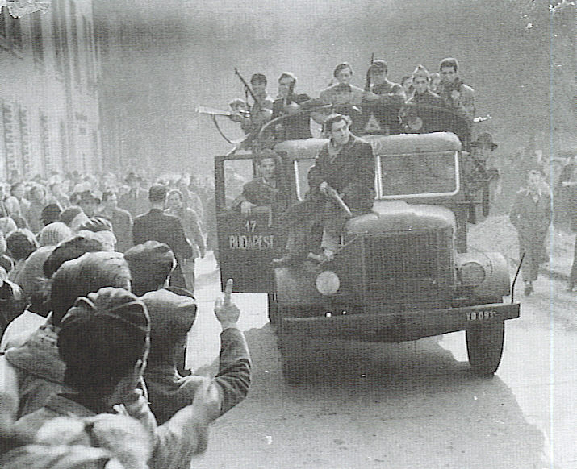
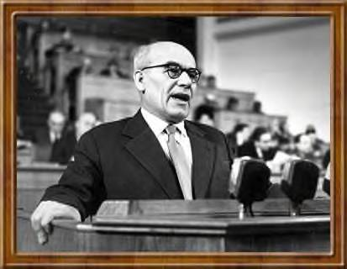
Upheaval in Eastern Europe
After Stalin’s death-unrest & repression-1953 East Berlin riots were squashed.
After de-Stalinization speech of 1956-unrest in Poland
Wladyslaw Gomulka came to power in Poland after unrest of 1956
  Relaxed political & economic controls.
  Loosened ties with Moscow
  Halted collectivization
  Improved relations with the Vatican
Notes:
Photo at right-Gomulka

Slide 8
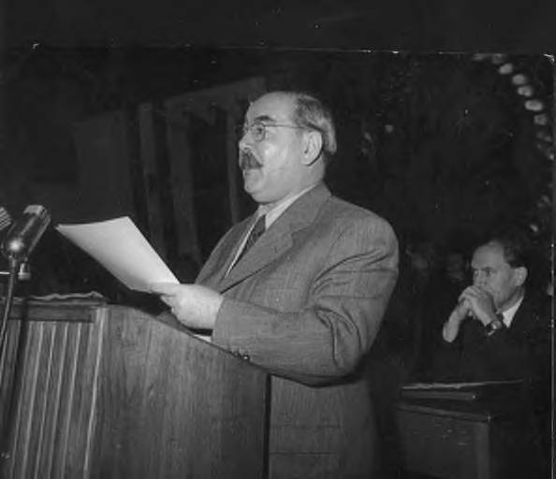
Upheaval in Eastern Europe
Hungarians encouraged by success in Poland topple Stalin’s statue & call for reforms
Imry Nagy (1896-1958) reform minded leader came to power & declared Hungary free, November 1, 1956-promised a free election & other reforms
Soviets became alarmed-Warsaw Pact troops invaded Budapest 11/3/56
Notes:
Top Imry Nagy
Bottom Hungarian Revolutionaries in action early November

Slide 9
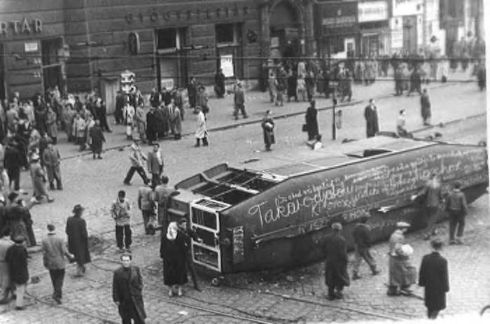
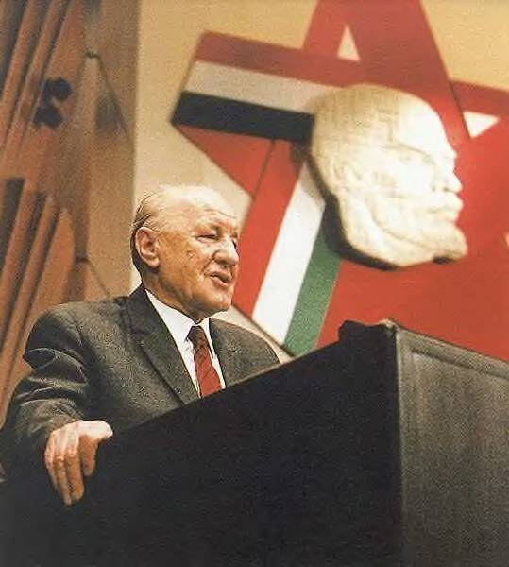
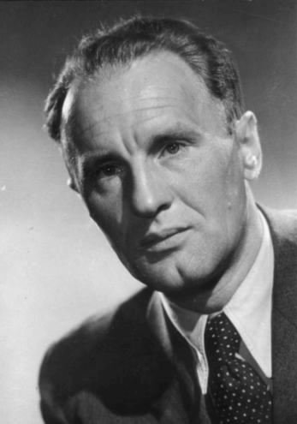
Upheaval in Eastern Europe
Janos Kadar was installed by the Soviets & ruled for the next 30 years.
Ironically-much of the reform proposed by Nagy was gradually carried out by Kadar.
Hungary developed “Goulash Communism” a blend of a market-consumer economy & communism
Notes:
Top Budapest in the aftermath of the Revolution
Bottom Janos Kadar when he first came to power & in old age.

Slide 10
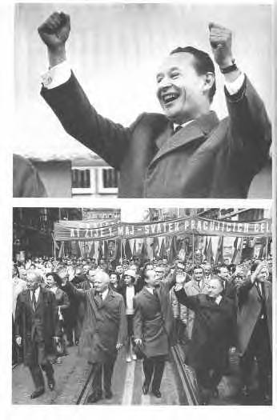
Upheaval in Eastern Europe
Brezhnev Doctrine-Soviets reserved the right to intervene wherever socialism was threatened.
Czechoslovakia-spring of 1968 Alexander Dubcek (1921-1992), proposed “socialism with a human face”
  Curbed police repression
  Allowed freedom of the press
  Legalized other political parties
  Neutrality & withdrawal from Soviet bloc
Notes:
Top Alexander Dubcek replacing Stalinist Novotny
Alexander Dubcek and other party officials in a parade

Slide 11
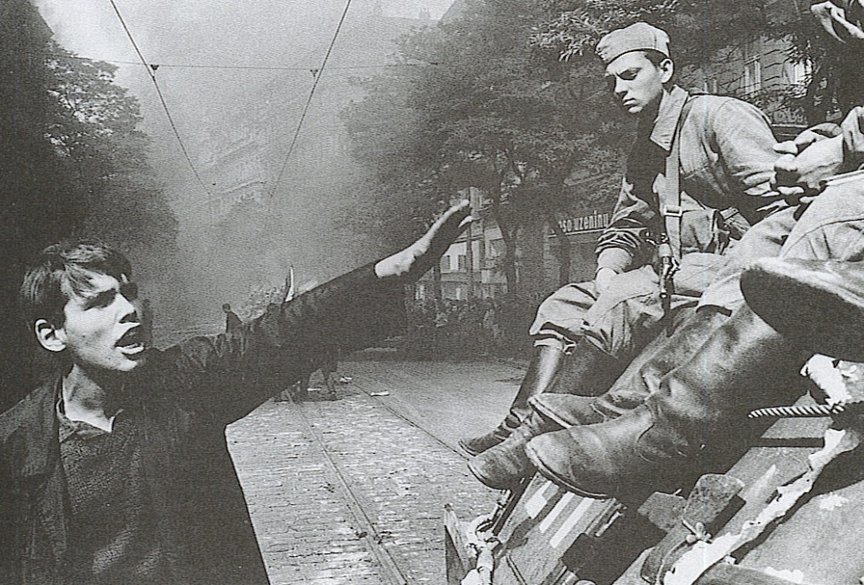
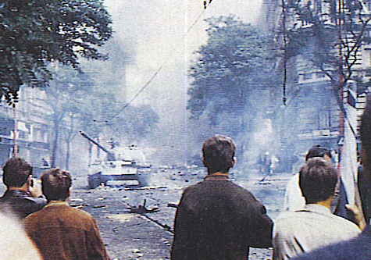
Upheaval in Eastern Europe
Brezhnev and the Politburo were threatened by “Prague Spring” as the reforms were called.
In August 1968 the Warsaw Pact invaded Czechoslovakia and Dubcek was imprisoned and replaced by Gustav Husak (1913-1991).
Notes:
August 20th 1968 a young Czech protests the presence of Soviet tanks in Prague
Czech youth watch as Soviet tanks patrol the streets of Prague

Slide 12
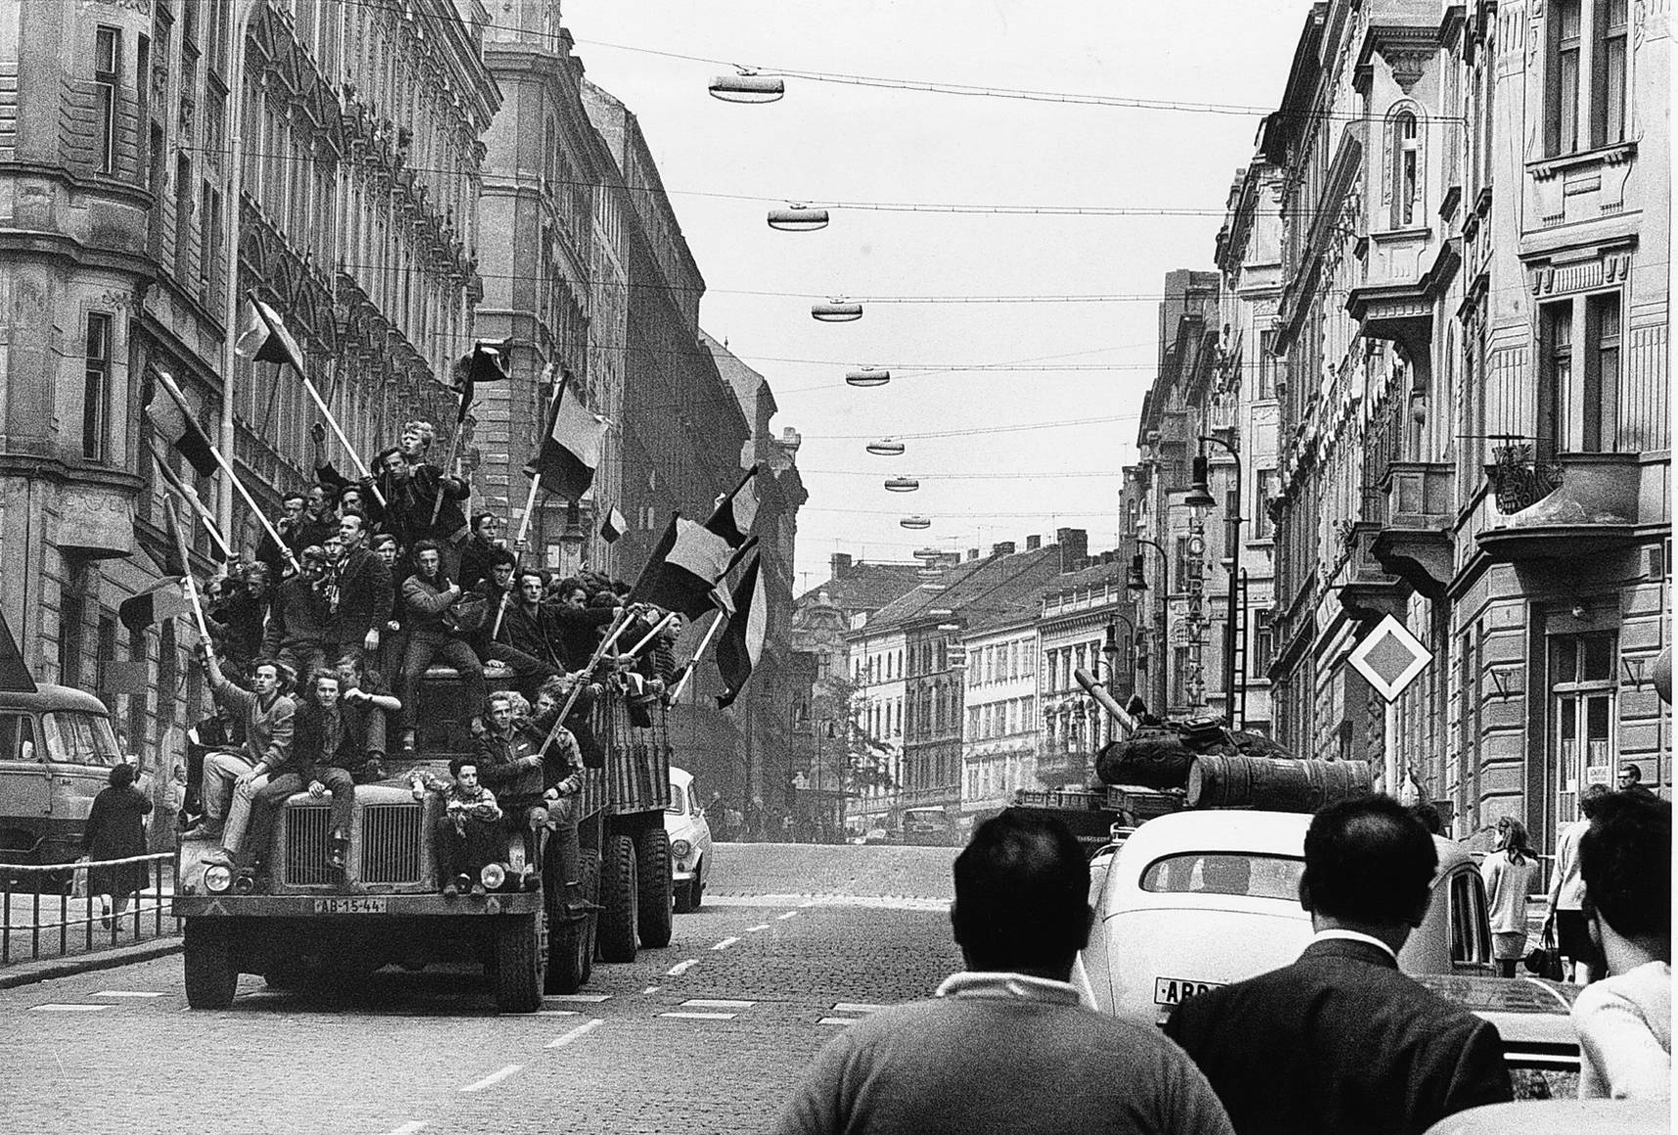
In the summer of 1968, Soviet tanks rolled into Czechoslovakia, ending that country’s experiment in liberalized communism. This picture shows defiant flag-waving Czechs on a truck rolling past a Soviet tank in the immediate aftermath of the invasion.

Slide 13
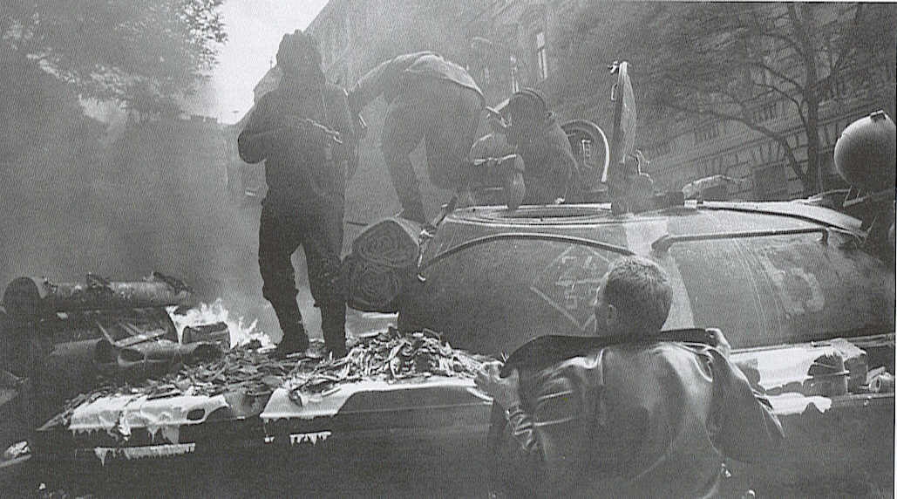
A Soviet tank crewman holds a rifle on a young Czech student demonstrator who holds a sign. Armed resistance was futile and generally avoided by the Czechs and Slovaks

Slide 14
Western Europe: The Revival of Democracy and the Economy
Women pushed out of jobs as soldiers came home.
Most rejected Communism, but feared dependence on US (memories of stock market crash)
Britain, France & Italy: heavy industry was nationalized & extensive economic planning, govt. intervention, social services created the “Welfare State”
From 1948 to 1974 unprecedented economic growth.
Marshall Plan accelerated Western European & world market growth-the US benefited the most.

Slide 15


West Germany
Nuremberg War Crimes Trial of 22 top Nazis & denazification took place.
Konrad Adenauer (1876-1967) leader of Christian Democrats, was Chancellor for 14 yrs.
Wirtschaftswunder “Economic miracle” by ‘58 Germany was the leading economic power-guest workers from Turkey, etc.
Notes:
West Germany had 75% of population & 52% of the land, but it already exceeded all of prewar Germany in economic productivity.
The economic miracle was largely guided by Adenauer’s finance minister Ludwig Erhard, who served as Chancellor after Adenauer

Slide 16
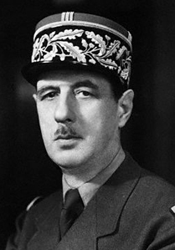

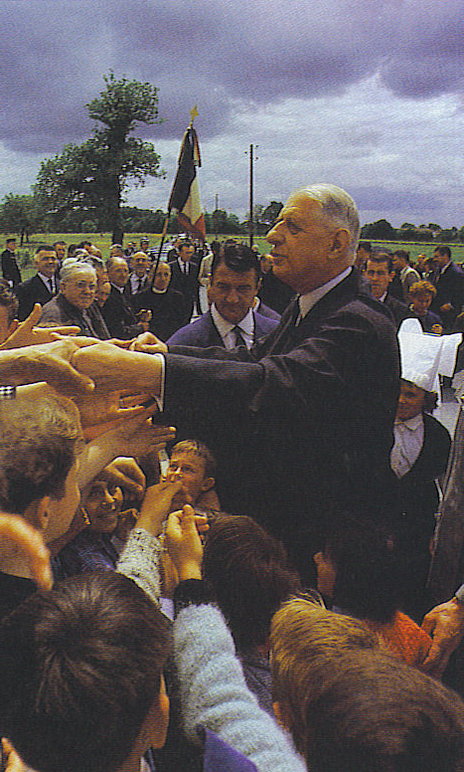
France
Charles de Gaulle (1890-1970) provisional president-symbol of resistance-Petain & Laval tried for collaboration-debated for years & divided the nation.
1946-1958 Fourth Republic had 28 cabinets-no stability
Algerian Crisis & Indochina Crisis ended Fourth Republic
De Gaulle demanded a stronger presidency-Fifth Republic-he solved Algerian Crisis
Notes:
President under the 5th Republic had the power to dissolve Parliament, choose the Prime Minister and supervise the defense and foreign policy

Slide 17
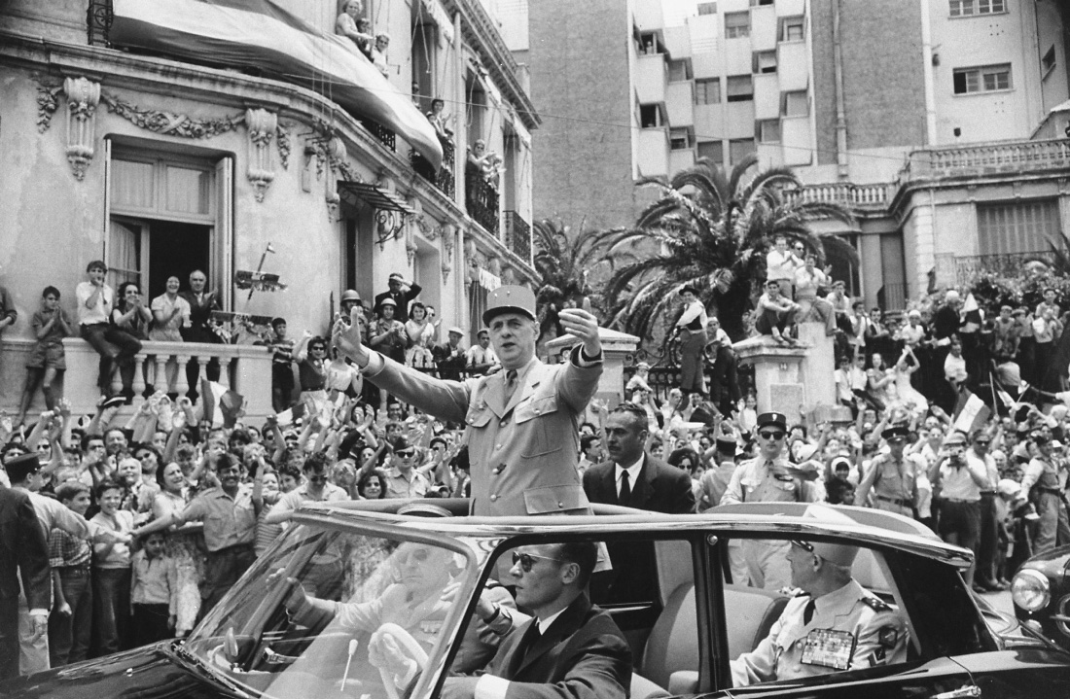
In 1959, Charles De Gaulle as President of the French Republic visited Algiers to great acclaim from its European inhabitants, known as colons. By 1962, however, he had sponsored a referendum that led to Algerian independence and the flight of most of those people.

Slide 18
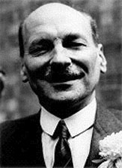
Great Britain: The Welfare State
Labour leader Clement Atlee (1883-1967), replaced Churchill
Labour nationalized the Bank of England, Coal, Electricity, Gas, Iron & Steel works-4/5 of industry was still in private hands
National Insurance Act & National Health Service Act 1946-comprehensive pension plan & national socialized medicine
Notes:
Photo at right Clement Atlee

Slide 19
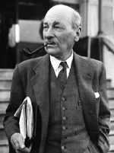
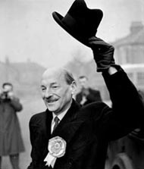
Great Britain: The Welfare State
Britain’s mixed economy welfare state grew more slowly than the rest of Europe.
Demands of British labor unions outstripped productivity
Unwillingness to adopt new technologies or to update machinery.
Loss of empire & trouble in Ulster (Northern Ireland)

Slide 20
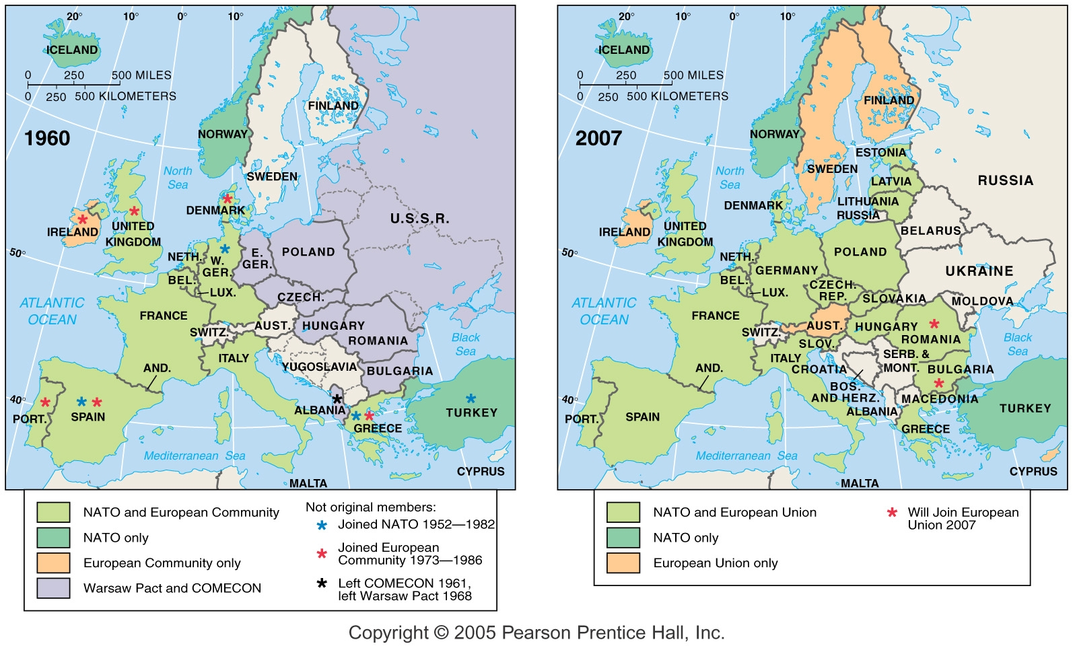
  The European Coal and Steel Community evolved into the European Economic Community (Common Market) which later became the European Union

Slide 21
Italian Republic
1946 elections-monarchy was dropped-new constitution created democratic republic with a ceremonial president & a cabinet government with legislative supremacy
Alcide de Gaspari (1881-1954) served as the first Prime Minister from the Christian Democratic Party.
Upper and middle class as well as southern peasants supported the Christian Democrats who were strongly allied with the Roman Catholic Church.
Much political instability, with average cabinet lasting 7 months
Eurocommunism-Italy’s communist party was the 2nd largest party-US was worried-helped the CDP stop the rise of communism.
Genoa, Milan & Turin the industrial triangle-also an economic miracle-except for the south that remained poor.

