Slide 1
WE THE PEOPLE
Aim: How does the Preamble to the Constitution Provide a framework for the meaning of the law of the United States?
Do Now: Write one sentence on the index card that the words “We the People” means to you? Include your name

Slide 2


Slide 3
The Preamble
We the People of the United States…
This gives the Power for the Government directly to the people.
Notes:
During Reading: Think aloud need questions and answers for what you are thinking.

Slide 4
The Preamble
…in Order to form a more perfect Union…
This says that
the union before
was not perfect (meaning the Articles of Confederation) & this union will be much better.

Slide 5
The Preamble
…. establish Justice, insure domestic Tranquility...
There will be justice for the people, and peace among the people

Slide 6
The Preamble
We the People of the United States, in Order to form a more perfect Union, establish Justice, insure domestic Tranquility… provide for the common defense…, promote the general Welfare, and secure the Blessings of Liberty to ourselves and our Posterity, do ordain and establish this Constitution for the United States of America.
The government
will protect the
people

Slide 7
The Preamble
We the People of the United States, in Order to form a more perfect Union, establish Justice, insure domestic Tranquility, provide for the common defense… …promote the general Welfare…, and secure the Blessings of Liberty to ourselves and our Posterity, do ordain and establish this Constitution for the United States of America.
The government
will do its best to
help the people

Slide 8
The Preamble
We the People of the United States, in Order to form a more perfect Union, establish Justice, insure domestic Tranquility, provide for the common defense, promote the general Welfare, …and secure the Blessings of Liberty to ourselves and our Posterity…, do ordain and establish this Constitution for the United States of America.
Secure rights for the
People and continue to do so for the future

Slide 9
The Preamble
We the People of the United States, in Order to form a more perfect Union, establish Justice, insure domestic Tranquility, provide for the common defense, promote the general Welfare, and secure the Blessings of Liberty to ourselves and our Posterity, …do ordain and establish this Constitution for the United States of America.
Makes this
Constitution
The law of the land.

Slide 10
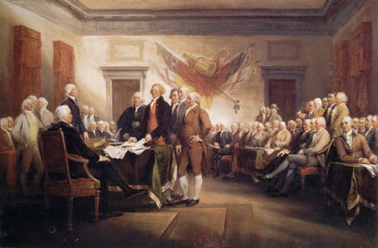
U.S. Constitution
1) The first three words of the U.S. Constitution are: WE THE PEOPLE?
a) True b) False
2) The Preamble is named “Preamble”
in the U.S. Constitution?
a) True b) False
3) The Preamble gives all of the power for governing to the states?
a) True b) False
4) The Preamble calls for a “more Perfect Union” ?
a) True b) False

Slide 11
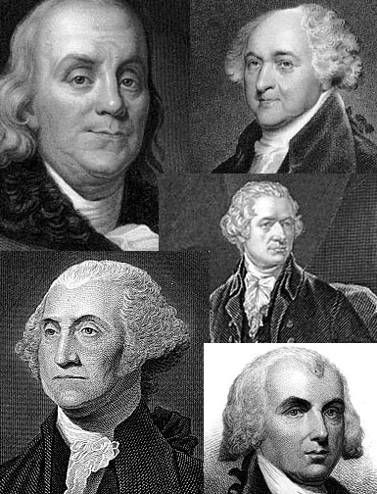
U.S. Constitution
5) The Preamble calls for the establishment of Justice?
a) True b) False
6) “Domestic Tranquility” means peace at home?
a) True b) False
7) The Preamble calls for each state government to protect its people from foreign countries?
a) True b) False

Slide 12
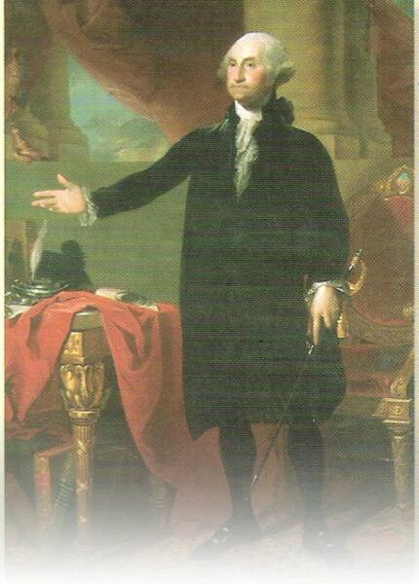
U.S. Constitution
8) The Preamble explains that the new government will have (3) three branches of government?
a) True b) False
9) “Blessings of Liberty” means Rights?
a) True b) False
10) “Posterity” means law of the land?
a) True b) False

