Slide 1
Europe Before and After the Cold War

Slide 2
Problems faced by USSR after WWII

Slide 3
Division of Europe
Superpowers= USA and USSR
Cold War- Post WWII tension/hostility between the superpowers
  No actual fighting
The US
  Avoided destruction of war
  Had use of atomic weapons

Slide 4
USSR
Suffered most of all countries
Puppet govts. established by force to protect Western frontiers (Buffer Zone)
“Satellites”- Poland, Czech., Hungary, Romania, Bulgaria (Bloc countries)
Albania and Yugoslavia- Communist
  Part of Soviet Bloc

Slide 5
USSR
Potsdam ignored- no free elections
  Truman upset
Buffer added 100 million communists
Bomb- people re-evaluate destruction of war
  Desire to avoid war

Slide 6
The United Nations

Slide 7
United Nations
April 1945 50 countries met
Charter and purpose developed
  Save future from war
  Promote national self-determination
  Promote respect for human rights
  Help nations solve problems
Headquarters- New York City

Slide 8
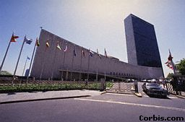
UN Headquarters

Slide 9
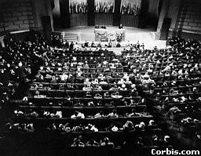
UN Conference

Slide 10
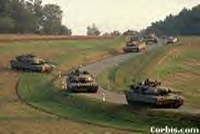
UN Practice

Slide 11
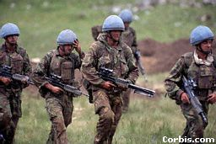
UN Troops in Bosnia

Slide 12
General Assembly
One vote per member
Develop solutions to problems
Choose people/nations to serve on other UN bodies

Slide 13
Security Council
Deal with international conflict
Bar trade
Send troops to keep peace
Permanent members
  Allies of WWII
  All must approve Council decisions
10 other members (2 year terms)

Slide 14
Other UN Bodies
International Court of Justice
  International law
Secretariat
  head- Secretary General
  Organize daily business

Slide 15
Advantages Over League
No major power refused to join
UN peace keeping force
  Armed group to enforce decisions

Slide 16
Overall…
UN more effective socially, economically not politically
1948 Universal Declaration of Human Rights-
  Protect from oppression
  Preservation of rights

Slide 17
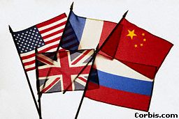
UN Security Council

Slide 18
Political/ Economic Models

Slide 19
 | Demo/Cap | Demo/Soc | Com/Soc
Politics | Rep. Demo. | Rep. Demo. | Total Control
Econ. | Market | Mixed | Comm-and
Social Policy | Little Govt. | Govt. support | Party runs

Slide 20
USSR

Slide 21
A Quick Review
March 1917- Nicholas II forced to abdicate
Provisional govt. under Kerensky
  Petrograd Soviet (Bolsheviks)- holds popular support
November 1917- Bolshevik/Communist Revolution
Civil War (Dec. 1917 – Nov. 1920)
  Whites- Czarists, West
  Red- Communists
  Greens- Ukrainian Peasants

Slide 22
USSR
1923 Lenin rename Russia the Union of Soviet Socialist Republics or the Soviet Union
Why: Address internal international nationalities question
  Threat of too many nationalities wanting to break away/self determination
Each republic is given its own constitution (all the same though)

Slide 23
Lenin & Economics
War Communism- Used in Civil War
  Banks, transportation, heavy industry confiscated & run by Bolsheviks
  Grain seized from peasants to feed Red Army & cities
Krondstat Rebellion- result of increased central party bureaucracy

Slide 24
Lenin & Economics
New Economic Policy (NEP)-
  Why: Retreat from War Communism
  Private economic enterprise in industries not of commanding importance
  Peasants could farm for profit- sell excess grain on open market
  Result: Successful in achieving stability
  Problem: No consumer goods for peasants

Slide 25
Stalin & Economics
Collectivization 1928- Small farms combined to create large state-run farms
  Why: Easier to modernize, produce enough grain for food and export, & free up peasants labor for factories
  Problem: Peasant resist and slaughter cattle & horses
  Result: 10 million peasants killed
  Millions shipped to collective farms & gulags (forced labor camps)

Slide 26
Stalin & Economics
First Five Year Plan (1928 – 1933)
  Goal: Double overall Soviet production
  Basic industry to grow 300%
  Electrification to grow 500%
  Factories had set quotas
  Problem: bad RR system kept materials from factories
  Result: Overall output more than doubles

Slide 27
Stalin & Economics
Second Five Year Plan (1933 – 1937)
  Goal: Shift to more balanced development of economy
  Creation of consumer goods
  Problem: War preparation brought economic stress on heavy industry

Slide 28
Stalin & Great Purges
Start: Stalin had secret police kill Kirov (gaining popular support)
  People told he was assassinated by Communist opposition
Millions killed- including leadership of Communist Party, the “Old Right” (Ex. Bukharin)
Goal: Eliminate all possible opposition to Stalin

Slide 29
The Secret Police
Secret police of czarist Russia continued under Communists
Lenin- starts Cheka
  Goal: repression of all dissident
Stalin: starts the GPU then the NKVD
  Goal: repression of all dissident
  Quotas, goals given to local units

Slide 30
USSR
20 million killed in WWII
Farming, industry destroyed
“Great Fatherland War”
Stalin rules as nationalist leader
  Not totalitarian Isolates USSR from West
Second Five Year Plan- rebuild industry (Superpower status)
  Resources from E. Europe

Slide 31
Khrushchev
“Thaw” dictatorship relaxed
Political controls loosened
1956 “Secret Speech” denounces Stalin
  Stalin’s brutality revealed
  Poland Revolts (peaceful compromise)
  Hungary Revolts (bloody repression)
  De-Stalinization
Cuban Missile Crisis- prestige falls, fired 1964

Slide 32
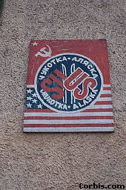
USA
USSR
Friendship

Slide 33
Brezhnev- at home
Believed “thaw” weakened Party’s power
  Restricted personal freedom
  Restored centralized planning
  Nuclear build-up (= the US)
Mid 1970’s standard of living up
Technology and communication lead to open opposition with West

Slide 34
Brezhnev- abroad
Détente- relaxation of tension
  Work for peace with US & W. Europe
  Trade promoted
1968 Liberal Socialist govt. in Czech crushed
Brezhnev Doctrine- Soviets will prevent the fall of communist govts.
1979- Afghanistan invaded

Slide 35
Dissidents
Opponents of the govt.
Cause: respect for basic rights and freedom
Actions: public protests, underground press
Consequences: prison, mental hospitals

Slide 36
Truman Doctrine
&
Marshall Plan

Slide 37
Relationships Worsen
“Iron Curtain”- Churchill
  Political barrier between West and Bloc
Greece and Turkey fall to Communism

Slide 38
Truman Doctrine March 1947
Containment of communism
  GB could no longer help Greece & Turkey resist Soviets
$400 million- econ & military aid
  Support for those “resisting subjugation” – short of war
US not overthrow existing Communist regimes

Slide 39
Marshall Plan 1947- US supervised
Econ response to Containment
US gives Western Europe $13 billion to rebuild
Increase industrial output and standard of living
US benefited- increased exports

Slide 40
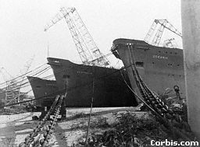
Marshall Plan at Work

Slide 41
Iron Curtain

Slide 42
Iron Curtain
Free elections disallowed by Stalin
1948 Communist govts.- Albania, Bulgaria, Romania, Poland, Hungary, Czechoslovakia
  Soviet satellites
  Policies dictated/influenced by Soviets

Slide 43
Soviet Response
Stalin forbids satellites to take Marshall Plan money
USSR offers COMECON
  Council for Mutual Economic Assistance
  Marshall Plan for Bloc
Yugoslavia’s Tito refuses to cooperate with Stalin
  Kicked out of Bloc, becomes “nonaligned”- neutral

Slide 44
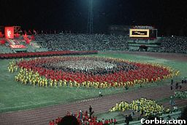
Tito's Birthday

Slide 45
Crisis in Germany
1948 East and West Germany in direct conflict
West Germany held by: US, GB, France
East Germany held by: USSR
Countries could not agree on how to rule Germany
Spring 1948- US, GB, France combine areas

Slide 46
Berlin Airlift
Stalin responds by blockading Berlin
  June 24, 1948- all roads, RRs, waterways linking West Berlin from Western zone blocked
US, GB- use cargo planes to fly in 2 million tons of supplies
May 1949- Blockade ended when Stalin gave up

Slide 47
A Divided Germany
Germany was the center of Cold War tension
West creates: Federal Republic of Germany (Parliamentary democracy)
Soviets create: German Democratic Republic (Communist regime)

Slide 48
NATO
April 1949
North Atlantic Treaty Organization
Mutual defense pact (west)
Attack on one member, attack against all
US keeps nuclear weapons in Europe

Slide 49
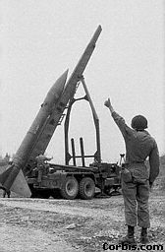
NATO
1957

Slide 50
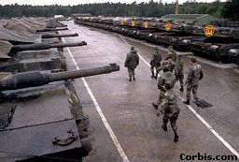
NATO Tanks

Slide 51
Warsaw Pact
1955
Mutual defense pact (eastern European countries, NO Yugoslavia)
Soviet troops kept in all member countries
Soviet commander in Moscow ran pact armies

Slide 52
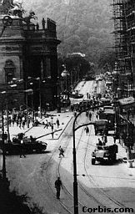
Warsaw Pact in Action

Slide 53
The Arms Race
Fall 1949- Soviets have atomic bomb
US and USSR begin building weapons
  Deterrence: build up of weapons to discourage conflict
1952 US explodes first hydrogen bomb
1957 USSR- first intercontinental ballistic missiles

Slide 54
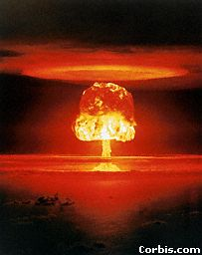
Bikini Atoll

Slide 55
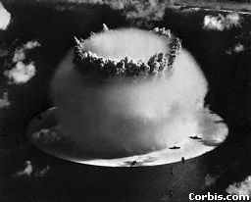

Bikini Atoll

Slide 56
Space Race
1957 Soviets launch “Sputnik”
  US forced to keep up with Soviets
1959 Soviets launched first space ship to land on moon
1961- Alan Shepard is the first US astronaut to go to space
July 20, 1969- Neil Armstrong and Edwin Aldrin are the first persons to land on the moon

Slide 57
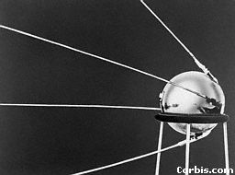
Sputnik

Slide 58
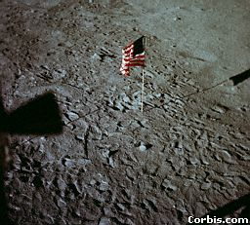
Apollo 11 1969

Slide 59
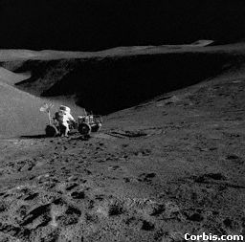
Apollo 15

Slide 60
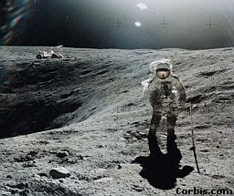
Apollo 16 1972

Slide 61
“Peaceful Coexistence”
Stalin dies 1953- Nikita Khrushchev succeeds
Khrushchev broke from Stalin’s position
  War between Capitalism and Socialism is inevitable
Superpowers meet to discuss arms control

Slide 62
The Meetings
Antarctic Treaty- US and USSR meet and decide to ban military activity
  Talk of peaceful use of outer space
1959 VP Nixon meets with Khrushchev in Moscow
1959 Khrushchev first Soviet leader to visit US
1960 meeting between Khrushchev and Eisenhower cancelled
  Soviets shot down US spy plane (U-2)

Slide 63
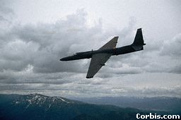
U-2

Slide 64
Cuban Missile Crisis
Oct. 1962
After communist revolution in Cuba- Soviets ship nuclear armed missiles to Cuba
US caught when intelligence flights see launching sites
JFK demands Soviets remove missiles and blockades Cuba
A few days later Khrushchev removes missiles

Slide 65
Marshall Plan Not Enough
Limited resources
1951 Schuman Plan- pool supplies to speed up reconstruction
1956 European Economic Community (Common Market)- eliminated tariffs, improves transportation
1967- Common Market becomes European Community (EC)

Slide 66
Eastern Europe
Under Soviet control
Followed same policies as USSR
  Collectivized farms
  5 Year Plans
Economies designed to benefit the USSR

Slide 67
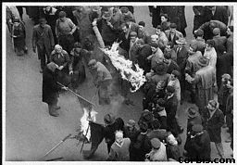
Hungary 1956

Slide 68
Hungary- Early Revolts
People join in Budapest uprising in Oct. 1956
  Get Soviets out of Hungary
Imre Nagy (liberal Communist) brought back to power by the people
  Free elections,Soviet troops out,no Warsaw Pact
Nov. 4- 2,000 Soviet troops sent to Budapest
  Soviets held off 10 days No help from West
  Soviets install Janos Kadar, Nagy executed
UN could do nothing- Security Council

Slide 69
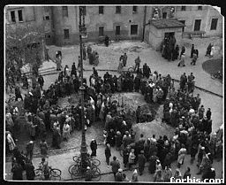
Hungary 1956

Slide 70
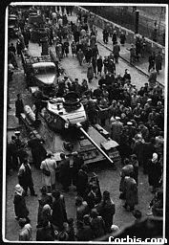
Hungary
1956

Slide 71
East Germany
Aug. 1961 East Germany builds Berlin Wall
Why? People were fleeing west
  12 feet high, 28 miles long
  Concrete, barbed wire, mines, guards
Symbolized the contrast between the West’s freedom and the East’s repression

Slide 72
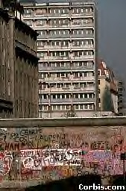
The
Berlin
Wall

Slide 73
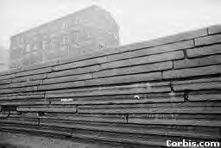
The Berlin Wall

Slide 74
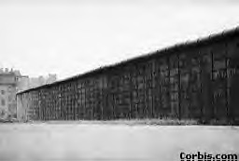
The Wall

Slide 75
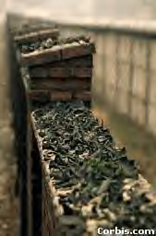
The
Wall

Slide 76
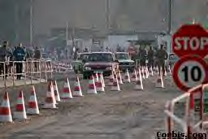
Checkpoint Charlie

Slide 77
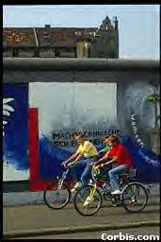
The
Wall

Slide 78
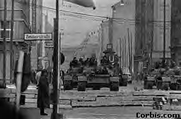
Soviet Tanks at Wall

Slide 79
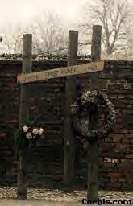
Wall
Memorial

Slide 80
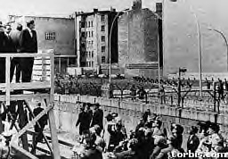
JFK at Wall

Slide 81
East Germany
1970’s standard of living improving
  Strongest economy in E. Europe
Communist ruler: Erich Honecker
  Stasi- secret police
  Dissent not tolerated

Slide 82
Czechoslovakia- Early Revolt
Alexander Dubcek loosens govt. controls
  Greater freedom of expression
  “Socialism w/ a human face”
  Prague Spring- reforms alarm Soviets
1968 Soviets invade and crush all dissent
  Warsaw Pact invades
Pro-Soviet leader replaces Dubcek
  Strictest govt. in E. Europe

Slide 83
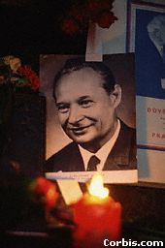

Dubcek

Slide 84
Poland- Early Revolts
Workers riot in June 1956
  “bread and liberty”
Khrushchev- Wladislaw Gomulka (pro-Soviet leader)
  Broke up collective farms
  Relaxed govt. control over industry, Church
  Govt. becomes restrictive

Slide 85
Solidarity in Poland
Trade with West develops
1980’s riots and unrest
  food and clothing
Govt. gives into some demands
  Right to strike
  Right to form unions
Solidarity- first labor union in bloc not under govt. control (head= Lech Walesa)

Slide 86
Solidarity in Poland
Demands:
  More workers’ rights
  End to censorship
  Freedom for Catholic Church
  Release of political prisoners
1981- Jaruzelski issues decree for martial law (strict military rule)
  Solidarity banned, leaders imprisoned

