Slide 1
Ancient
Rome
AIM: What is a Republic?
Do Now: Quiz
Mr. Ott – BETA 2010

Slide 2
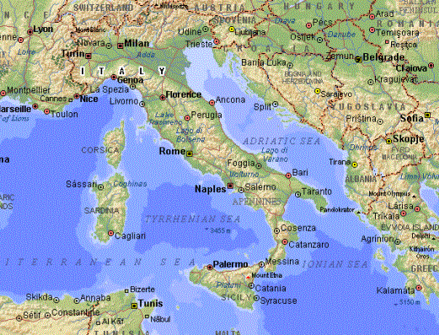
The Geography of Rome

Slide 3
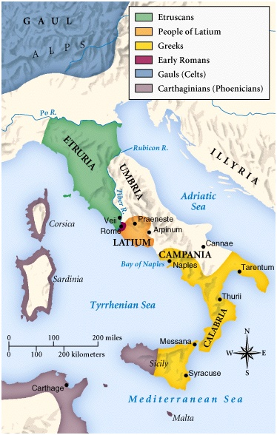
Italy in 750 BCE

Slide 4
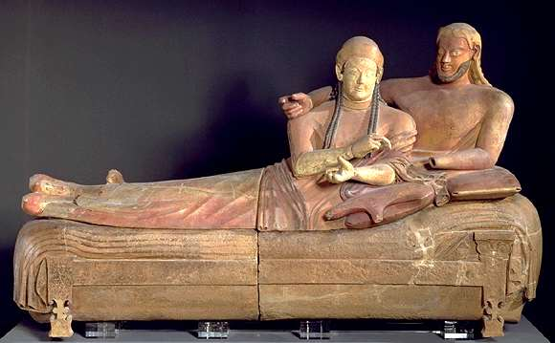
Influence of the Etruscans
Writing
Religion
The Arch

Slide 5
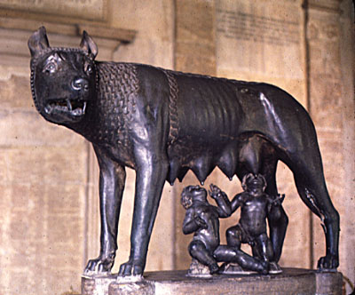
The Mythical Founding of Rome:
Romulus & Remus

Slide 6
The Roman
Republic:
509 BCE - 27 BCE

Slide 7
Republican Government
2 Consuls
(Rulers of Rome)
Senate
(Representative body for patricians)
Patricians are Rich Landowners
Tribal Assembly
(Representative body for plebeians)
Common People of Ancient Rome

Slide 8
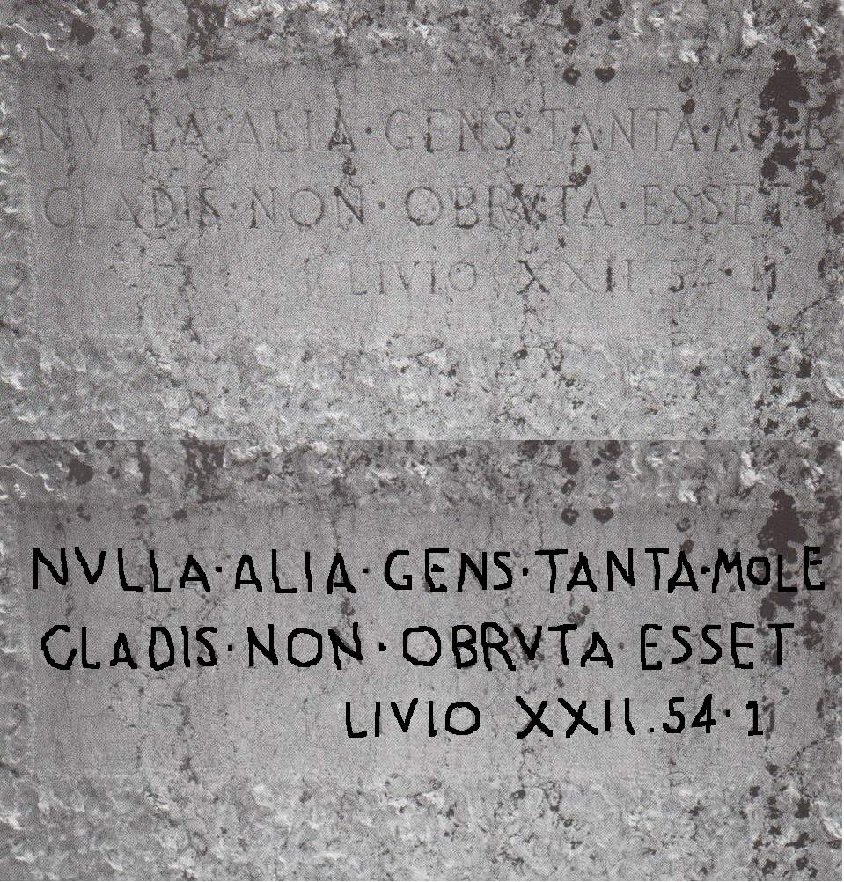
The Twelve Tables, 450 BCE
Providing political and social
rights for the plebeians.

Slide 9
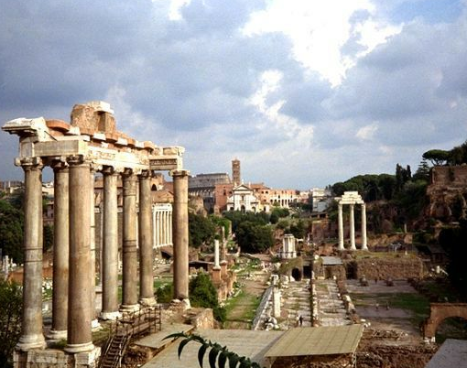
The Roman Forum

Slide 10
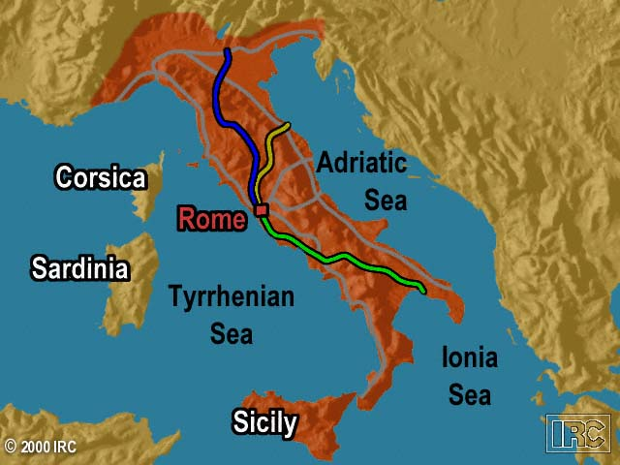
Rome’s Early Road System

Slide 11
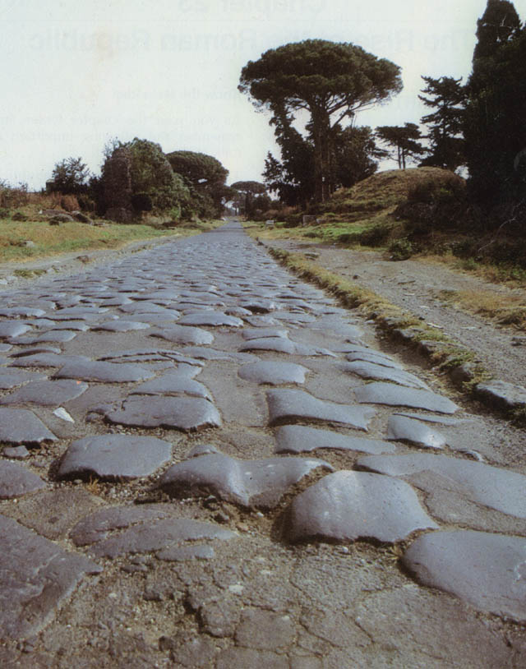
Roman Roads:
The Appian Way

Slide 12
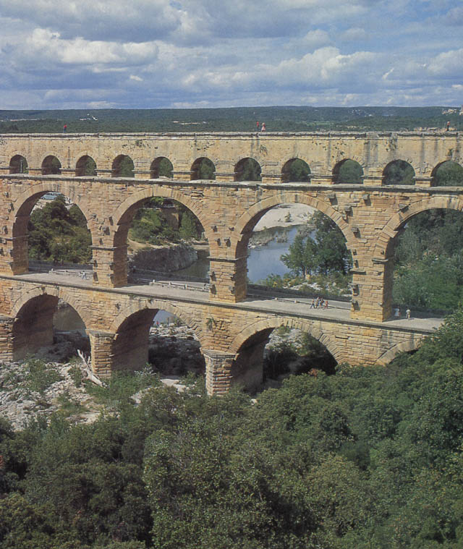
Roman Aqueducts

Slide 13
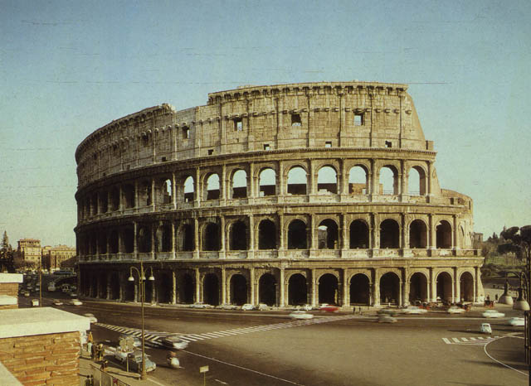
The Roman Colosseum
ca. 70–80 AD

Slide 14
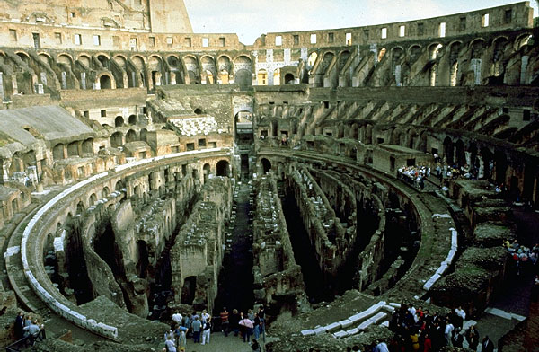
The Colosseum Interior

Slide 15

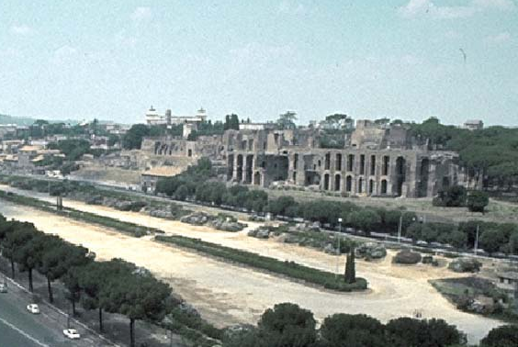
Circus Maximus

Slide 16
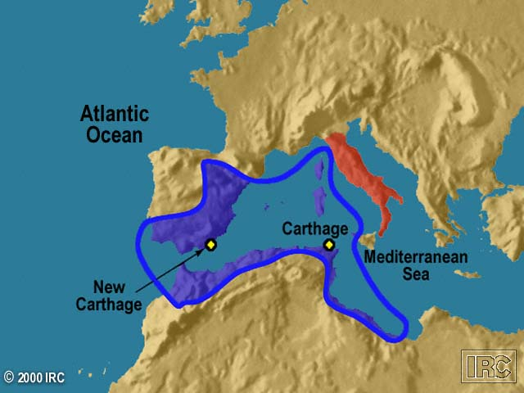
Carthaginian Empire

Slide 17
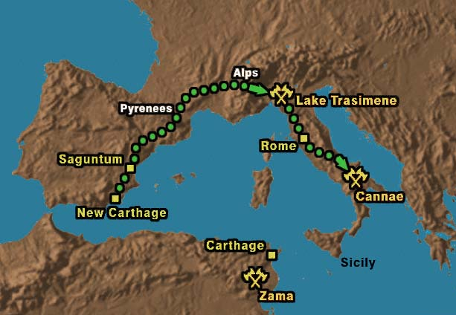
Hannibal’s Route
Punic Wars

Slide 18
Reform Leaders
Tiberius and Gaius Gracchus
  the poor should be given grain and small plots of free land.
Military Reformer
Gaius Marius
  recruited an army from the poor
  and homeless.
  professional standing army.

Slide 19
