Slide 1

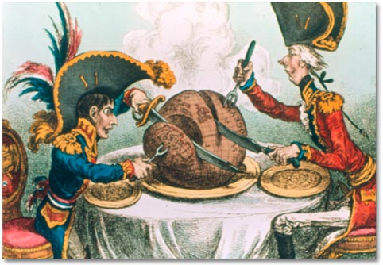
Nationalism
Nations out of Empires
AIM: What is Nationalism and how does it affect societies and countries?
Do Now: Answer in your notebooks:
What was The Congress of Vienna and what was its goals?

Slide 2
What are the Features
of Nationalism?
Collective Pride
in Your Nation
Loyalty to the
nation-state
Attachment to
local traditions
Patriotism
NATIONALISM
A state
of mind
Justifies authority
of the state

Slide 3

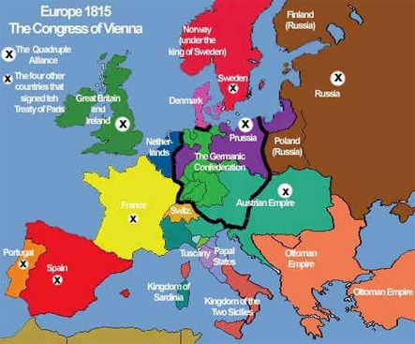

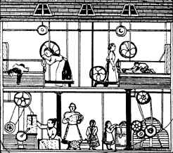
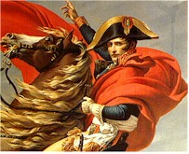
I’ve tasted freedom,
and I want more!
Why did a growing sense of nationalism develop among European peoples in the late 18th and
19th centuries?

Slide 4
Causes
The Enlightenment
Establishes Free Thinking
The Congress of Vienna
Re-establishes Monarchies
The Industrial Revolution
The Rise of the Middle Class
The French Revolution & Napoleonic Wars
Ravaged Europe

