Slide 1
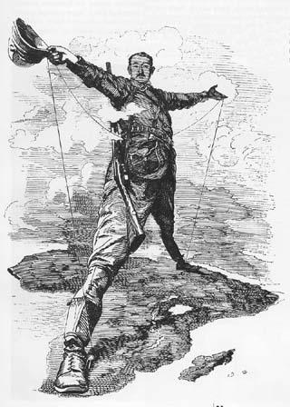
Cartoon
Analysis
AIM: How to do analyze a political cartoon for the NYS Regents Exam?
Do Now: With a partner answer the questions on your worksheet about the political cartoon shown.

Slide 2
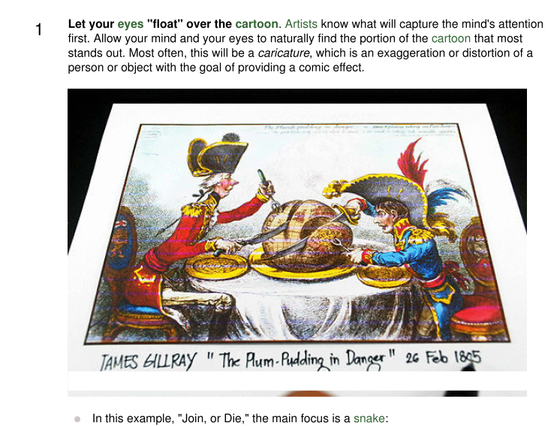
Cartoon Analysis
What is the Action?

Slide 3
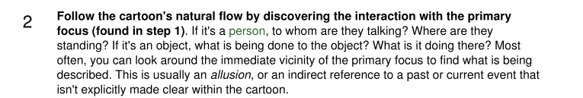
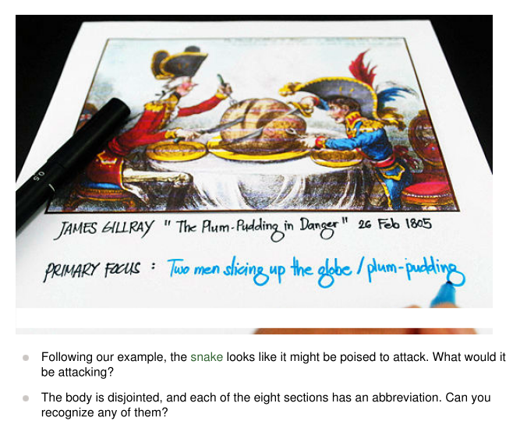
Cartoon Analysis

Slide 4
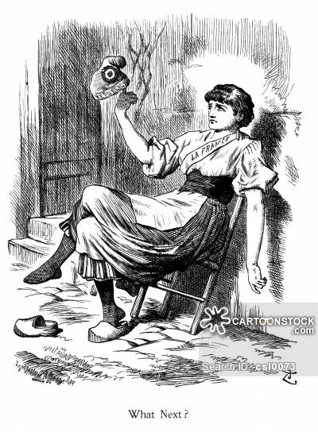
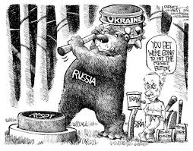
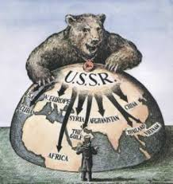
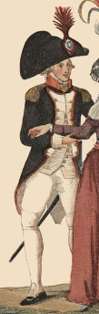
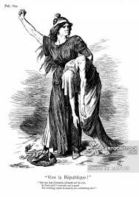
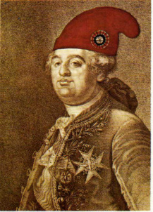
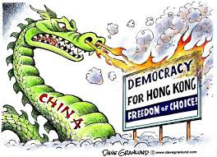
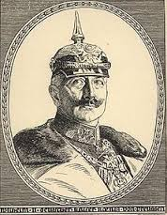
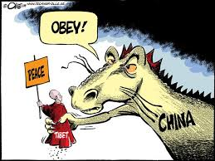
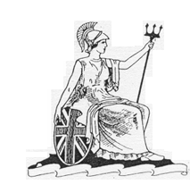
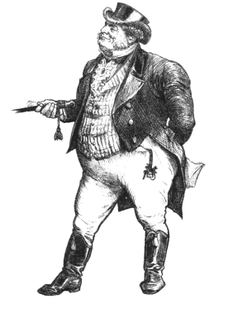

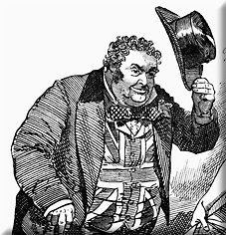

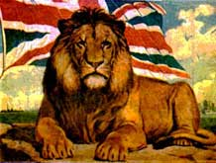
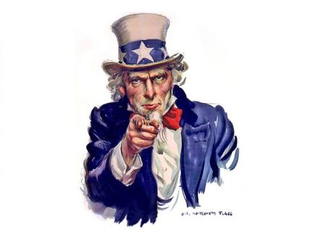
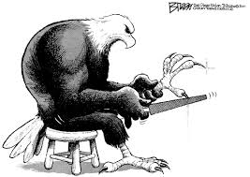
Cartoon Analysis
3
Uncle Sam or an eagle for the United States
John Bull, Britannia or a lion for the United Kingdom
a bear or polar bear for Russia / USSR / Soviet Union
a dragon for China
a sun for Japan
Liberty or French Hat or Napoleon
for France
Kaiser Helmet for Germany

Slide 5

Cartoon Analysis
3
Uncle Sam or an eagle for the United States
John Bull, Britannia or a lion for the United Kingdom
a bear or polar bear for Russia / USSR / Soviet Union
a dragon for China
a sun for Japan
Liberty or French Hat or Napoleon for France
Kaiser Helmet for Germany

Slide 6
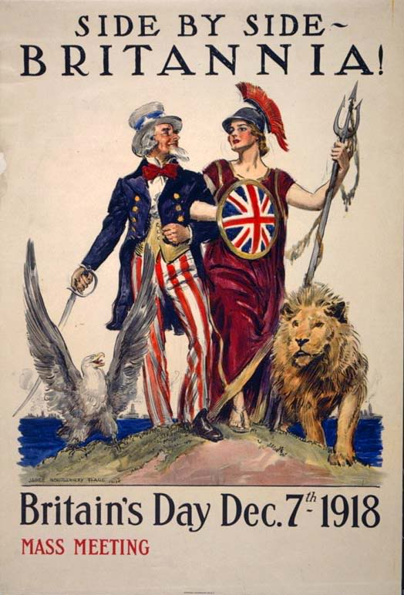
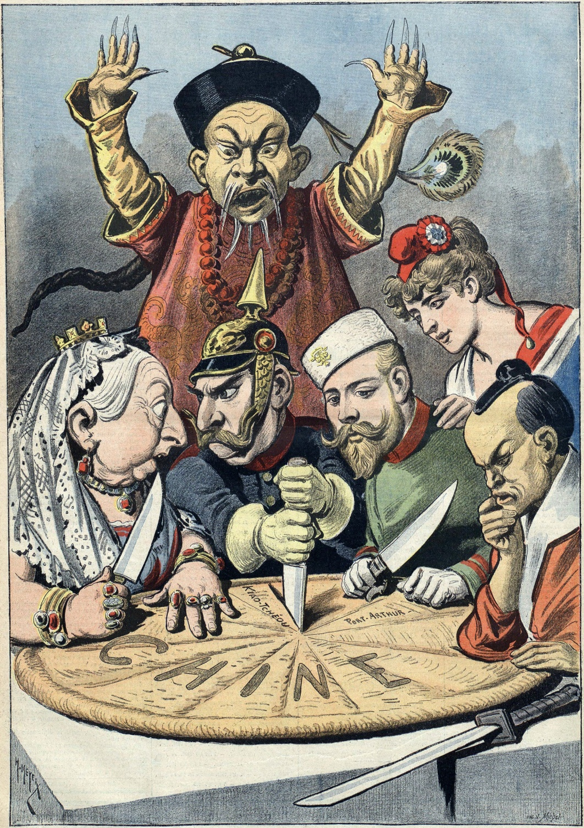
Cartoon Analysis

Slide 7
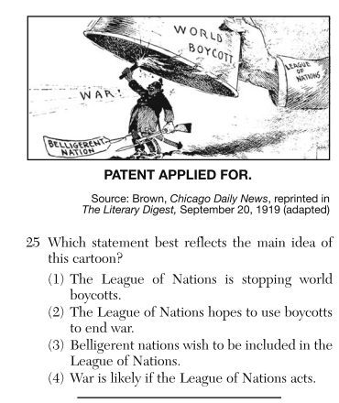

Slide 8
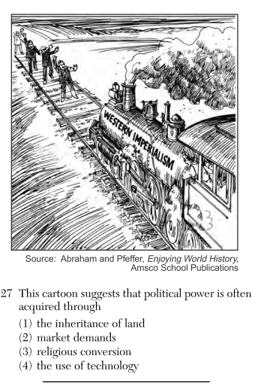

Slide 9
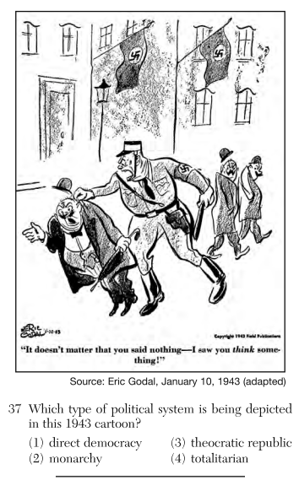

Slide 10
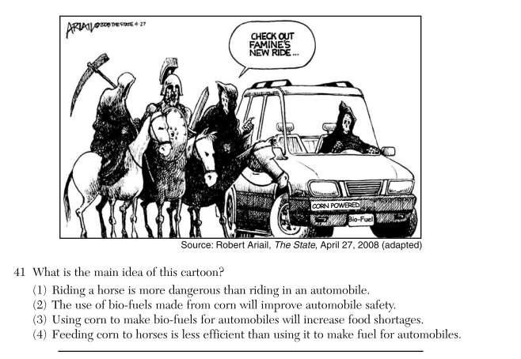

Slide 11
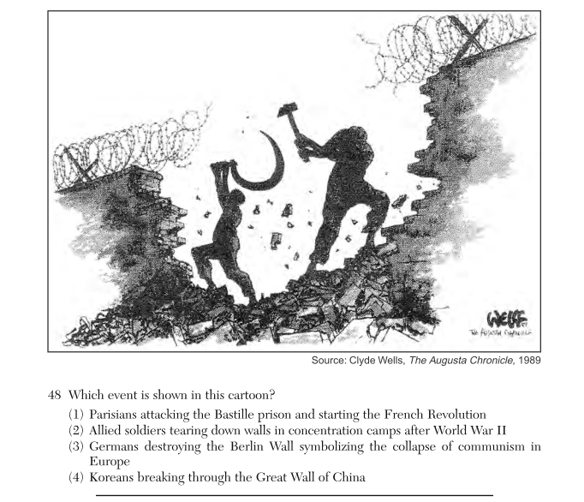

Slide 12
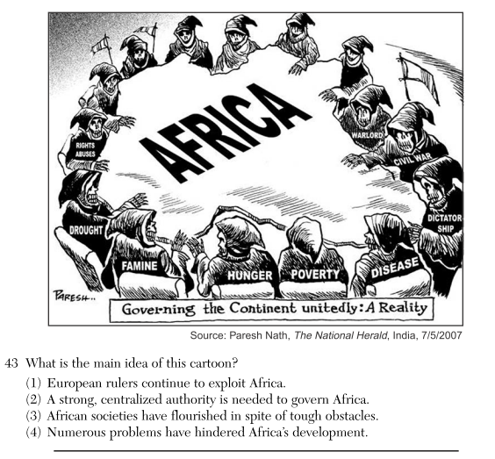

Slide 13
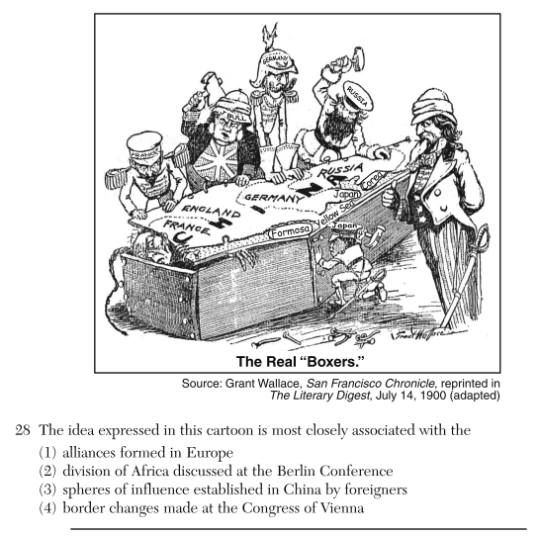

Slide 14
