Slide 1
THE
COLD WAR

Slide 2
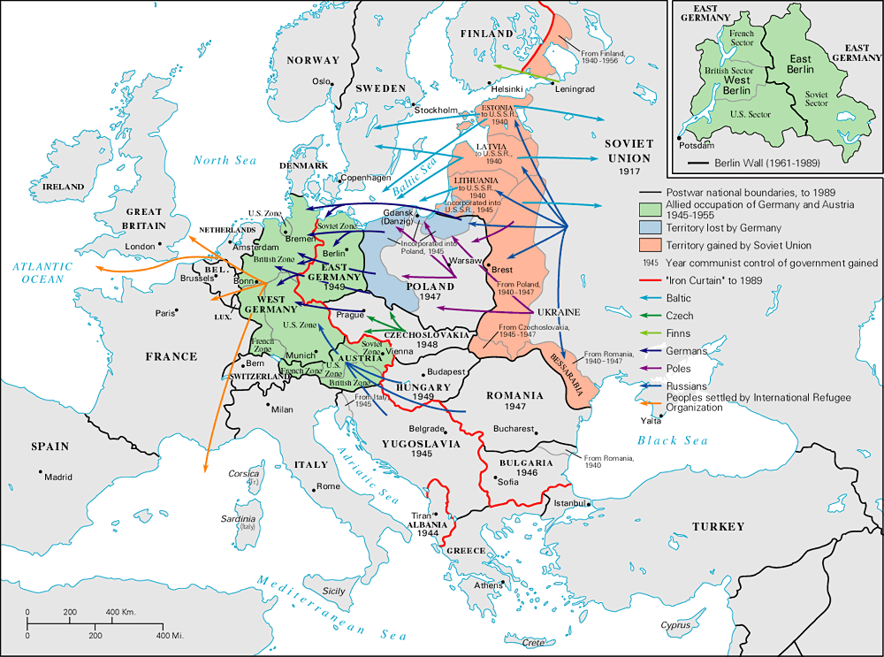
The “Iron Curtain”
From Stettin in the Balkans, to Trieste in the Adriatic, an iron curtain has descended across the Continent. Behind that line lies the ancient capitals of Central and Eastern Europe.
-- Sir Winston Churchill, 1946

Slide 3
The Ideological Struggle
Soviet & Eastern Bloc Nations
[“Iron Curtain”]
US & the
Western Democracies
GOAL → spread world-wide Communism
GOAL → “Containment” of Communism & the eventual collapse of the Communist world.
[George Kennan]
METHODOLOGIES:
Espionage [KGB vs. CIA]
Arms Race [nuclear escalation]
Ideological Competition for the minds and hearts of Third World peoples [Communist govt. & command economy vs. democratic govt. & capitalist economy] → “proxy wars”
Bi-Polarization of Europe [NATO vs. Warsaw Pact]

Slide 4
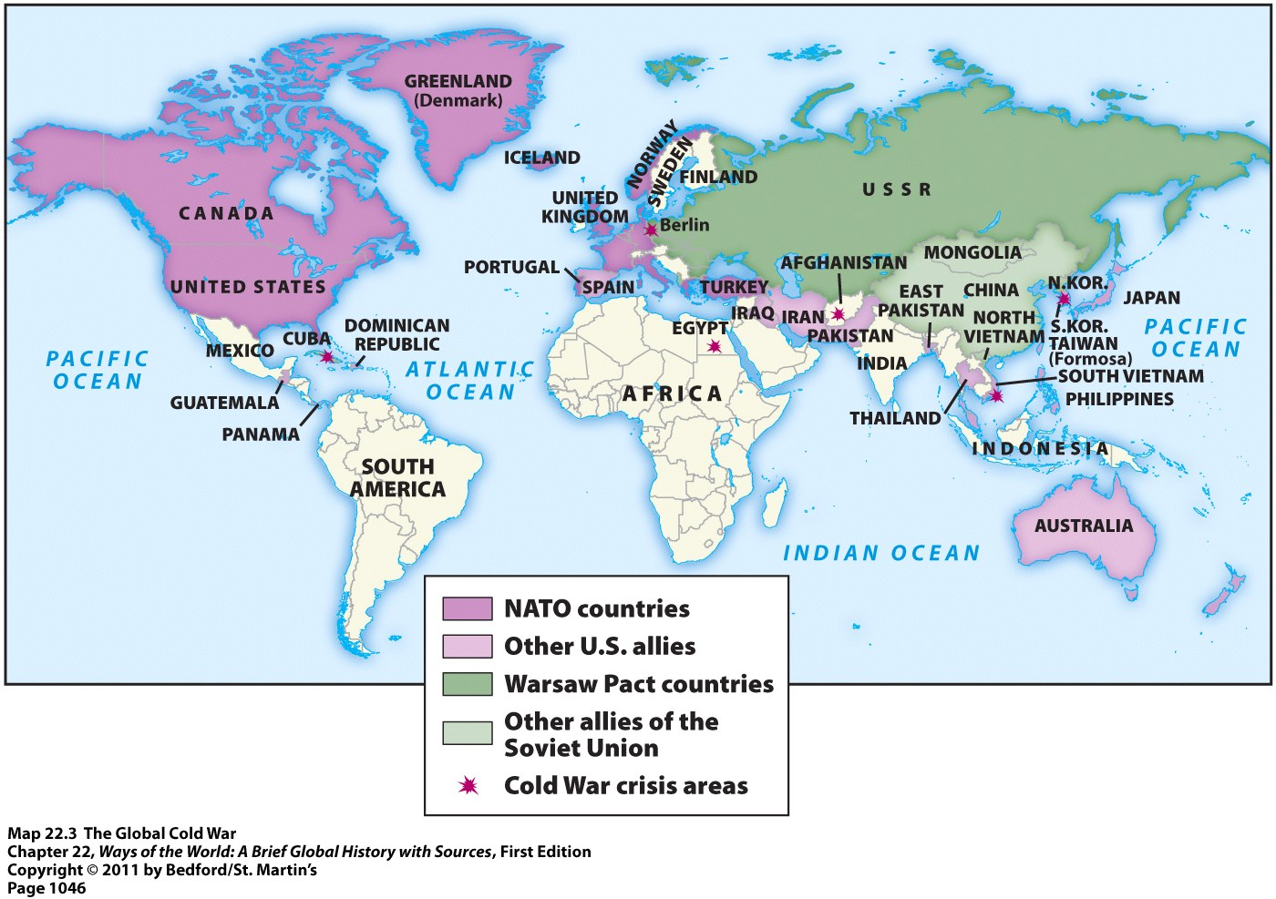

Slide 5
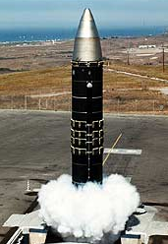

The Arms Race:
A “Missile Gap?”
The Soviet Union exploded its first A-bomb in 1949.
Now there were two nuclear superpowers!

Slide 6
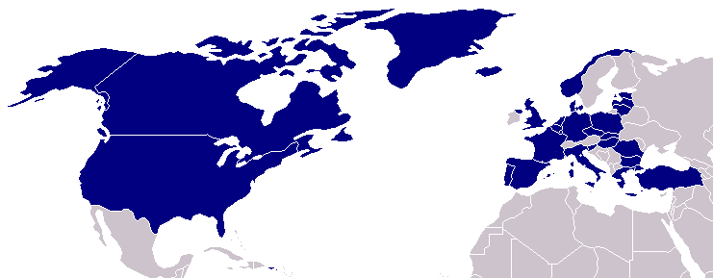
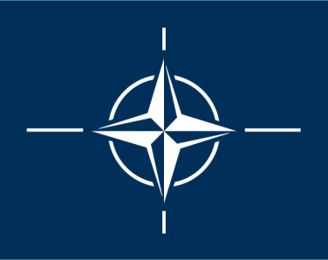
North Atlantic Treaty Organization (1949)
United States
Belgium
Britain
Canada
Denmark
France
Iceland
Italy
Luxemburg
Netherlands
Norway
Portugal
1952: Greece &
Turkey
1955: West Germany
1983: Spain

Slide 7

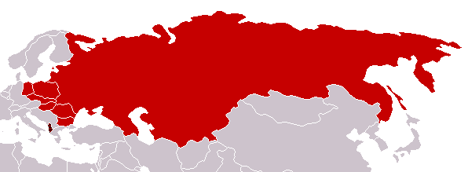
Warsaw Pact (1955)
U. S. S. R.
Albania
Bulgaria
Czechoslovakia
East Germany
Hungary
Poland
Romania

Slide 8
The Cold War Melts:
The End of Communism

Slide 9
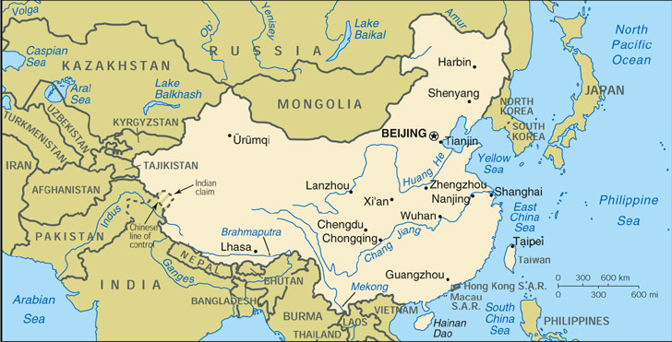
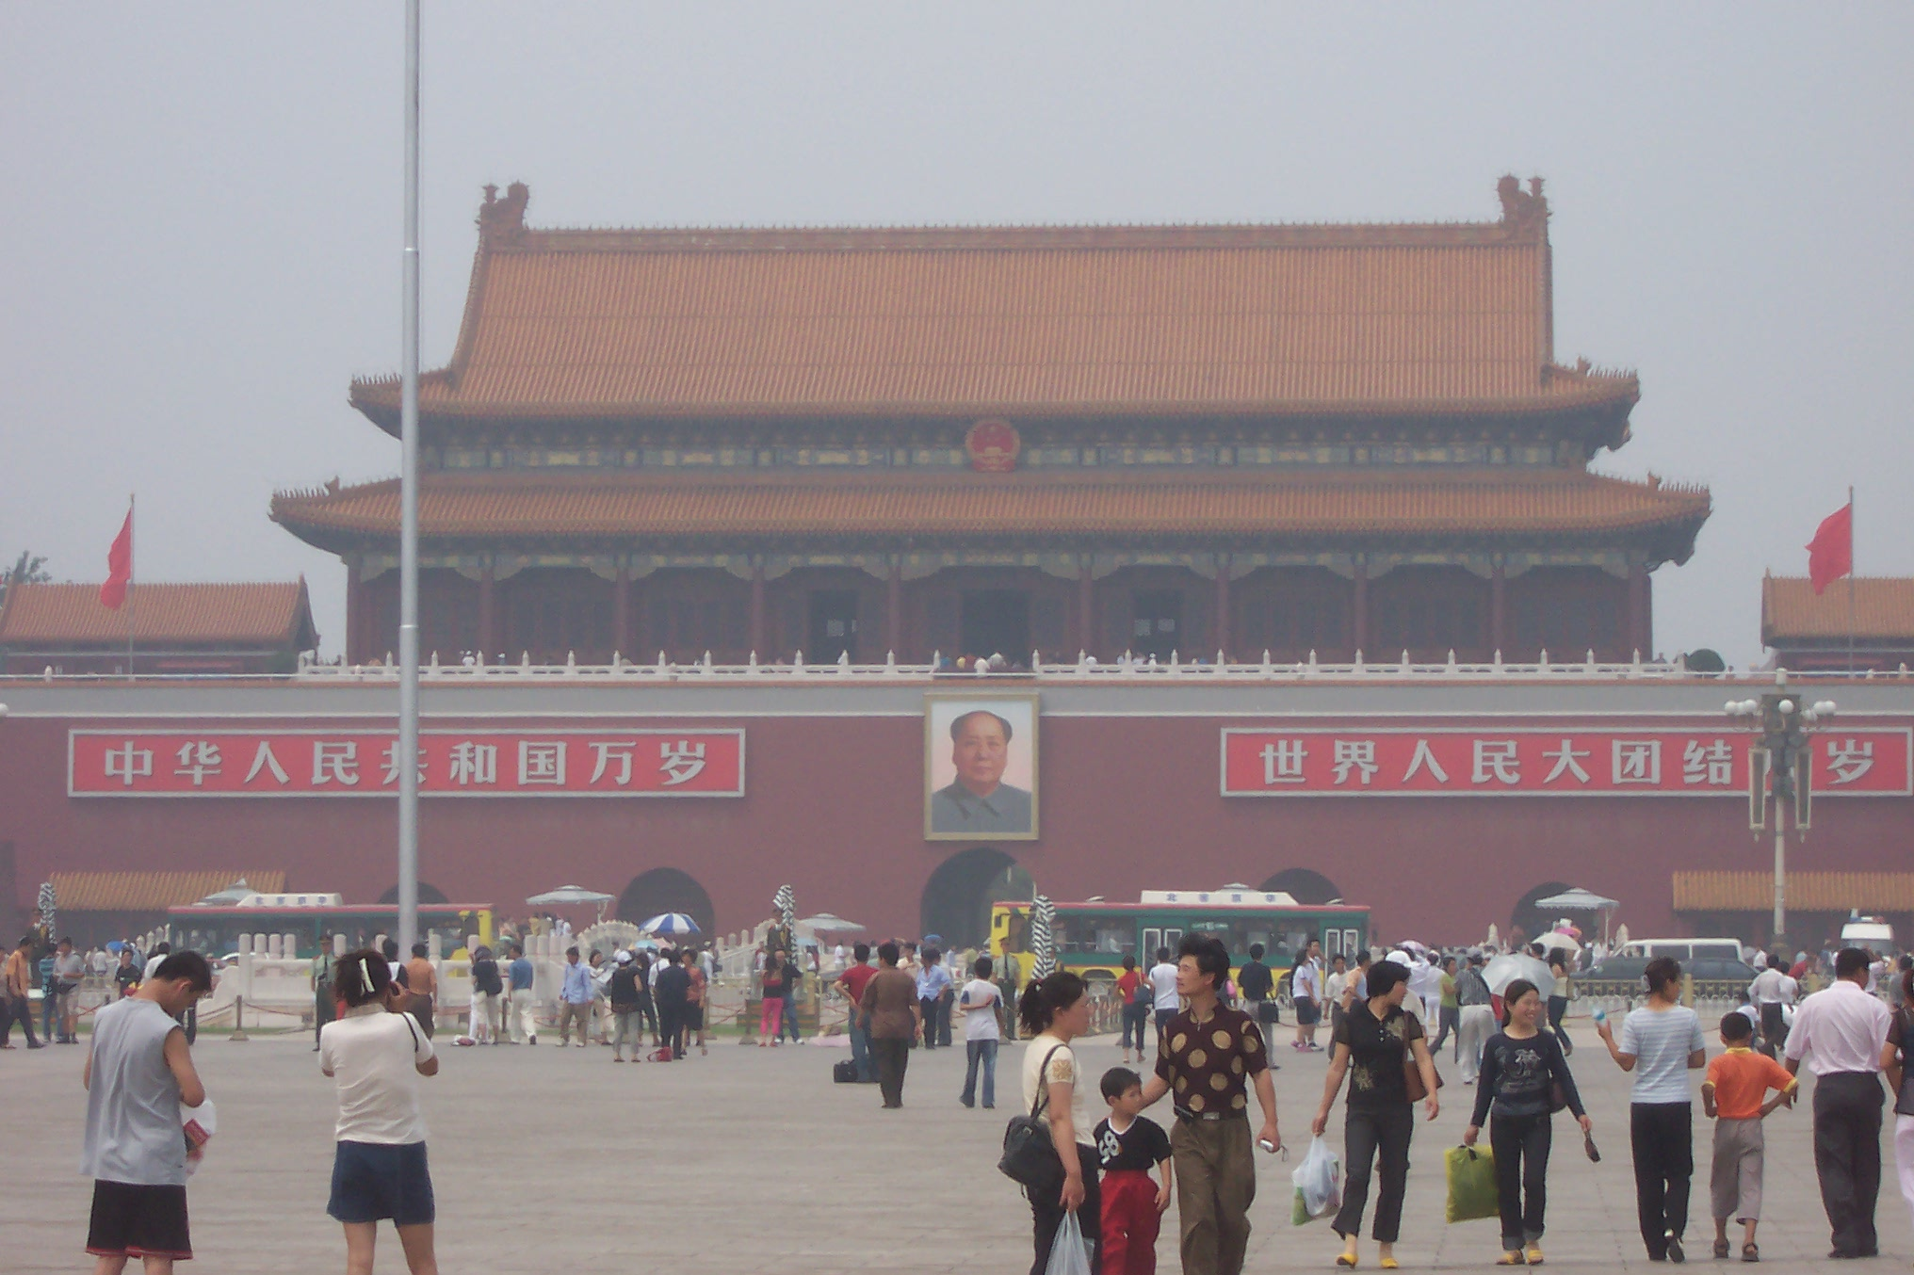
Tiananmen Square (Beijing, China)

Slide 10
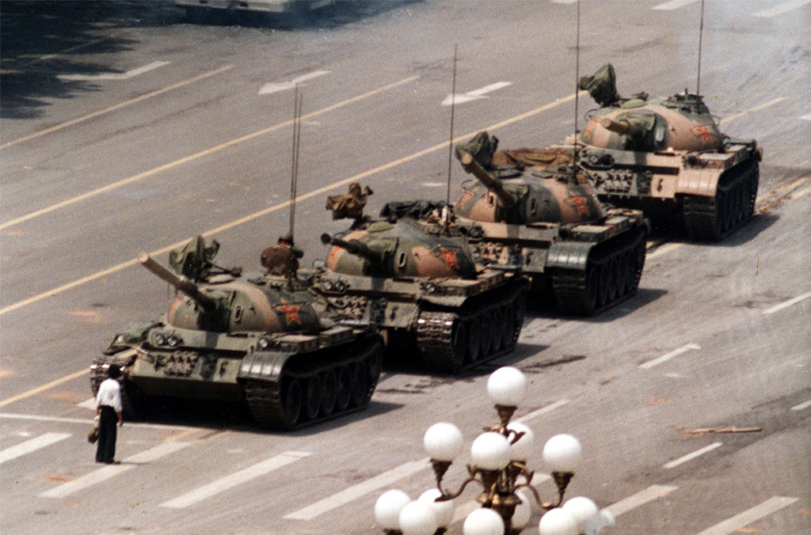
Tiananmen Square Uprising (1989)
Fall of the Berlin Wall

Slide 11
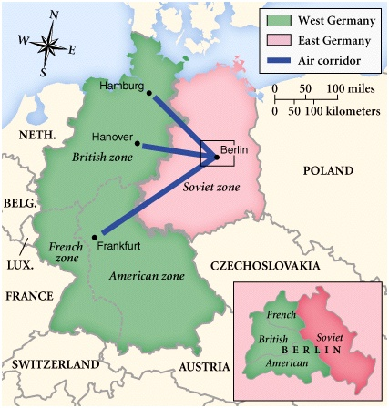
Post-War Germany

Slide 12
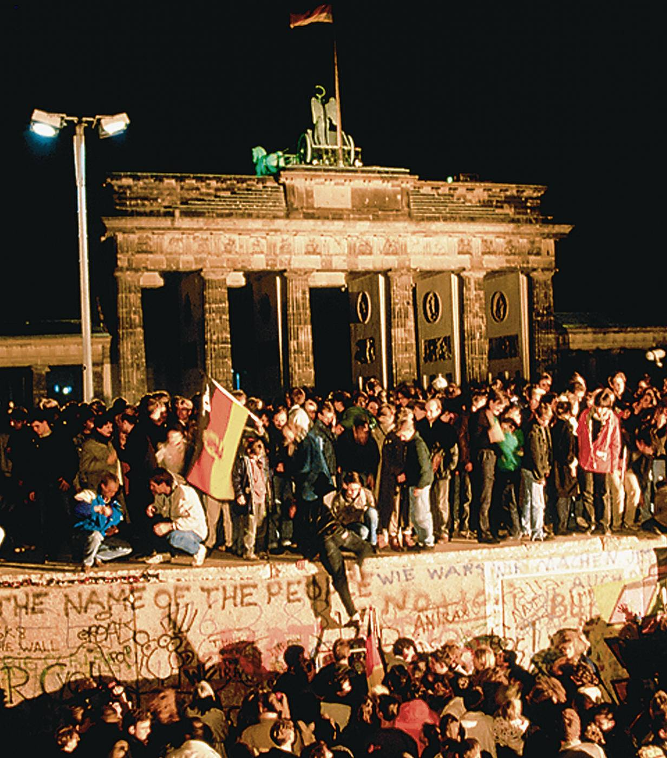
Fall of the Berlin Wall (1989)

Slide 13
COMPARISON: FALL OF COMMUNISM | SOVIET UNION | PEOPLES’ REP. OF CHINA
REFORMER
POLITICAL FACTORS
ECONOMIC FACTORS
SOCIAL FACTORS
OUTCOME

Slide 14
COMPARISON: FALL OF COMMUNISM | SOVIET UNION | PEOPLES’ REP. OF CHINA
REFORMER | Mikhail Gorbachev
POLITICAL FACTORS
ECONOMIC FACTORS
SOCIAL FACTORS
OUTCOME

Slide 15
COMPARISON: FALL OF COMMUNISM | SOVIET UNION | PEOPLES’ REP. OF CHINA
REFORMER | Mikhail Gorbachev | Deng Xiaoping
POLITICAL FACTORS
ECONOMIC FACTORS
SOCIAL FACTORS
OUTCOME

Slide 16
COMPARISON: FALL OF COMMUNISM | SOVIET UNION | PEOPLES’ REP. OF CHINA
REFORMER | Mikhail Gorbachev | Deng Xiaoping
POLITICAL FACTORS | Increased democratization, military spending cuts, & arms negotiations w/ U.S.
ECONOMIC FACTORS
SOCIAL FACTORS
OUTCOME

Slide 17
COMPARISON: FALL OF COMMUNISM | SOVIET UNION | PEOPLES’ REP. OF CHINA
REFORMER | Mikhail Gorbachev | Deng Xiaoping
POLITICAL FACTORS | Increased democratization, military spending cuts, & arms negotiations w/ U.S. | CCP kept its political power
ECONOMIC FACTORS
SOCIAL FACTORS
OUTCOME

Slide 18
COMPARISON: FALL OF COMMUNISM | SOVIET UNION | PEOPLES’ REP. OF CHINA
REFORMER | Mikhail Gorbachev | Deng Xiaoping
POLITICAL FACTORS | Increased democratization, military spending cuts, & arms negotiations w/ U.S. | CCP kept its political power
ECONOMIC FACTORS | Perestroika caused sharp decline in Soviet economy
SOCIAL FACTORS
OUTCOME

Slide 19
COMPARISON: FALL OF COMMUNISM | SOVIET UNION | PEOPLES’ REP. OF CHINA
REFORMER | Mikhail Gorbachev | Deng Xiaoping
POLITICAL FACTORS | Increased democratization, military spending cuts, & arms negotiations w/ U.S. | CCP kept its political power
ECONOMIC FACTORS | Perestroika caused sharp decline in Soviet economy | adopted reforms that opened up China to world economy
SOCIAL FACTORS
OUTCOME

Slide 20
COMPARISON: FALL OF COMMUNISM | SOVIET UNION | PEOPLES’ REP. OF CHINA
REFORMER | Mikhail Gorbachev | Deng Xiaoping
POLITICAL FACTORS | Increased democratization, military spending cuts, & arms negotiations w/ U.S. | CCP kept its political power
ECONOMIC FACTORS | Perestroika caused sharp decline in Soviet economy | adopted reforms that opened up China to world economy
SOCIAL FACTORS | Glasnost permitted wide range of cultural & intellectual freedoms
OUTCOME

Slide 21
COMPARISON: FALL OF COMMUNISM | SOVIET UNION | PEOPLES’ REP. OF CHINA
REFORMER | Mikhail Gorbachev | Deng Xiaoping
POLITICAL FACTORS | Increased democratization, military spending cuts, & arms negotiations w/ U.S. | CCP kept its political power
ECONOMIC FACTORS | Perestroika caused sharp decline in Soviet economy | adopted reforms that opened up China to world economy
SOCIAL FACTORS | Glasnost permitted wide range of cultural & intellectual freedoms | Relaxed censorship; sharp social inequalities & urban problems
OUTCOME

Slide 22
COMPARISON: FALL OF COMMUNISM | SOVIET UNION | PEOPLES’ REP. OF CHINA
REFORMER | Mikhail Gorbachev | Deng Xiaoping
POLITICAL FACTORS | Increased democratization, military spending cuts, & arms negotiations w/ U.S. | CCP kept its political power
ECONOMIC FACTORS | Perestroika caused sharp decline in Soviet economy | adopted reforms that opened up China to world economy
SOCIAL FACTORS | Glasnost permitted wide range of cultural & intellectual freedoms | Relaxed censorship; sharp social inequalities & urban problems
OUTCOME | “miracle year” of 1989; Soviet Empire collapsed (1991)

Slide 23
COMPARISON: FALL OF COMMUNISM | SOVIET UNION | PEOPLES’ REP. OF CHINA
REFORMER | Mikhail Gorbachev | Deng Xiaoping
POLITICAL FACTORS | Increased democratization, military spending cuts, & arms negotiations w/ U.S. | CCP kept its political power
ECONOMIC FACTORS | Perestroika caused sharp decline in Soviet economy | adopted reforms that opened up China to world economy
SOCIAL FACTORS | Glasnost permitted wide range of cultural & intellectual freedoms | Relaxed censorship; sharp social inequalities & urban problems
OUTCOME | “miracle year” of 1989; Soviet Empire collapsed (1991) | “strange & troubled hybrid” nation; world’s next superpower?

Slide 24
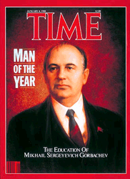
Mikhail Gorbachev
Soviet Premier (r.1985-91)

Slide 25
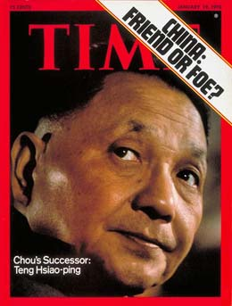
Deng Xiaoping
Head of the CCP (r. 1976-97)

Slide 26
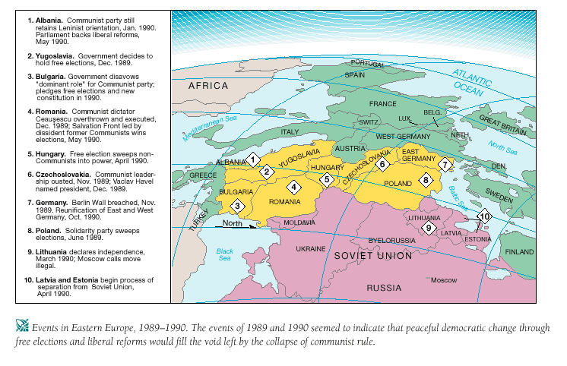

Slide 27
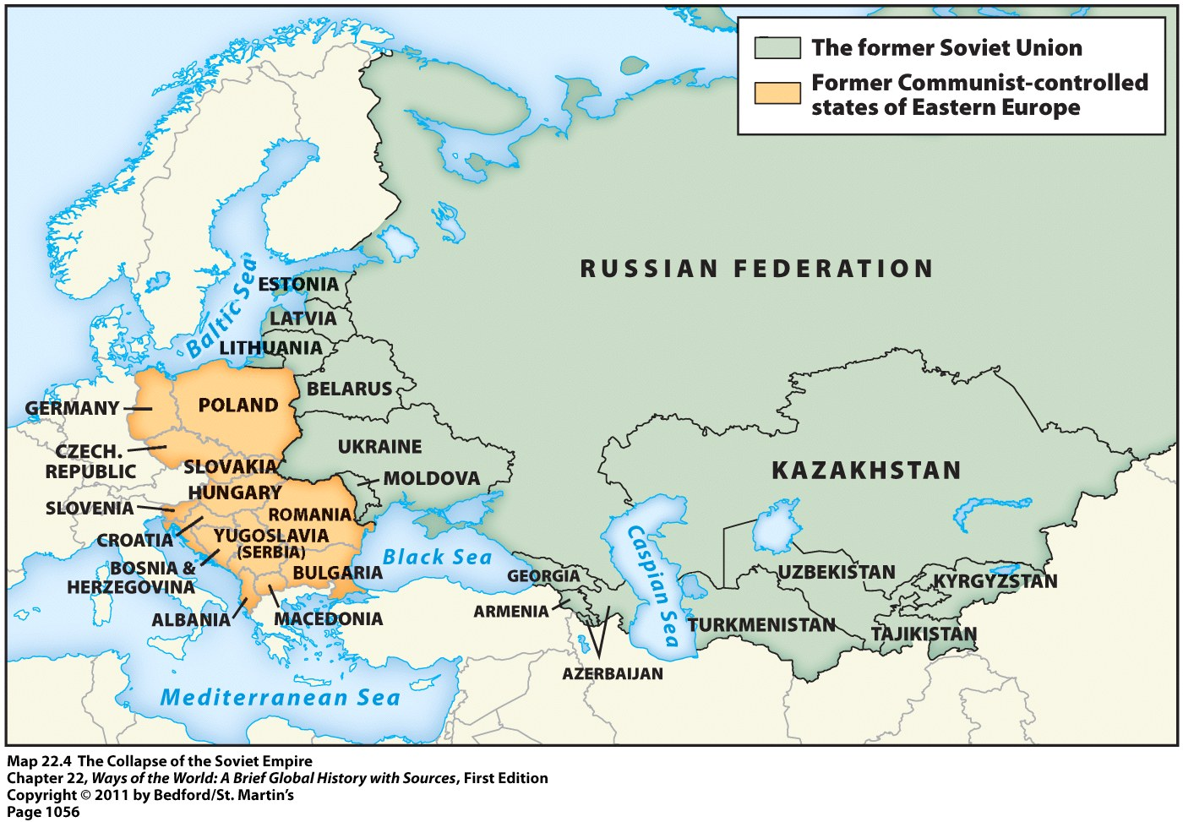
The Collapse of the Soviet Empire

Slide 28
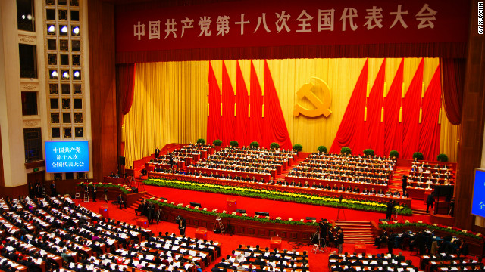
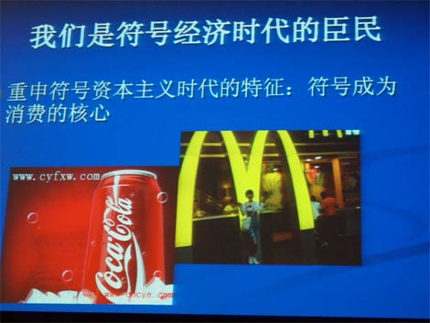
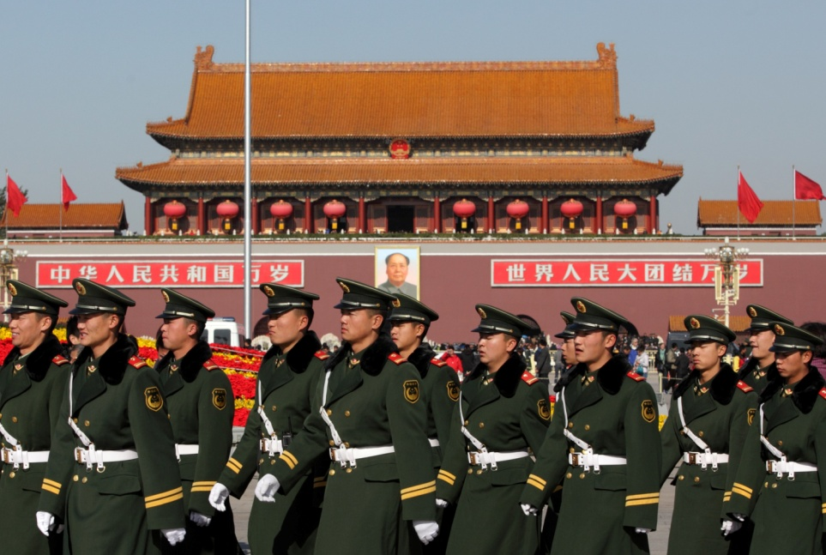

The Changing Face of Chinese Communism

Slide 29
Part III:
Decolonization

Slide 30
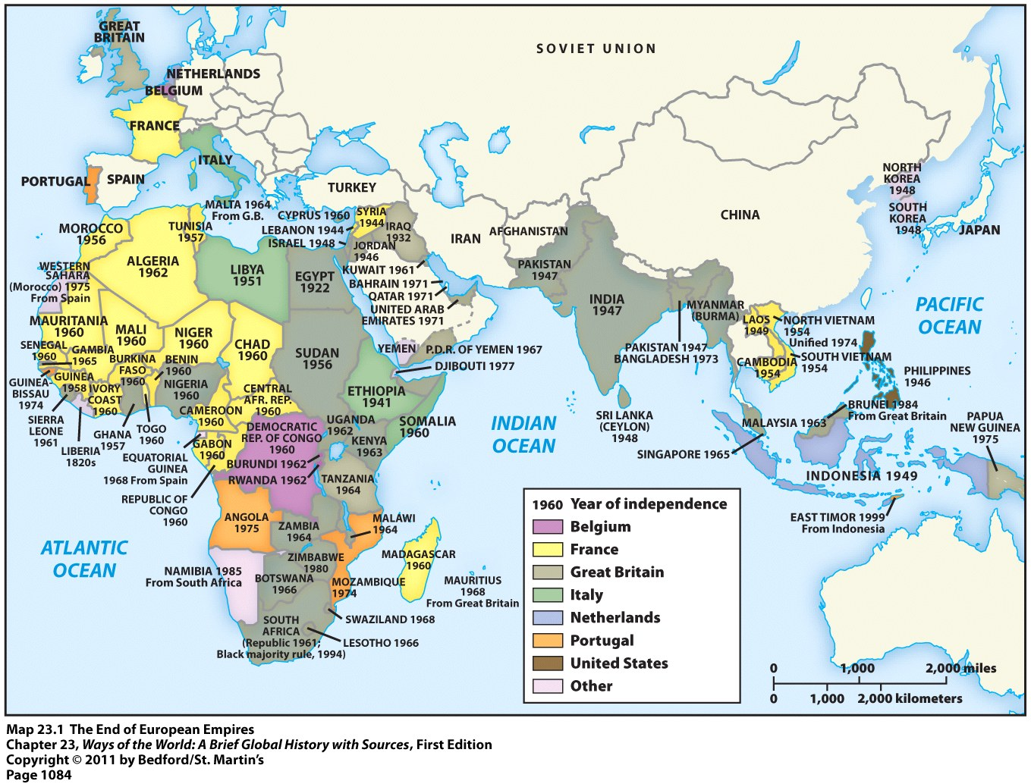
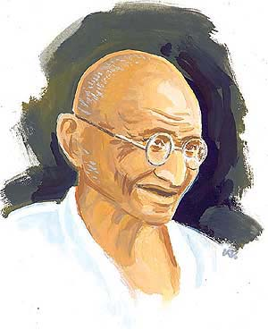
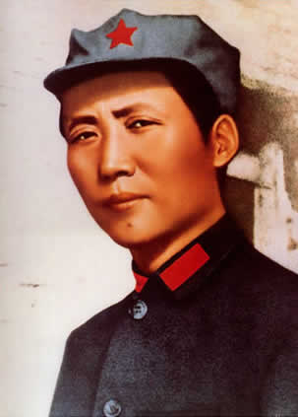
Decolonization
What is the best strategy to gain independence from colonial masters?
“Victory attained by violence is tantamount to a defeat, for it is momentary.”
- Mohandas K. Gandhi
“Political Power grows out of the barrel of a gun.”
- Mao Zedong

Slide 31
Decolonization
What is the best strategy to gain independence from colonial masters?
“Victory attained by violence is tantamount to a defeat, for it is momentary.”
- Mohandas K. Gandhi
“Political Power grows out of the barrel of a gun.”
- Mao Zedong

Slide 32
Decolonization? Why?
Most of the world’s colonies became free of colonial rule & achieved statehood b/t 1947-1967
Decolonization was a difficult & sometimes bitter process; countries reluctant to let go of empires
Reasons for decolonization…
    Rising nationalism of Asian & African peoples
    Destruction of Europe during world wars weakened the European states
    Colonialism went against the Allied goal of self-determination after the war
    Educated intellectuals in colonies used European ideas against their colonial rulers

Slide 33
Part III:
Nation-Building in the Developing World

Slide 35


Mexico (1917)
“United States of Mexico”

Slide 36


The Philippines (1946)
“Republic of the Philippines”

Slide 37

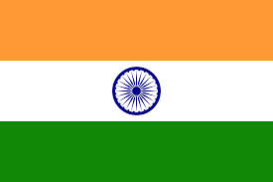
India (1947)
“Truth Alone Triumphs”

Slide 38


Israel (1948)
“Israel”

Slide 39


Nigeria (1960)
“Unity and Faith, Peace and Progress”

Slide 40

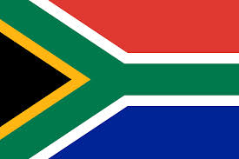
South Africa (1994)
“Diverse people unite”

Slide 41
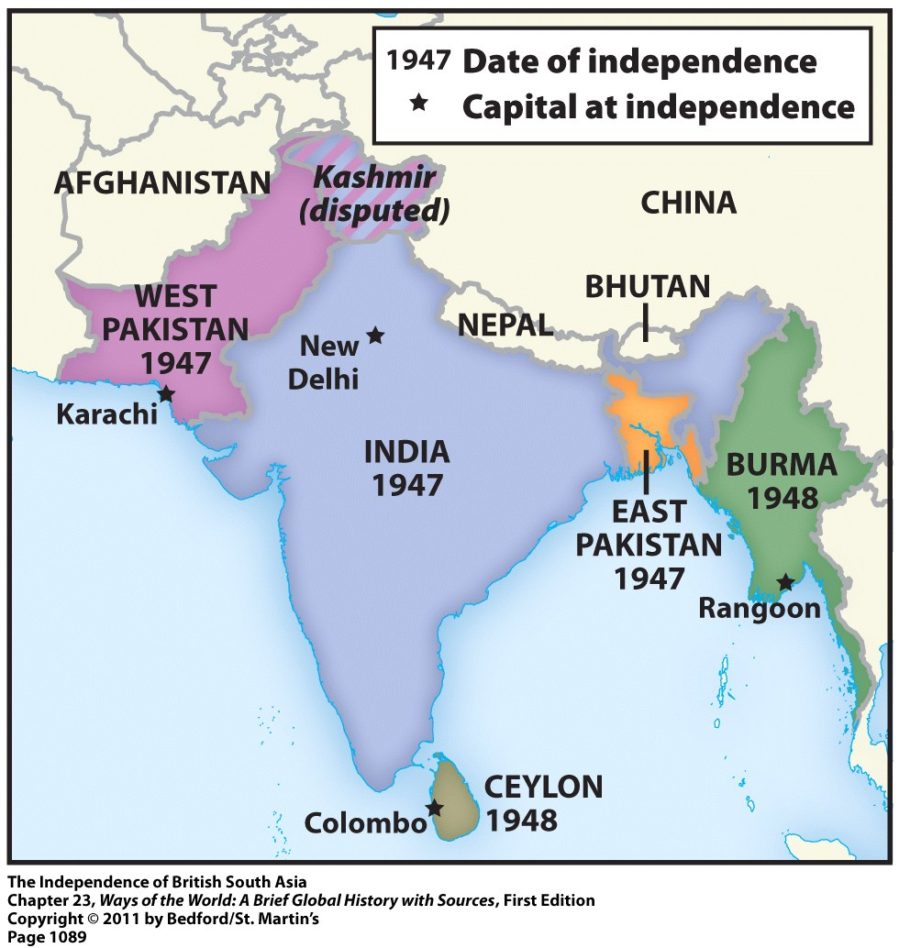
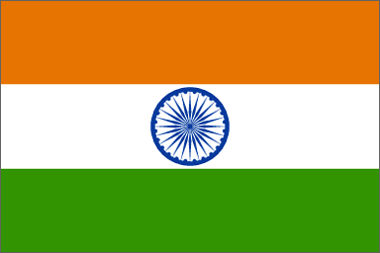
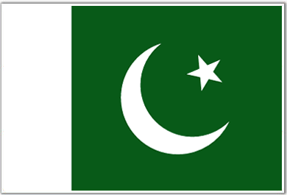
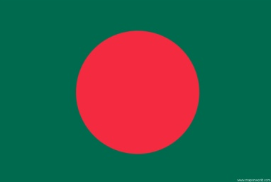
Partition of India (1947)

Slide 42
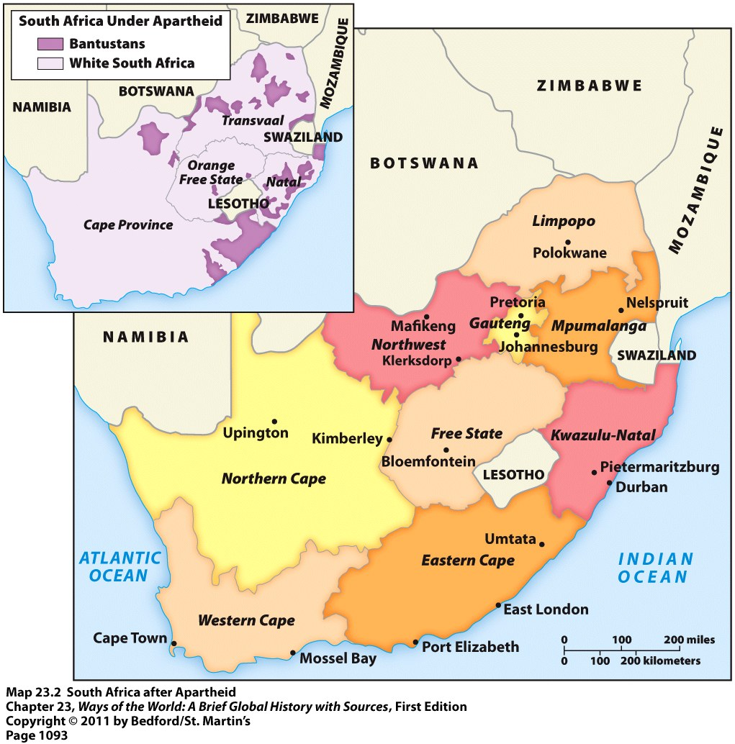
Decolonization in South Africa

Slide 43
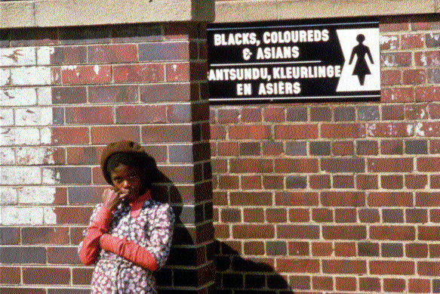
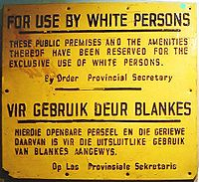
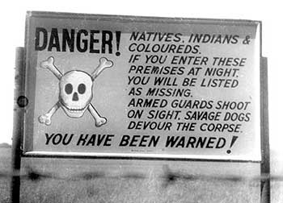
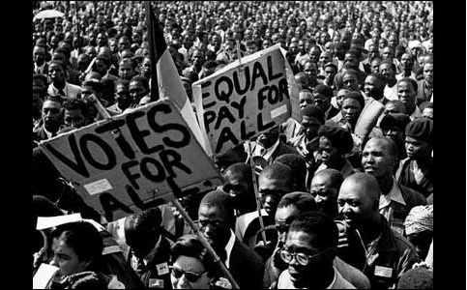
Apartheid in South Afica

Slide 44
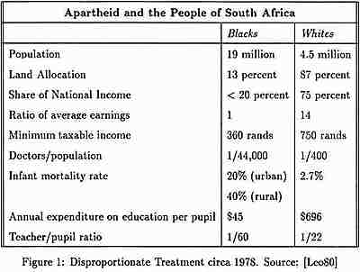
Inequality of Apartheid

Slide 45
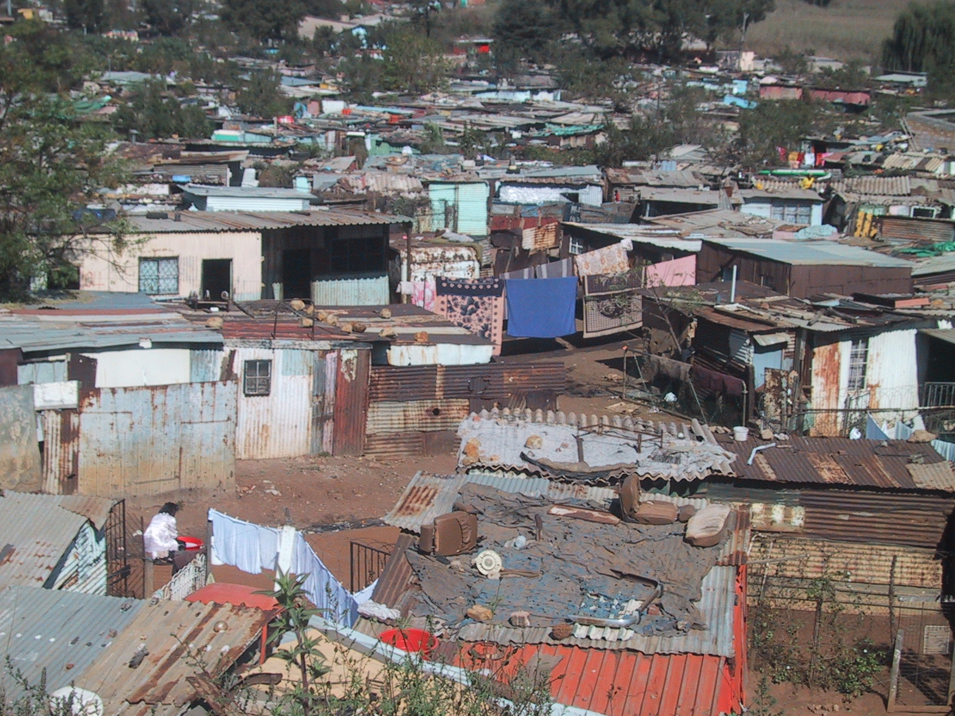
Soweto, South Africa

Slide 46
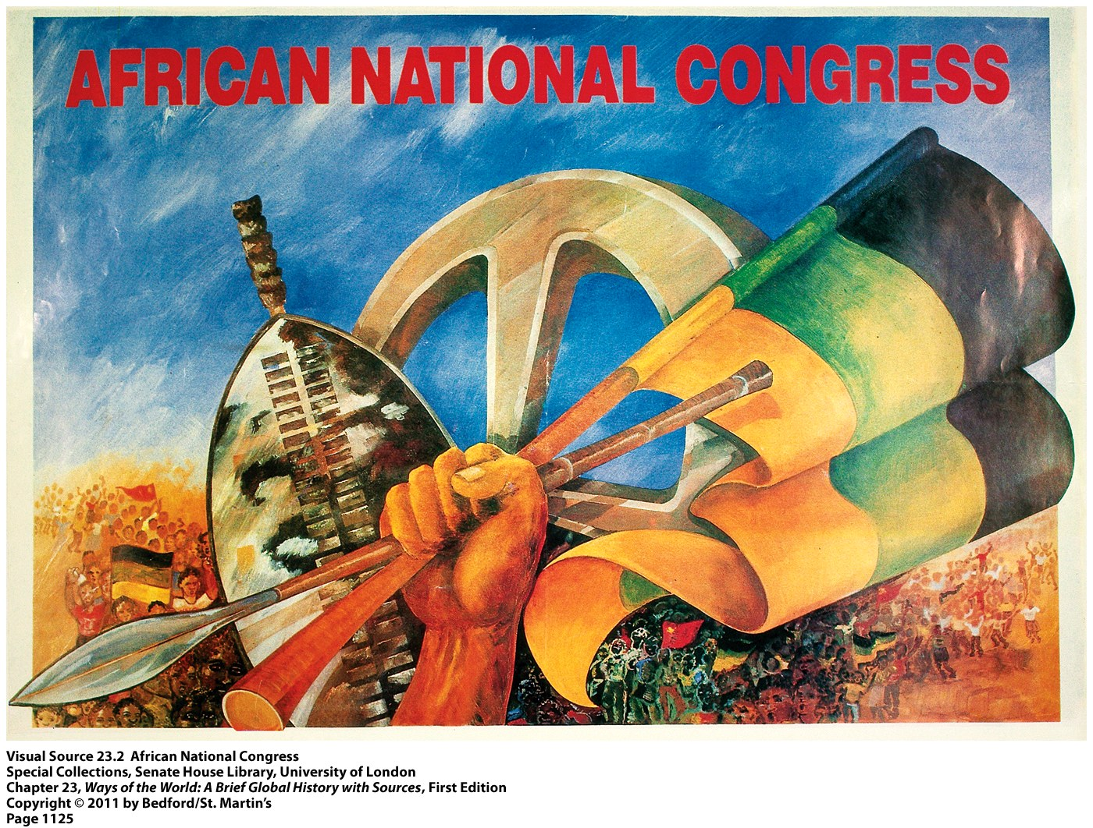

Slide 47
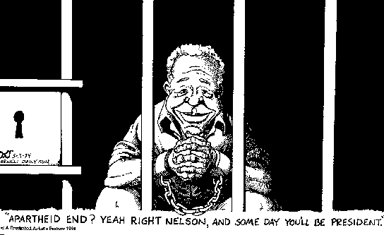
Nelson Mandela

Slide 48
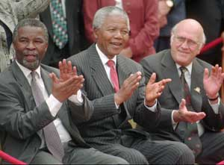
President Mandela (1994-99)

Slide 49
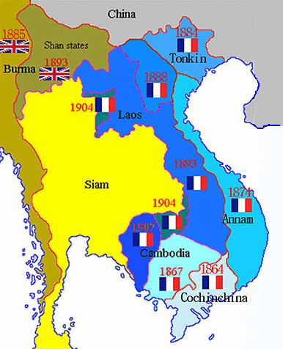
French Indochina

Slide 50
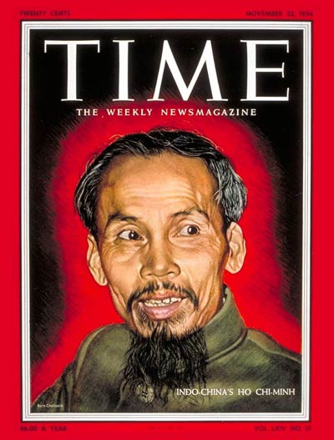
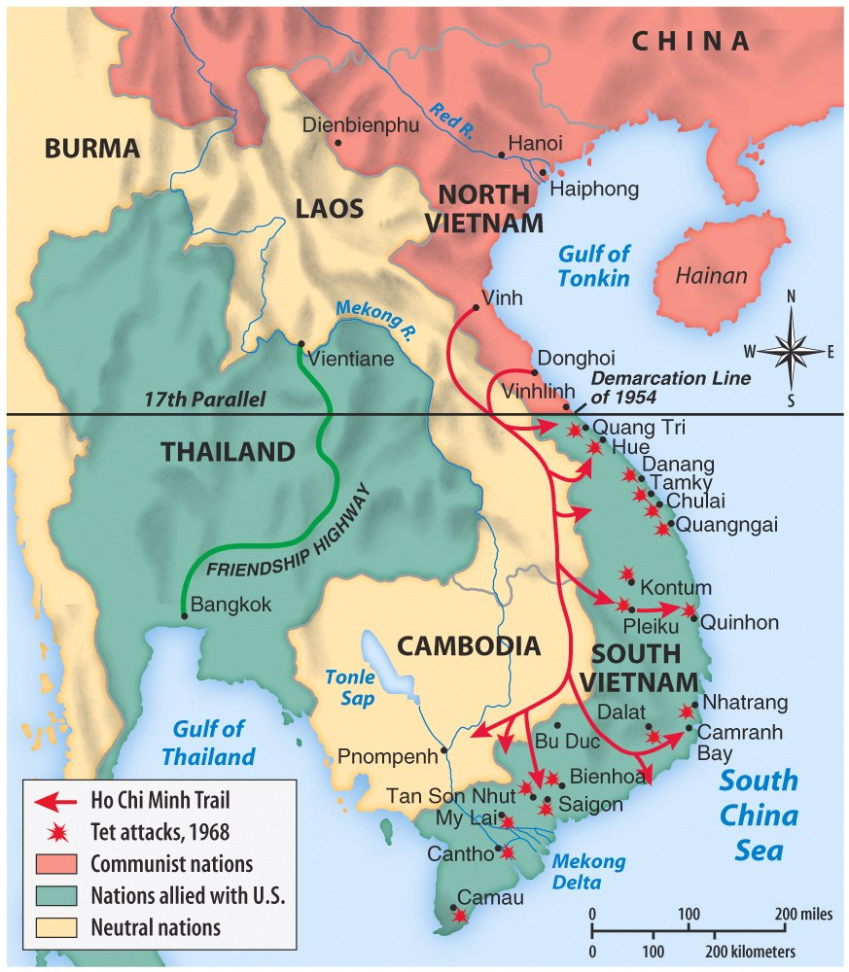
Dien Bien Phu (1954) – Independence for Vietnam?

Slide 51
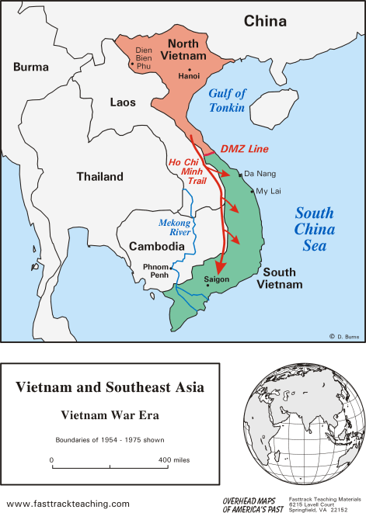
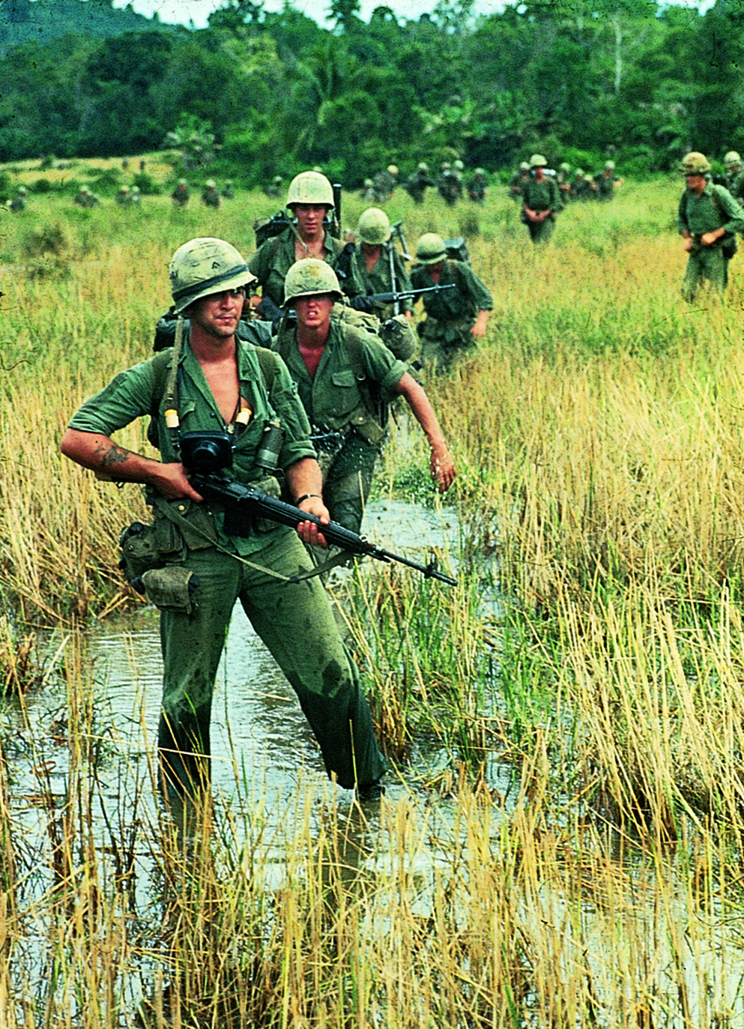
The Vietnam War (1955-1975)

Slide 52
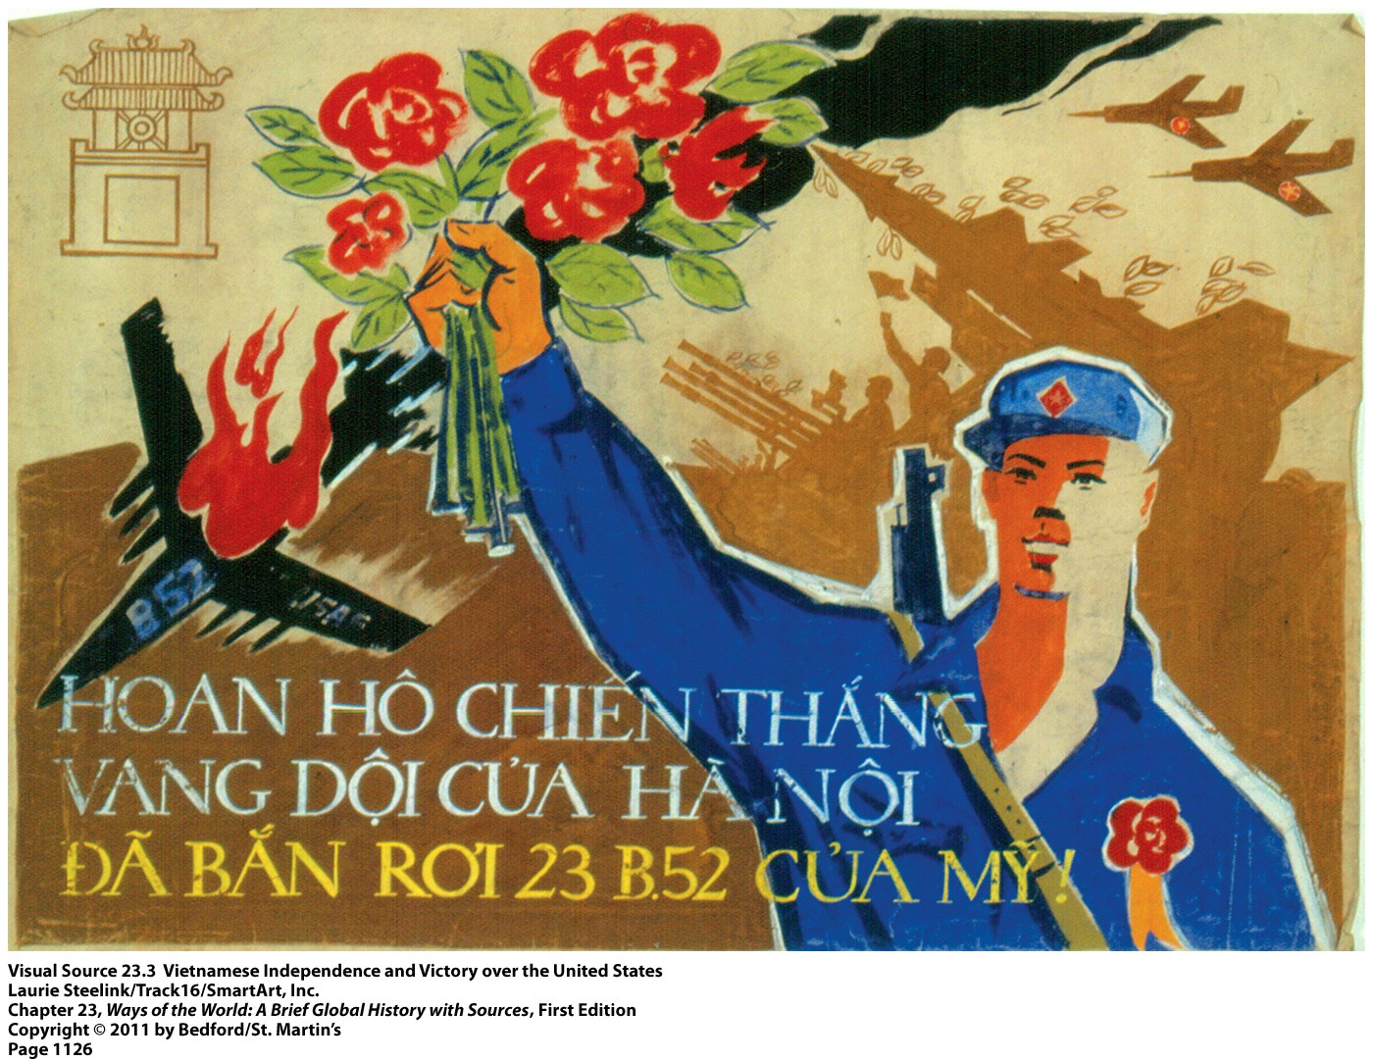

Slide 53
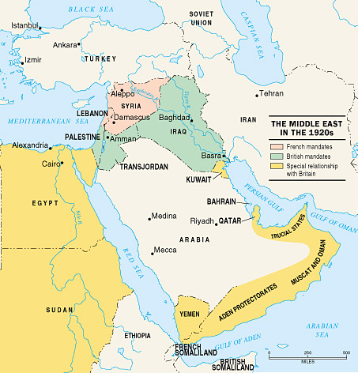
Decolonization in Palestine

Slide 54


Slide 55
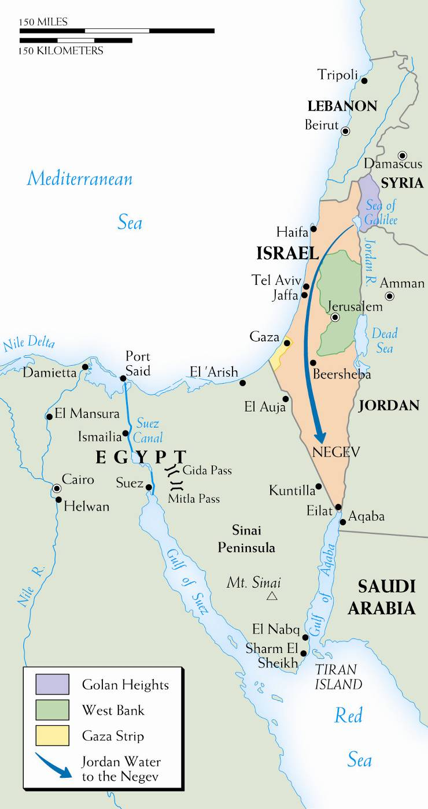

Nation of Israel (1948)

Slide 56
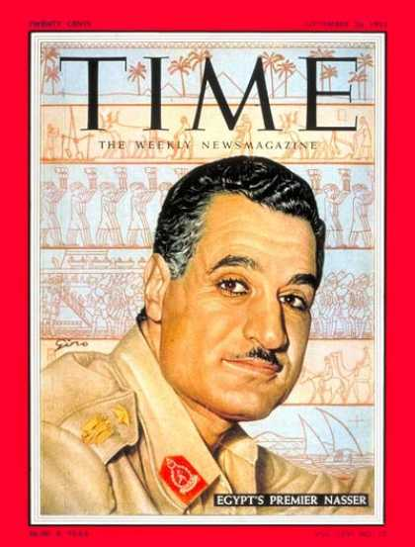
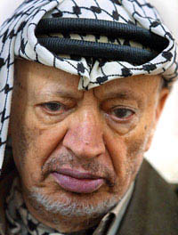
Pan-Arabism
Col. Gamal Abdel Nasser (Egypt)
Arab Nationalist
Goal: United Arab Republic (UAR)
Yasir Arafat
Head of Palestine Liberation Org. (PLO)
Goal: Palestinian state

Slide 57
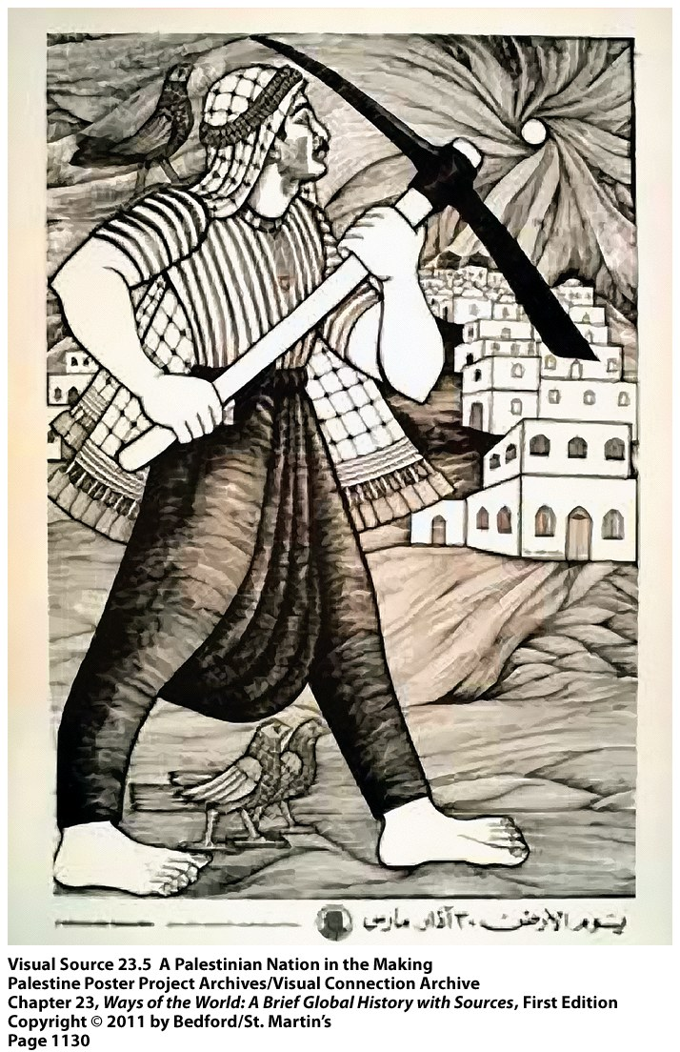

Slide 58
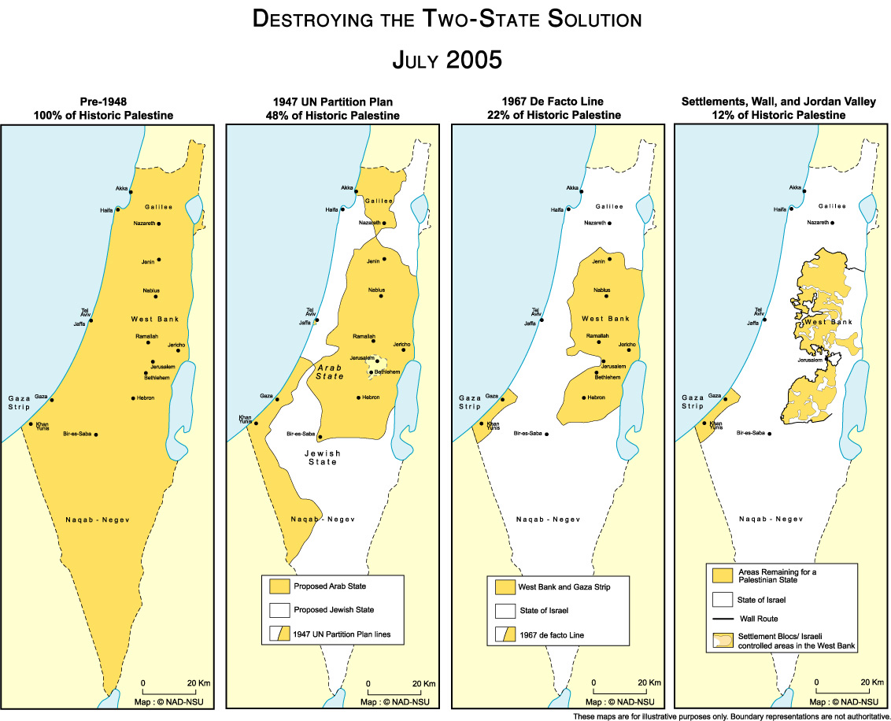

Slide 59
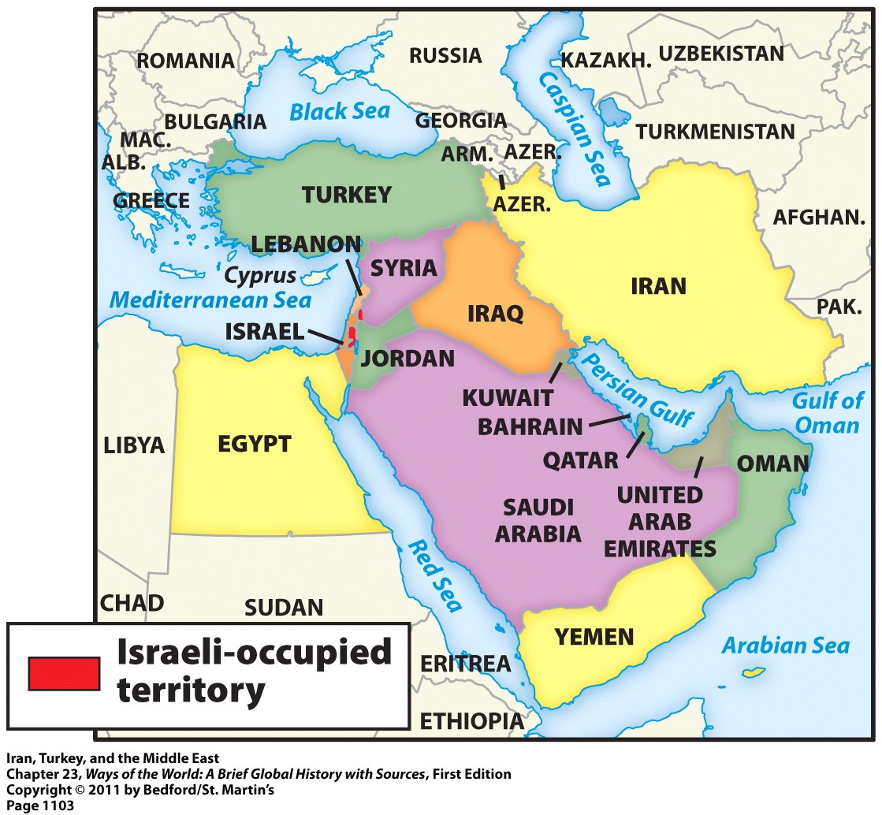
Revolution in Iran

Slide 60

Shah Reza Pahlavi & his wife

Slide 61

Iran during Shah’s reign

Slide 62

Iranian Revolution (1979)

Slide 63



Iranian Green Revolution 2009

Slide 64




Iranian Green Revolution 2009

Slide 65



State-sponsored Violence

