Slide 1

French Revolution Stage 2 & 3
AIM: How did the stages of the French Revolution differ and which group benefited the most?
Do Now: Complete the following sentence
France was originally led by a ______________ whose powers were __________. The ______________ wrote a new constitution and limited the king’s power a tried to equalize the ___________.

Slide 2
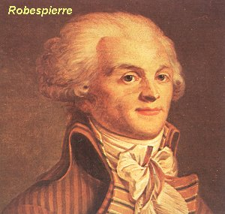
Second Stage
Radical Revolution
Disillusionment of the lower class (inflation)
No strong leader
France drawn into war in Europe
Failure in wars (1792-1797)
  Moderates removed as
  leaders of
  National Assembly
  Counter-revolutions
  King and queen arrested

Slide 3
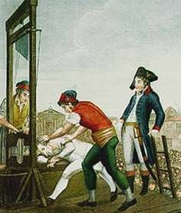
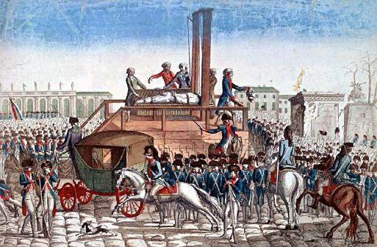
Second Stage
Reign of Terror (1793-1794)
Committee for Public Safety
Headed by Robespierre
Reforms
  Metric system
  New calendar
  Universal suffrage
  Slavery eliminated
  Paris commune
  Land redistribution
  Defaced churches
Guillotine
  Approx 40,000+ die
  By summary execution
  or guillotine
  King and Queen Beheaded

Slide 4

Execution of 40,000+
“Enemies of the Nation”
Stress on radical definition
of equality
Wanted a legal maximum on
personal wealth
Wanted a regulation of
commercial profits
End of Robespierre’s
dictatorship on July 28, 1794
Robespierre executed by
Guillotine

Slide 5
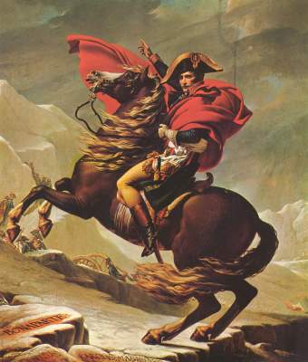
Third Stage—Return of the Moderates (1794-1799)
The Directory governed
Death of Robespierre
Some military successes (Napoleon as General)
Directory criticized for
poor leadership
Directory & the people desperate for a popular
leader who could fix everything
Napoleon invited to be “consul” to protect Paris & France from riots and foreign enemies

Slide 6
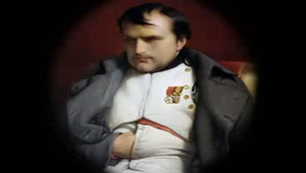
“Impossible is a word to be found
only in the dictionary of fools.”
“A leader is a
dealer in hope.”
“Ten people who speak make more noise than ten thousand who are silent.”
“You must not fight too often with one enemy, or you will teach him all your art of war.”
“Never interrupt your enemy when he is making a mistake.”
“In politics stupidity is not a handicap.”
The Rise of Napoleon
“History is the version of past events that people have decided to agree upon.”
“Death is nothing, but to live defeated and inglorious is to die daily.”

