Slide 1
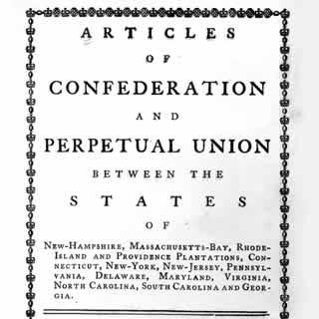
The Articles of Confederation
Aim: What were the strengths and weaknesses
of the Articles of Confederation?
Do Now: Why was it important for the
colonies to form a national government?

Slide 2
The Articles of Confederation
America’s 1st Government 1781-1789
Why did the Founding Fathers Choose a Confederation plan of government?
The first system of government designed by the Founding Fathers was a Confederation.
Under a Confederate system, the National or Central Government is given only a few powers, while most of the power is reserved for the States.

Slide 3


The Articles of Confederation
America’s 1st Government 1781-1789
Strengths
Weaknesses
Congress was given the power to:
Declare War &
Establish an Army/Navy
No Power to Draft Soldiers

Slide 4
The Articles of Confederation
America’s 1st Government 1781-1789
Strengths
Weaknesses
Congress was given the power to:
Make Peace & Sign Treaties
No Power to Enforce Treaties

Slide 5
The Articles of Confederation
America’s 1st Government 1781-1789
Strengths
Weaknesses
Congress was given the power to:
No Power to Collect Taxes from the States or Coin Money
Borrow Money

Slide 6
The Articles of Confederation
America’s 1st Government 1781-1789
Strengths
Weaknesses
Congress was given the power to:
Could not Enforce Laws
Organize a
Post Office

Slide 7
The Articles of Confederation
America’s 1st Government 1781-1789
Strengths
Weaknesses
No Chief Executive
Congress was given the power to:
No national court system
No Power to Regulate Interstate Commerce
No National Currency
Difficult to Pass laws (2/3 vote) / 1 vote per state

Slide 8
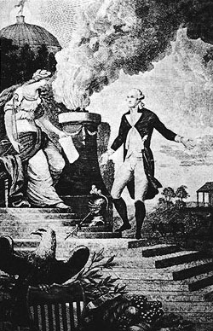
Why did the Founding Fathers Choose a Confederation plan of government?
They feared that a strong central government would create tyranny, and stamp out the peoples natural God given rights.

Slide 9

Shay’s Rebellion in Massachusetts demonstrated the need for a stronger national government.

Slide 10
Activity: Create a “T” Chart of the Strengths and Weaknesses of the Articles of Confederation.
Strengths
Weaknesses

