Slide 1
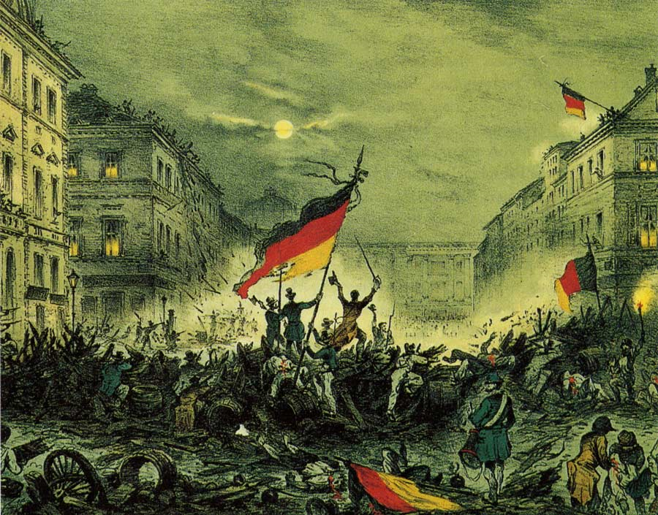
Nationalism
Unification of Germany
AIM: How Did Bismarck Unify Germany?
Do Now:
Unification of Germany Worksheet

Slide 2
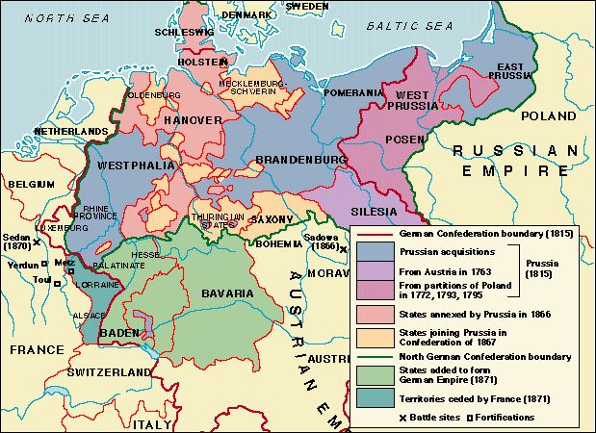

Slide 3
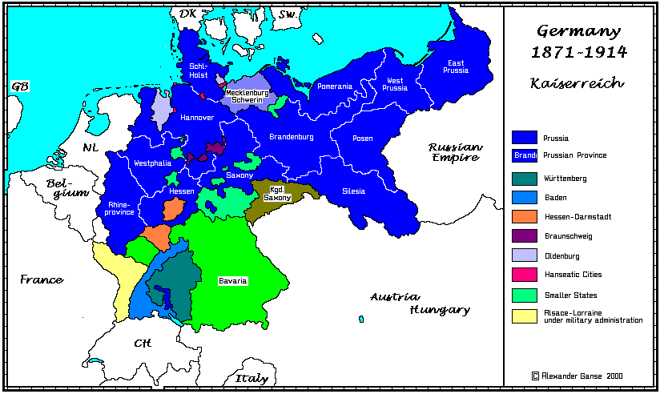

Slide 4
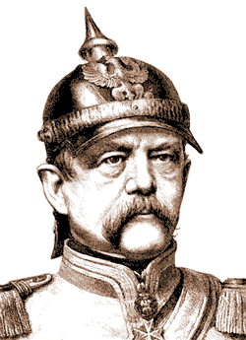
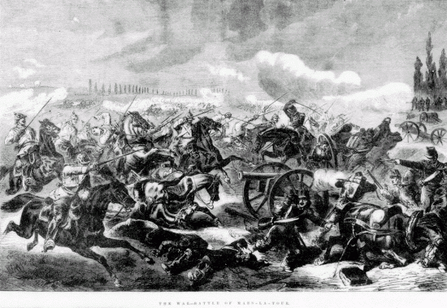
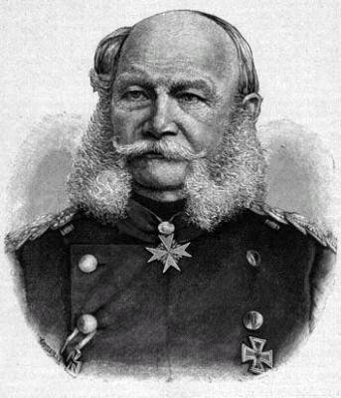
Volksgeist (people’s spirit)
German Unification
What are the major events and who are the key leaders associated with German unification?
Franco-Prussian War
Battle of Mars-la-Tour
1870
Chancellor
Otto von Bismarck
King
Wilhelm I

Slide 5
 | GOALS | METHODS
BISMARCK | Unification of Germany Increase Prussian Power Decrease Austrian influence in Germany (drive them out of Germany) | “blood and iron” – war, trickery, etc… (7 Weeks War, tricked Austria; Franco-Prussian War) Realpolitik - do whatever is necessary to achieve goals, not what is moral or right
BISMARCK

Slide 6
Franco-Prussian War
All German states joined in a war against France (Franco-Prussian War)
Overwhelming German victory
Results of War
  French Empire collapses
    Third Republic declared
  France loses Alsace-Lorraine
  France pays Germany 5,000,000,000 francs
  France accepts an army of occupation

Slide 7
The German Empire
January 18, 1871
  William I proclaimed Emperor of the Germans at Versailles

Slide 8
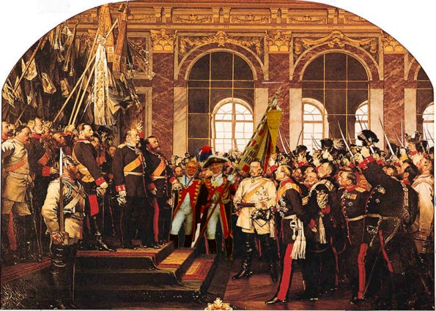
Volksgeist: German Unification
1871 Proclamation of the German Empire
The Hall of Mirrors, Palace of Versailles
January 18, 1871

Slide 9
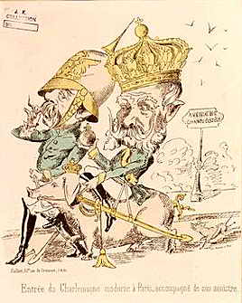
Volksgeist:
German Unification
King Wilhelm I & Otto von Bismarck:
Who wears the pants?
I’m King of the World!
Wait, uh, chancellor? Now I’m really confused…

