Slide 1
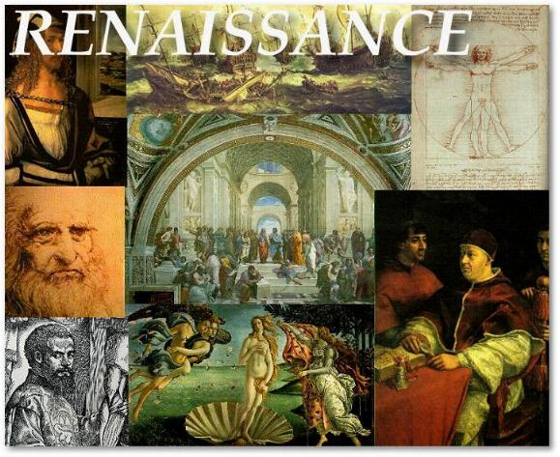
The Renaissance
Ca. 1350-1550

Slide 2
Opening Question…
François Rabelais (c. 1494-1553) – French Renaissance humanist and author:
  “Out of the thick Gothic night, our eyes were awakened to the glorious light of the sun.”
  What did Rabelais mean?
  Why did he believe this?
  To what extent was he correct?

Slide 3
Themes of the Renaissance
Intellectual history?
Cultural history?
Political history?
Diplomatic history?
Social history?
Economic history?

Slide 4
What is the Renaissance?
What does Renaissance mean?
French for “rebirth”. What was reborn? What was dead?
  First used in the mid-16th century in reference to medieval painters
  If rebirth, why associated with classical Greece & Rome?
  Was there truly a clear, obvious break from the medieval?
  To what does the term apply? When & how?
    Styles in painting & sculpture?
    New literary forms?
    An original lifestyle?
Jacob Burckhart
  Civilization of the Renaissance in Italy (1860)
Counter-arguments?

Slide 5
Traditional Themes of the Renaissance
Humanism
Secularism
Individualism
Rationalism
Virtu (Civic Responsibility)

Slide 6
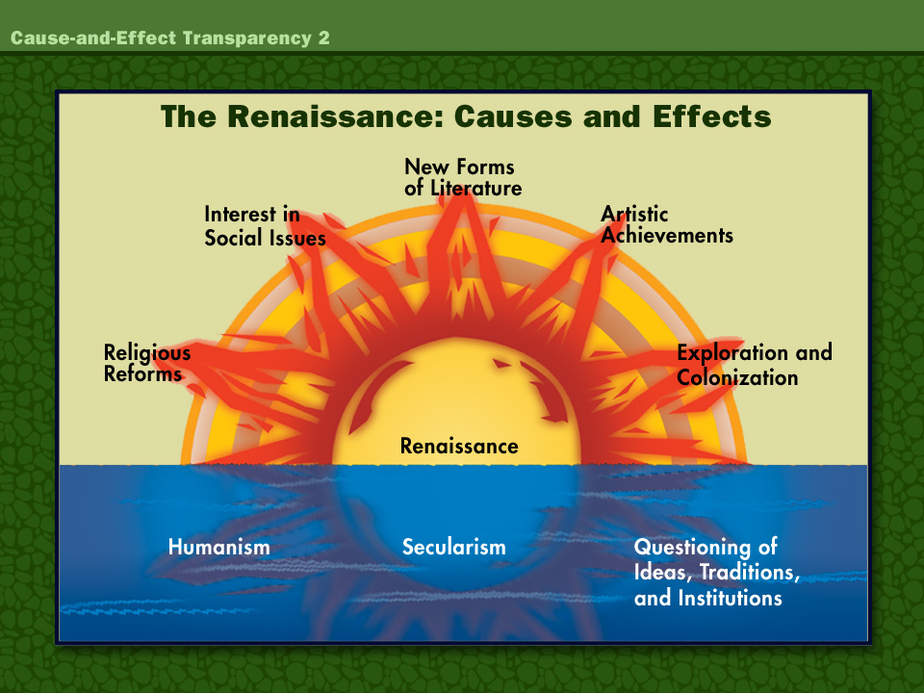

Slide 7
What is true?
Time of transition:
  Increased national consciousness
  Increased political centralization
  Urbanizing economy: Capitalism and commerce
  Increased lay & secular control of thought, culture, and even religion
Essential step toward Reformations

Slide 8
Rough chronology of the Renaissance
Up to 1370, individual geniuses emerge, especially in Italy, but no clear movement
To 1470s, the Florentine period: Great things happen in Florence
By 1450s: Renaissance “received” in Rome, Milan, and Venice
After 1500, Renaissance crosses Alps

Slide 9
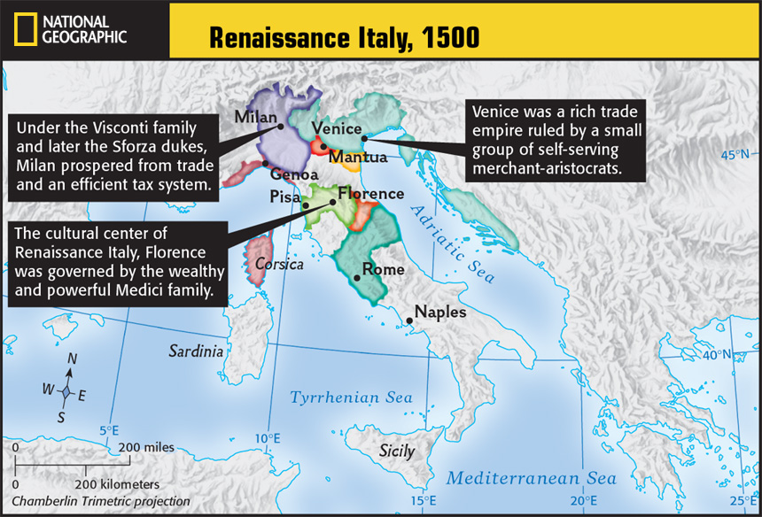
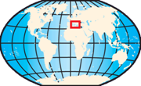
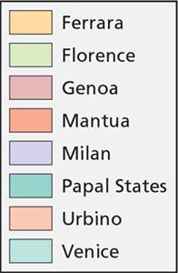

Slide 10


Italian Renaissance
Why Italy?
  Higher level of literacy and lay education
  Crossroads of trade & cultural exchange
  Greater wealth = patronage
  Historic roots in antiquity
  Less bound to feudal/chivalric values
  City-states = Urban culture
On which classes did the Renaissance have the greatest effect?

Slide 11
Why Italy?
Geography
Roman Law
Rich in agriculture and trade
Banking finances trade, facilitates accumulation of capital
Trade w. East
Social influences?

Slide 12
Italian city-states
Many technically constitutional republics, actually oligarchies
Development of bureaucracies
Military ethos dominates courts
Larger city states were very militarily aggressive
Florence becomes dominant
  Tuscan emerges as Italian countrly language
  Medici rulers support secular learning
  Luxury goods and crafts lead to artistic tradition
  Relatively high educational levels
  Rule by merchants/guilds
Despotic rule (outside Venice)
  Venice: Doge and Senate
  Papal States
    Pope a temporal prince
    Babylonian Captivity?
  Visconti/Sforza in Milan
  De’ Medici in Florence
    Cosimo (r. 1434-1464)
    Lorenzo the Magnificent (r. 1478-1492)
  Podesta and condottieri
Four major social classes
  Old rich (old nobles and merchants)
  New rich (capitalists and bankers)
  Middle burghers (small business & guilds)
  The little people
Perpetual strife and internal warfare

Slide 13
Opening Question
What is humanism?

Slide 14
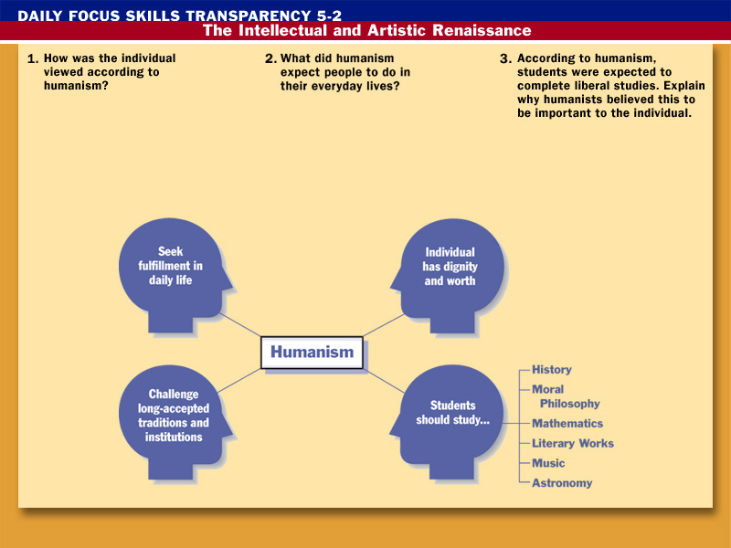
Humanism

Slide 15
Humanism
Very vague term
Many interpretations: What are they?
Burckhardt: Birth of modernity, secular, stress on individualism, secular values
Champions of Catholic Christianity vs. Aristotelian scholasticism
Scholarship that promotes civic responsibility & personal liberty = Civic Humanism
Simply an educational program based on rhetoric and sound scholarship

Slide 16
Characteristics of Humanist Scholarship
Critical study of classics and Church fathers in original languages (Greek & Latin)
Study of the liberal arts
  Grammar
  Rhetoric
  Poetry
  History
  Politics
  Moral Philosophy
Study of primary sources instead of received wisdom
Why important? What are the effects?

Slide 17
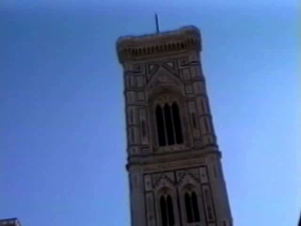
Humanism

Slide 18
Key early Italian humanist thinkers
*Petrarch (1304-1374)
  “Father of humanism”, sonnets to Laura
*Dante (Divine Comedy), Boccaccio (Decameron) (Both medieval…)
  Vernacular literature
*Christine de Pisan (1364-1430)
Lorenzo Valla (1406-1457)
  Disproval of Donation of Canstantine
Pico della Mirandola (1463-1494)
  Founds Florentine Platonic Academy
  Oration on the Dignity of Man (1486)
Castiglione (1478-1529)
  Book of the Courtier

Slide 19

Renaissance Society
Nobles:
  Baldassare: Book of the Courtier
  Show achievements and grace
  Sets standards for centuries
Peasants (85-90% of population):
  Serfdom disappears in Western Europe
Townspeople
  Patricians
  Burghers
  Workers
    Very low wages
Family life: Arranged marriages—dowries
  Father-centered family
Women: Perhaps even more repressed, few rights.
  Why? What was their one place to have social significance?
  Still, rule within many homes.

Slide 20
The Renaissance and Discovery
Renaissance Conclusion: Northern Renaissance, Discovery, and Art

Slide 21
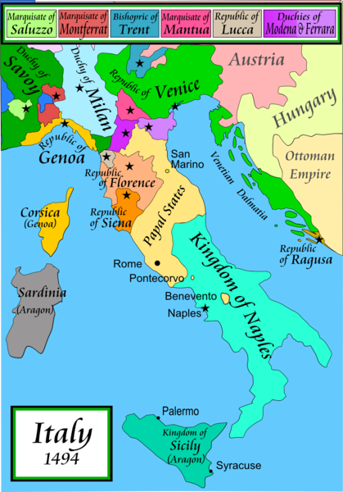

Slide 22
Italian Diplomacy & External Wars in the High Renaissance
Late 1400s = Economic & political decline = French & Spanish dominance of peninsula
  Fall of Constantinople
  Portuguese fleets & Atlantic trade
  Increased competition
Peace of Lodi (1454)
French, Spanish, German conflict over Italy
  First French invasion (1494) on Ludovico’s request
    Charles VIII plummets through peninsula toward Naples
  Spanish/HRE intervene
  Florence
    1494-1498: Savanarola (1452-1498) sets up religious dictatorship opposing Medici, French, Popes
    Excommunicated, executed
    Medicis returned
Louis XII invades with Pope Alexander VI’s support
Wars in Italy until 1559
Emperor Charles V sacks Rome in 1527
  HRE dominates most of peninsula
  Pope depends on HRE for defense against Turks
Results?
  End of High Renaissance
  Division of Italy
  Increasing secular/military involvement of popes (Esp. Alexander VI (Borgia) and Julius II )

Slide 23
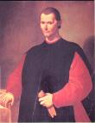
Machiavelli
Florentine diplomat in France and Rome
Believed Italians lacked “civic virtue”
The Prince (1513)
  Pragmatic guide to obtaining & keeping power.
  Strong prince could end instability, bring moral regeneration
  Faith in political leadership
  Government’s goal = Stability
  Not guide to dictatorship; merely observation.
  “Reasons of state” justification for political action
  Realpolitik

Slide 24
The “New Monarchies”
Monarchy strengthens in England, France, and Spain

Slide 25
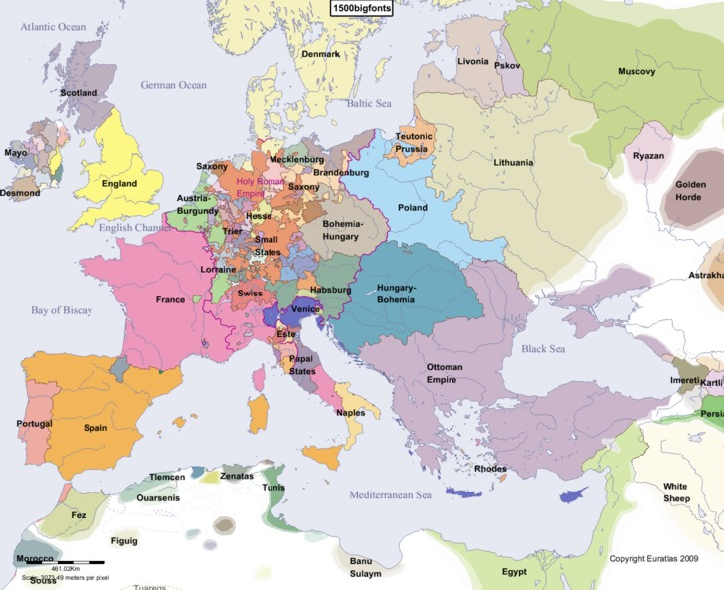

Slide 26
The “New Monarchies”
  After 1450 – Shift from feudal to unified national monarchies
    Royal burghers become royal advisors
    Towns ally with king. Why?
  Representative assemblies begin to emerge
    England: Parliament
    France: Estates General
    Spain: Cortes
  New states = Sovereign
    Taxes, war-making, law enforcement become NATIONAL
  Factors leading to monarchical dominance
    Appointments & bureaucracies
    Standing national, more professional, armies
    Raising money:
      Rent from domains
      National taxes on food, clothing
      Direct taxes on peasants
      Sale of offices
      Borrowing from Italian, German bankers

Slide 27
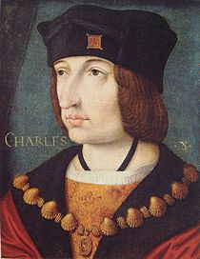
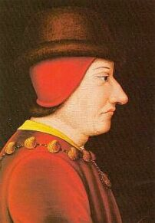
New Monarchy: France
Charles VII (r. 1422-1461)
  Exceptional advisors
  Professionalization of the army: 100 Years’ War
    Defeat of Burgundy & Charles the Bold
  Jacques Coeur
    Develops strong army
    Diplomatic corps
    National administration
Louis XI (r. 1461-1483)
  Makes France a great power
  Final defeat of England and elimination of Burgundy
  2x size of France
  Harnesses nobility
  Expands trade & industry

Slide 28
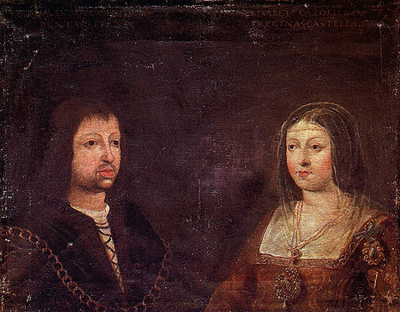
New Monarchies: Spain
Isabella of Castile (r. 1474-1504) & Ferdinand of Aragon (1479-1516): Marry in 1469
In 1492: Complete reconquista of Moors in Grenada
  Force conversions or exile of Jews and Muslims
  Later conquer Naples (1504) and Navarre (1512) – secure borders
Nobility’s power reduced
  Town league (hermandad) supports king
  Townspeople replace nobility in administration
Church power reduced
  Appointment of higher clergy
  Control Inquisition (Torquemada)
Cardinal Cisneros: Solidifies bond to Catholic Church
Marriage alliances:
  Joanna “the Mad” to Philp of Habsburg (son=HRE Charles I)
  Catherine of Aragon (eventually) to Henry VIII

Slide 29
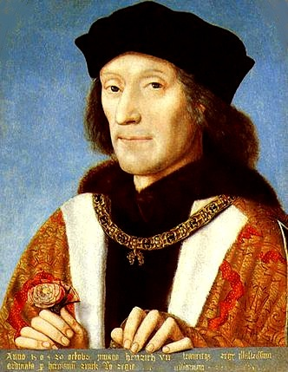
New monarchies: England
War of the Roses (1455-1485)
  Civil war between houses of York (White) and Lancaster (Red)
    Richard III (Edward IV’s brother – York) seizes throne, murders princes
    Support wells for Henry Tudor (Lancaster)
    Henry wins at Bosworth Field (1485)
Henry VII (r. 1485-1509)
  Begins Tudor dynasty
  Establishes power over nobility
    Court of Star Chamber
  Legal precedent used to support monarchy
    Take land and fortunes from nobility
    Become financially independent of Parliament

Slide 30
Closing question
What factors led to the strengthening of the “New Monarchies”?

Slide 31
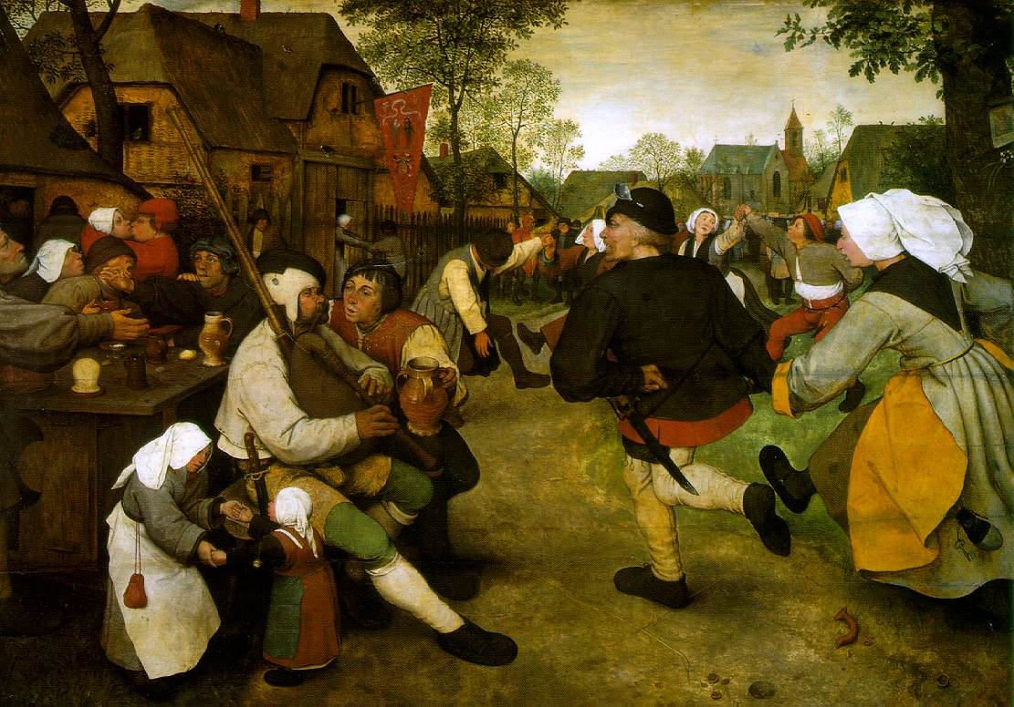

Slide 32
Big Questions About the Northern Renaissance
How did the Renaissance transform when it crossed the Alps into the North?
Why did northern scholars turn to the Bible and the Church fathers rather than Greece and Rome?

Slide 33
Northern Renaissance
Northern reformers set stage for Reformation
“New Learning” or “Italian Learning”
  Exported by students, artists, merchants, and the Brethren of the Common Life

Slide 34
Differences and similarities between the “Renaissances”
Italy
Northern Europe
Lay culture: urban, literate, affluent
Secular culture has greater influence on intellectual life
ad fontes: (“back to the sources”), but focus on Rome & Greece. Why?
Reading and study paths to betterment. Civic duty.
Man flawed, but perfectible.
Stress on free will: Humans free to rise or sink.
Lay culture: rural, illiterate, poor
Church more influential in intellectual life
Scholasticism more deeply rooted
ad fontes: But, sources tend to be the Bible & Church fathers. Why?
Christian humanists also see reading and study as paths to improvement. Religious objectives.
Man flawed, but perfectible.
Stress on free will: Humans free to rise or sink.

Slide 35
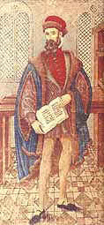
Gutenberg & Printing
Large increase in lay literacy
Development of cheap paper replaces vellum
Gutenberg prints first book with movable type: Bible (1455).
By 1500 → 40,000 titles published
  By 1500: 60 presses, 200 around Europe
  Mostly religious books
  Latin & Greek classics
Results?
  Encourages scholarly research
  Increases public access to learning
  Spread of new religious ideas

Slide 36
James Burke: The Printing Press (21:00)
http://www.youtube.com/watch?v=GGHIS8ErZhE

Slide 37
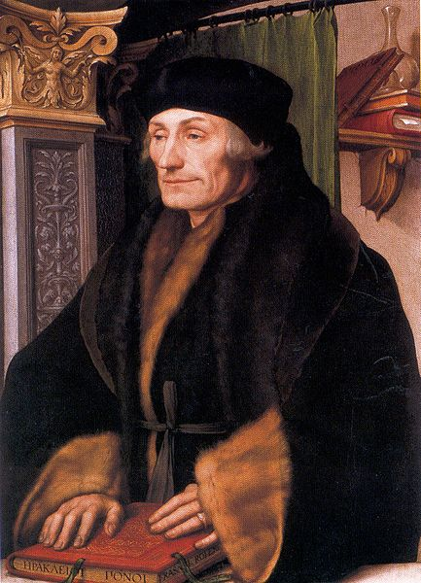

Slide 38
Desiderius Erasmus (1469-1536)
“Prince of the Humanists”: Leading Christian humanist
Obscure background, modest schools, Brethren of the Common Life = acquaintance with humanism
Augustinian, ordained priest, itinerant scholar in Paris, Louvain, Oxford, and Italy. (Befriends Thomas More)
Early work: Greek text of New Testament (both a Latin translation and a new Greek edition)
Published editions of Church fathers (Jerome, Chrysostom)
“Philosophy of Christ”: Christianity without dogma or ceremony
Most known for Praise of Folly (1512) and Julius Excluded
Will battle Martin Luther on human will and perfectibility
Contributes to Protestants, but does not join

Slide 39
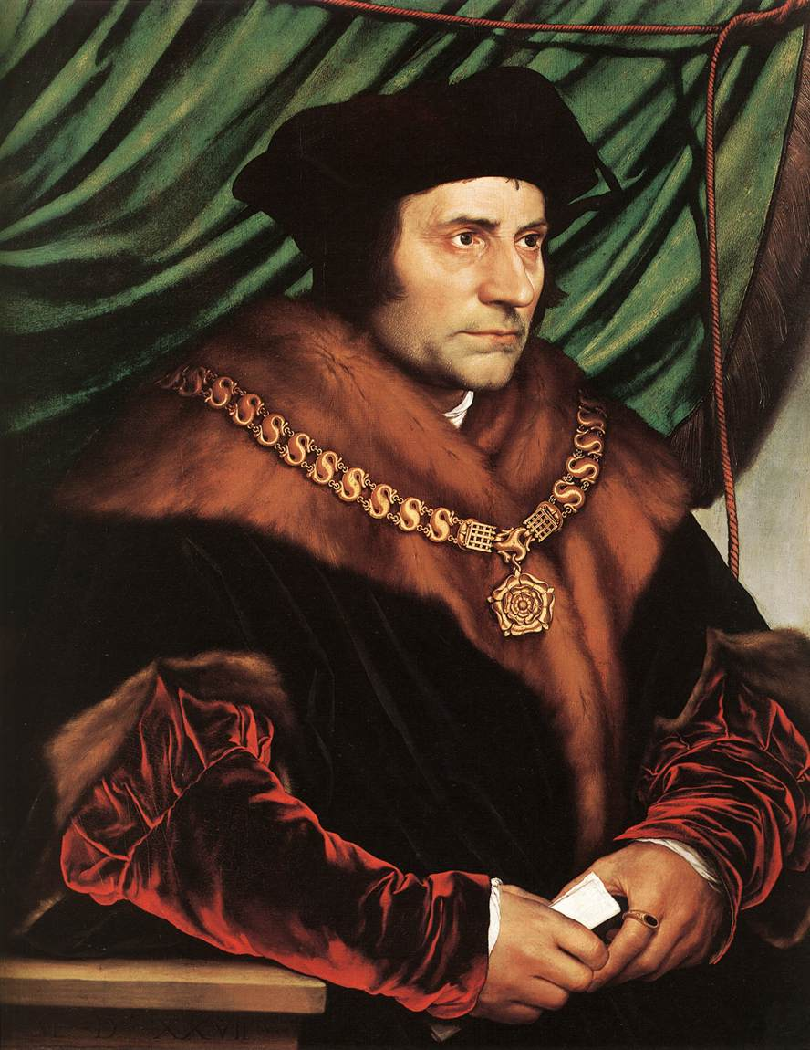

Slide 40
Sir Thomas More (1478-1535)
Romanticized figure.
Middle-class London family, good education
Enters Cardinal Morton’s household at 13, begins studies
Studied and even taught law
Holds series of distinguished positions for Henry VIII; Lord Chancellor in 1529
Publishes Utopia (1516). Non-existent land based on natural law and simple logic. Satire of contemporary situations.
Writes Henry VIII’s opposition to Luther
Translates Old Testament from Hebrew, despite opposition
Breaks with King Henry VIII in matter of his annulment, parting with Roman Church. Executed.

Slide 41
A Larger World Opens: Expanded Influence of Western Civilization
1400-1550
Age of Exploration and Colonization

Slide 42
Opening Question
What were the factors that drove European exploration and conquest?

Slide 43
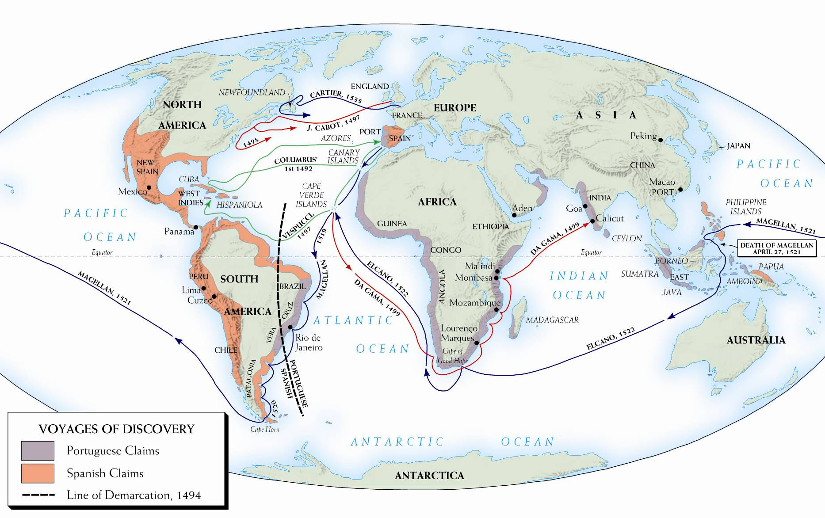
Notes:
Map 10–2 EUROPEAN VOYAGES OF DISCOVERY AND THE COLONIAL CLAIMS OF SPAIN AND PORTUGAL IN THE FIFTEENTH AND SIXTEENTH CENTURIES The map dramatizes Europe’s global expansion in the fifteenth and sixteenth centuries.

Slide 44
Motives in the Age of Exploration
Attracted to East for silks, spices, luxury
  Bypass Venetian and Muslim middle-men
  Potential for immense profits
Difficult to trade with Islamic empires
  1453 Byzantine Empire fell to Turks
Desire for wealth and adventure
Religious zeal- save souls
Summary
  Gold, God, and Glory (Guns)

Slide 45
Improvements in Navigation
Better maps, follow coasts at first
Improved compass
Better ships- square sails and new hull design, heavy enough to carry cannon
Use of astrolabe (latitude)
Knowledge of wind patterns
First the Portuguese (Prince Henry) then Spanish, France and England

Slide 46
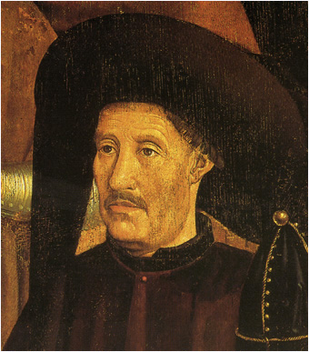
Portuguese Explorers
Prince Henry the Navigator (1394-1460)
  Hoped to Christianize Africa, link w. Abyssinia
  Established school of navigation (1419)
  Explored Madeira and Azores by 1430
  Cape Verde by (1460)—Spanish settlers on all
Slave trading station begun in 1442 off of E. Africa
Bartholomew Diaz- made it to Cape of Good Hope 1488
Vasco da Gama- went in search of Christians and spices- arrived in India in 1498 & returned, rich, in 1499
1510 Portuguese flags in Goa, India and Macao, China
European commerce shifts from Med. to Atlantic

Slide 47
“The Day the Universe Changed” Navigation – 36:00
http://www.youtube.com/watch?v=NWEIZThPaRw

Slide 48
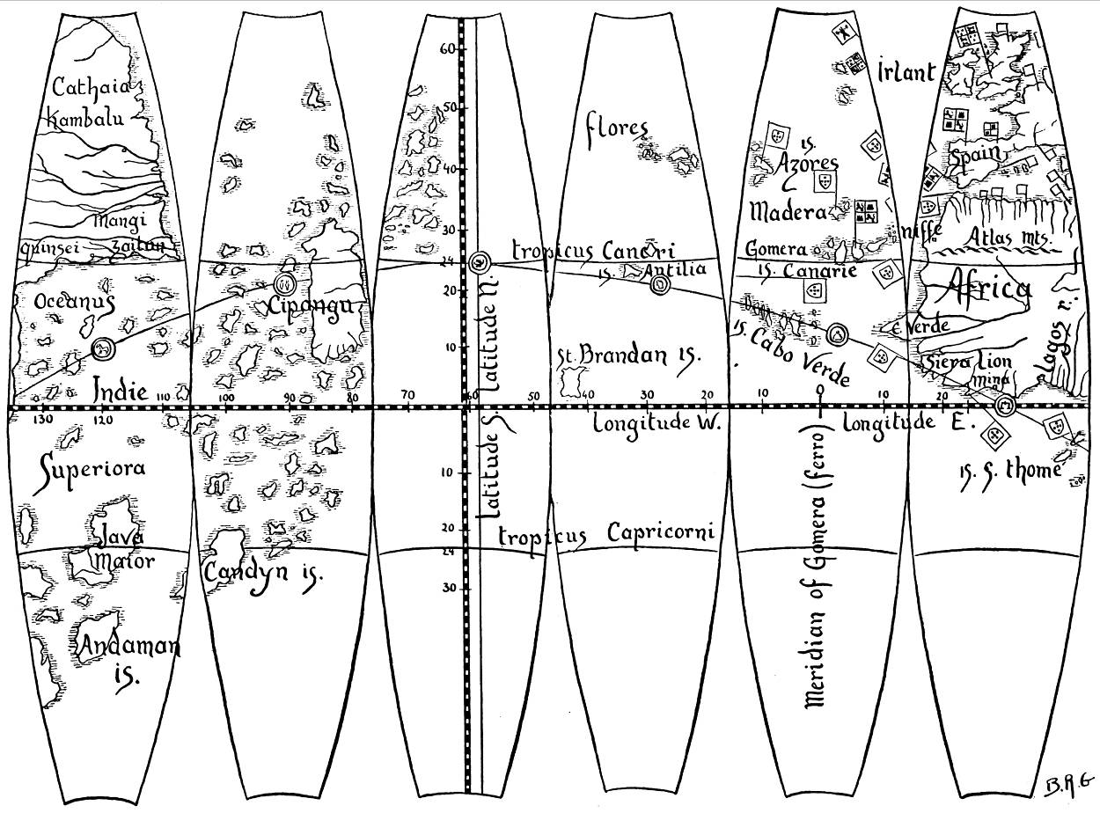
Notes:
What Columbus knew of the world in 1492 was contained in this map by the Nuremberg geographer Martin Behaim, creator of the first spherical globe of the earth. The ocean section of Behaim’s globe is reproduced here. Departing the Canary Islands (in the second section from the right), Columbus expected his first major landfall to be Japan (Cipangu, in the second section from the left). When he landed at San Salvador, he thought he was on the outer island of Japan. Thus, when he arrived in Cuba, he thought he was in Japan.
From ADMIRAL OF THE OCEAN SEA by Samuel Eliot Morison. Copyright © 1942 by Samuel Eliot Morison; Copyright © renewed 1970 by Samuel Eliot Morison. By permission of Little, Brown and Company, (Inc.)

Slide 49
The Spanish
Believed had to be a short-cut by sailing west
Columbus (Genoan) went west 1492
  Arrived in Caribbean thought it was the Indies thus the West Indies
  Three later voyages around Caribbean
Amerigo Vespucci (1501) – Coast of Brazil
Ferdinand Magellan (1480-1521):
  Circumnavigates the world
  Does not complete himself; One ship returns in 1522
East and West divided- Pope drew a line dividing the world between Spain and Portugal (Treaty of Tordesillas - 1494)

Slide 50
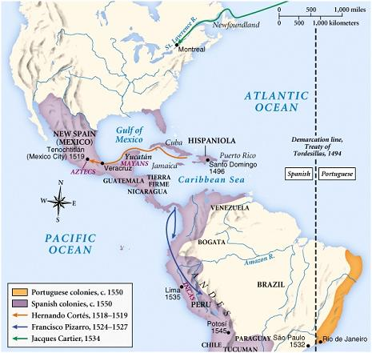

Slide 51
Spain in the Americas
Mexico and central America
Peru
Aztecs conquer & dominate neighbors by 1500
Hernan Cortes
  Lands in 1519 w. 600 men
  Defeats Montezuma
  “New Spain” by 1521
Incas also a harsh empire
Francisco Pizarro
  Invades in 1531
  Executes Atahualpa (1433)
  Spanish internal divisions slow consolidation (1560s under royal control)

Slide 52
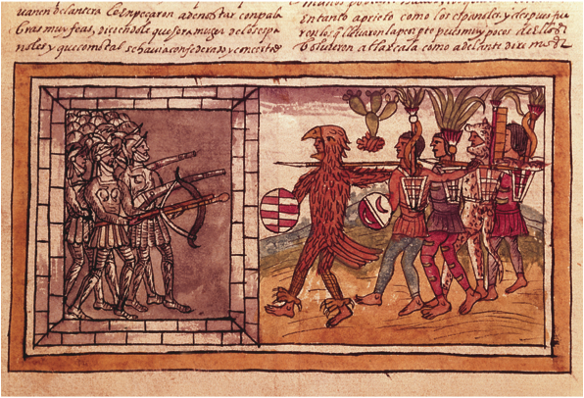
Notes:
Armored Spanish soldiers, under the command of Pedro de Alvarado (d. 1541) and bearing crossbows, engage unprotected and crudely armed Aztecs, who are nonetheless portrayed as larger than life by Spanish artist Diego Duran (16th century).
Codex Duran: Pedro de Alvarado (c. 1485–1541), companion-at-arms of Hernando Cortés (1845-1547) besieged by Aztec warriors (vellum) by Diego Duran (16th Century), Codex Duran, Historia De Las Indias (16th century). Biblioteca Nacional, Madrid, Spain. The Bridgeman Art Library International Ltd.

Slide 53
Slave Trade
Portuguese- trade with Africa- To Portugal as servants than to Brazil to work on plantations
Africans less susceptible to European diseases than Native Americans
But death rate was high: 13-30% just on the trip
African middlemen active- depopulate entire areas of Africa- food from Americas helped increase birthrate

Slide 54
The Church in Spanish America
The conquerors wanted to convert the captured native people to Christianity and to accept European culture
Some religious leaders felt the natives were being treated poorly, such as Bartolome de Las Casas
Despite the opposition, the Roman Catholic Church becomes one of the most powerful conservative forces in Latin America

Slide 55
Columbian Exchange
Diseases go both directions
  Syphilis from Americas to Europe
  Smallpox, diphtheria, measles, whooping cough, chicken pox, malaria, typhoid, yellow and scarlet fevers, influenza, tuberculosis, and bubonic plague from Europeans
    Up to 90% of native population dies
    Not intentional
Animals to New World
  Cattle, sheep, pigs, goats, donkeys, dogs, cats, and horses
Old World plants to New World
  Oats, barley, wheat, and dandelions (!)
New World plants to Old
  Maize (corn), potatoes, and sweet potatoes

Slide 56
Latin America Exploitation
Mining – the Spanish conquistadores or conquerors mined gold and silver with forced labor
Agriculture – on haciendas, large land estates owned by the peninsulares (people born in Spain) and creoles (people of Spanish descent born in America) used forced labor for mining, farming and ranching
Plantations in the West Indies used slaves to get sugar
Economic activity in government offices, the legal profession, and shipping
Labor servitude in order of appearance:
  Encomienda – a formal grant of the right to the labor of a specific number of Indians
  Repartimiento – required adult male Indians to devote a certain number of days of labor annually to Spanish economic enterprises
  Debt peonage – Indian laborers required to purchase goods from the landowner to who they were forever indebted
  Black slavery

Slide 57
Impact on Europe
Increases skepticism of “received wisdom”. Why?
Increased concern with natives’ welfare
Beginning of globalization and European dominance
Economically
  Spiraling, but steady, inflation
  Problem = Wages lag prices
  New wealth = greater investment in research & expansion
  Some gov’t centralization of economic functions

Slide 58
Breakout of capitalism
What is capitalism?
Growth of trade in late Middle Ages spurs development of capitalism
Banking
  Italy: Medici, others, set up major banking centers, branches across Italy
  Northern Europe: Fuggers
New industries: Cloth, mining, printing, shipbuilding, arms
New consumer goods: Sugar, tea, rice, tobacco, cocoa

