Slide 1
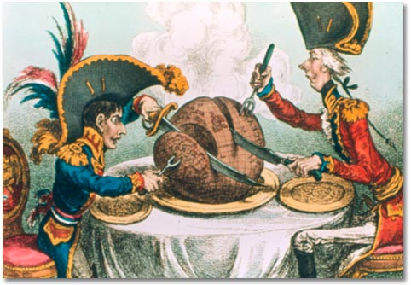
Nationalism
Nations out of Empires
AIM: What is Nationalism and how does it affect societies and countries?
Do Now:
Nationalism Worksheet

Slide 2
What are the Features
of Nationalism?
Pride and Devotion
to One’s Country
Loyalty to the
nation-state
Attachment to
local traditions
Patriotism
NATIONALISM
A state
of mind
Justifies authority
of the state

Slide 3

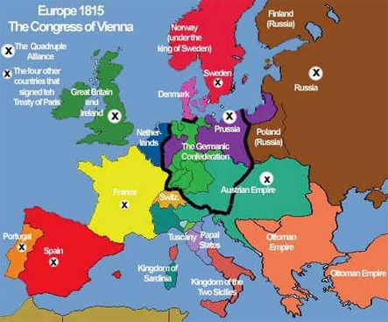
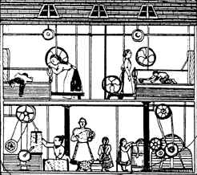
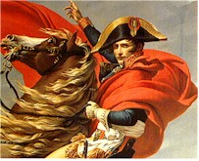
I’ve tasted freedom,
and I want more!
Why did a growing sense of nationalism develop among European peoples in the 19th century?

Slide 4
The Congress of Vienna
re-establishes monarchies
The Enlightenment
introduces free thinking
Causes
The French Revolution & Napoleonic Wars
ravage Europe
The Industrial Revolution
aids in the rise of the middle class

Slide 5
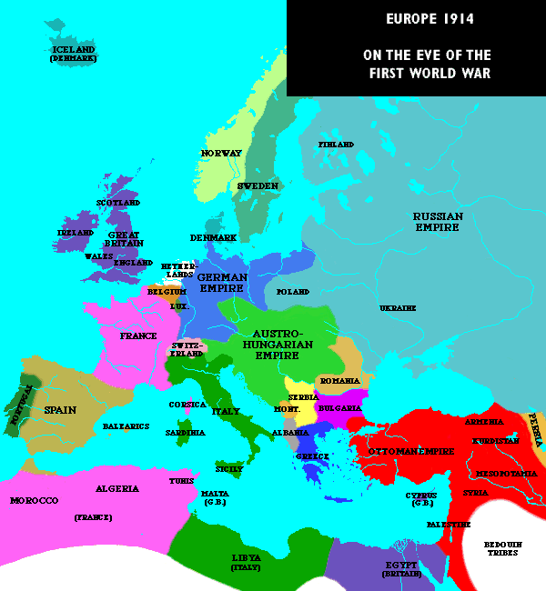
1831 – Belgium!
1871 – Germany!
1878 – Serbia??
1861 – Italy!
1821 – Greece!

