Slide 1
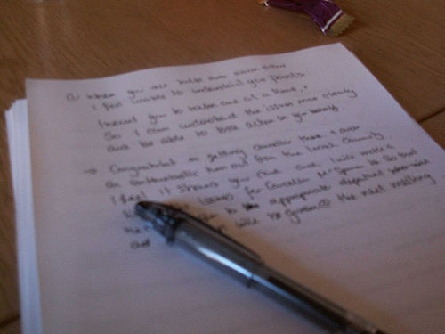
NOTE TAKING SKILLS
For Students
© Mr. A. Ott, 2008
Notes:
Five Important Reasons to Take Notes
It triggers basic lecturing processes and helps you to remember information.
It helps you to concentrate in class.
It helps you prepare for tests.
Your notes are often a source of valuable clues for what information the instructor thinks most important (i.e., what will show up on the next test).
Your notes often contain information that cannot be found elsewhere (i.e., in your textbook).
Guidelines for Note-Taking
Concentrate on the lecture or on the reading material.
Take notes consistently.
Take notes selectively. Do NOT try to write down every word. Remember that the average lecturer speaks approximately 125-140 words per minute, and the average note-taker writes at a rate of about 25 words per minute.
Translate ideas into your own words.
Organize notes into some sort of logical form.
Be brief. Write down only the major points and important information.
Write legibly. Notes are useless if you cannot read them later!
Don't be concerned with spelling and grammar.
Tips for Finding Major Points in Lectures
The speaker is usually making an important point if he or she:
Pauses before or after an idea.
Uses repetition to emphasize a point.
Uses introductory phrases to precede an important idea.
Writes an idea on the board.
Forms of Note-Taking
Outlining
I. Topic sentence or main idea
A. Major points providing information about topic
1. Subpoint that describes the major point
a. Supporting detail for the subpoint
Patterning: flowcharts, diagrams
Listing, margin notes, highlighting
Ways to Reduce and Streamline Notes
Eliminate small connecting words such as: is, are, was, were, a, an, the, would, this, of. Eliminate pronouns such as: they, these, his, that, them. However, be careful NOT to elimate these three words: and, in, on.
Use symbols to abbreviate, such as:
+, & for and, plus
= for equals
- for minus
# for number
x for times
> for greater than, more, larger
< for less than, smaller, fewer than
w/ for with
w/o for without
w/in for within
----> for leads to, produces, results in
<---- for comes from
/ for per
For example:
"The diameter of the Earth is four times greater than the diameter of the Moon."
Becomes:
"Earth = 4x > diameter of Moon."
Substitute numerals with symbols, for instance:
Substitute "one" with 1
Substitute "third" with 3rd
Abbreviate:
Drop the last several letters of a word. For example, substitute "appropriate" with "approp."
Drop some of the internal vowels of a word. For example, substitute "large" with "lrg."

Slide 2
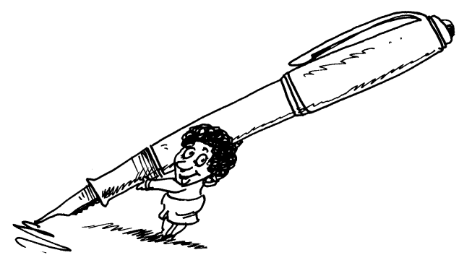
Five Important Reasons to Take Notes
It triggers basic lesson processes and helps you to remember information.
It helps you to concentrate in class.
It helps you prepare for tests.
Your notes are often a source of valuable clues for what information the teacher thinks most important (i.e., what will show up on the next test).
Your notes often contain information that cannot be found elsewhere (i.e., in your textbook).

Slide 3

Guidelines for Note-Taking
Concentrate on the lesson or on the reading material.
Take notes consistently.
Take notes selectively.
Do NOT try to write down every word.
Remember that the average teacher speaks approximately 100-125 words per minute, and the
average note-taker writes at a rate of about 25 words
per minute.
Translate ideas into your own words.
Organize notes into some sort of logical form.
Be brief. Write down only the major points and important information.
Write legibly. Notes are useless if you cannot read them
later!

Slide 4

Tips for Finding
Major Points In
Lessons
The teacher is usually making an important point if
he or she:
Pauses before or after an idea.
Uses repetition to emphasize a point.
Uses introductory phrases to precede an important idea.
Writes an idea on the board.

Slide 5

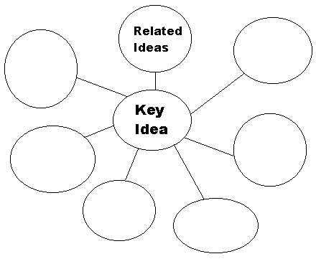
Forms of Note-Taking
Outlining
I. Topic sentence or main idea
A. Major points providing information about topic
1. Subpoint that describes the major point
a. Supporting detail for the subpoint
Patterning: flowcharts, diagrams (Venn),
Web Mapping
Listing, margin notes, highlighting

Slide 6
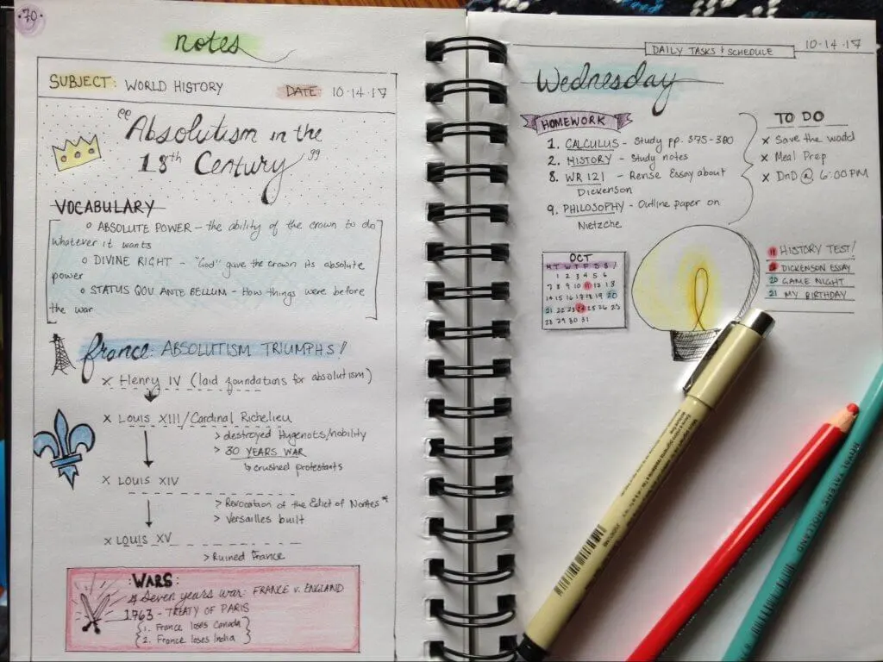
Ways to Reduce and Streamline Notes
Eliminate small connecting words such as:
is, are, was, were, a, an, the, would, this, of.
Eliminate pronouns such as:
they, these, his, that, them.
However, be careful NOT
to eliminate these three words:
and, in, on.

Slide 7
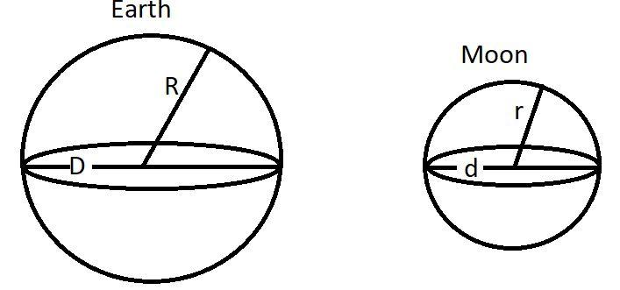
Ways to Reduce and Streamline Notes
Use symbols to abbreviate, such as:
+, & for and, plus = for equals - for minus # for number x for times | > for greater than, more, larger < for less than, smaller, fewer than / for per | w/ for with w/o for without w/in for within ----> for leads to, produces, results in <---- for comes from
For example:
"The diameter of the Earth is four times greater
than the diameter of the Moon."
Becomes:
"Earth = 4x > diameter of Moon."

Slide 8
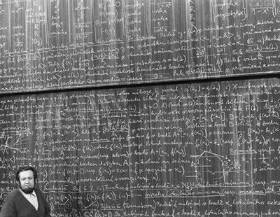
Ways to Reduce and Streamline Notes
Substitute numerals with
symbols, for instance:
Substitute "one" with 1
Substitute "third" with 3rd
Abbreviate:
Drop the last several letters of a word. For example, substitute “probably" with “prob."

Slide 9
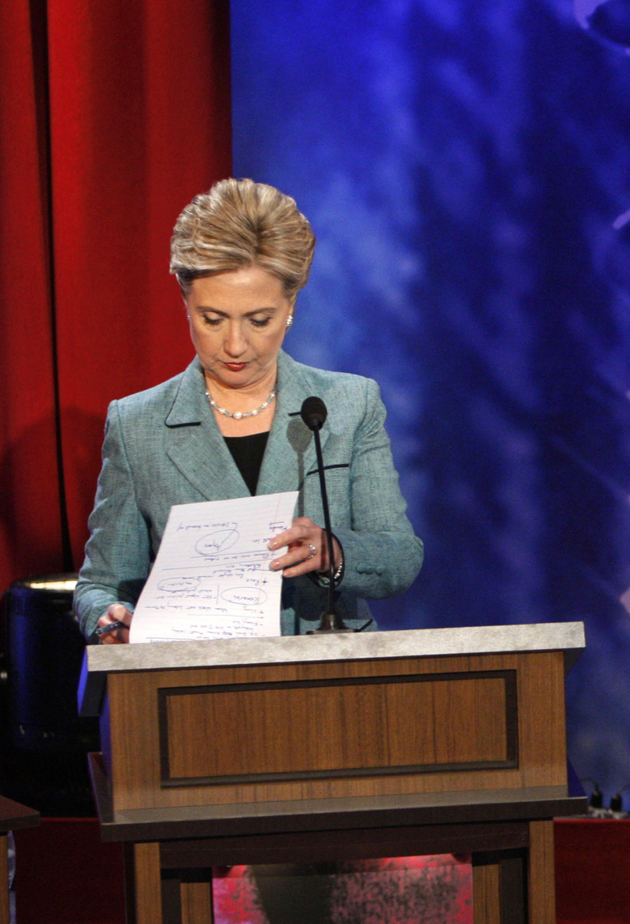
Good Notes
=
Good
Study
Habits

