Slide 1
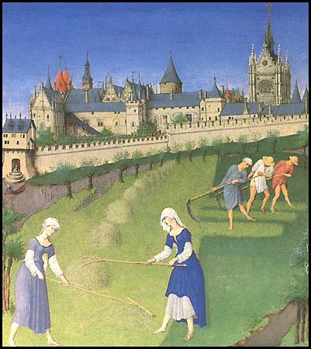
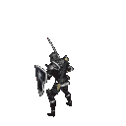
The Fall of Rome and the beginning of the
Middle Ages
Aim: What event led to the term Dark Ages and
Why was Feudalism important during the middle ages?
Do Now: Worksheet / Answer True/False Only
Dark/Middle Ages: 500AD-1350AD

Slide 2
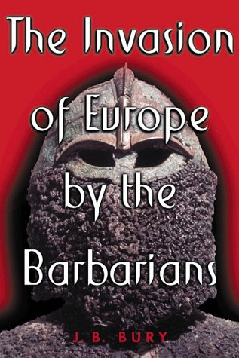
Fall of Rome
Rome was besieged by various tribes from modern day Germany and France.
Disease – Plague
No Strong Central Authority – Empire Split – East Strong – West Weak

Slide 3

Dark/Middle Ages: 500AD-1350AD
Although the fall of the Western Roman Empire did not happen overnight, many historians consider its fall the beginning of the Middle Ages or Dark Ages.

Slide 4
The Middle Ages were a dangerous time in Europe
The strong empires of
Rome and Greece that protected trade routes
and encouraged science and personal liberties were fading away.
The Roman empire not only had to fight the plague but fight invaders from Europe and Asia (Mongols).

Slide 5
No more large cities, trade, education
With all the disease, riots, outside attacks and starvation people fled the cities of the once strong Roman empire.
In Europe, people now lived on manors, self-sufficient communities consisting of a castle, church, village and surrounding farmlands.

Slide 6
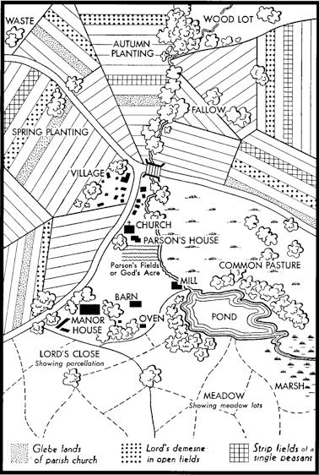
Manoralism
(Medieval Economic System)
Most people lived on a manor, which consisted of the castle, the church, the village, and the surrounding farm land.
For safety and for defense, people in the Middle Ages formed small communities around a central lord or master.
These manors were isolated,
with occasional visits from peddlers, pilgrims on their way to the Crusades, or soldiers
from other fiefdoms.

Slide 7
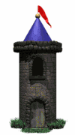

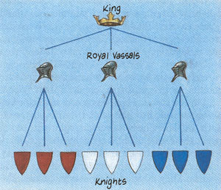
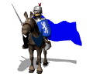
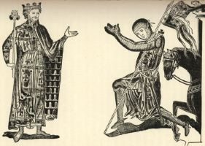
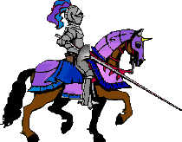
Feudalism: Land for
Military Service

Slide 8
Feudalism
(Medieval Political System)
The kings had lots of land; he gave land to lords in exchange for protection and money.
Lords gave their land to knights in exchange for protection & money.
Land given to knight for service was called a fief
  Anyone accepting fief was called a vassal
  Person from whom he accepted fief was his lord
Knights let serfs work the land and he would protect them.
Serfs got food and shelter.
Thus, each person had rights and responsibilities
Historians call system of exchanging land for military service the feudal system, or feudalism

Slide 9
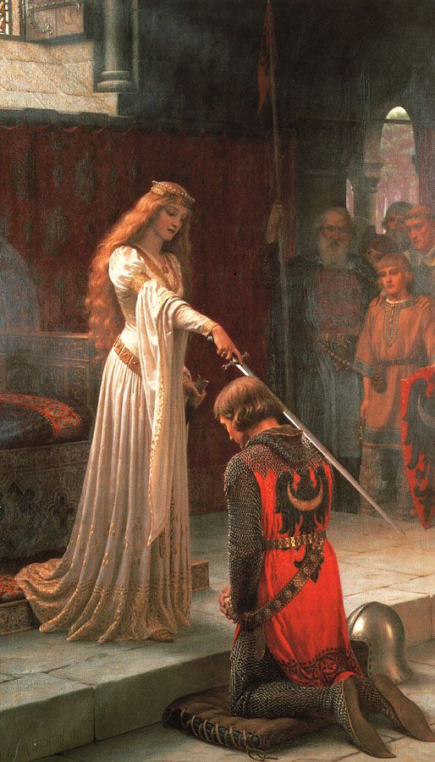
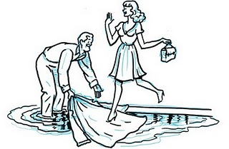
What is Chivalry?
A code of honor

Slide 10
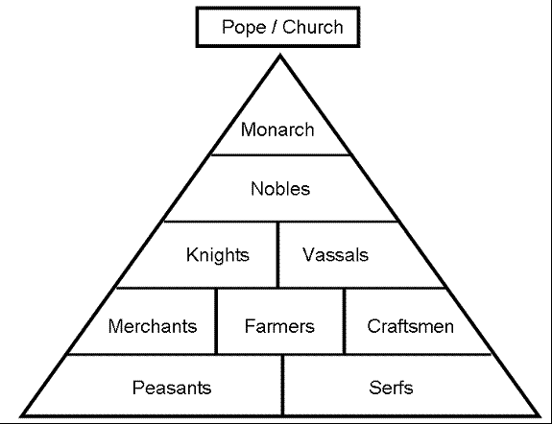
Feudalism
(Medieval Social Pyramid)

