Slide 1
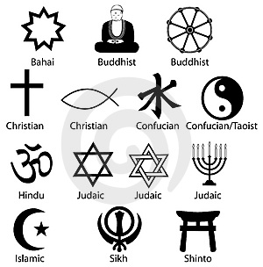
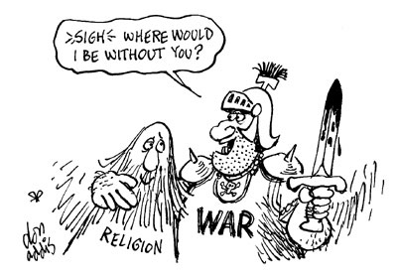
Belief Systems

Slide 2
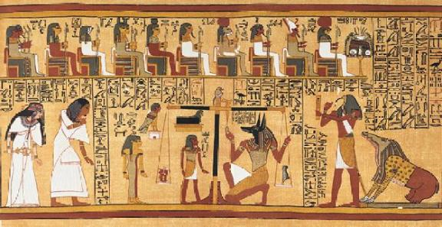
POLYTHEISTIC
BELIEF IN OR WORSHIP OF MULTIPLE GODS
THE WORD COMES FROM A ANCIENT GREEK WORD
MOST ANCIENT RELIGIONS WERE POLYTHEISTIC
OFTEN PRACTICED RITUALS AND SACRIFICES TO THE MANY GODS

Slide 3
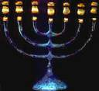
Monotheistic
Definition: a belief in a single god
Greek words “mono” meaning “one” and
“theism” meaning “god-worship”
The Hebrews (Jews) were the first religions to become monotheistic. They believed in one god for protection who they called Yahweh. Yahweh had power over everyone, not just the Jews and Hebrews.
God was not a physical being, and no physical images were to be made of him.
According to the Torah the reason Yahweh looked after the Hebrews was because Abraham promised to obey him, not because of ceremonies or sacrifices as seen in polytheism.

Slide 4
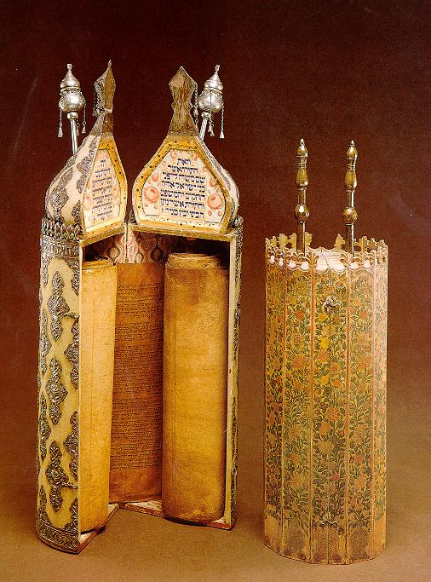
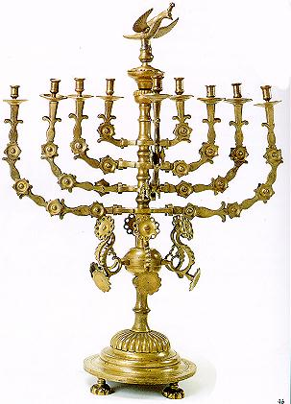
Judaism
Monotheistic – belief in one God who is present
everywhere, all-knowing, all-powerful
Holy book – Torah
Writings are a sacred recording of the laws and
events in Jewish history
Also writings of the prophets (spiritual leaders)
Believe that God made a covenant (agreement) with Abraham and the
Hebrews to protect them
Ten Commandments from God given to Moses –
laws that describe how people should behave towards
God and each other
Believe that God chose the Hebrews as His people
Prophets were people who God talked to, they taught about moral standards and justice
Judaism later had a strong influence on Christianity and Islam

Slide 5


Christianity
Jesus was the founder of Christianity.
He was born around 6 to 4 B.C.
He began his ministry at age 30.
Jesus’ teachings included many Jewish beliefs, such as monotheism and the Ten Commandments. He stressed God’s personal relationship with each person.
Jesus’ followers were called ‘disciples’ and later ‘apostles’.
Jesus was crucified around A.D. 29 for ‘challenging the authority of the Roman government’. Jesus’ disciples believed that his crucifixion was a triumph over death and that he was the Messiah. The Jewish priests of the time did not believe he was the Messiah and call his ministry blasphemy.
Jesus’ disciples continued to spread Jesus’ teachings and
Christianity later became a prominent religion throughout
the world.

Slide 6

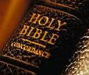
Bible
Christians used the book as a way to follow their god.
The book consisted of the old and new testament.
The bible contains stories and messages about their god.
The New Testament is about Jesus’ life as it was on earth and how it came to be.

Slide 7


Islam(600s – Present)
Islam is a religion that came about in the early 600s.
The founder was a merchant named Muhammad Ali.
He claimed that one night the voice of Allah (God) spoke to him, and thus he began the religion.
To be a Muslim (a submitted one) or a follower of Islam, followers must obey the five pillars or five duties to Allah.

Slide 8

Allah
IS THE MUSLIM GOD
HE IS THE ONE GOD OF ISLAM
WORSHIPED MOSTLY THE MIDDLE EAST, AFRICA, and ASIA

Slide 9
Muhammad
* Muhammad was born into a clan of a powerful Mecca Family. He was a merchant, in his travels he came into contact with Jews and Christians.
* Muhammad took great interest in religion. When he was alone he mostly prayed and meditated.
* When he was 40 a voice called to him while he was meditating. The voice was believed to say that Muhammad was a messenger of god.
* In 622 Muhammad left Mecca. He went 200 miles north of Mecca to a town called Yathrib. This journey by Muhammad was known as the Hijrah.
* Muhammad returned to Mecca in 630 with his 10,000 followers.
* Mecca surrendered and Muhammad became leader. Most people in Mecca converted to Islam to pledge their loyalty to Muhammad.
* Muhammad dies two years later at the age of 62.

Slide 10
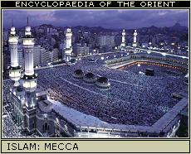
Five Pillars
This applies to the Islamic religion.
Faith
  To become muslin, you need to testify to the statement of faith: “there is no god but allah, Muhammad is the messenger of Allah.
Prayer
  Muslims must face Mecca and pray five times a day.
Alms
  Muslims have been taught to support the less fortunate.
Fasting
  During the Muslim month of Ramadan, Muslims fast. Fasting is eating and drinking nothing from sun up to sun down.
Pilgrimage
  Muslims must go on a pilgrimage to Mecca at least once in their lifetime.

Slide 11
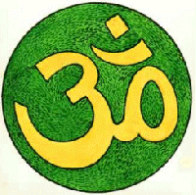
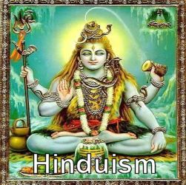
HINDUISM
Started with Nomads in the Indus Valley in 1500 B.C.
Brahmah – one unifying spirit
  Brahma the Creator, Vishnu the Preserver, Shiva the Destroyer
Goal of life is to unite with Brahman (through reincarnation)
Reincarnation – rebirth of the soul in a new body, get closer to Brahman with every rebirth
Karma – deeds of ones life that effect his or her next life
Dharma – moral and religious duties that are expected from an individual
Caste system – social class system
Vedas – one of the books of Hinduism,
filled with sacred teachings

Slide 12
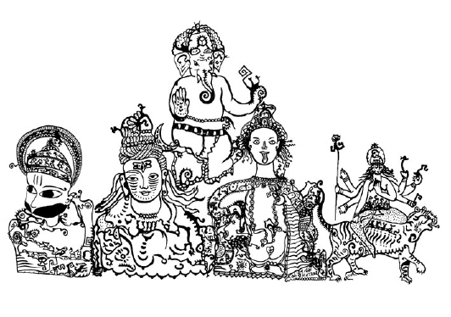
Karma (750 B.C.)
Hindus share a common world-view.
They see religion as a way of liberating the soul from the illusions, disappointments, and mistakes of everyday existence.
Sometime between 750 B.C. and 550 B.C., Hindu teachers tried to interpret and explain the hidden meaning of the Vedic hymns.
As they meditated on the Vedas, they asked:
    What is the nature of reality?
    What is morality?
    Is there eternal life?
    What is the soul?
A belief in reincarnation, or rebirth of the soul in another body after death, forms the basis of Hinduism and underlies the entire cast system.
    A person’s cast is their reward or punishment for karma, deeds committed in a previous life.
    Karma influences specific life circumstances, such as the cast one is born into, one’s state of health, wealth or poverty, and so on.

Slide 13
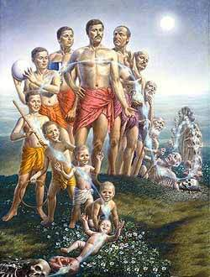

Reincarnation
Reincarnation is a central teaching of the Hindu Religion.
When one is born they are given life by Brahma, as they pass through life they are preserved by Vishnu, until Shiva claims you in death.
Than the cycle is repeated over and over again until one finally achieves Moksha.
Rivers are used to symbolize reincarnation because they have a constant flow, yet follow the same course.

Slide 14

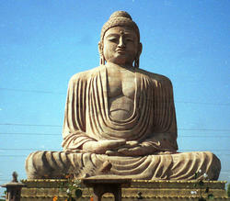
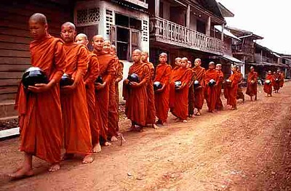
Buddhism
Originated in India, by Siddhartha Guatama
Four Noble truths-
All life is suffering
Suffering is caused by desire for material things that are illusions
The way to eliminate suffering is to eliminate desire
Following the Eightfold Path will help people overcome desire
Sacred text-
Tripitaka- Three baskets of wisdom
Ultimate goal: Nirvana- union with the universe and release from the cycle of death and rebirth

Slide 15
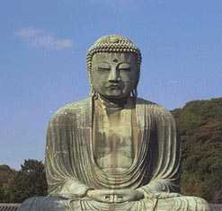
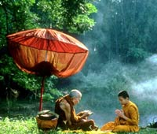
Four Noble Truths
The Four Noble Truths were a part of Siddhartha Gautama’s Buddhism.
These truths were what was understood by Siddhartha in his enlightenment.
They were ideas that were supposed to be followed to seek enlightenment, or wisdom.
The First Noble Truth- Everything in life is suffering and sorrow.
The Second Noble Truth- The cause of all suffering is people’s selfish desire for the temporary pleasures of this world.
The Third Noble Truth- The way to end all suffering is to end all desires.
The Fourth Noble Truth- The way to overcome such desires and to attain enlightenment is to follow the Eightfold Path, which is called the Middle Way between desires and self-denial.

Slide 16
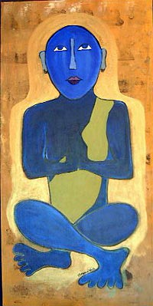
Nirvana- 250 B.C.
Belief of the Buddhist religion.
Defined as union with the universe. It is also a
release from the cycle of death and rebirth.
It is also a release from selfishness and pain.
Buddha stressed that each individual person could reach a peace state called nirvana.
You have to follow the Eightfold Path in order to reach nirvana.
To achieve Nirvana, you would have to reject the sensory world and embracing spiritual discipline.

Slide 17
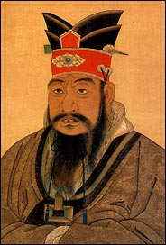
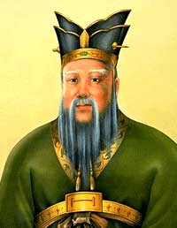
Confucianism
Confucianism started in China during the Zhou Dynasty
Confucianism was the guide to the nature of
government and the structure to society
Men were thought to be superior to women
Confucius wrote The Analects
Confucius believed in order to establish social order, harmony and a good government he needed to use the
Five key relationships 1. friend to friend, 2.father to son, 3. ruler to subject, 4. husband to wife, 5. older brother to younger brother
Confucius stressed that children should practice
filial piety or respect for their elders
There was also an influence on the Japanese

Slide 18

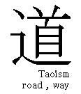

Taoism (or Daoism) c. 500 B.C.
Founder= Laozi
Live in harmony with nature
Contemplate Tao, or the ‘way’
Yielding and acceptance are important virtues
Followers rejected the world and human government, they often became hermits, mystics or poets.
Balance of yin and yang
Yin= earth, darkness, female forces
Yang= heaven, light, and male forces
Collected works: The Way of Virtue and zhuang-zi

Slide 19
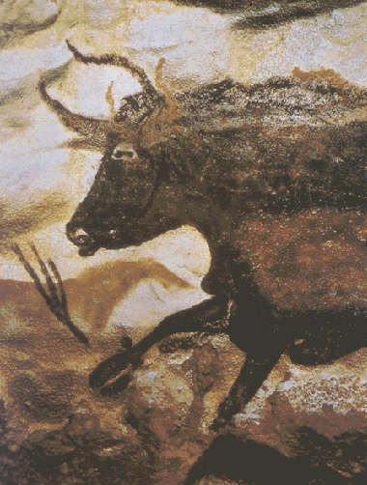

Animism
An ancient religion that centralizes it’s beliefs around the belief that human-like spirits are present in animals, plants, and all other natural objects.
The spirits are believed to be the souls of dead ancestors.
Spirits possess living and non-living things
Often combined with other religions to extend beliefs.

Slide 20
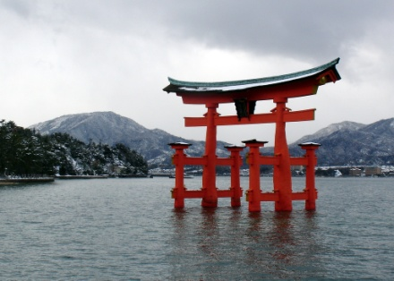
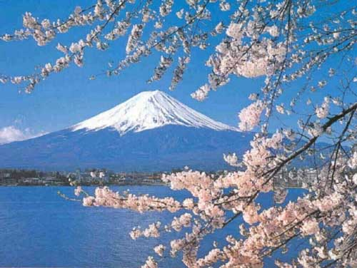
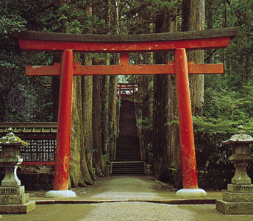
Shintoism
Shinto, which means "Way of the Gods," is the traditional religion of Japan that focuses on nature. Many consider Shinto to be a form of Animism due to the many similarities found between them.
Established: Shinto was founded around the year 500 BCE.
Founder: Evolved from a mixture of tribal religions with similar beliefs.
Geographic Origin: Developed on the Japanese archipelago.
Currently Practiced: Most common in Japan.
Significant Writings: Kokiji, or Record of Ancient Matters and Nikong, or Chronicles of Japan.
Places of Worship: Shinto shrines are usually dedicated near sites of impressive natural beauty (e.g., mountains, lakes, etc.), or of historical importance to Japan. The entrance to these shrines is usually indicated by the presence of a red gateway called a torri.
Significant Religious People: Traditionally, the Emperor of Japan was considered to be a direct descendant of the Sun Goddess who created the Japanese islands. Therefore, the Emperor was considered divine by the people who practiced Shinto. After Japan surrendered to the United States in WWII, Emperor Hirohito renounce his divinity and political authority.
Teachings and Beliefs:
Shinto teaches that there is a sacredness of the whole universe and that humans can be in tune with this sacredness. Every mountain, river, plant, animal, and all the diverse phenomena of heaven and earth have spirits, or kami, which inhabit them. Reverence is paid to the ancestors through the practice of ancestor worship.

Slide 21

Shintoism
Significant Writings: Kokiji, or Record of Ancient Matters and Nikong, or Chronicles of Japan.
Places of Worship: Shinto shrines are usually dedicated near sites of impressive natural beauty (e.g., mountains, lakes, etc.), or of historical importance to Japan. The entrance to these shrines is usually indicated by the presence of a red gateway called a torri.
Significant Religious People: Traditionally, the Emperor of Japan was considered to be a direct descendant of the Sun Goddess who created the Japanese islands. Therefore, the Emperor was considered divine by the people who practiced Shinto. After Japan surrendered to the United States in WWII, Emperor Hirohito renounce his divinity and political authority.
Teachings and Beliefs:
Shinto teaches that there is a sacredness of the whole universe and that humans can be in tune with this sacredness. Every mountain, river, plant, animal, and all the diverse phenomena of heaven and earth have spirits, or kami, which inhabit them. Reverence is paid to the ancestors through the practice of ancestor worship.

