Slide 1
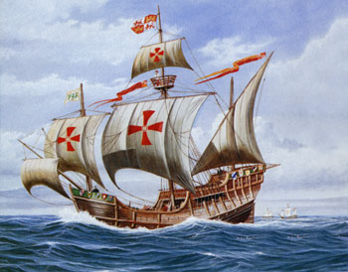

European Exploration
The First Global Age
AIM: Why did Europeans want to go out and explore the world?
Do Now: Name the four important turning points that allowed the First Global Age (AKA: Age of Discovery, Age of Exploration, The Encounter) to occur.
Mr. Ott - Global History & Geography

Slide 2
Creates the funds for international shipping/trade
First Global Age
Crusades
Commercial Revolution
Protestant Reformation
Scientific Revolution
Creates a push for Roman Catholics to convert people
Age of Exploration
&
Discovery of the “New World”
Creates an interest in trade of Asian goods
Creates new tools for Exploration

Slide 3
AIM: Why did Europeans want to go out and explore the world?
God- Europeans see themselves as superior to others and feel the need to spread Christianity throughout the world, especially the “Heathens”
Glory- What better way to “show off” than to go out and be the first to discover something new.
Gold- By controlling trade routes to the east, Europeans could cut out the middle men. Also, they could try to find Gold in the new land.
Technology- New technology such as the caravel, astrolabe, and compass.
3 “G’s”
and
a
“T”

Slide 4
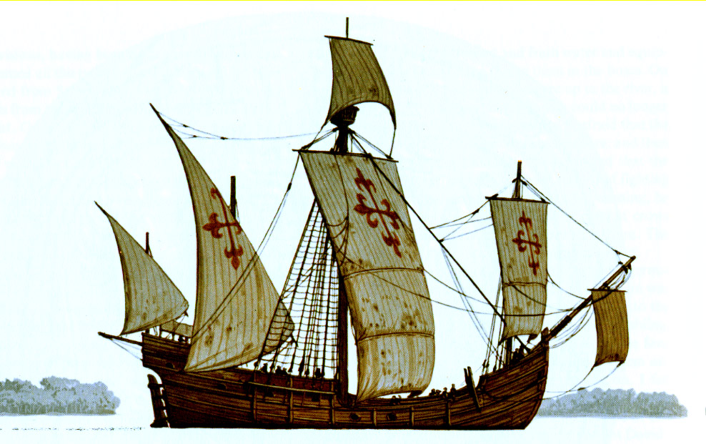
Caravel
Technology
Fast and popular ship
design during exploration
Nina and Pinta were both caravels
(Columbus’ Ships)
Most had triangular sails that allowed them to tack or sail on a zig-zag course which made them go faster.

Slide 5
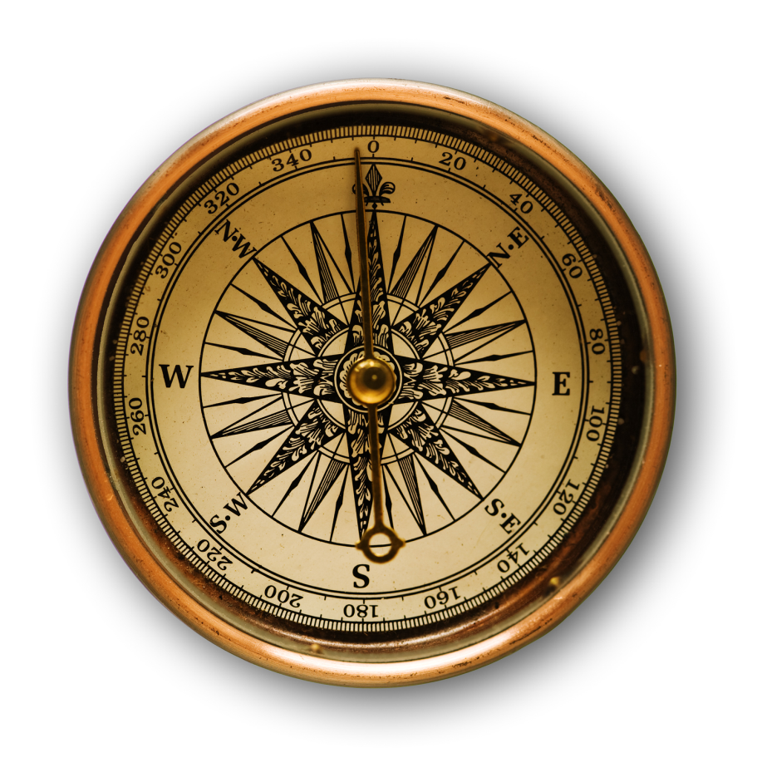
Compass, Astrolabe and Sextant
More Technology
Compass
Uses the Earth’s magnetic field to find direction
Invented in China about 259BC
Used by Europeans during exploration

Slide 6
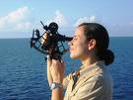
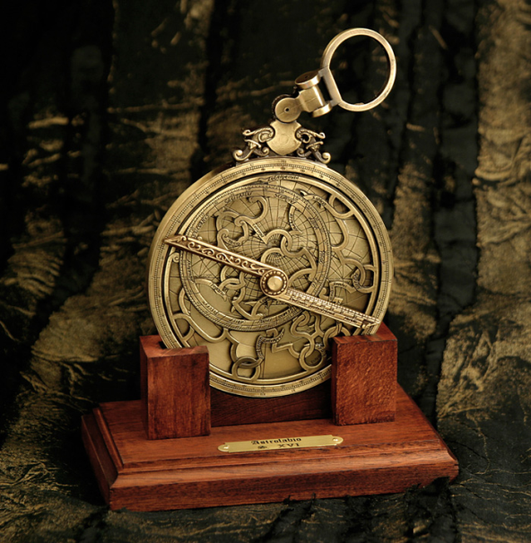
Compass, Astrolabe and Sextant
More Technology
Sextant
Instrument used to measure the altitude of a celestial body
Astrolabe
Ancient astronomical computer
Astrolabes are used to show how the sky looks at a specific place at a given time

Slide 7
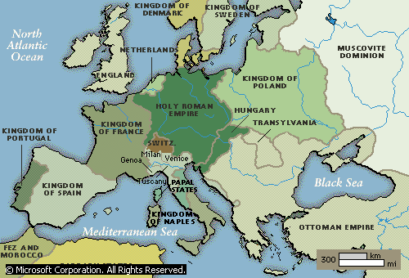
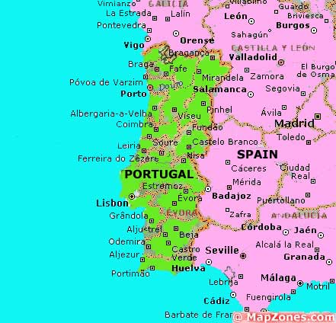
Portugal Leads The Way
Located right by the Atlantic Ocean
Whole country is
within 100 miles of the ocean
Leader in exploration under Prince Henry
the Navigator
First country to have trading posts down
west coast of Africa
Henry wants to get to
Asia and spread Christianity
Atlantic

Slide 8
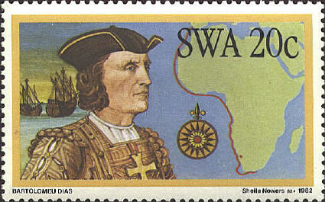
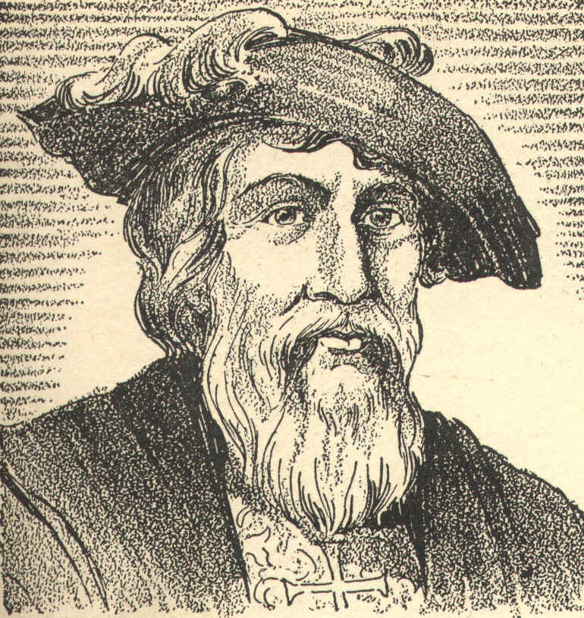
Portugal Leads the Way
Portuguese also trade slaves for guns and rum with Africans
1487- Bartolomeau Dias reaches the Southern tip of Africa
1489- Vasco Da Gama rounded Africa & reached India

Slide 9
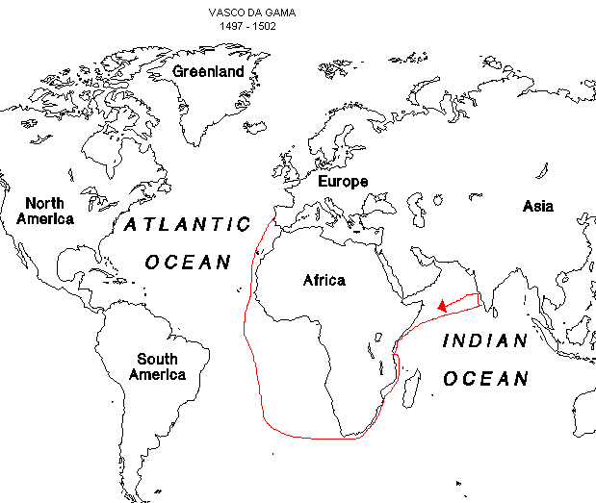

Slide 10
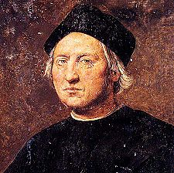
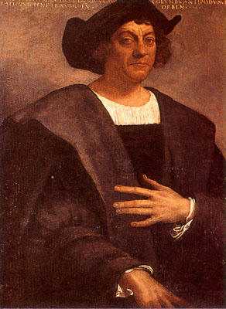
Christopher Columbus
(c. 1451 – 20 May 1506)
Explorer, Navigator, Colonizer
Voyages across Atlantic led to general European awareness of the American continents (Did not discover America – Vikings here 1st)
Voyages funded by Isabella I Castile (Spain)
Initiated Spanish Colonization of the
“New World” which would lead to European Colonization of the Americas (Was not aware of problem of European diseases such as Small Pox, which the Native population did not have an immunity)
People aready knew world was round, not flat.

Slide 11
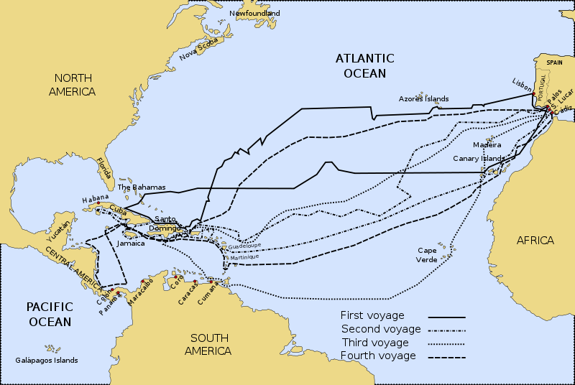
In 1492, Columbus sailed the ocean blue.
The Nina, the Pinta, and the Santa Maria

Slide 12
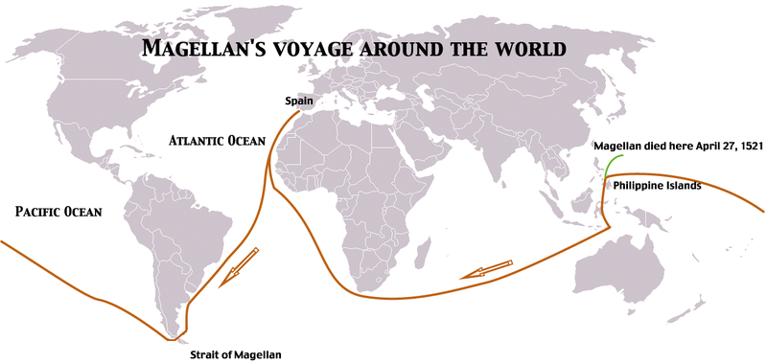
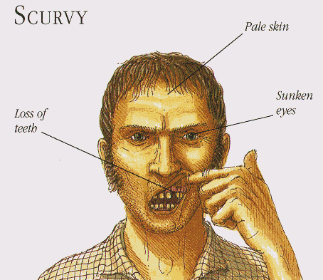
Ferdinand Magellan
1519- Ferdinand Magellan tries to sail around the world.
He dies in the Philippines, but his crew makes it back in 1522.
Problem with long travels was a lack of vitamin “C”
Sailors developed Scurvy from which they could die on the voyage

Slide 13
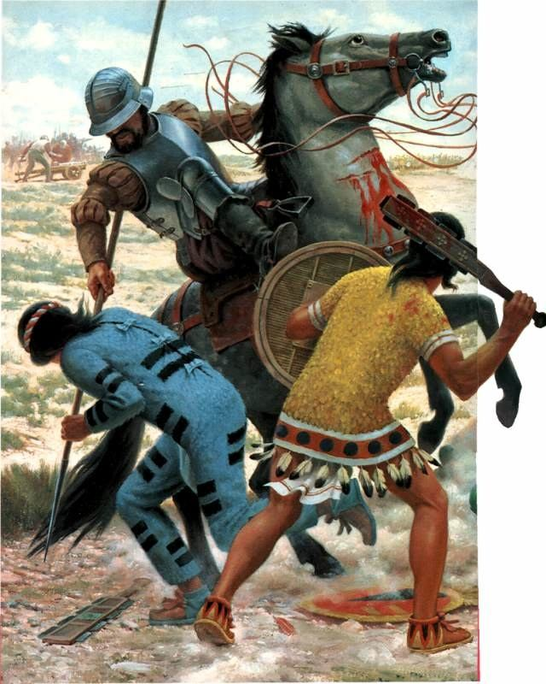
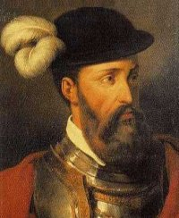
The Conquistadors
Spanish explorers following Columbus became known as conquistadors, or conquerors
The 2 most famous were
Hernando Cortez and
Francisco Pizarro.
Cortez conquered the Aztecs and Pizarro conquered the Incas.
Both Civilizations come to an end because of them. (war & disease primary causes)
Pizarro

Slide 14
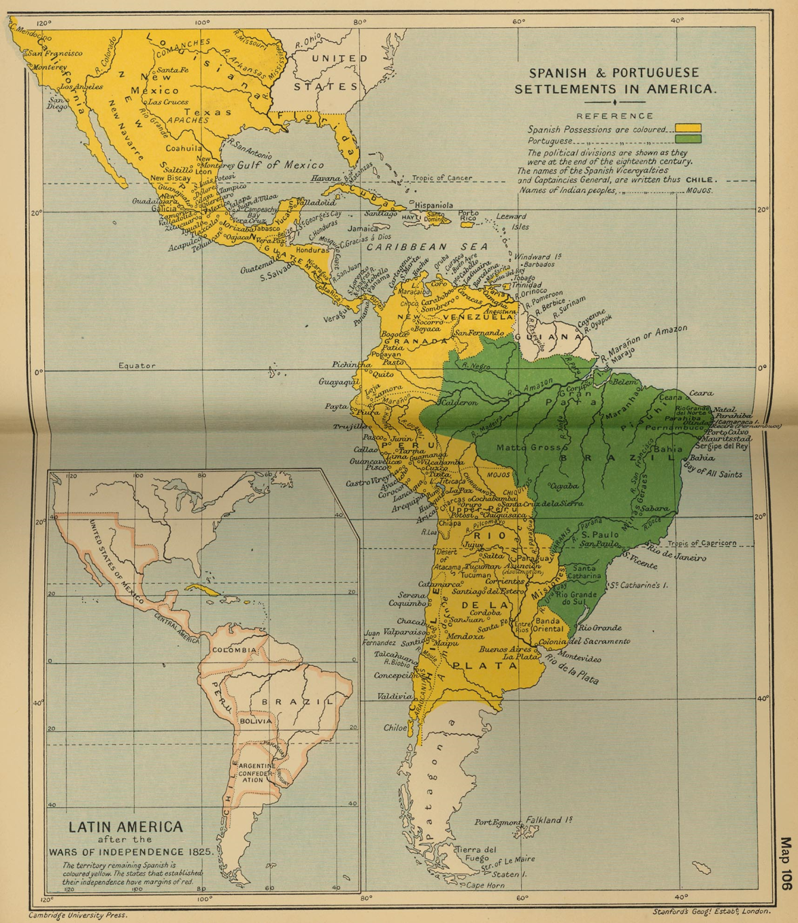
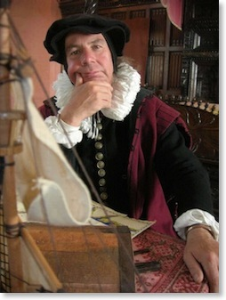
The Spanish Possessions
These and others helped Spain claim most of Mexico, the Western U.S.
and most of South America
What is a Cartographer?
A Mapmaker

Slide 15

The Spanish Conquest

Slide 16
Cortez the Conqueror
Cortez was able to conquer the Aztecs for several reasons:
SUPERIOR
WEAPONS
OTHER
NATIVES
(War)
DISEASES: MEASLES, MUMPS, TYPHUS, AND SMALLPOX
This was to become a theme for future conquests

Slide 17
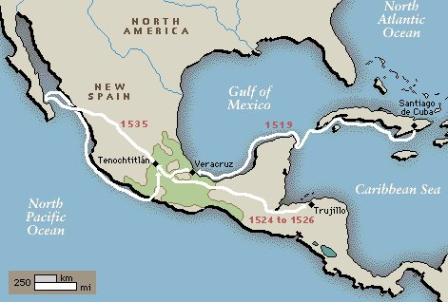
Conquest of Cortez

