Slide 1
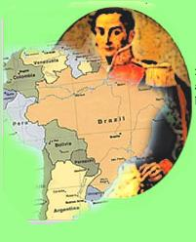
Latin American
Nationalism & Independence
AIM: How Did Nationalism Affect Latin America?
Do Now: Latin American Independence Worksheet

Slide 2
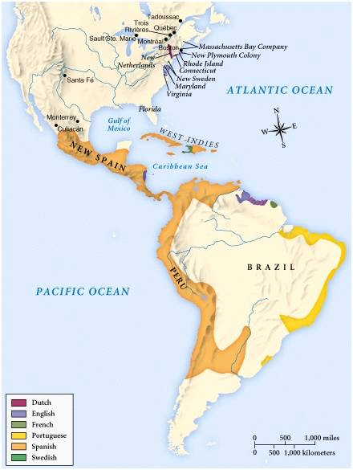
European Empires: 1660s
Dutch
Spain
Portugal
English
French

Slide 3
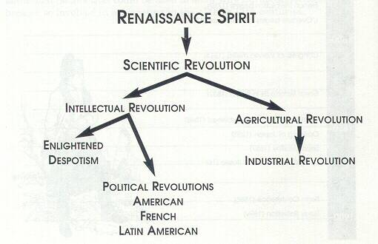
1700-1800s:
New Ideas Brewing in Europe
Enlightenment
Rulers

Slide 4
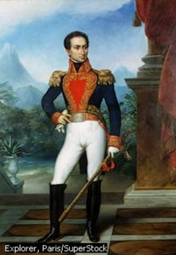
Causes of Latin American
Revolutions
Enlightenment Ideas → writings of
John Locke & Jean Rousseau
Creole discontent at being left out of government jobs and trade concessions.
Inspiration of the American/French Revolutions.
Preoccupation of Spain & Portugal in fighting the Napoleonic Wars.

Slide 5
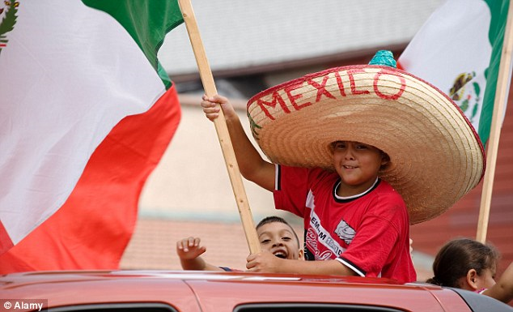
Enlightenment Ideas
Laws of nature [NATURAL LAWS] govern natural science and human society.
Give people rights → life, liberty, property!
Make fair societies based on
reason possible.
Challenged the theory of
“Divine Right” monarchy.

Slide 6
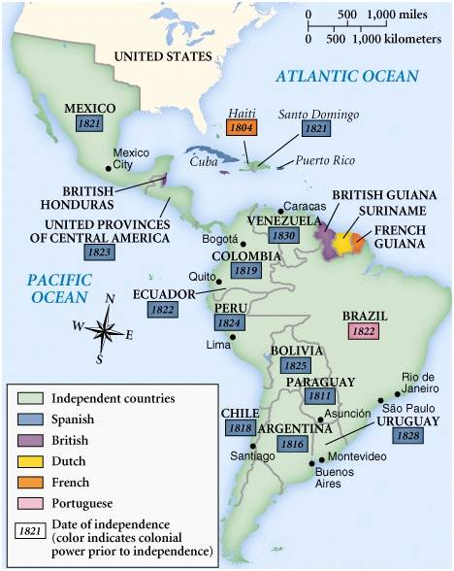
Latin American Revolutions

Slide 7
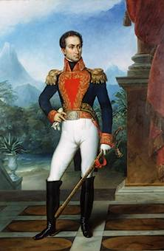
Simón Bolivar:
The “Brains”
of the Revolution
Creole leader of the revolutions in Venezuela.
Spent time in Europe and the newly-independent United States.

Slide 8
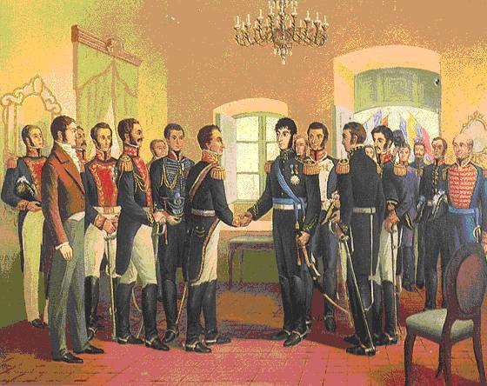
Simón Bolivar Meets
José de San Martin

Slide 9
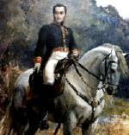
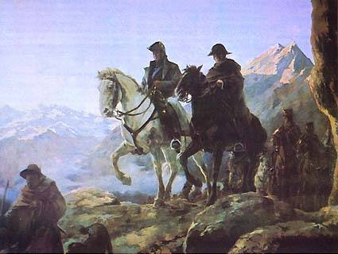
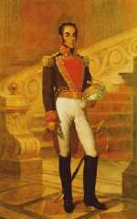
Bolivar coming from the North.
The “Muscle” of the Revolution
José de St. Martín and Bernard O’Higgins cross the Andes Mountains.

Slide 10
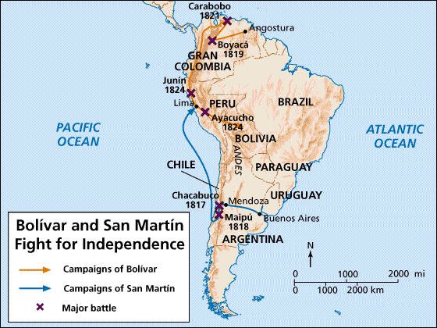
Bolivar & San Martin
Fight for Independence!

Slide 11
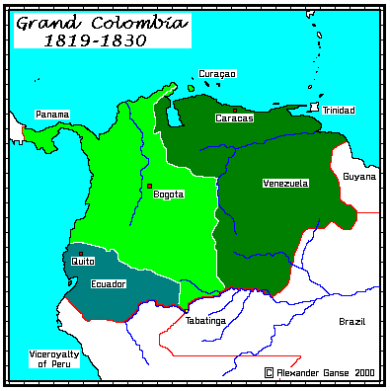
Bolivar’s Accomplishments

Slide 12
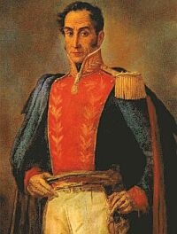
Bolivar’s Failure
After uniting Venezuela, Columbia, & Ecuador into Gran Columbia, he left to help free the rest of Latin America.
He died a year later, with his goal of uniting all of South America unfulfilled!

