Slide 1

CRQ Moments in History
Global History & Geography II
1750 to Present

Slide 2
On a blank piece of paper, answer the question below:
. . . Finally, gather together all that we have said, so great and so august [important], about royal authority. You have seen a great nation united under one man: you have seen his sacred power, paternal and absolute: you have seen that secret reason which directs the body politic, enclosed in one head: you have seen the image of God in kings, and you will have the idea of majesty of kingship. God is holiness itself, goodness itself, power itself, reason itself. In these things consists the divine majesty. In their reflection consists the majesty of the prince. . . .
— Jacques-Benigne Bossuet
What is the purpose of the document by
Jacques-Benigne Bossuet?
Notes:
Notes to presenter:
What is your purpose for sharing this reflection?
Is it at the end of a unit or project?
Are you sharing this reflection, at the attainment of a learning goal you set for yourself?
Is it at the end of a course?
State your purpose for the reflection or even the purpose of the learning experience or learning goal. Be clear and be specific in stating your purpose.

Slide 3

On a blank piece of paper, answer the question below:
Who was the audience that James I was addressing
this statement?
Notes:
Notes to presenter:
What is your purpose for sharing this reflection?
Is it at the end of a unit or project?
Are you sharing this reflection, at the attainment of a learning goal you set for yourself?
Is it at the end of a course?
State your purpose for the reflection or even the purpose of the learning experience or learning goal. Be clear and be specific in stating your purpose.

Slide 4
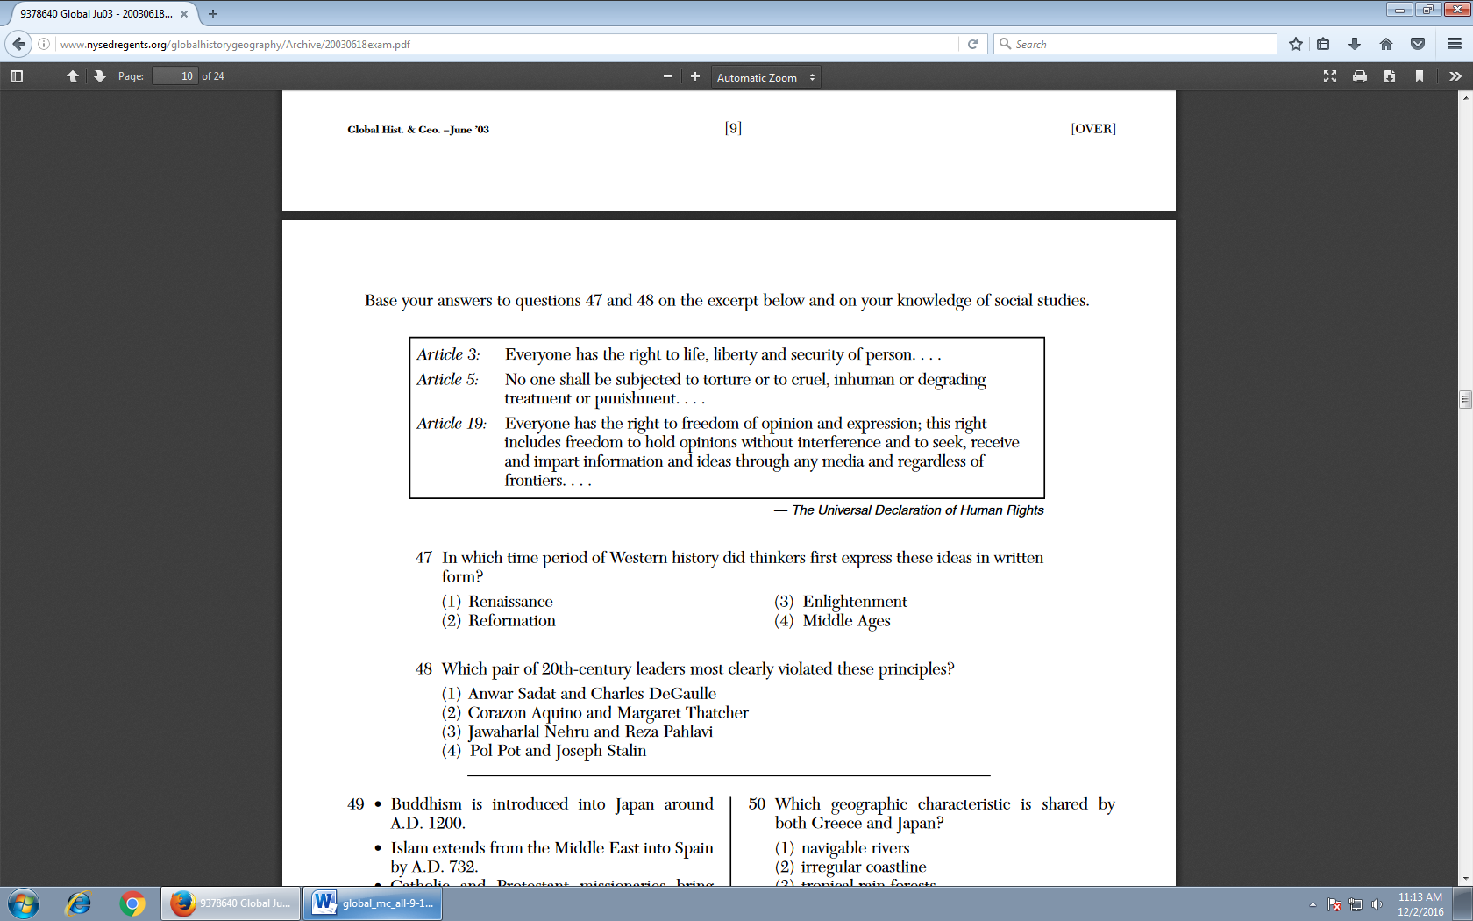
On a blank piece of paper, answer the question below:
In the Universal Declaration of Human Rights, what is
the point-of-view of these articles?
Notes:
Notes to presenter:
What is your purpose for sharing this reflection?
Is it at the end of a unit or project?
Are you sharing this reflection, at the attainment of a learning goal you set for yourself?
Is it at the end of a course?
State your purpose for the reflection or even the purpose of the learning experience or learning goal. Be clear and be specific in stating your purpose.

Slide 5
On a blank piece of paper, answer the question below:
[When] the legislature shall . . . grasp [for] themselves, or put into the hands of any other, an absolute power over their lives, liberties, and estates of the people, . . . they forfeit the power the people had put into their hands for quite contrary ends, and it [passes] to the people, who have a right to resume their original liberty. . . .
— John Locke, Two Treatises on Civil Government
What is John Lockes point-of-view in this excerpt from
the Two Treatisies of Government?
Notes:
Notes to presenter:
What is your purpose for sharing this reflection?
Is it at the end of a unit or project?
Are you sharing this reflection, at the attainment of a learning goal you set for yourself?
Is it at the end of a course?
State your purpose for the reflection or even the purpose of the learning experience or learning goal. Be clear and be specific in stating your purpose.

Slide 6
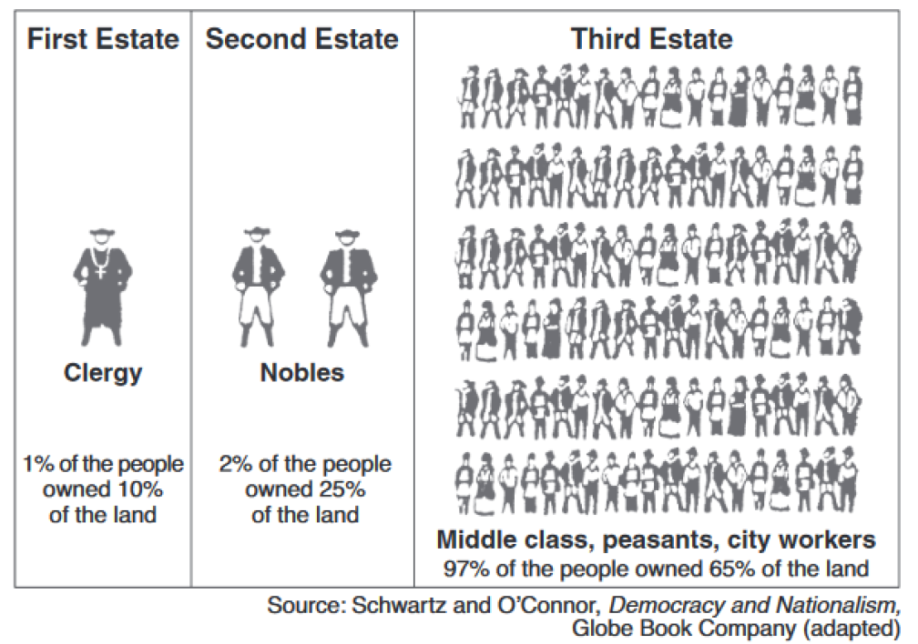
On a blank piece of paper, answer the question below:
What is the
purpose shown in this graphic?
Notes:
Notes to presenter:
What is your purpose for sharing this reflection?
Is it at the end of a unit or project?
Are you sharing this reflection, at the attainment of a learning goal you set for yourself?
Is it at the end of a course?
State your purpose for the reflection or even the purpose of the learning experience or learning goal. Be clear and be specific in stating your purpose.

Slide 7
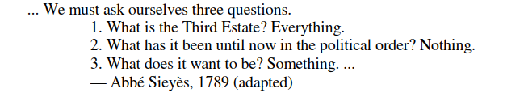
On a blank piece of paper, answer the question below:
Who is the audience for this excerpt from Abbe Sieyes?
Notes:
Notes to presenter:
What is your purpose for sharing this reflection?
Is it at the end of a unit or project?
Are you sharing this reflection, at the attainment of a learning goal you set for yourself?
Is it at the end of a course?
State your purpose for the reflection or even the purpose of the learning experience or learning goal. Be clear and be specific in stating your purpose.

Slide 8
On a blank piece of paper, answer the question below:
...The document so frantically cobbled together was stunning in its sweep and simplicity. Never once mentioning king, nobility, or church, it declared the “natural, inalienable and sacred rights of man” to be the foundation of any and all government. It assigned sovereignty to the nation, not the king, and pronounced everyone equal before the law, thus opening positions to talent and merit and implicitly eliminating all privilege based on birth. More striking than any particular guarantee, however, was the universality of the claims made. References to “men,” “man,” “every man,” “all men,” “all citizens,” “each citizen,” “society,” and “every society” dwarfed the single reference to the French people.... — Lynn Hunt, Inventing Human Rights: A History
What is the purpose of the statement by Lynn Hunt in
Inventing Human Rights: A History?
Notes:
Notes to presenter:
What is your purpose for sharing this reflection?
Is it at the end of a unit or project?
Are you sharing this reflection, at the attainment of a learning goal you set for yourself?
Is it at the end of a course?
State your purpose for the reflection or even the purpose of the learning experience or learning goal. Be clear and be specific in stating your purpose.

Slide 9
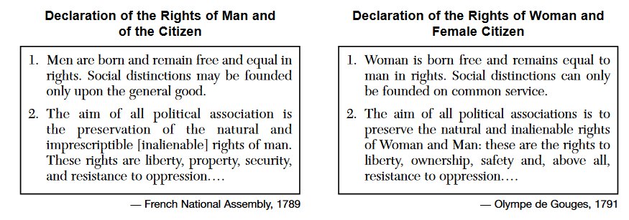
On a blank piece of paper, answer the question below:
Explain the cause and effect relationship between
these two primary source documents?
Notes:
Notes to presenter:
What is your purpose for sharing this reflection?
Is it at the end of a unit or project?
Are you sharing this reflection, at the attainment of a learning goal you set for yourself?
Is it at the end of a course?
State your purpose for the reflection or even the purpose of the learning experience or learning goal. Be clear and be specific in stating your purpose.

Slide 10
On a blank piece of paper, answer the question below:
The Laws ought to be so framed, as to secure the Safety of every Citizen as much as possible.
. . . The Equality of the Citizens consists in this; that they should all be subject to the same Laws. . . .
— Documents of Catherine the Great, W. F. Reddaway, ed., Cambridge University Press (adapted)
What was the cause and effect relationship that led
Catherine the Great to write these statements?
Notes:
Notes to presenter:
What is your purpose for sharing this reflection?
Is it at the end of a unit or project?
Are you sharing this reflection, at the attainment of a learning goal you set for yourself?
Is it at the end of a course?
State your purpose for the reflection or even the purpose of the learning experience or learning goal. Be clear and be specific in stating your purpose.

Slide 11
On a blank piece of paper, answer the question below:
. . . The history of all hitherto existing society is the history of class struggles. Freeman and slave, patrician [a person of high birth] and plebeian [common person], lord and serf, guild-master and journeyman, in a word, oppressor and oppressed, stood in constant opposition to one another, carried on an uninterrupted, now hidden, now open fight, a fight that each time ended, either in a revolutionary reconstitution of society at large, or in the common ruin of the contending [competing] classes. . . .
Karl Marx, The Communist Manifesto Chapter 1 (1848)
What was cause and effect relationship that caused
Karl Marx to write the statements above in The
Communist Manifesto in 1848?
Notes:
Notes to presenter:
What is your purpose for sharing this reflection?
Is it at the end of a unit or project?
Are you sharing this reflection, at the attainment of a learning goal you set for yourself?
Is it at the end of a course?
State your purpose for the reflection or even the purpose of the learning experience or learning goal. Be clear and be specific in stating your purpose.

Slide 12
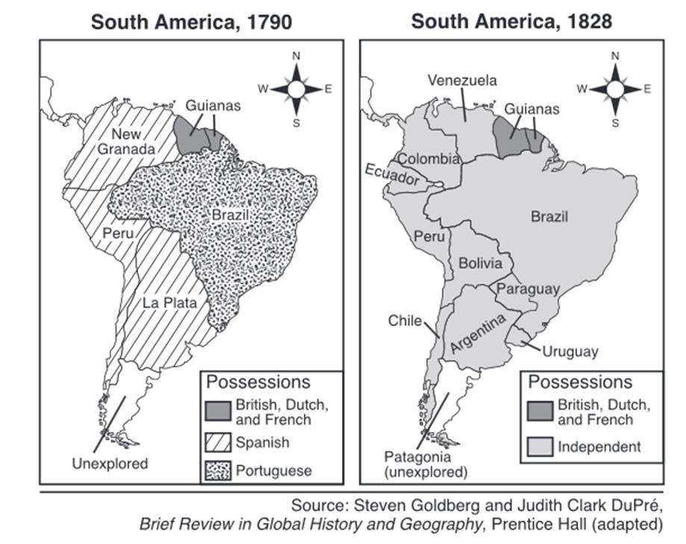
On a blank piece of paper, answer the question below:
What is the cause and effect relationship between these two maps?
Notes:
Notes to presenter:
What is your purpose for sharing this reflection?
Is it at the end of a unit or project?
Are you sharing this reflection, at the attainment of a learning goal you set for yourself?
Is it at the end of a course?
State your purpose for the reflection or even the purpose of the learning experience or learning goal. Be clear and be specific in stating your purpose.

Slide 13
On a blank piece of paper, answer the question below:
“. . . Give Venezuela such an executive power in the person of a president chosen by the people or their representatives, and you will have taken a great step toward national happiness. No matter what citizen occupies this office, he will be aided by the Constitution, and therein being authorized to do good, he can do no harm, because his ministers will cooperate with him only insofar as he abides by the law. If he attempts to infringe upon the law, his own ministers will desert him, thereby isolating him from the Republic, and they will even bring charges against him in the Senate. The ministers, being responsible for any transgressions committed, will actually govern, since they must account for their actions. . . .”
— Simón Bolívar, 1819
Who was the audience that Simon Bolivar was addressing
this statement in 1819?
Notes:
Notes to presenter:
What is your purpose for sharing this reflection?
Is it at the end of a unit or project?
Are you sharing this reflection, at the attainment of a learning goal you set for yourself?
Is it at the end of a course?
State your purpose for the reflection or even the purpose of the learning experience or learning goal. Be clear and be specific in stating your purpose.

Slide 14

On a blank piece of paper, answer the question below:
What was the point-of-view of in this political cartoon?
Notes:
Notes to presenter:
What is your purpose for sharing this reflection?
Is it at the end of a unit or project?
Are you sharing this reflection, at the attainment of a learning goal you set for yourself?
Is it at the end of a course?
State your purpose for the reflection or even the purpose of the learning experience or learning goal. Be clear and be specific in stating your purpose.

Slide 15
On a blank piece of paper, answer the question below:
“In the Manufacture of Woollens, the Scribbling Mill, the Spinning Frame, and the Fly Shuttle, have reduced manual Labour nearly One third, and each of them at its – first Introduction carried an Alarm to the Work People, yet each has contributed to advance the Wages and to increase the Trade, so that if an Attempt was now made to deprive us of the Use of them, there is no Doubt, but every Person engaged in the Business, would exert himself to defend them. . . .”
                — Letter from Leeds Cloth Merchants, 1791
What turning point is associated with this excerpt?
Notes:
Notes to presenter:
What is your purpose for sharing this reflection?
Is it at the end of a unit or project?
Are you sharing this reflection, at the attainment of a learning goal you set for yourself?
Is it at the end of a course?
State your purpose for the reflection or even the purpose of the learning experience or learning goal. Be clear and be specific in stating your purpose.

Slide 16
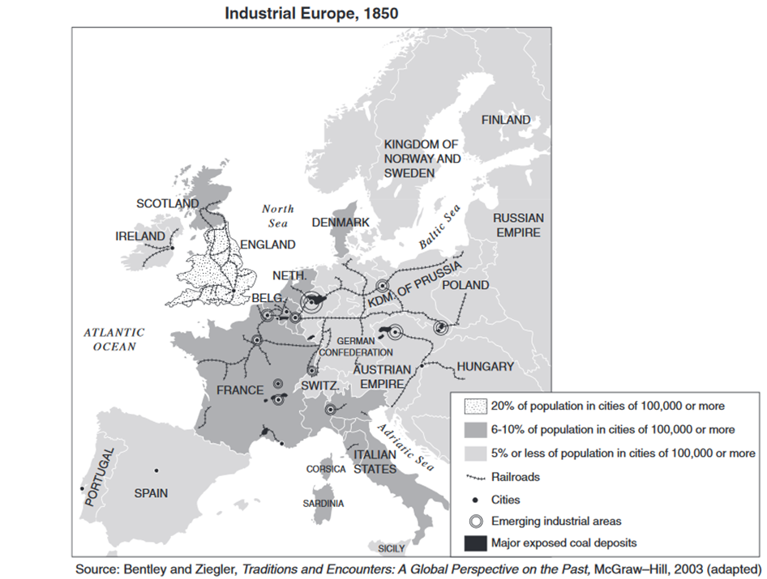
On a blank piece of paper, answer the question below:
Who is the cause and
effect relationship
seen in the map?
Notes:
Notes to presenter:
What is your purpose for sharing this reflection?
Is it at the end of a unit or project?
Are you sharing this reflection, at the attainment of a learning goal you set for yourself?
Is it at the end of a course?
State your purpose for the reflection or even the purpose of the learning experience or learning goal. Be clear and be specific in stating your purpose.

Slide 17
On a blank piece of paper, answer the question below:
“. . . A place more destitute of all interesting objects than Manchester, it is not easy to conceive. In size and population it is the second city in the kingdom, containing above fourscore thousand [80,000] inhabitants. Imagine this multitude crowded together in narrow streets, the houses all built of brick and blackened with smoke; frequent buildings among them as large as convents, without their antiquity, without their beauty, without their holiness; where you hear from within, as you pass along, the everlasting din of machinery; and where when the bell rings it is to call wretches to their work instead of their prayers, . . . ”
— Robert J. Southey, Letters from England, 1807
What is the point-of-view of the letters of
Robert J. Southey in 1807?
Notes:
Notes to presenter:
What is your purpose for sharing this reflection?
Is it at the end of a unit or project?
Are you sharing this reflection, at the attainment of a learning goal you set for yourself?
Is it at the end of a course?
State your purpose for the reflection or even the purpose of the learning experience or learning goal. Be clear and be specific in stating your purpose.

Slide 18
On a blank piece of paper, answer the question below:
. . .That in some few instances the regular hours of work do not exceed ten, exclusive of the time allowed for meals; sometimes they are eleven, but more commonly twelve; and in great numbers of instances the employment is continued for fifteen, sixteen, and even eighteen hours consecutively. That in almost every instance the Children work as long as the adults; being sometimes kept at work sixteen, and even eighteen hours, without any intermission. . . .
— The Physical and Moral Condition of the Children and
Young Persons Employed in Mines and Manufactures, 1843
What is the purpose of the statement from 1843?
Notes:
Notes to presenter:
What is your purpose for sharing this reflection?
Is it at the end of a unit or project?
Are you sharing this reflection, at the attainment of a learning goal you set for yourself?
Is it at the end of a course?
State your purpose for the reflection or even the purpose of the learning experience or learning goal. Be clear and be specific in stating your purpose.

Slide 19
On a blank piece of paper, answer the question below:
. . . The factory owners did not have the power to compel anybody to take a factory job. They could only hire people who were ready to work for the wages offered to them. Low as these wage rates were, they were nonetheless much more than these paupers could earn in any other field open to them. It is a distortion of facts to say that the factories carried off the housewives from the nurseries and the kitchens and the children from their play. These women had nothing to cook with and [nothing] to feed their children. These children were destitute [poor] and starving. Their only refuge was the factory. It saved them, in the strict sense of the term, from death by starvation. . . .
— Ludwig von Mises, Human Action, A Treatise on Economics , Yale University Press
What is the point-of-view of the passage above by
Ludwig von Mises?
Notes:
Notes to presenter:
What is your purpose for sharing this reflection?
Is it at the end of a unit or project?
Are you sharing this reflection, at the attainment of a learning goal you set for yourself?
Is it at the end of a course?
State your purpose for the reflection or even the purpose of the learning experience or learning goal. Be clear and be specific in stating your purpose.

Slide 20
On a blank piece of paper, answer the question below:
“. . . I am willing to admit my pride in this accomplishment for Japan. The facts are these:
It was not until the sixth year of Kaei (1853) that a steamship was seen for the first time; it was only in the second year of Ansei (1855) that we began to study navigation from the Dutch in Nagasaki; by 1860, the science was sufficiently understood to enable us to sail a ship across the Pacific. This means that about seven years after the first sight of a steamship, after only about five years of practice, the Japanese people made a trans-Pacific crossing without help from foreign experts. I think we can without undue pride boast before the world of this courage and skill. As I have shown, the Japanese officers were to receive no aid from Captain Brooke throughout the voyage. Even in taking observations, our officers and the Americans made them independently of each other. Sometimes they compared their results, but we were never in the least dependent on the Americans. . . .”
— Eiichi Kiyooka, trans., The Autobiography of
| Fukuzawa Yukichi, The Hokuseido Press, 1934
What is the Turning Point that the Autobiography of
Fukuzawa Yukichi is discussing?
Notes:
Notes to presenter:
What is your purpose for sharing this reflection?
Is it at the end of a unit or project?
Are you sharing this reflection, at the attainment of a learning goal you set for yourself?
Is it at the end of a course?
State your purpose for the reflection or even the purpose of the learning experience or learning goal. Be clear and be specific in stating your purpose.

Slide 21
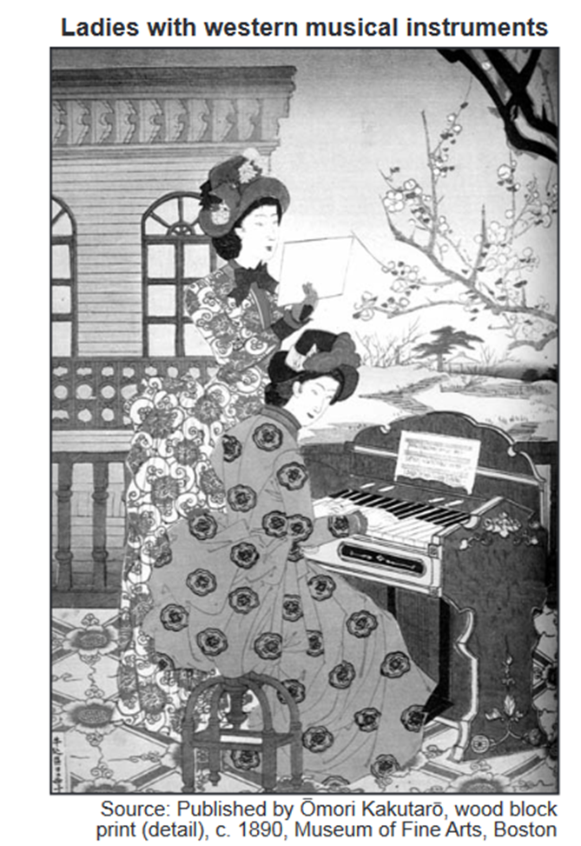
On a blank piece of paper, answer the question below:
Who is the audience for this drawing of “Ladies with western musical instruments” ?
Notes:
Notes to presenter:
What is your purpose for sharing this reflection?
Is it at the end of a unit or project?
Are you sharing this reflection, at the attainment of a learning goal you set for yourself?
Is it at the end of a course?
State your purpose for the reflection or even the purpose of the learning experience or learning goal. Be clear and be specific in stating your purpose.

Slide 22
On a blank piece of paper, answer the question below:
. . .The bourgeoisie, by the rapid improvement of all instruments of production, by the immensely facilitated means of communication, draws all nations, even the most barbarian, into civilisation. The cheap prices of its commodities are the heavy artillery with which it batters down all Chinese walls, with which it forces the barbarians’ intensely obstinate [persistent] hatred of foreigners to capitulate [give in]. It compels all nations, on pain of extinction, to adopt the bourgeois mode of production; it compels them to introduce what it calls civilisation into their midst, i.e., to become bourgeois themselves. In aword, it creates a world after its own image. . . .
— Karl Marx and Friedrich Engels
What is the bias of the passage above by
Karl Marx and Friedrich Engels?
Notes:
Notes to presenter:
What is your purpose for sharing this reflection?
Is it at the end of a unit or project?
Are you sharing this reflection, at the attainment of a learning goal you set for yourself?
Is it at the end of a course?
State your purpose for the reflection or even the purpose of the learning experience or learning goal. Be clear and be specific in stating your purpose.

Slide 23

On a blank piece of paper, answer the question below:
What is the point-of-view of the political cartoon above?
Notes:
Notes to presenter:
What is your purpose for sharing this reflection?
Is it at the end of a unit or project?
Are you sharing this reflection, at the attainment of a learning goal you set for yourself?
Is it at the end of a course?
State your purpose for the reflection or even the purpose of the learning experience or learning goal. Be clear and be specific in stating your purpose.

Slide 24
On a blank piece of paper, answer the question below:
. . . What has poor Ireland done, mother, —What has poor Ireland done, That the world looks on, and sees us starve, Perishing one by one? Do the men of England care not, mother, — The great men and the high, — For the suffering sons of Erin’s isle, Whether they live or die? .
— A. M. Edmond, “Give Me Three Grains of Corn, Mother”
Who is the audience that the excerpt from Give Me
Three Grains of Corn, Mother was written for?
Notes:
Notes to presenter:
What is your purpose for sharing this reflection?
Is it at the end of a unit or project?
Are you sharing this reflection, at the attainment of a learning goal you set for yourself?
Is it at the end of a course?
State your purpose for the reflection or even the purpose of the learning experience or learning goal. Be clear and be specific in stating your purpose.

Slide 25
On a blank piece of paper, answer the question below:
“Famine seems to be the last, the most dreadful resource of nature. The power of population is so superior to the power in the earth to provide subsistence for man, that premature death must in some shape or other visit the human race. . . .”
— Thomas Malthus, “Essay on Population,” 1798
What is the bias of the passage above by
Thomas Malthus in his “Essay on Population” ?
Notes:
Notes to presenter:
What is your purpose for sharing this reflection?
Is it at the end of a unit or project?
Are you sharing this reflection, at the attainment of a learning goal you set for yourself?
Is it at the end of a course?
State your purpose for the reflection or even the purpose of the learning experience or learning goal. Be clear and be specific in stating your purpose.

Slide 26
On a blank piece of paper, answer the question below:
“It was a town of red brick, or of brick that would have been red if the smoke and ashes had allowed it; but as matters stood it was a town of unnatural red and black like the painted face of a savage. It was a town of machinery and tall chimneys, out of which interminable serpents of smoke trailed themselves for ever and ever, and never got uncoiled. It had a black canal in it, and a river that ran purple with ill- smelling dye. . . .”
— Charles Dickens, Hard Times
What is the point-of-view of the passage above by
Charles Dickens in “Hard Times”?
Notes:
Notes to presenter:
What is your purpose for sharing this reflection?
Is it at the end of a unit or project?
Are you sharing this reflection, at the attainment of a learning goal you set for yourself?
Is it at the end of a course?
State your purpose for the reflection or even the purpose of the learning experience or learning goal. Be clear and be specific in stating your purpose.

Slide 27
On a blank piece of paper, answer the question below:
What is the point-of-view of the passage above by
Ludwig von Mises?
Notes:
Notes to presenter:
What is your purpose for sharing this reflection?
Is it at the end of a unit or project?
Are you sharing this reflection, at the attainment of a learning goal you set for yourself?
Is it at the end of a course?
State your purpose for the reflection or even the purpose of the learning experience or learning goal. Be clear and be specific in stating your purpose.

Slide 28
On a blank piece of paper, answer the question below:
What is the point-of-view of the passage above by
Ludwig von Mises?
Notes:
Notes to presenter:
What is your purpose for sharing this reflection?
Is it at the end of a unit or project?
Are you sharing this reflection, at the attainment of a learning goal you set for yourself?
Is it at the end of a course?
State your purpose for the reflection or even the purpose of the learning experience or learning goal. Be clear and be specific in stating your purpose.

Slide 29
On a blank piece of paper, answer the question below:
What is the point-of-view of the passage above by
Ludwig von Mises?
Notes:
Notes to presenter:
What is your purpose for sharing this reflection?
Is it at the end of a unit or project?
Are you sharing this reflection, at the attainment of a learning goal you set for yourself?
Is it at the end of a course?
State your purpose for the reflection or even the purpose of the learning experience or learning goal. Be clear and be specific in stating your purpose.

Slide 30
On a blank piece of paper, answer the question below:
What is the point-of-view of the passage above by
Ludwig von Mises?
Notes:
Notes to presenter:
What is your purpose for sharing this reflection?
Is it at the end of a unit or project?
Are you sharing this reflection, at the attainment of a learning goal you set for yourself?
Is it at the end of a course?
State your purpose for the reflection or even the purpose of the learning experience or learning goal. Be clear and be specific in stating your purpose.

Slide 31
On a blank piece of paper, answer the question below:
What is the point-of-view of the passage above by
Ludwig von Mises?
Notes:
Notes to presenter:
What is your purpose for sharing this reflection?
Is it at the end of a unit or project?
Are you sharing this reflection, at the attainment of a learning goal you set for yourself?
Is it at the end of a course?
State your purpose for the reflection or even the purpose of the learning experience or learning goal. Be clear and be specific in stating your purpose.

Slide 32
On a blank piece of paper, answer the question below:
What is the point-of-view of the passage above by
Ludwig von Mises?
Notes:
Notes to presenter:
What is your purpose for sharing this reflection?
Is it at the end of a unit or project?
Are you sharing this reflection, at the attainment of a learning goal you set for yourself?
Is it at the end of a course?
State your purpose for the reflection or even the purpose of the learning experience or learning goal. Be clear and be specific in stating your purpose.

Slide 33
On a blank piece of paper, answer the question below:
What is the point-of-view of the passage above by
Ludwig von Mises?
Notes:
Notes to presenter:
What is your purpose for sharing this reflection?
Is it at the end of a unit or project?
Are you sharing this reflection, at the attainment of a learning goal you set for yourself?
Is it at the end of a course?
State your purpose for the reflection or even the purpose of the learning experience or learning goal. Be clear and be specific in stating your purpose.

Slide 34
On a blank piece of paper, answer the question below:
What is the point-of-view of the passage above by
Ludwig von Mises?
Notes:
Notes to presenter:
What is your purpose for sharing this reflection?
Is it at the end of a unit or project?
Are you sharing this reflection, at the attainment of a learning goal you set for yourself?
Is it at the end of a course?
State your purpose for the reflection or even the purpose of the learning experience or learning goal. Be clear and be specific in stating your purpose.

Slide 35
On a blank piece of paper, answer the question below:
What is the point-of-view of the passage above by
Ludwig von Mises?
Notes:
Notes to presenter:
What is your purpose for sharing this reflection?
Is it at the end of a unit or project?
Are you sharing this reflection, at the attainment of a learning goal you set for yourself?
Is it at the end of a course?
State your purpose for the reflection or even the purpose of the learning experience or learning goal. Be clear and be specific in stating your purpose.

Slide 36
On a blank piece of paper, answer the question below:
What is the point-of-view of the passage above by
Ludwig von Mises?
Notes:
Notes to presenter:
What is your purpose for sharing this reflection?
Is it at the end of a unit or project?
Are you sharing this reflection, at the attainment of a learning goal you set for yourself?
Is it at the end of a course?
State your purpose for the reflection or even the purpose of the learning experience or learning goal. Be clear and be specific in stating your purpose.

Slide 37
On a blank piece of paper, answer the question below:
What is the point-of-view of the passage above by
Ludwig von Mises?
Notes:
Notes to presenter:
What is your purpose for sharing this reflection?
Is it at the end of a unit or project?
Are you sharing this reflection, at the attainment of a learning goal you set for yourself?
Is it at the end of a course?
State your purpose for the reflection or even the purpose of the learning experience or learning goal. Be clear and be specific in stating your purpose.

Slide 38
On a blank piece of paper, answer the question below:
What is the point-of-view of the passage above by
Ludwig von Mises?
Notes:
Notes to presenter:
What is your purpose for sharing this reflection?
Is it at the end of a unit or project?
Are you sharing this reflection, at the attainment of a learning goal you set for yourself?
Is it at the end of a course?
State your purpose for the reflection or even the purpose of the learning experience or learning goal. Be clear and be specific in stating your purpose.

