Slide 1
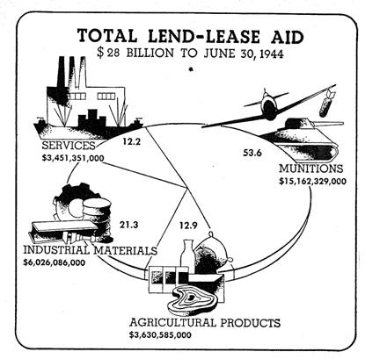
Neutrality Acts and
Lend-Lease
AIM: How did the Neutrality Acts and Lend-Lease lead to America’s involvement in World War II?
Do Now: What did President George Washington warn us about in his farewell speech?
Mr. Ott @ BETA 2011-12

Slide 2
Neutrality Acts
1935
  prohibited export of “arms, ammunition, & implements of war” to foreign, warring nations
1937
  warring nations could get any item except arms
1939
  lifted arms embargo, putting all trade with warring nations under terms of “cash-&-carry”
    any item could be sold as long as it was immediately paid for

Slide 3
Lend-Lease
United States would provide a country with supplies needed to fight Germany
the country would NOT have to pay the United States back immediately
United States contracted Lend-Lease agreements with 30+ countries, worth $50B
program was designed to allow America to indirectly help defeat Germany

Slide 4

Pearl Harbor – Dec 7th, 1941
Japanese Surprise Attack against Naval Base
Goal : To knock out America’s Pacific Fleet
Aftermath: 4 Battleships / 2,402 Dead /1,282 Wounded
Mistake: Did not sink Aircraft Carriers which were out on maneuvers.

Slide 5
Pearl Harbor
December 7, 1941
  hundreds of Japanese bombers & fighters attacked naval base Pearl Harbor
  RESULTS
    2,402 Americans dead
    nearly 200 aircraft destroyed
    all but 8 battleships were sunk/damaged
  December 8 → US declares war on Japan
  December 11 → Germany & Italy declare war on US

Slide 6
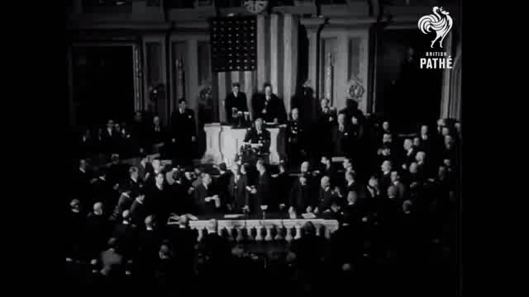
Congress declares war on Japan – Dec 8th, 1941
FDR’s – Date of Infamy Speech

Slide 7
On a separate sheet of paper…
Answer the questions in your classwork packet:
1. What was the Lend Lease Act?
2. What did it allow the United States to do?
3. What was the policy of the United States before the Lend Lease Act?
4. What was the U.S. response to Japanese imperialism in the Pacific?
5. Who attacked the U.S. at Pearl Harbor?
6. Why did the United States enter World War II?
7. Name the Axis Powers (Countries):
8. Name the Allied Powers(Countries):
9. What branch of the U.S. government, under the U.S. Constitution has the power to Declare War?

