Slide 1
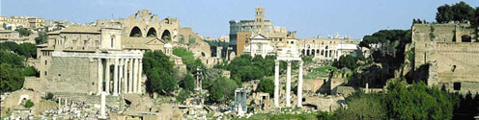
The Roman Republic
& the Punic Wars
Chaney
Early Western Civilization

Slide 2
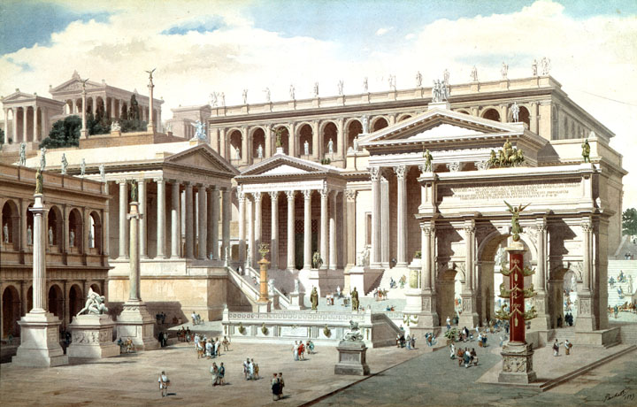
Hypothetical reconstruction of Roman Forum in Imperial times.
Watercolor (18th century), Giuseppe Becchetti

Slide 3
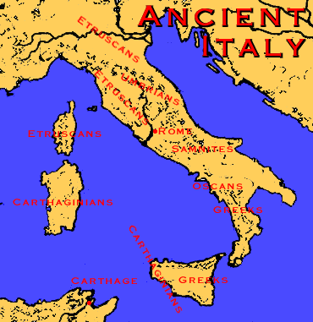
Ancient Italy
(c. 6th century B.C.)
PEOPLE:
The Latins
-Rome: “The First Romans”
The Etruscans
-Northern Italy
-Urbanized Rome:
Building Programs (the Forum)
-Influence on Romans:
the arch, alphabet
The Greeks
-Southern Italy and Sicily
-Influence on Romans:
art, architecture, literature, ..government, engineering
GEOGRAPHY:
-Tiber River & Mediterranean Sea
-Fertile Soil & Strategic Location

Slide 4
The Roman Republic (509 B.C. – 27 B.C.)
509 B.C., Romans rejected Etruscan king (monarchy) and established a republic.
  Power rests with the citizens who have the right to vote for their leaders.
  In Rome, citizenship with voting rights was granted only to free-born male citizens.

Slide 5
The Roman Republic (509 B.C. – 27 B.C.)
  STRUGGLE FOR POWER: CLASS CONFLICT
    Patricians- wealthy landowners who held most of the power: inherited power and social status
    Plebeians- (Plebs) common farmers, artisans and merchants who made up the majority of the population: can vote, but can’t rule
      Tribunes- elected representatives who protect plebeians’ political rights.

Slide 6
The Roman Republic (509 B.C. – 27 B.C.)
A “Balanced” Government
Rome elects two consuls– one to lead army, one to direct government
Senate- chosen from patricians (Roman upper class), make foreign and domestic policy
Popular assemblies elect tribunes, make laws for plebeians (commoners)
Dictators- leaders appointed briefly in times of crisis (appt. by consuls and senate)

Slide 7
The Roman Republic (509 B.C. – 27 B.C.)
THE TWELVE TABLES
451 B.C., officials carve Roman laws on twelve tablets and hung in Forum.
Laws confirm right of all free citizens to protection of the law
Become the basis for later Roman law

Slide 8
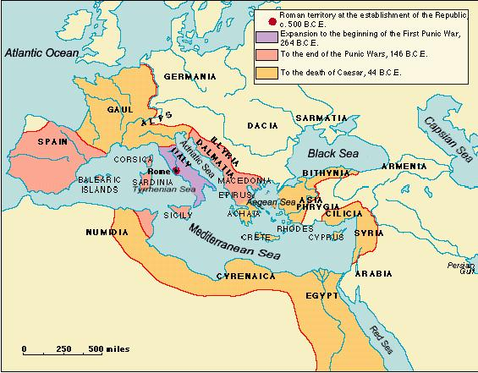
Why were the Romans able to conquer Italy
& the Mediterranean World?

Slide 9
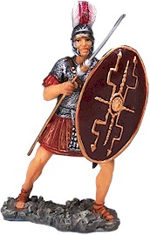
The Roman Army
All citizens were required to serve
Army was powerful:
  Organization & fighting skill
Legion- military unit of 5,000 infantry (foot soldiers) supported by cavalry (horseback)

Slide 10
Rome Spreads its Power
Romans defeat Etruscans in north and Greek city-states in south
Treatment of Conquered:
  Forge alliances
  Offer citizenship
By 265 B.C., Rome controls Italian peninsula

Slide 11
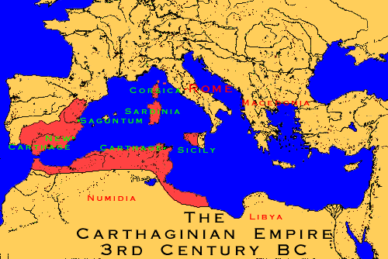
Rome’s Commercial Network
Rome establishes a large trading network
Access to Mediterranean Sea provides many trade routes
Carthage, powerful city-state in North Africa, soon rivals Rome

Slide 12
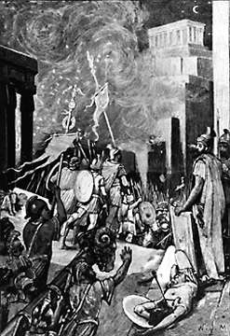
Punic Wars (264-146 B.C.)
Three Wars between Rome and Carthage
1st Punic War- Rome gains control of Sicily & western Mediterranean Sea.
The destruction of Carthage during the Punic Wars.
New York Public Library Picture Collection

Slide 13
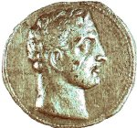
Punic Wars (264-146 B.C.)
2nd Punic War- Carthaginian General Hannibal’s “surprise” attack through Spain & France
  60,000 soldiers and 60 elephants
  Romans experience severe losses, but eventually ward off attacks & invade North Africa
The destruction of Carthage during the Punic Wars.
New York Public Library Picture Collection

Slide 14
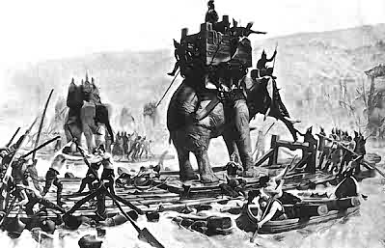
Hannibal's troops crossing the Rhone River on their way to attack northern Italy.

Slide 15
Punic Wars (264-146 B.C.)
3rd Punic War- Rome seizes Carthage
  Scipio- Roman Strategist
  Conquered people sold into slavery
The destruction of Carthage during the Punic Wars.
New York Public Library Picture Collection

Slide 16


