Slide 1
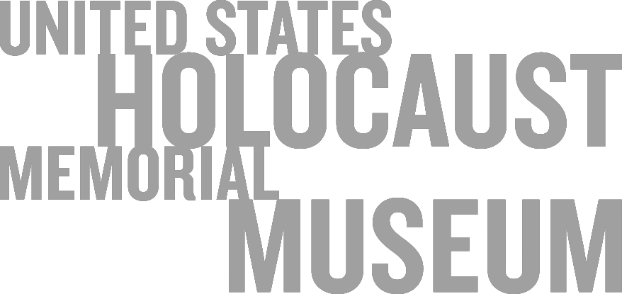

Slide 2
Between 1933 and 1945, the German government led by Adolf Hitler and the
Nazi Party carried out the systematic persecution and murder of Europe’s Jews.
This genocide is now known as the Holocaust.

Slide 3
The Nazi regime also persecuted and killed millions of other people it considered politically, racially, or socially unfit.

Slide 4
The Allies’ victory ended World War II, but
Nazi Germany and its collaborators had left millions dead and countless lives shattered.

Slide 5
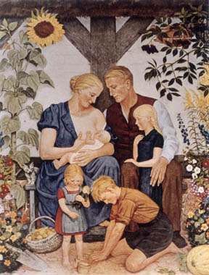
The Nazi racial stereotypical Aryan family reinforced in art. From a painting by Wolf Willrich.

Slide 6
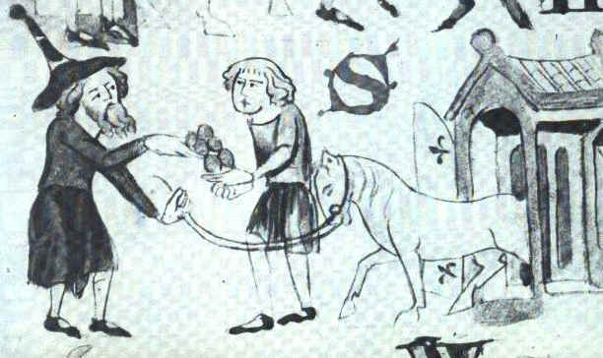
A Jew trading with a Christian, from the Dresden Sachsenspiegel, 1220

Slide 7


Slide 9
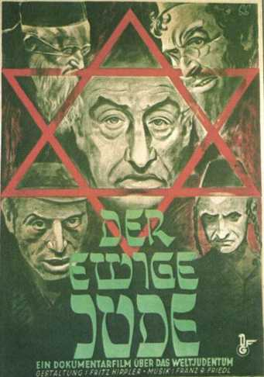
“The Eternal Jew" is the most famous Jewish Nazi propaganda film. It depicts the Jews of Poland as corrupt, filthy, lazy, ugly, and perverse. They are an alien people which have taken over the world through their control of banking and commerce, yet which still live like animals.
http://www.holocaust-history.org/der-ewige-jude/

Slide 10
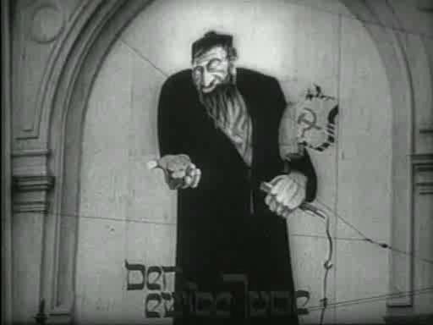

Slide 11
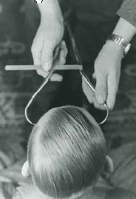
A Nazi racial hygienist measures the forehead of a young man to determine his "race", 1937

Slide 12
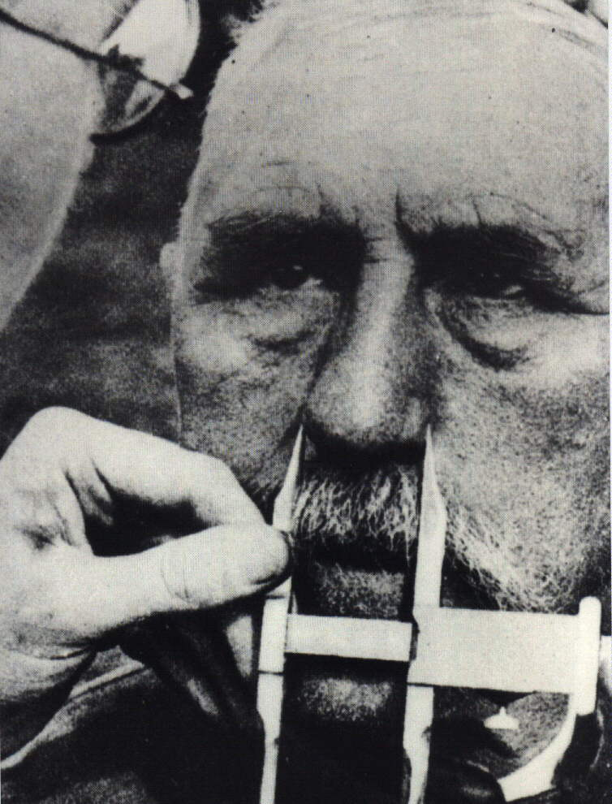
How did the Nazi decide who was Jewish?
At the Wannsee conference it was decided that if one of person’s parents was Jewish, then they were Jewish.
However, if only one of their grandparents had been Jewish then they could be classified as being German.
In 1940, all Jews had to have their passports stamped with the letter ‘J’ and had to wear the yellow Star of David on their jacket or coat.
Notes:
Some historians believe that Hitler’s grandfather was Jewish. His Grandmother used to work for a rich Jewish landowner in Austria and it is believed that she had an affair whilst she worked as his house keeper. He later helped his son get a job as a civil servant. Some Psychologists put this down as being one of the possible reasons why Hitler hated Jews. However, it is interesting to note that the Jewish doctor who helped his mother whilst she was dying of cancer was dropped off at the Swiss border by the SS in 1940!

Slide 13
Directions: In a couple of paragraphs, answer
the following question.
Predict whether the Holocaust was a
function of the state in a series of events,
Or a intentional act of the ideology of the
Nazi party.
Give some examples and details.

