Slide 1
The Age of Genocide
Exploring 20th century genocides

Slide 2
A crime without a name…
“The aggressor ... retaliates by the most frightful cruelties. As his Armies advance, whole districts are being exterminated. Scores of thousands - literally scores of thousands - of executions in cold blood are being perpetrated by the German Police-troops upon the Russian patriots who defend their native soil. Since the Mongol invasions of Europe in the Sixteenth Century, there has never been methodical, merciless butchery on such a scale, or approaching such a scale.
“And this is but the beginning. Famine and pestilence have yet to follow in the bloody ruts of Hitler's tanks.
“We are in the presence of a crime without a name.”
- Winston Churchill describing the brutality of the German forces occupying Russia, 1941.

Slide 3
Genocide geno – meaning race cide – meaning killing
The word genocide was coined by Raphael Lempkin in the midst of the Holocaust.
Notes:
Before 1944, no word existed to describe a coordinated assault on civilian populations. That year Raphael Lemkin, a Polish-Jewish legal scholar who had fled Nazi-occupied Poland and arrived in the United States in 1941, introduced the word "genocide" to give the crime a name.

Slide 4
THE UNITED NATIONS
The UN was founded on October 24, 1945, when the Charter of the UN was drafted at the UN Conference on International Organization in San Francisco
The conference was attended by 50 nations and several non governmental organizations
Main principles: save future generations from war, reaffirm human rights, and establish equal rights for all nations
Purposes of the UN: maintaining international peace and security, developing friendly international relations among world nations, solving international problems of any nature (economic, cultural, social, humanitarian…)

Slide 5
The 1948 U.N. Convention on the Prevention and Punishment of Genocide defines genocide as any of the following acts committed with the intent to destroy, in whole or in part, a national, ethnical, racial or religious group, as such:
Killing members of the group;
b. Causing serious bodily or mental harm to members of the group;
c. Deliberately inflicting on the group conditions of life calculated to bring about its physical destruction in whole or in part;
d. Imposing measures intended to prevent births within the group;
e. Forcibly transferring children of the group to another group.
Notes:
The specific "intent to destroy" particular groups is unique to genocide. A closely related category of international law, crimes against humanity, is defined as widespread or systematic attacks against civilians.
The specific "intent to destroy" particular groups is unique to genocide. A closely related category of international law, crimes against humanity, is defined as widespread or systematic attacks against civilians.
Due in no small part to the efforts of Raphael Lemkin, the UN Convention on the Prevention and Punishment of the Crime of Genocide was unanimously adopted on December 9, 1948. The Convention entered into force on January 12, 1951, after more than 20 countries from around the world ratified it.

Slide 6
20th Century Genocides
With the definition of genocide in mind,
try to list as many 20th century genocides
as you can.

Slide 7
Major genocides of the 20th century
The Herero Genocide, Namibia, 1904-05
Death toll: 60,000 (3/4 of the population)
The Armenian Genocide, Ottoman Empire, 1915-23
Death toll: Up to 1.5 million
The Ukrainian Famine, 1932-1933
Death toll: 7 million
The Nanking Massacre, 1937-1938
Death toll: 300,000 (50% of the pop)
The World War II Holocaust, Europe, 1942-45
Death toll: 6 million Jews, and millions of others, including Poles, Roma, homosexuals, and the physically and mentally handicapped,
The Cambodian Genocide, 1975-79
Death toll: 2 million
The East Timor Genocide, 1975- 1999
Death toll: 120,000 (20% of the population)
The Mayan Genocide, Guatemala,
1981-83
Death toll: Tens of thousands
Iraq, 1988
Death toll: 50-100,000
The Bosnian Genocide, 1991-1995
Death toll: 8,000
The Rwandan Genocide, 1994
Death toll: 800,000
The Darfur Genocide, Sudan ,
2003-present
Death toll: debated. 100,000? 300,000? 500,000?

Slide 8
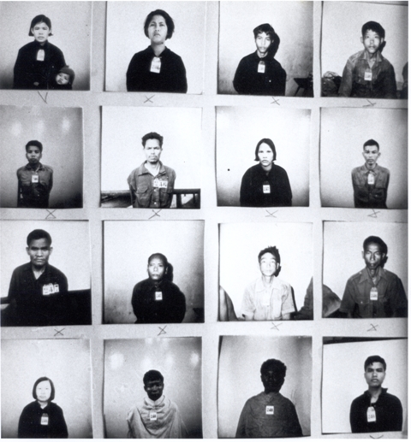
1950’s-Present:
The Promise Goes Unfulfilled
Though massive atrocities against civilian populations were committed in the years following the Holocaust and throughout the Cold War, the very countries that signed their names to the Genocide Convention scarcely considered whether these crimes constituted genocide.
Notes:
Not one country invoked the Genocide Convention when the Khmer Rouge (1975–79) regime in Cambodia caused the deaths of an estimated 1.7 million people. Cambodia itself ratified the convention in 1950. These prisoners were interred at Tuol Sleng (Security Prison 21), a secret center operated by the Khmer Rouge in Phnom Penh, Cambodia. Documentation Center of Cambodia, Phnom Penh

Slide 9
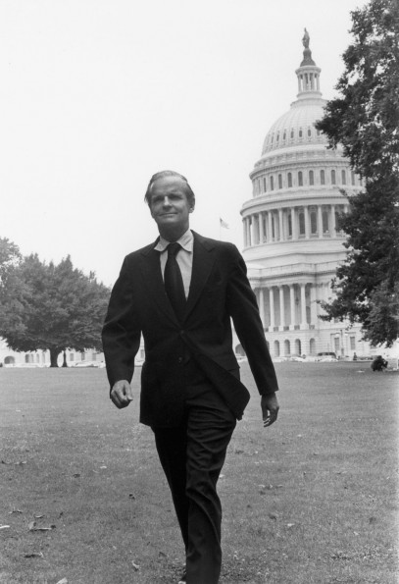
1988: U.S. Ratifies the Convention
Despite facing strong opposition by those who believed it would diminish U.S. sovereignty, President Ronald Reagan signed the 1948 UN Convention on the Prevention and Punishment of Genocide on November 5, 1988. Among the Convention's most vocal advocates was Wisconsin Senator William Proxmire, who delivered more than 3,000 speeches before Congress arguing for its passage.

Slide 10
The World Acts to Punish but Not to Halt Atrocities in the Former Yugoslavia
Targeted civilian groups suffered brutal atrocities throughout the conflicts in the former Yugoslav republics of Croatia (1991-95) and Bosnia-Herzegovina (1992-95). Though the international community showed little will to stop the crimes as they were taking place, the UN Security Council did establish the International Criminal Tribunal for the former Yugoslavia (ICTY) in The Hague. It was the first international criminal tribunal since Nuremberg and the first mandated to prosecute the crime of genocide.
Notes:
Milošević was indicted in May 1999, during the Kosovo War, by the UN's International Criminal Tribunal for the Former Yugoslavia for crimes against humanity in Kosovo. Charges of violating the laws or customs of war, grave breaches of the Geneva Conventions in Croatia and Bosnia and genocide in Bosnia were added a year and a half later.
Following Milošević's transfer, the original charges of war crimes in Kosovo were upgraded by adding charges of genocide in Bosnia and war crimes in Croatia. On 30 January 2002, Milošević accused the war crimes tribunal of an "evil and hostile attack" against him. The trial began at The Hague on 12 February 2002, with Milošević defending himself while refusing to recognize the legality of the court's jurisdiction.[
Trial went on for five years, no conviction because he died of a heart attack while in custody.
View video Milosovik on Trial.

Slide 11
1998- First Conviction for Genocide is Won
On September 2, 1998, the International Criminal Tribunal for Rwanda issued the first conviction for genocide after a trial, declaring Jean-Paul Akayesu guilty for acts he engaged in and oversaw as mayor of the Rwandan town of Taba.

Slide 12
2004: U.S. Declares Genocide is Occurring in Darfur
Testifying before the U.S. Senate Foreign Relations Committee on September 9, 2004, Secretary of State Colin Powell declared that "genocide has been committed in Darfur."
Though the United Nations and other governments agreed on the scale of atrocities being committed against civilians, they did not declare them "genocide."

Slide 13
8 Stages of Genocide
Understanding the genocidal process is one of the most important steps in preventing future genocides
The first six stages are early warning signs
    Classification
    Symbolization
    Dehumanization
    Organization
    Polarization
    Preparation

Slide 14
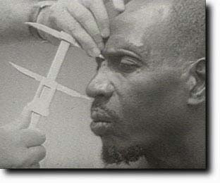
Stage 1: Classification
Us vs. Them
Distinguish by nationality, ethnicity, race, or religion.
Belgians distinguished between Hutus and Tutsis by nose size, height & eye type. Another indicator to distinguish Hutu farmers from Tutsi pastoralists was the number of cattle owned.
Notes:
Promote common identities (national, religious, human.)
Use common languages (Swahili in Tanzania, science, music.)
Actively oppose racist and divisive politicians and parties.

Slide 15
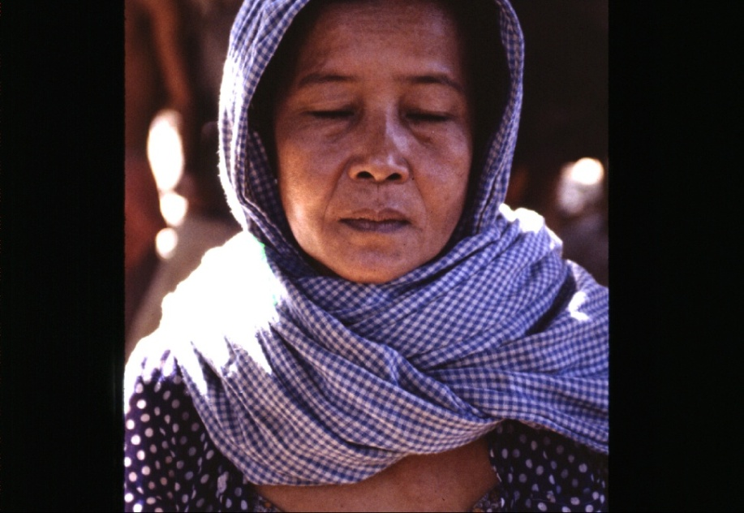
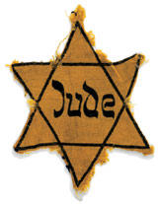
Stage 2: Symbolization
Names (Jew, Hutu, Tutsi)
Languages
Types of dress
Group Uniforms
ID cards
    Blue checked scarf Eastern Zone in Cambodia
Notes:
Blue checkered scarf used to distinguish people by the Khamer Rouge

Slide 16
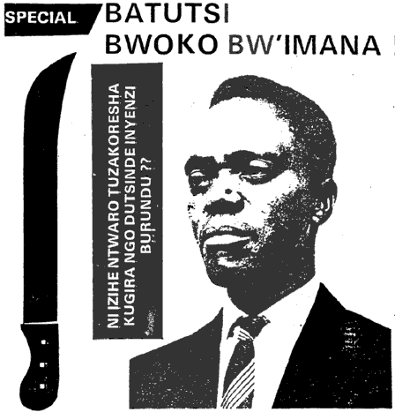
Stage 3: Dehumanization
One group denies the humanity of another group, and makes the victim group seem subhuman
Hate propaganda in speeches, print and on hate radios vilify the victim group
Dehumanization invokes superiority of one group and inferiority of the “other.”
Dehumanization justifies murder by calling it “ethnic cleansing,” or “purification.” Such euphemisms hide the horror of mass murder
Kangura Newspaper, Rwanda: “The Solution for Tutsi Cockroaches”

Slide 17
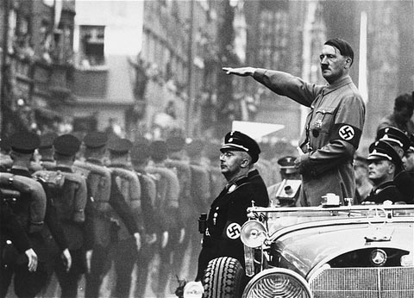
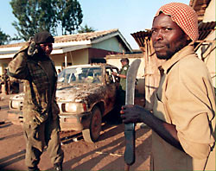
Stage 4: Organization
Genocide is a group crime, so must be organized
Hutu Power” elites armed youth militias called Interahamwe ("Those Who Stand Together”).
The government and Hutu Power businessmen provided the militias with over 500,000 machetes and other arms and set up camps to train them to “protect their villages” by exterminating every Tutsi.
Notes:
The state usually organizes, arms and financially supports the groups that conduct the genocidal massacres. (State organization is not a legal requirement --Indian partition.)
Plans are made by elites for a “final solution” of genocidal killings

Slide 18
Stage 5: Polarization
Extremists drive the groups apart.
Hate groups broadcast and print polarizing propaganda.
Laws are passed that forbid intermarriage or social interaction.
Political moderates are silenced, threatened and intimidated, and killed.
Notes:
Attacks are staged and blamed on targeted groups.
In Germany, the Reichstag fire was blamed on Jewish Communists in 1933.
Cultural centers of targeted groups are attacked.
On Kristalnacht in 1938, hundreds of synagogues were burned.

Slide 19
Stage 6: Preparation
Members of victim groups are forced to wear identifying symbols.
Death lists are made.
Victims are separated because of their ethnic or religious identity.
Segregation into ghettoes is imposed, victims are forced into concentration camps.
Victims are also deported to famine-struck regions for starvation.
Weapons for killing are stock-piled.
Extermination camps are even built. This build- up of killing capacity is a major step towards actual genocide.

Slide 20
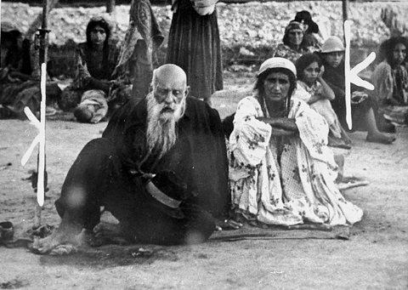
Step 7: Extermination
Extermination begins, and becomes the mass killing legally called "genocide." Most genocide is committed by governments.
The killing is “extermination” to the killers because they do not believe the victims are fully human. They are “cleansing” the society of impurities, disease, animals, vermin, “cockroaches,” or enemies.
Roma (Gypsies) in a Nazi death camp

Slide 21
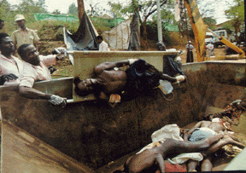
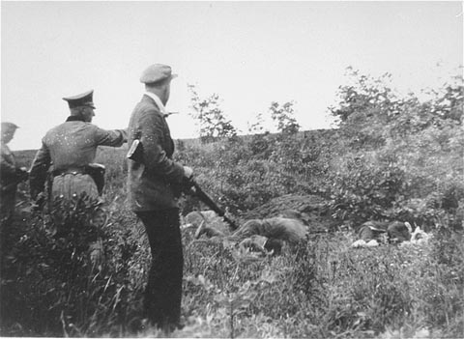
Stage 7: Extermination (Genocide)
Although most genocide is sponsored and financed by the state, the armed forces often work with local militias.
Rwandan militia killing squads
Nazi killing squad working with local militia
Notes:
Regional organizations, national governments, and the UN Security Council should impose targeted sanctions to undermine the economic viability of the perpetrator regime.
Sales of oil and imports of gasoline should be stopped by blockade of ports and land routes.
Perpetrators should be indicted by the International Criminal Court.

Slide 22
Stage 8: Denial
Denial is always found in genocide, both during and after it.
Continuing denial is among the surest indicators of further genocidal massacres.

Slide 23
Types of Denial
Deny the Evidence
Deny that there was any mass killing at all.
Question and minimize the statistics.
Block access to archives and witnesses.
Intimidate or kill eye-witnesses.
Attack the Truth-Tellers
Attack the motives of the truth-tellers. Say they are opposed to the religion, ethnicity, or nationality of the deniers.
Notes:
Destroy the evidence. (Burn the bodies and the archives, dig up and burn the mass graves, throw bodies in rivers or seas.)

Slide 24
Types of Denial
Deny Genocidal Intent
Claim that the deaths were inadvertent (due to famine, migration, or disease.)
Blame “out of control” forces for the killings.
Blame the deaths on ancient ethnic conflicts.
Blame the Victims
Emphasize the strangeness of the victims. They are not like us. (savages, infidels)
Claim they were disloyal insurgents in a war.
Call it a “civil war,” not genocide.
Claim that the deniers’ group also suffered huge losses in the “war.” The killings were in self-defense.

Slide 25
Types of Denial
Denial for Current Interests
Avoid upsetting “the peace process.” “Look to the future, not to the past.”
Deny to assure benefits of relations with the perpetrators or their descendents. (oil, arms sales, alliances, military bases)
Don’t threaten humanitarian assistance to the victims, who are receiving good treatment.
Deny Facts Fit Definition of Genocide
  They’re crimes against humanity, not genocide.
  They’re “ethnic cleansing”, not genocide.
  There’s not enough proof of specific intent to destroy a group, “as such.” (“Many survived!”-
  UN Commission of Inquiry on Darfur.)
  Claim declaring genocide would legally obligate us to intervene. (We don’t want to intervene.)

Slide 26
Darfur
What can you do?
Teaching students about social activism
  Educating yourself on the issues
  Demanding action from Congress
  Educating your community ~ raising awareness
  Volunteering for refugee organizations

Slide 27
Why has the UN not stopped genocide ?
Genocide succeeds when state sovereignty blocks international responsibility to protect.
The UN represents states, not peoples.
Since founding of UN:
  Over 45 genocides and politicides
  Over 70 million dead
Genocide prevention ≠ conflict resolution

Slide 28
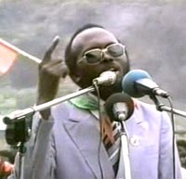
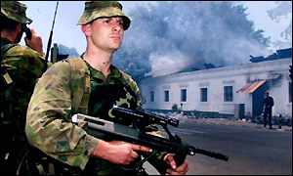
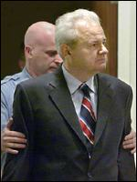
Prevention requires:
Early
warning
2. Rapid
response
3. Courts for
accountability

Slide 29
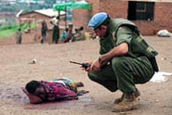
Genocide continues due to:
Lack of authoritative international
institutions to predict it
•Lack of ready rapid response forces to stop it
UNAMIR peacekeeper in Rwanda, April 1994

Slide 30
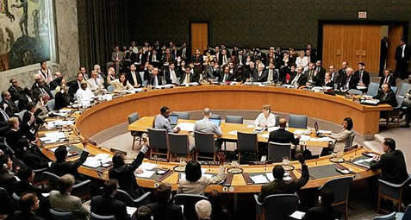
Genocide continues due to:
Lack of political will to peacefully prevent it
and to forcefully intervene to stop it
UN Security Council votes to withdraw
UNAMIR troops from Rwanda, April 1994

Slide 31
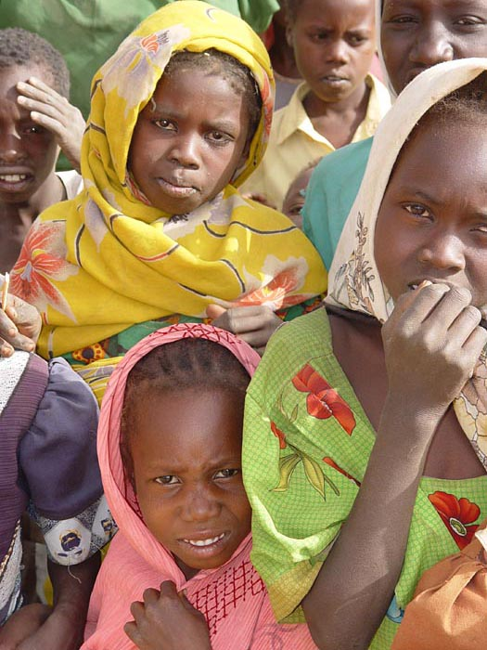
Never Again? Or Again and Again?
How can we use the 8 Stages of Genocide to develop more effective ways to prevent genocide in the future?
Would it be useful for the UN to establish a Genocide Prevention Center to work with the Special Adviser for Genocide Prevention?
Even with Early Warning, how can we achieve effective Early Response to prevent and stop genocide?

Slide 32
Scenario
Will genocide happen here?
Multiethnic state
Political and ethnic cleavage with strict physical division
Competing religious groups, including large numbers of Christians and Muslims
A history of inter-communal violence
Repeated and sustained hate speech
Previously expressed (and documented on the world sage) intent to slaughter the minority population
Uneven economic administration and discriminatory policies
Majority is persisting in international isolation of the minority
Foreign invasion
Continued military presence from outside nations and UN forces
Is the “recipe” for a genocide present?
What country/region do you think this is?

