Slide 1
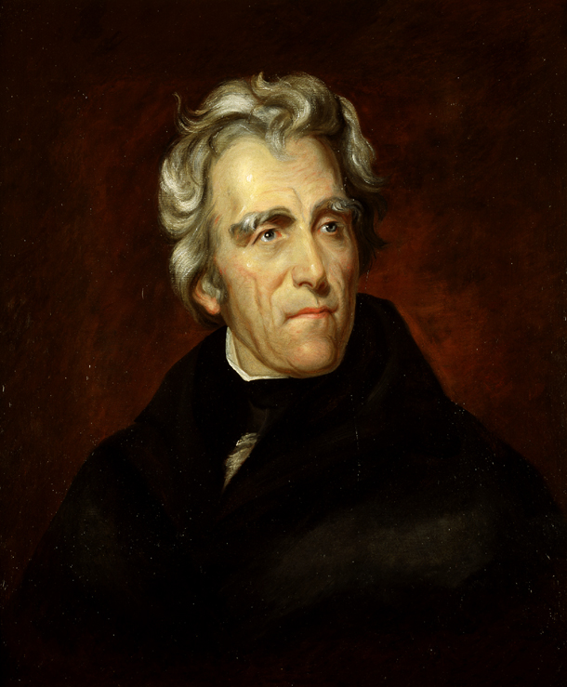
The Jacksonian Era
AIM: What were the results of the Jacksonian Age?
Do Now: What do we call the separation of America into its cultural and economic parts?
Andrew Jackson

Slide 2
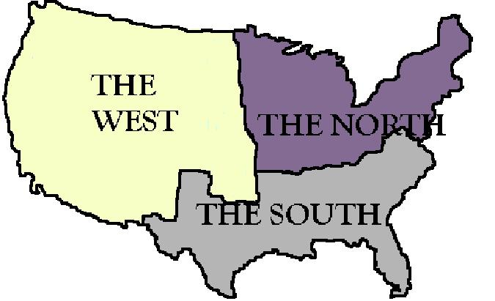
Sectionalism
?
trade, shipping & manufacturing
(Factories)
blended both.
Agriculture (Farming)
Plantations & Slavery

Slide 3
The Jacksonian Era
Hero of New Orleans
Fought the Seminole Indians
President 1829-1837
Indian Removal Act (1830)
Trail of Tears – Cherokee Removal
Andrew Jackson

Slide 4
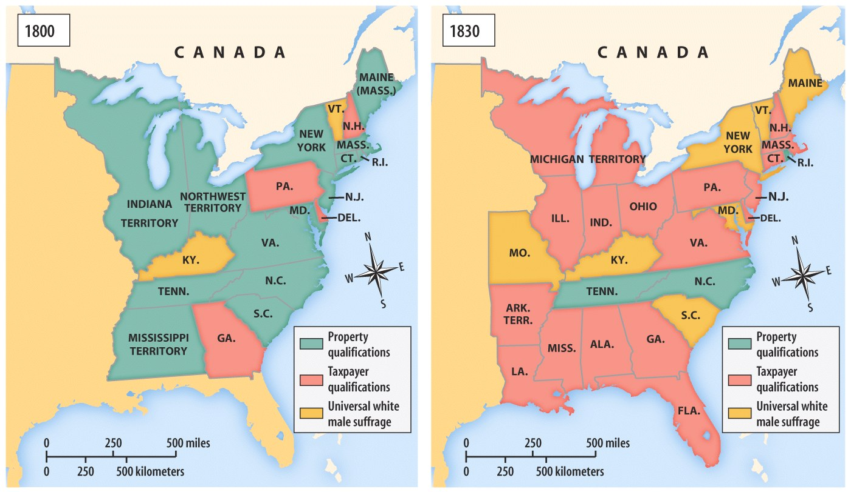
Voting Requirements
in the Early 19th Century (1800s)

Slide 5
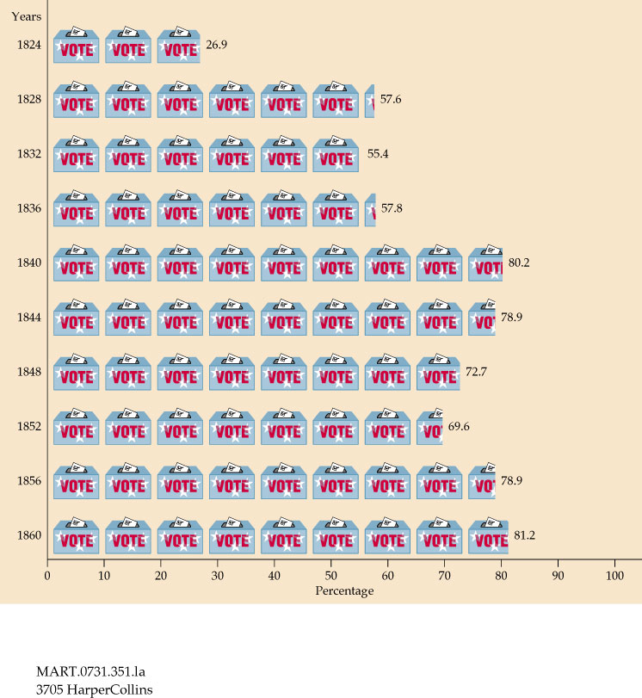
Voter Turnout: 1820 - 1860

Slide 6
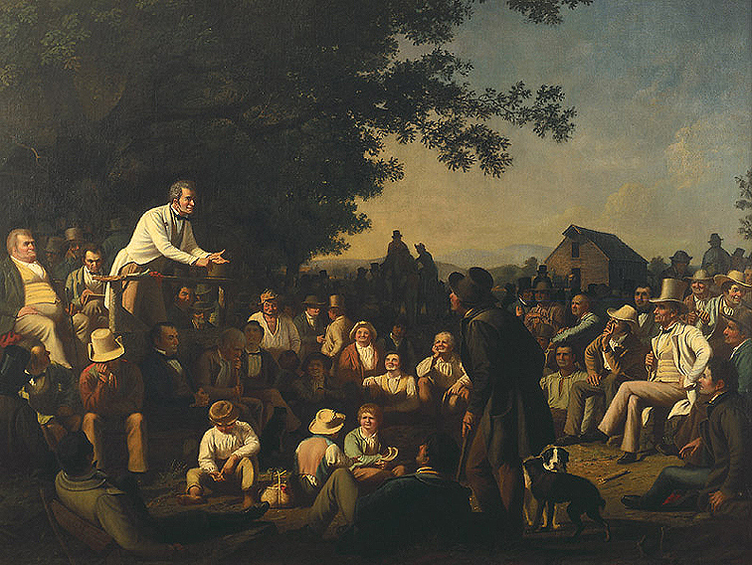
Why Increased Democratization?
White male suffrage increased
Political Party nominating committees.
Voters chose their state’s
slate of Presidential electors.
Spoils system.
Rise of Third Parties.
Popular campaigning
(speeches, parades, rallies, floats, etc.)
Two-party system returned in the 1832 election:
  Dem-Reps → Natl. Reps.(1828) → Whigs
  (1832) → Republicans (1854)
  Democrats (1828)

Slide 7
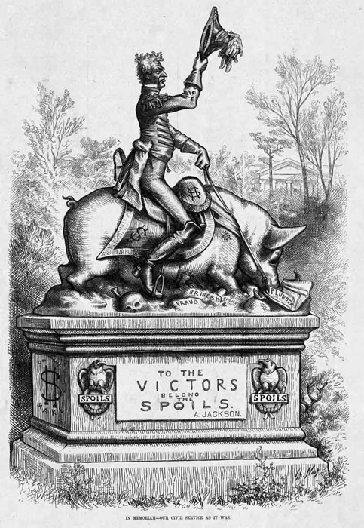
Jacksonian Democracy
Suffrage
  Men who didn’t own property could vote
Spoils System
  Replacing Government Employees with the Winning Parties People
Tariff Debate
  High Tariff on Goods from Europe
    North=YES
    South = No

Slide 8
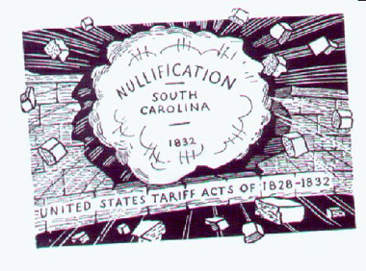
Nullification Crisis
South Carolina says it can NULLIFY
the Federal
Tariff
on Imported Goods.
States Rights
Vs.
Federalism
Crisis ended when Congress lowered the tariff and threatened to use the military to force
South Carolina to comply.

Slide 9
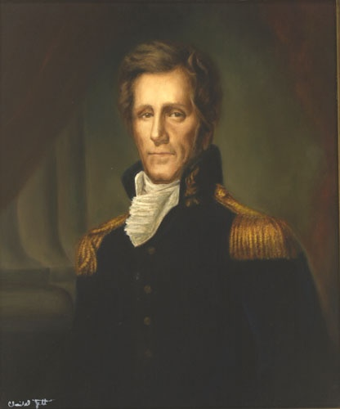
Indian Removal Act
As a Result of Indian Wars
The Senate passed the measure 28–19, the House 102–97. Jackson signs the Indian Removal Act (1830)
It authorized President
Jackson to negotiate for land in
the East while giving land to the
Indians in the lands from the
West (Louisiana Territory Lands)
It DID NOT Authorize the President to remove the Native-Americans
Andrew Jackson
The "Five Civilized Tribes“
Chickasaw, Choctaw, Creek, Seminole, and Cherokee.

Slide 10

Why the Indian Removal Act?
America’s 1st Gold Rush – Georgia (1829)
  Supreme Court rules that only states can remove Indians
  “Chief Justice John Marshall has made his decision, now let him enforce it” – President Andrew Jackson

Slide 11
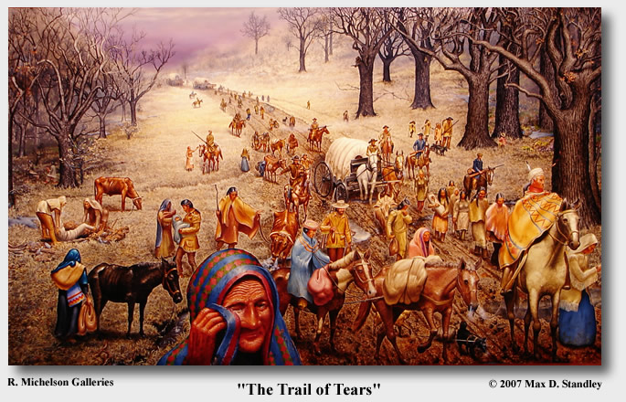
The Trail of Tears

Slide 12
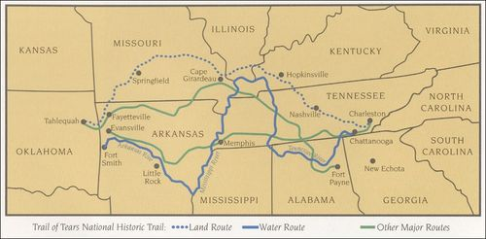
Trail of Tears
Est. 4000 Died on Trail
Cherokee

Slide 13
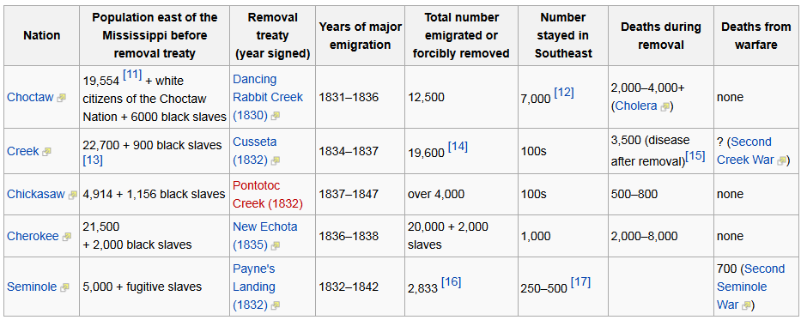
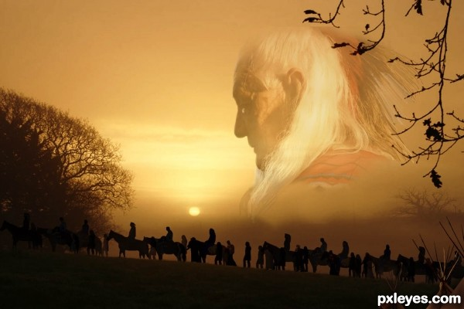
Results of Indian Removal

Slide 14
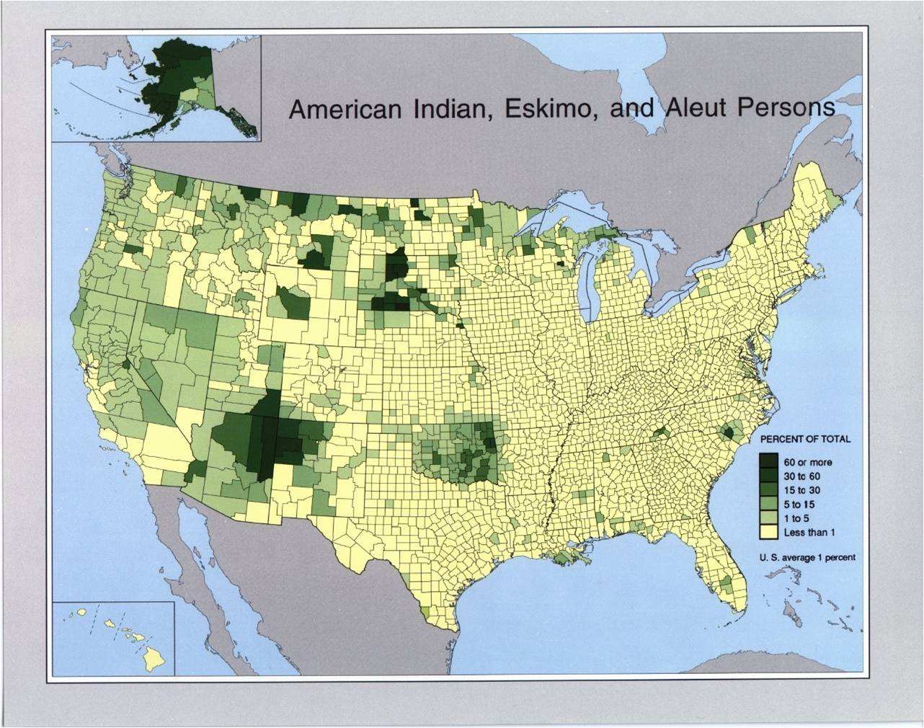

Slide 15
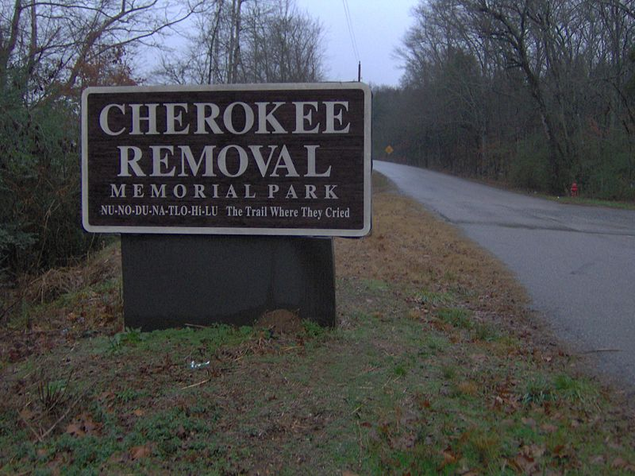
The Trail of Tears is generally considered to be one
of the most regrettable episodes in American history.
To commemorate the event, the U.S. Congress designated the Trail Of Tears National Historic Trail in 1987. It stretches for 2,200 miles across nine states.

Slide 16
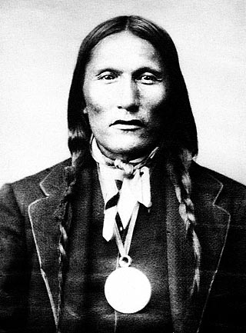
In 2004, Senator Sam Brownback (Republican of Kansas) introduced a joint resolution (Senate Joint Resolution 37) to “offer an apology to all Native Peoples on behalf of the United States” for past “ill-conceived policies by the United States Government regarding Indian Tribes.”
The United States Senate has yet to take action on the measure.

Slide 17
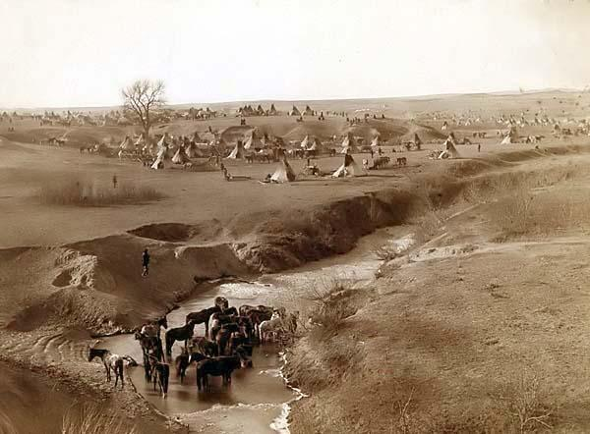

Slide 18
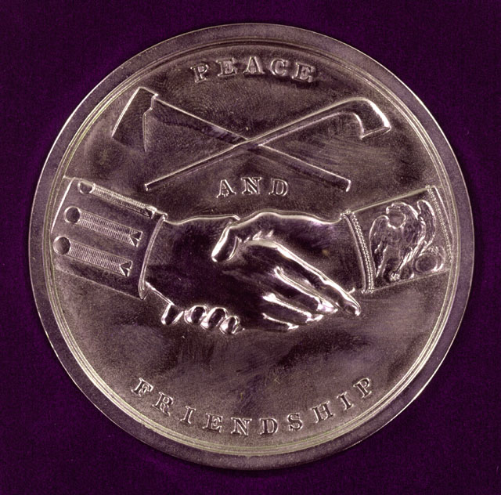

Slide 19
