Slide 1
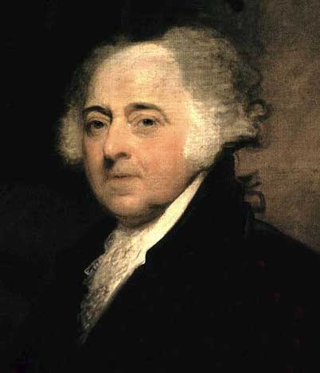
The Presidency of John Adams (1797-1801)
AIM: What kind of problems did John Adams have as president?
Do Now: What did George Washington warn about in his Farewell Address?

Slide 2
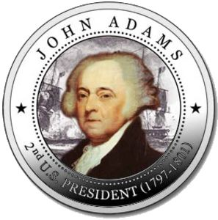
A Contentious Beginning…
Political parties had developed into powerful forces in the states
  States control electoral college, electors cast two votes each for President
Federalists
  John Adams
Democratic-Republicans
  Thomas Jefferson
Alexander Hamilton tries to get Pinckney elected by getting Southerners to make him their second vote
Adams wins in the electoral college anyway, but by only three votes
  Problems?

Slide 3
On this week’s episode of
Desperate Founding Fathers…
Constitution Says…
  Two candidates with the most votes become President and Vice President! So…..
President Adams and Vice President Jefferson are from different political parties
This is changed by Amendment XII (1804)
Any Predictions?

Slide 4
Signs of hope
It almost works at first
  Adams and Jefferson have a lot of mutual respect from Revolutionary days
  Adams states support for republican government, respect for French, offers Madison high position as envoy to France
But Federalist cabinet (mostly Washington loyalists & holdovers) protests and wins.
  Doesn’t take control of cabinet until last year of his presidency
Beginning of the end of support for Adams

Slide 5

Interferes
American merchant ships being seized by French warships
  French not happy with Jay’s treaty
Adams sends delegates to France to negotiate
XYZ Affair
  French ministers (X, Y, & Z) requested bribes in order to enter into negotiations

Slide 6
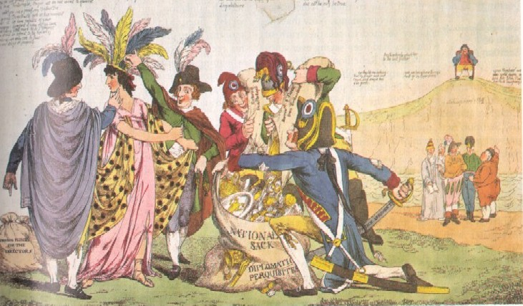
Public Opinion toward France Shifts
Britain looking on from on high
5 members of the Directory in France
Rest of the world looking on
The XYZ affair - Maiden America ravaged by the French

Slide 7
Fallout from XYZ Affair
Many Americans calling for war with France
  Hamilton, others thought U.S. could gain land
  “Millions for defense, but not one cent for tribute!”
Adams feels that U.S. Army and Navy not strong enough to fight a major power
  Sends new ministers instead
Unpopular move, but….?

Slide 8
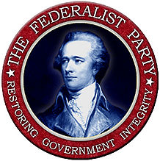
Federalists take control of Congress
Public anger with France strengthens Federalists in congress
  Win majority of both houses in 1798
  Enacted laws that were restrictive to Democratic-Republican rivals
What did Washington warn about again?

Slide 9

Naturalization Act
What did it do?
Increases from five to
fourteen number of years
required to qualify for U.S. citizenship
Why would it favor the Federalists?
Most immigrants voted with the Democratic-Republicans

Slide 10

Alien Acts
What did it do?
Authorized the president to deport any aliens considered to be dangerous
Authorized the president to detain any enemy aliens in a time of war
Why would it favor the Federalists?
Democratic-Republicans sympathetic to the French Revolution

Slide 11
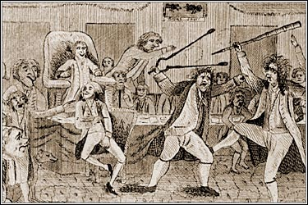
Sedition Act
What did it do?
Makes it illegal for newspapers to criticize
the president or Congress
Imposed heavy penalties for editors who violated the new law
  Fines
  Imprisonment
Why would it favor
the Federalists?
Representative Matthew Lyon of Vermont, arrested under the Sedition Act of 1798, attacking a fellow congressman

Slide 12
Responses to Alien and Sedition Acts
Republicans say that they violate First Amendment
  Judicial Review not yet established, so no Supreme Court case (1803).
Kentucky and Virginia Resolutions
  Written, respectively, by Jefferson and Madison
Argument: Since states had entered into the compact (Constitution), they can nullify a federal law that breaks the agreement. Tried to get other state legislatures enact “nullification” laws.
They didn’t. What other time in American History did this occur? Any Ideas?
To void it.

Slide 13
The Crisis Fades
Federalists, due to the unpopularity of these laws, lose their majority in the election of 1800
  Republicans allow the Alien and Sedition Acts to expire or repeal parts of them
  Under John Marshall, Supreme Court will establish role as the last resort in determining if a law is constitutional
News of a new peace with France doesn’t make it to the U.S. until after the election

Slide 14
Judging Adams
Dislike for the Federalist Congress and the Alien and Sedition Acts cost Adams his reelection and gave control of Congress to the Republicans. But in weighing his presidency, we have to consider the negative along with the positive:
Relationship with France damaged
New taxes imposed
Party politics become entrenched
Keeps U.S. out of war, preserves neutrality
Strengthens the Navy
Peaceful transfer of power in 1800
Con’s
Pro’s

